Slide 1
Ecology, Evolution, and
Game Theory at IIASA:
Overview & Highlights
Ulf Dieckmann
Program Director
Evolution and Ecology Program dieckmann@iiasa.ac.at

Slide 2
Living Systems
Ecology
Evolution
Socio-
economics
Anthropogenic environmental impacts
on fisheries, biodiversity, common goods, …

Slide 3
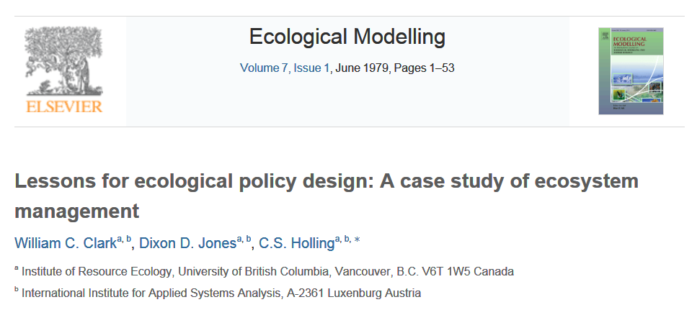

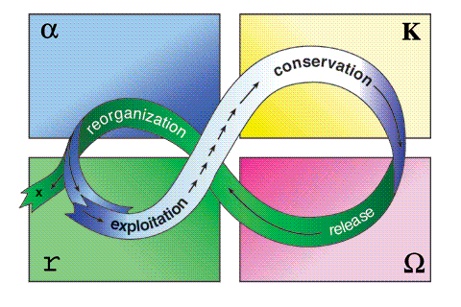
Early Highlights in Ecology
Pest management models
Adaptive management
Resilience dynamics

Slide 4
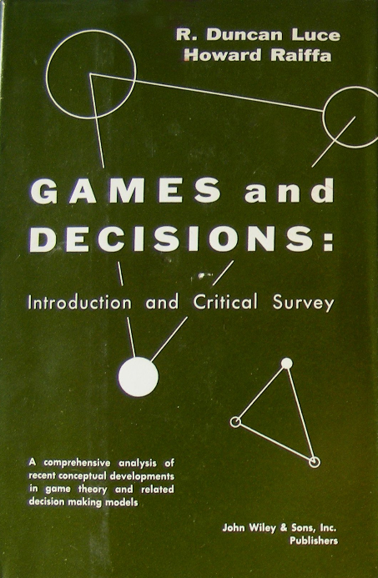

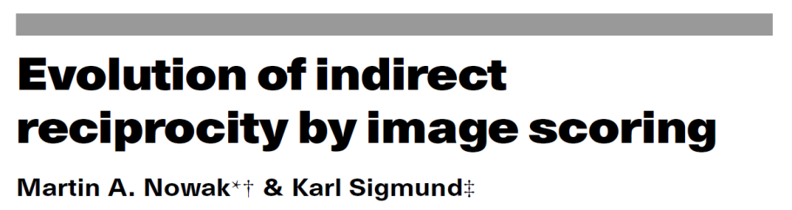
Early Highlights in Game Theory
Game theory, decision analysis
Indirect reciprocity
Other methodological innovations
Replicator dynamics
Win-stay, lose-shift
Adaptive dynamics

Slide 5
Ecology
1

Slide 6
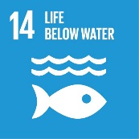
Fishery Systems
Management system
Management
measures
Fishery policy and planning
Service
values
Fishery management
Fishery development
Fishery research
Socio-economic system
Ecosystem services
Fishers
Supporting services
Processors and retailers
Regulating services
Consumers
Provisioning services
Socio-economic environment
Cultural services
Natural system
Target stock
Non-target species
Fishing
pressure
Ecosystem embedding
Ecosystem
status
Physical environment

Slide 7
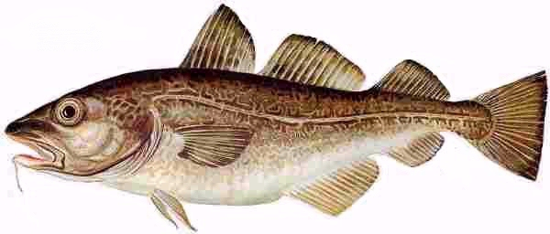
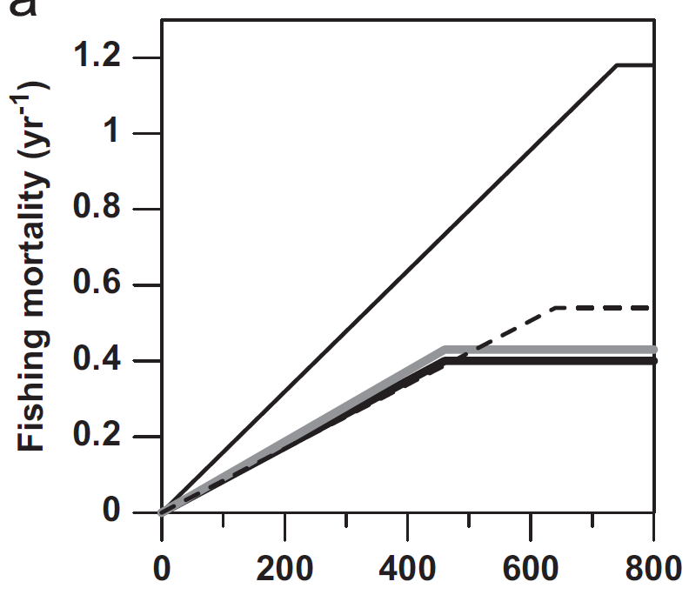
Management of Northeast Arctic Cod
Challenge Harvest-control rules are politically negotiated without support from quantitative modeling
Innovation Our integrated assessment model couples biological with economic processes and probes alternative objectives
Results Current rule maximizes profit, while alternative objectives lead to more aggressive exploitation
Yield-maximizing HCR
(Johannesburg World
Summit 2002)
Welfare-maximizing HCR
Current HCR
Profit-maximizing HCR
Adult biomass (1000 tonnes)
Marine Policy 39:172 (2013)

Slide 8
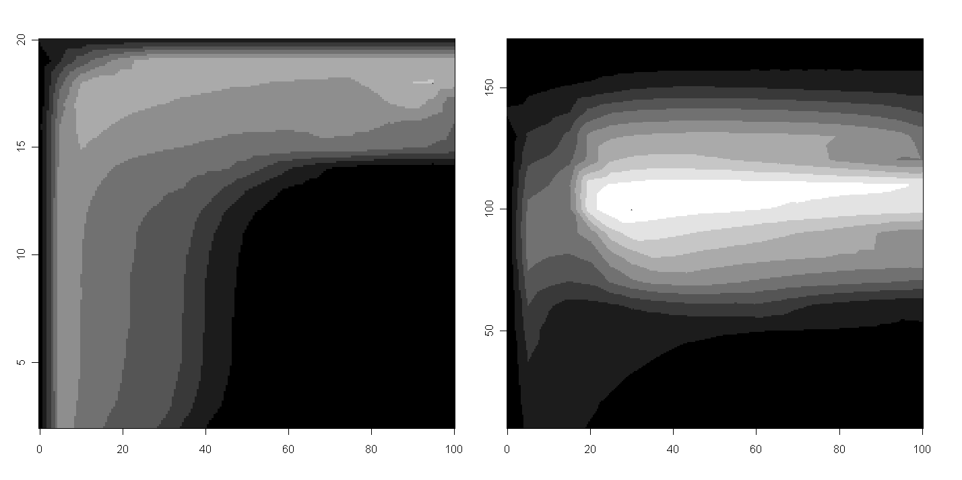
Management of Barents Sea Capelin
Challenge Traditional assessments account for quotas, yields, and a single stakeholder group
Innovation Our integrated assessment model accounts for 2 regulations (quotas and minimum-size limits), 4 benefits (yields, profits, employment, and ecological impact), and 5 stakeholder groups
Results Maximum joint satisfaction is high, and is best achieved through minimum-size limits
80%
5 10 15 20
Status quo
Minimum-size limit (cm)
0 20 40 60 80 100
Annual harvest proportion of
unprotected stock (%)
Dankel et al., in prep.

Slide 9
Evolution
2

Slide 10
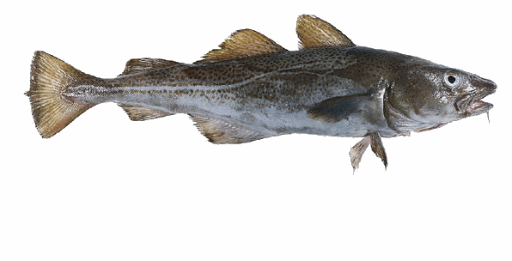
Collapse of Northern Cod
Challenge Stock collapsed in 1992 and has not recovered since; heavy exploitation favors earlier maturation at smaller size
Innovation Pioneering statistical and modeling techniques
Results We have documented a 30% drop in size at maturation and showed that such evolutionary impacts of fishing are very slow and difficult to reverse
Size at 50% maturation
probability at age 5 (cm)
80
70
60
Moratorium
50
Early warning
40
30
1975
1992
2004
Nature 428:932 (2004)

Slide 11
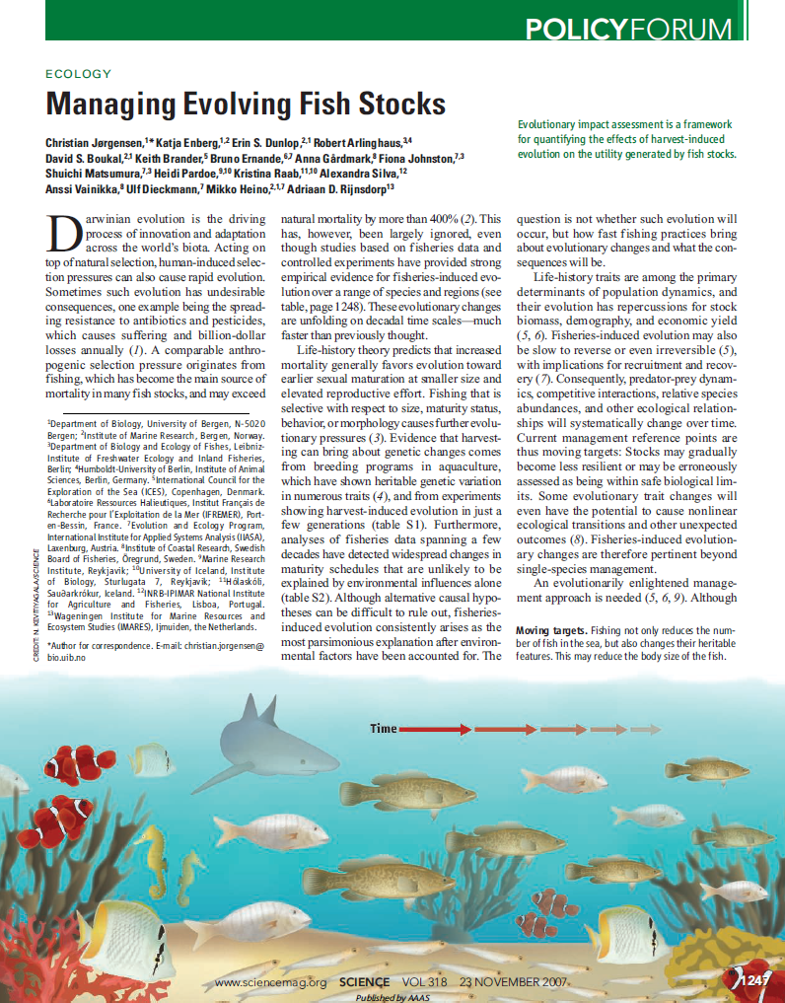
Improving Fishing Policies
Challenge Evolutionary considerations are a blind spot of current fisheries management
Innovation Established international expert group on Fisheries-induced Evolution as part of the scientific advice by the International Council for the Exploration of the Sea (ICES)
Results Monitoring maturation evolution has become a binding EU requirement; new tool: Evolutionary Impact Assessments (EvoIAs)
Science 318:1247 (2007)
Science 320:48 (2008)

Slide 12
Fisheries-induced Evolution: Timeline
1000
1st IIASA
study
Case study in
Nature
Science
Policy Forum
Economic
repercussions in PNAS
New statistical method
New modeling framework
New calibration method
Citations to articles containing
“fisheries-induced evolution” etc.
Inclusion in EU Marine Strategy Framework Directive
1998
2004
2010
2016

Slide 13
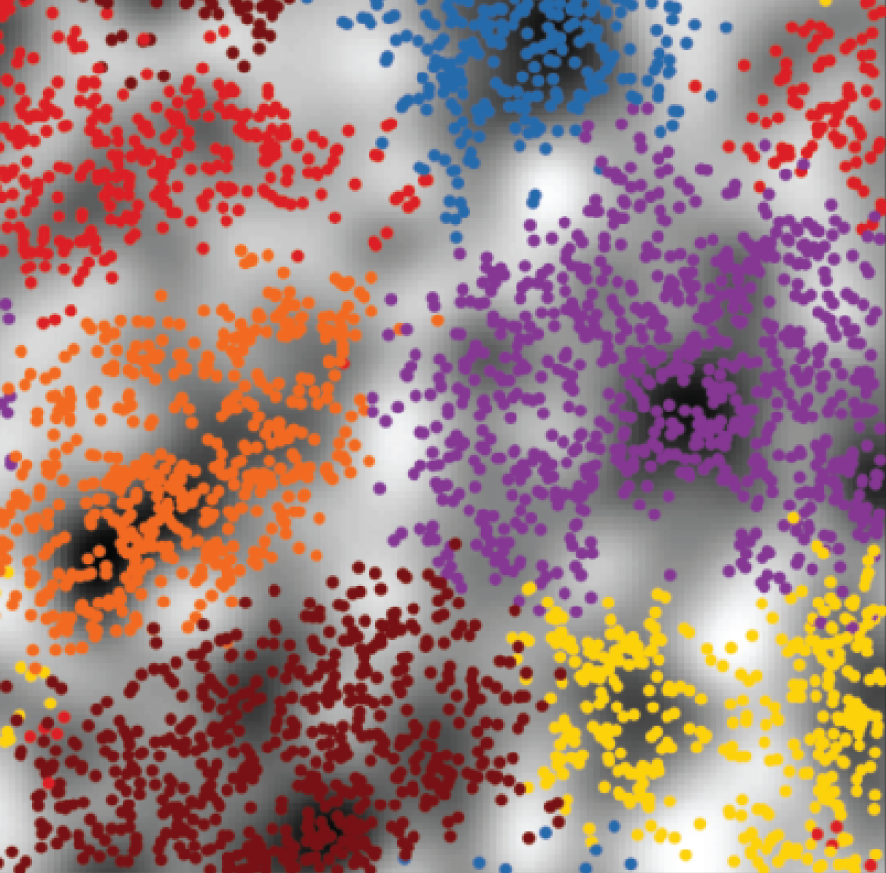
A New Understanding of Biodiversity
Challenge Factors maintaining biodiversity are poorly understood
Innovation New model accounting for spatial structure and partner choice
Results Correction of a textbook error and refocusing of debate: biodiversity can be maintained without ecological differentiation
Nature 484:506 (2012)

Slide 14

Calibrated Stream Ecosystem Models
Challenge Causal processes underlying biodiversity patterns need to be understood
Innovation New process-based and empirically calibrated model of biodiversity in stream ecosystems
Results Patterns observed in unpolluted rivers are recovered; responses to pollution can be predicted
Unpolluted rivers
1
10⁻¹
10⁻²
10⁻³
Log relative abundance
Polluted rivers
1
10⁻¹
10⁻²
10⁻³
1
10
20
30
Species rank

Slide 15
Game Theory
3

Slide 16
Indirect Reciprocity: Agenda Setting
5000
1st IIASA
study
A new field of study with more than 5000 citations per year
Citations to articles containing
“indirect reciprocity”
1998
2004
2010
2016

Slide 17

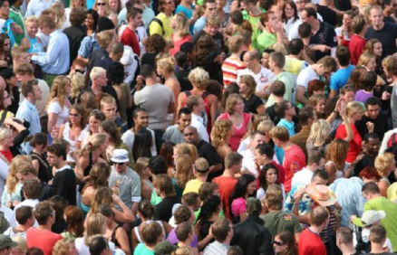
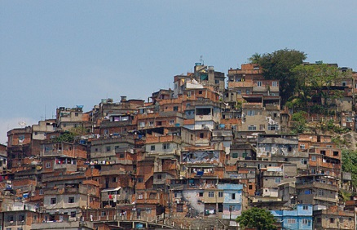
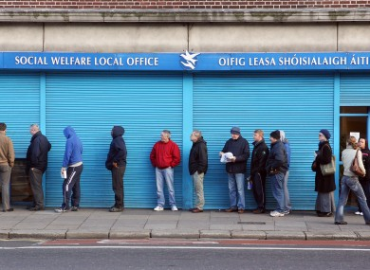
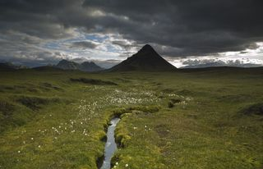
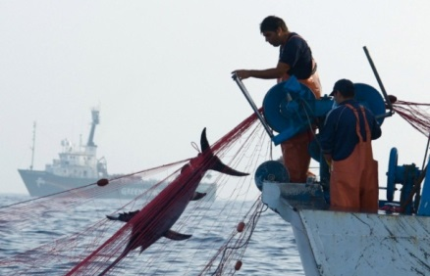
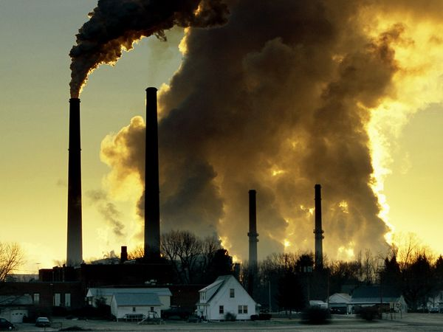

Social Dilemmas & Common Goods
Challenge Many common goods are under the threat of selfish actors (such as individuals, companies, governments)
Innovations IIASA’s work is overcoming key limitations of current cooperation models
Two examples
Wealth inequality
Incentive design
Global climate
Demography
Urbanization
Social security
Land use
Living resources
Clean air
Internet

Slide 18

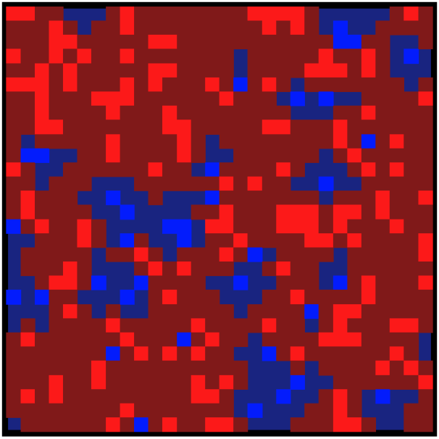

Wealth Inequality
Challenge Until recently, game-theoretical studies of cooperation have almost universally ignored agent heterogeneity
Innovation We show how qualitatively new insights emerge when wealth inequality is taken into account
Results A small level of wealth inequality suffices to jump-start cooperation under adverse conditions
Without
wealth inequality
With
wealth inequality
Blue: cooperators
Red: defectors
Bright: rich sites
Dark: poor sites
4:2453 (2013)

Slide 19
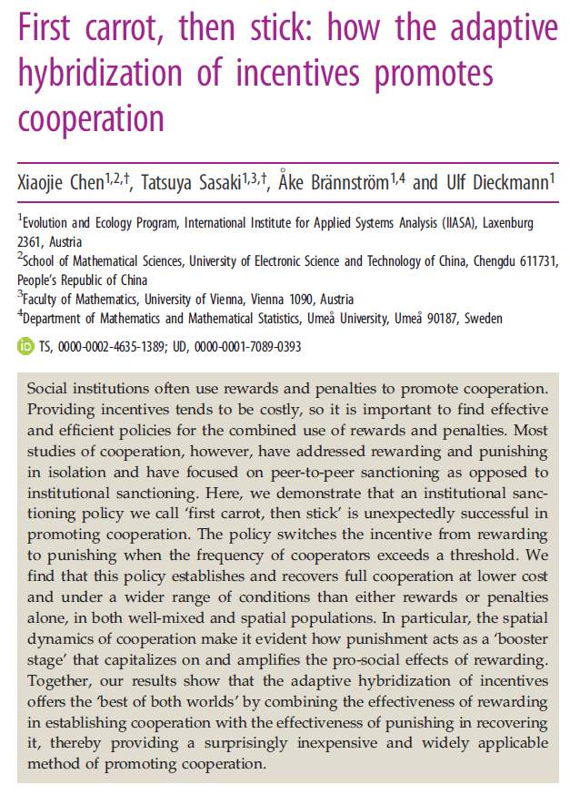

Incentive Design
Challenge Game-theoretical analyses of incentives have focused on peer-to-peer sanctions; positive and negative incentives are mostly studied in separation
Innovation We show how institutional positive and negative incentives are best combined
Results “First carrot, then stick” incentive policy is not only most effective, but also most efficient (cost saving)
12:20140935 (2014)

Slide 20
Interdisciplinary Bridges
Cross-cutting projects on
systemic risk, equitable governance,
and vegetation modeling
Ecology
Evolution
Socio-
economics
Anthropogenic environmental impacts
on fisheries, biodiversity, common goods, …

