Slide 1
Systems analysis of socio-economic impacts of COVID-19: State-of-the-Art, Gaps and Good Practices
Nikita Strelkovskii, Elena Rovenskaya
International Institute for Applied Systems Analysis (IIASA), Laxenburg, Austria
The COVID-19 Public Health and Social Measures (PHSMs) Research Outcome Conference
6. October 2021

Slide 2
Complexity of the COVID-19 crisis
Employment
?
Well-being
Number of (active) COVID-19 cases
?
NPIs
Mental health
?
…
New technologies
A complex system:
Cannot be explained by breaking it down into components due to their strong interdependency
Interdisciplinary in nature
Source: Cairney, 2012. Complexity Theory in Political Science and Public Policy, Political Studies Review, 10(3) 346-358

Slide 3
Systems thinking
Systems thinking and holistic approach are needed to find effective nexus solutions and to reduce risks of unwanted consequences in complex systems
“COVID-19 means systems thinking is no longer optional”
Seth Reynolds
Systems thinking is based on analyzing causal interconnections, indirect effects and feedback loops
Decision makers can be assisted by formal tools of qualitative systems thinking, which can help reveal tradeoffs and synergies
Formal tools can also help reduce “wickedness” of the problem and discipline a dialogue

Slide 4
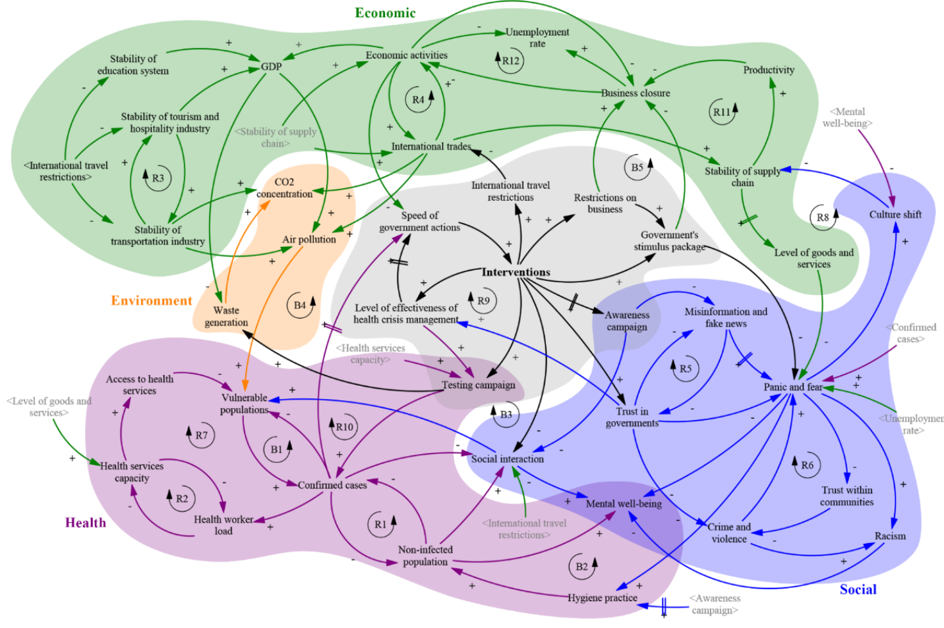
Systems maps (causal loop diagrams)
A link (arrow) represents a causal relation between two factors. A link from A to B implies that if A changes, as a result B will change, too.
A link polarity denotes the direction of the relationship between two factors. A positive causality between A and B means that the change in B is in the same direction as A. A negative causality means that the change in B is in opposite direction.
Source: Sahin, O.; Salim, H.; Suprun, E.; Richards, R.; MacAskill, S.; Heilgeist, S.; Rutherford, S.; Stewart, R.A.; Beal, C.D, 2020. Developing a Preliminary Causal Loop Diagram for Understanding the Wicked Complexity of the COVID-19 Pandemic. Systems, 8, 20, doi:10.3390/systems8020020.
Notes:
For instance, if A increases, B increases, too; or vice versa.
For instance, if A increases, B decreases.

Slide 5

Systems mapping to address the COVID-19 crisis: a review
About 10 academic papers assessing COVID-19 impact on a wider socio-economic systems published to date
Number of components: 17—78 (mean: 34)
Number of links: 34—125 (mean: 61)
Sources: expert workshops and literature
Research questions

Slide 6
COVID-19-relevant system components in the reviewed studies
Common:
Number of actually infected people and diagnosed cases
Number of COVID-19 deaths
Panic and/or fears
Business closures (lockdowns)
Unemployment
Impact on the healthcare system
Social distancing
Rare:
Environmental impact (e.g., waste generation)
Social tensions (lack of trust, home violence, racism)
Role of research institutions
Role of vaccines
Social and economic inequality

Slide 7
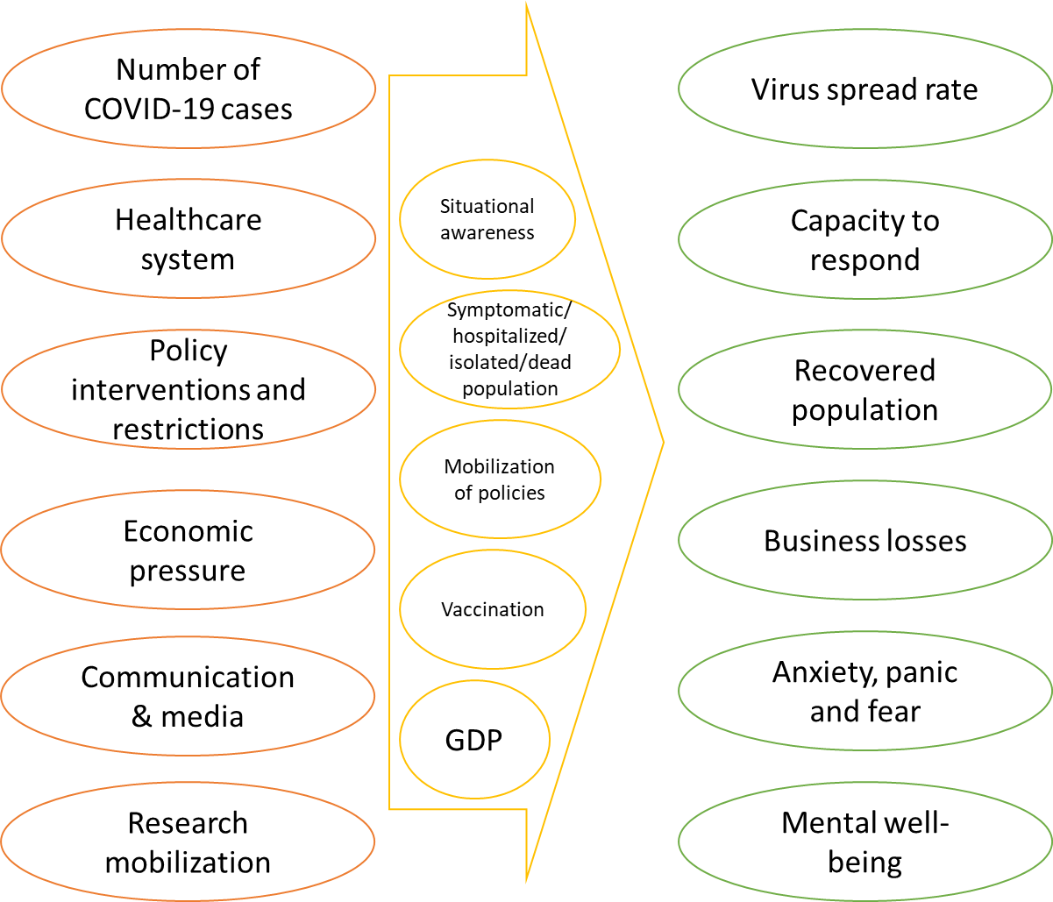
Types of system components
Active components – most links outgoing (high out-degree)
Passive components – most links incoming (high in-degree)
Critical buffers – both (several) incoming and outgoing links (high total degree)
Source: Vester, F., 2007. The art of Interconnected Thinking; MCB Publishing House: München, Germany.

Slide 8
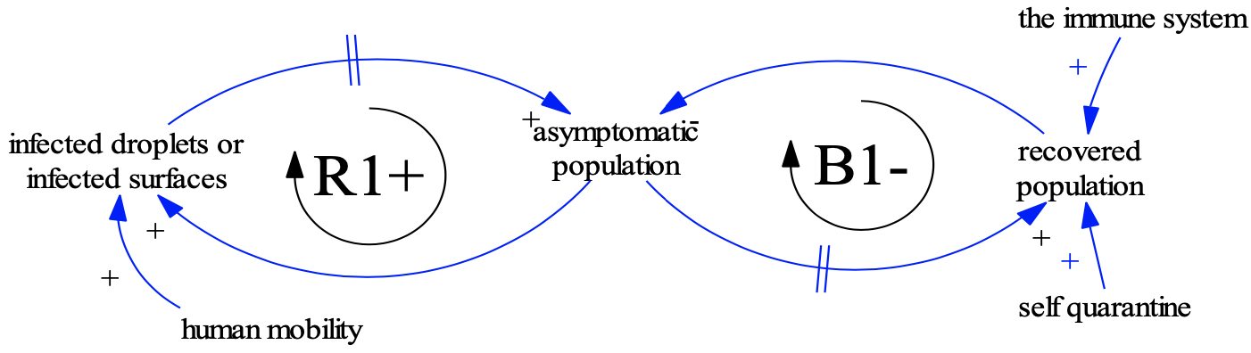
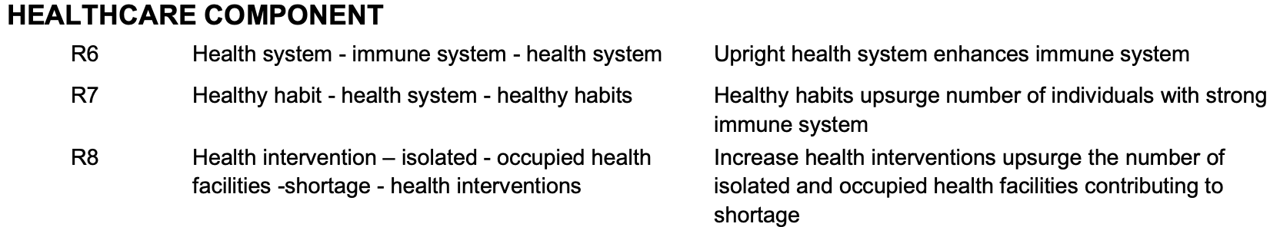
Feedback loops
A feedback loop is a sequence of links connecting components by forming a cycle
Reinforcing feedback loop – an initial increase/decrease of the state of any component further increases/decreases after every cycle
Balancing feedback loop – an initial increase/decrease of the state of any component decreases/increases after every cycle.
Identifying feedback loops is a primary analysis method of systems maps
Source: Bahri, M., 2020. The Nexus Impacts of the COVID-19: A Qualitative Perspective. Preprints, 2020050033, doi:10.20944/preprints202005.0033.v2
Source: Tonnang, H.; Greenfield, J.; Mazzaferro, G.; Austin, C.C., 2020. COVID-19 Emergency Public Health and Economic Measures Causal Loops: A Computable Framework. SSRN Electron. J., doi:10.2139/ssrn.3686027.
Notes:
i.e., the sequence begins and ends in the same component.

Slide 9




Systems thinking is good, but hard
Human brains have limited ability to execute systems thinking (Levy et al., 2018)
Prevalence of network motifs compared to random networks as a measure of systems thinking (Aminpour et al., 2021)
Systems maps might be biased by their authors’ expertise, beliefs and values
  Could quantitative data be used?
Bidirectionality
Multiple causes
Multiple effects
Indirect effect
Moderated effect
Feedback loops
Overrepresented
Underrepresented
Underrepresented
Underrepresented
Balanced
Overrepresented

Slide 10
Systems maps applications (not only COVID-19)
Sense-making, understanding of indirect and feedback effects of policies
Identification of leverage points
Development of simulation models, e.g., systems dynamics
IIASA ongoing project: systems mapping of impacts of COVID-19 NPIs on national well-being
Systemic (better) decision-making

Slide 11

Thank you for your time!
Questions?
Nikita Strelkovskii
Advancing Systems Analysis (ASA) program
strelkon@iiasa.ac.at

