Slide 1
Ecosystem Services and Management
Michael Obersteiner
Blitz, 2017

Slide 2
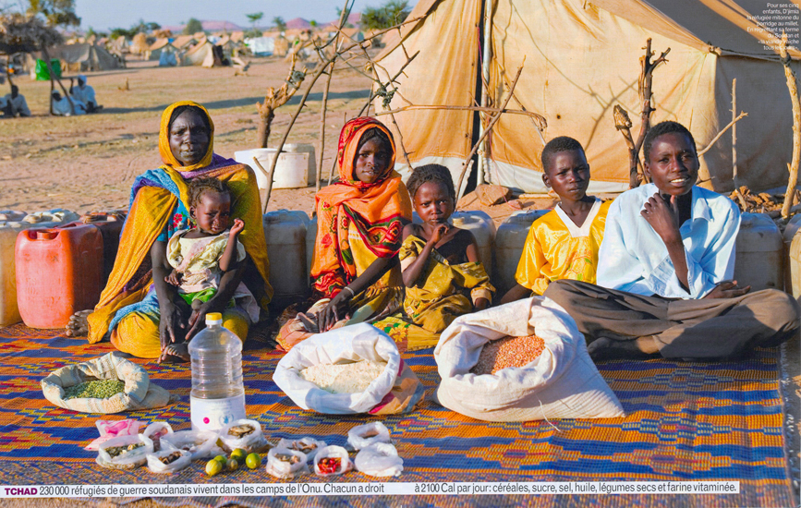
Food for a Week, Displaced Family, Chad
© 2007 PETER MENZEL PHOTOGRAPHY

Slide 3
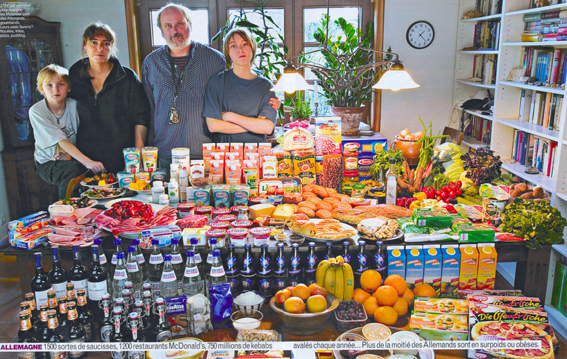
Food for a Week, German Family
© 2005 PETER MENZEL PHOTOGRAPHY

Slide 4
Land Use Change
Courtesy: StoraEnso

Slide 5
Courtesy: StoraEnso

Slide 6
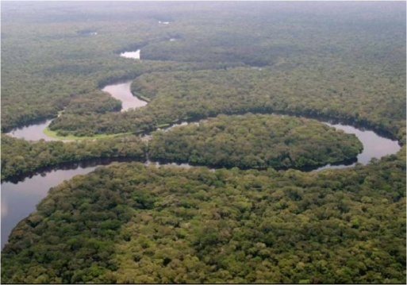
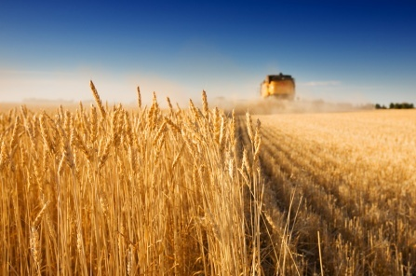
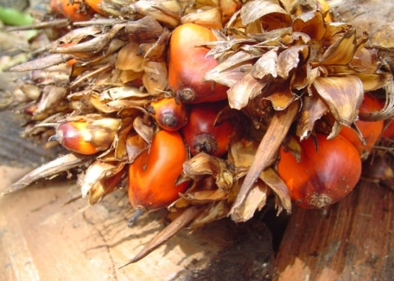
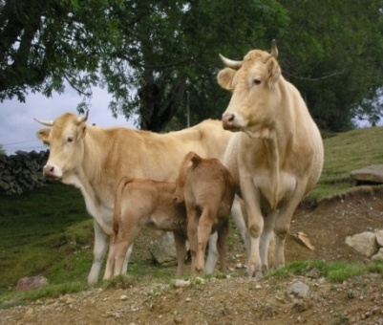
Data

Slide 7
Cropland Disagreement

Slide 8
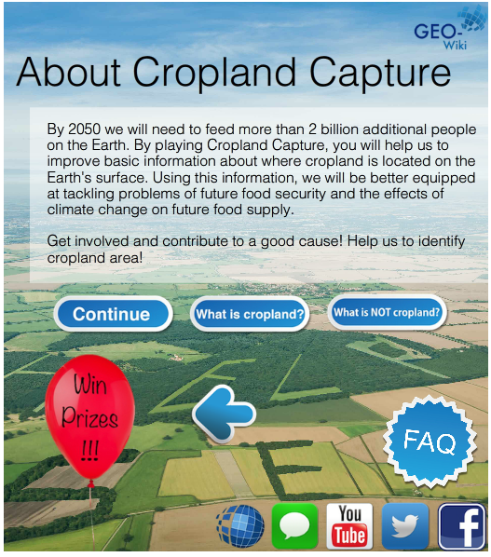
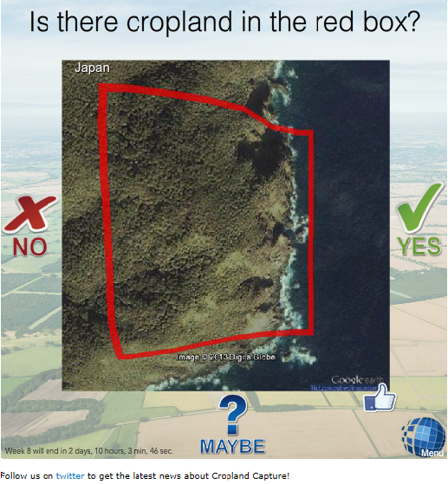
Cropland Capture Game
Classified 2.5 million pixels in 7 weeks

Slide 9
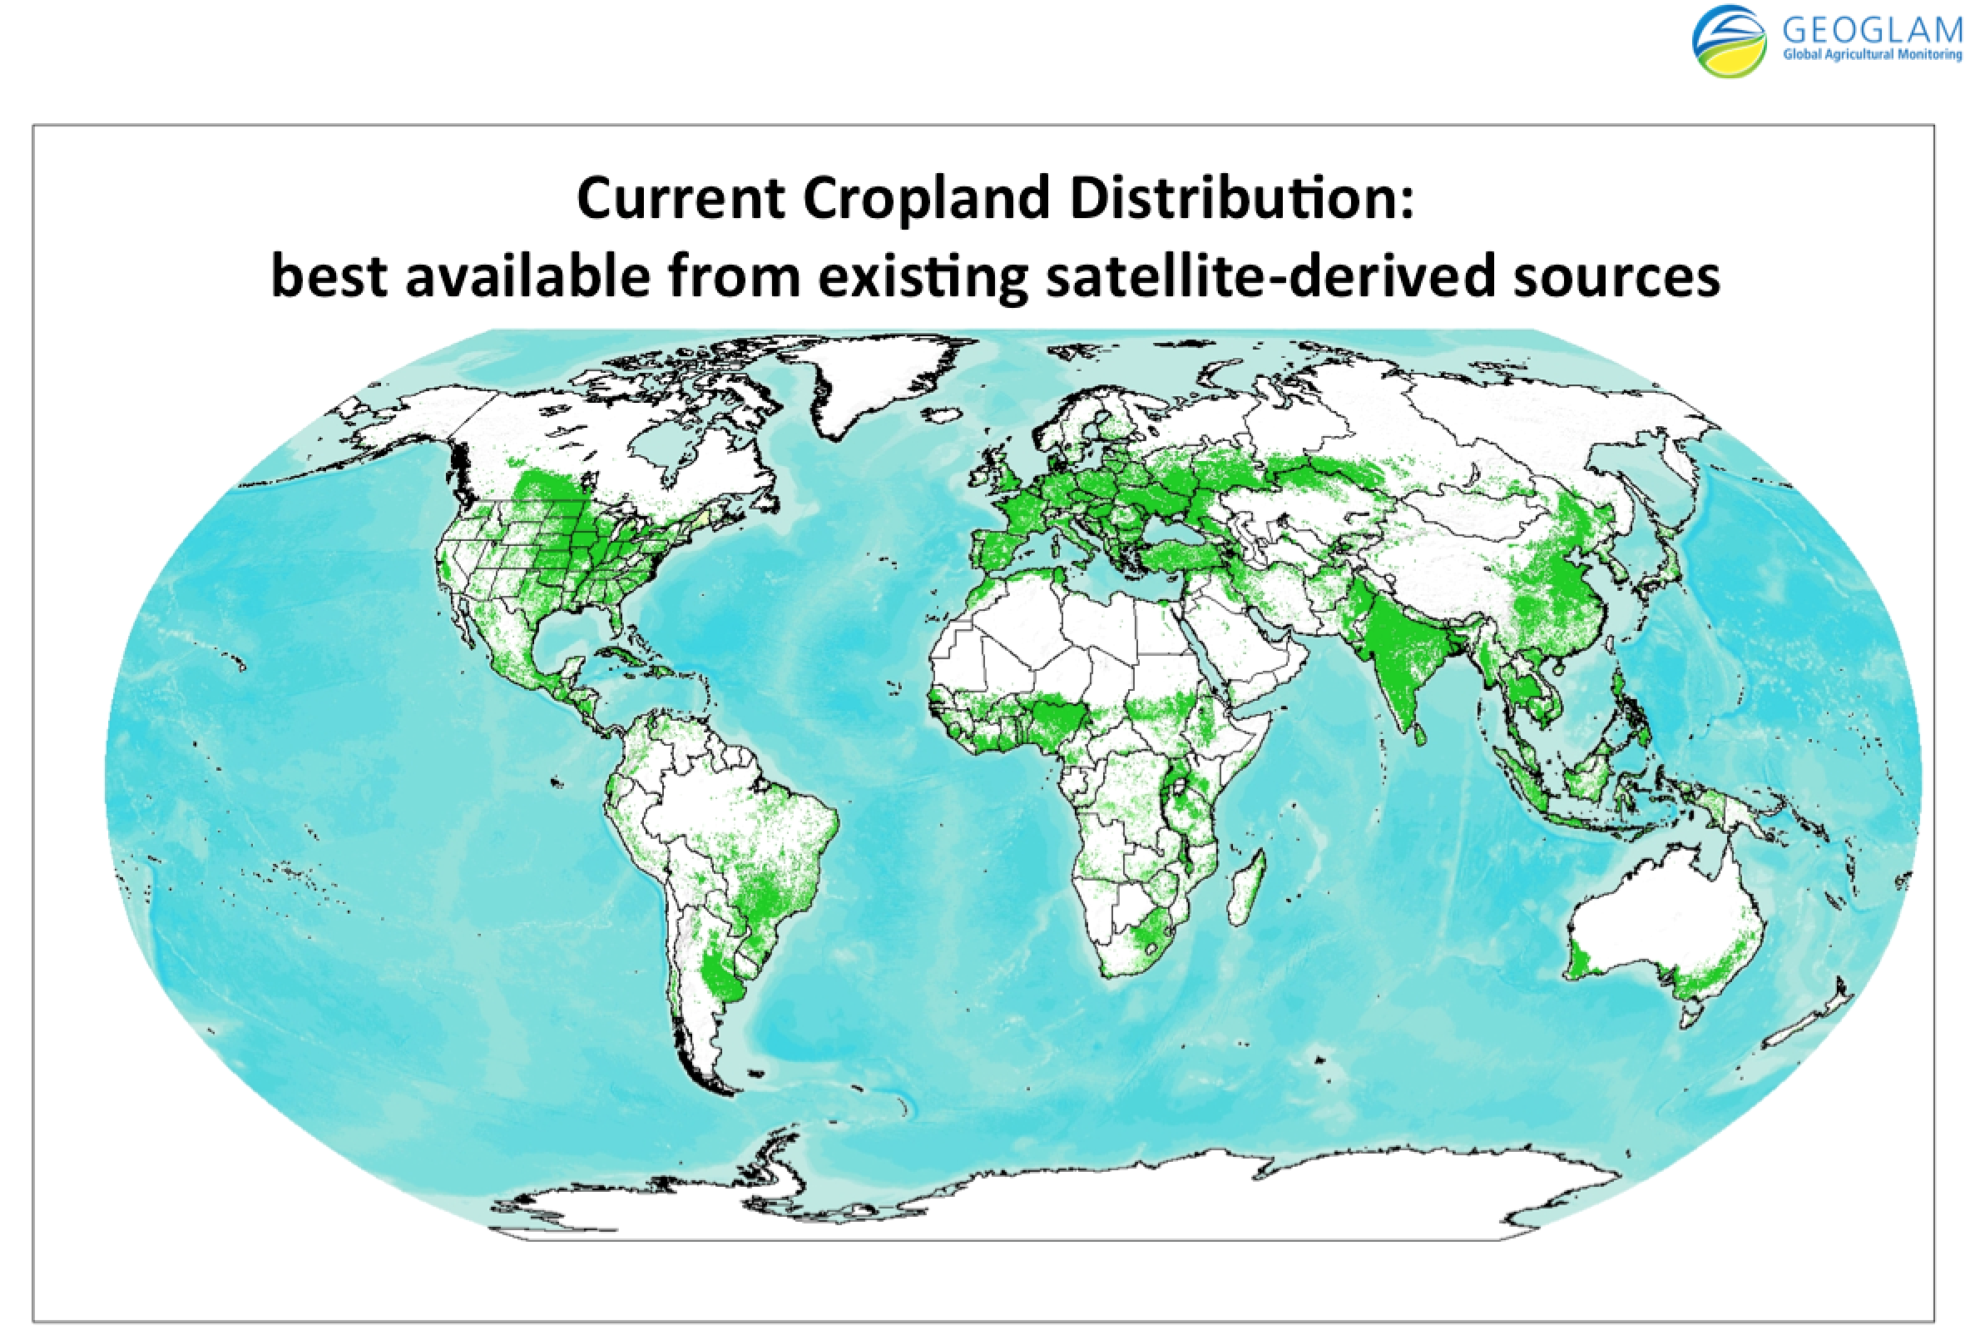
Probably the most accurate cropland map
See et al., 2014
Notes:
Openly acknowledged as the best source of baseline cropland information by GEOGLAM

Slide 10
Policy impact assessment

Slide 11
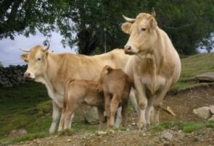
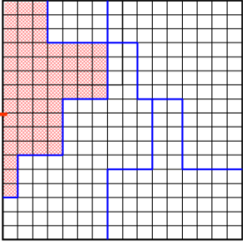
Demand
Population, GDP, preferences
Food
Fibers
Energy
Water
Markets
ECONOMIC MARKET + Spatial equilibrium trade → PRICES
Production
RUMINANT
Digestibility model
Feed intake
Animal production
GHG emissions
BIOENERGY
Processing
MJ biofuel
MJ bioelectric
Coproducts
G4M
Global Forest model
Harvestable wood
Harvesting costs
18 crops (FAO + SPAM)
Wheat, Rice, Maize, Soybean, Barley, Sorghum, Millet, Cotton, Dry beans, Rapeseed, Groundnut, Sugarcane, Potatoes, Cassava, Sunflower, Chickpeas, Palm Fruit, Sweet potatoes
3 different systems
7 animals (FAO + Gridded livestock)
Cattle & Buffalo
Sheep & Goat
Pig
Poultry
8 different systems
Land suitable for Poplar
Pillow
Eucalyptus
Productivity from literature
Downscaled FAO FRA at grid level
Area
Carbon stock
Age
Tree size
Species
Rotation time
Thinning
Land use
Land cover
Cropland
Grassland
Short rotation plantations
Managed forest
Natural
forest
Other natural land
Global Land Cover 2000

Slide 12
Land USE in Brazil - INDC

Slide 13
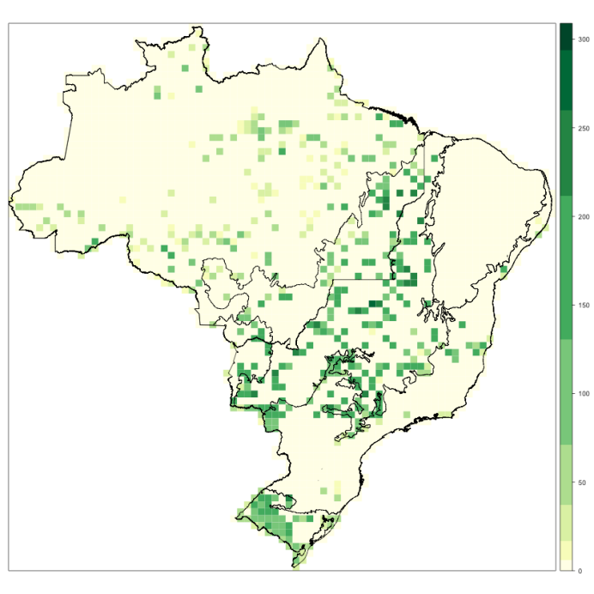
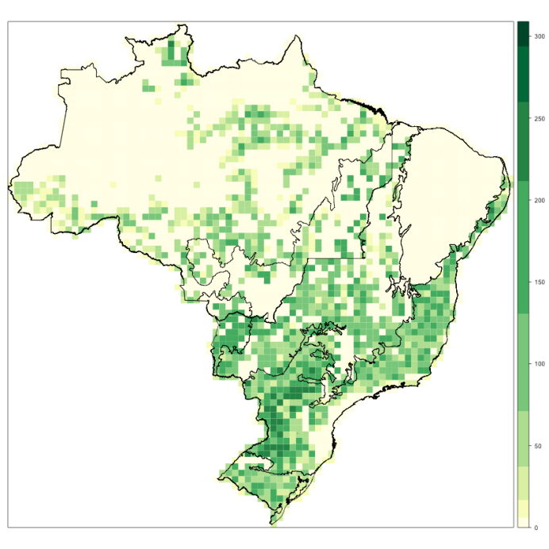
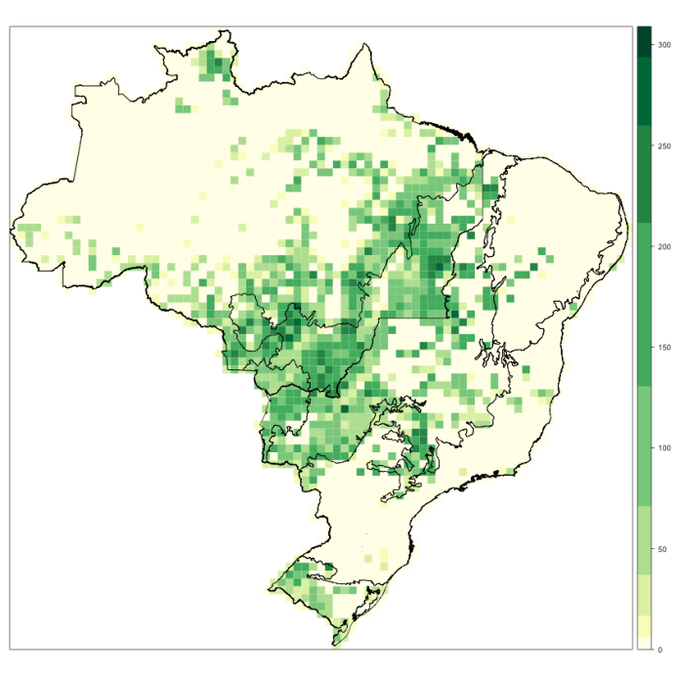
Details of Policy Instruments Matter Regenerated Forest – 2050
Forest code Forest code Forest code
Without TPs with TPs Small Farms Amnesty

Slide 14
Outlook
Scope
Ecosystem Services (e.g. biodiversity)
Earth System linkage
Macro-economics
Globally consistent National Assessments – NDC/SDG
Time consistent transition planning

