Slide 1
An integrated environmental-economic model for robust pollution control under uncertainty
Matthias Wildemeersch, Tatiana Ermolieva, Shaohui Tang,
Yuri Ermoliev, Michael Obersteiner
EU Conference on Modelling for Policy Support
26-27 November, 2019

Slide 2
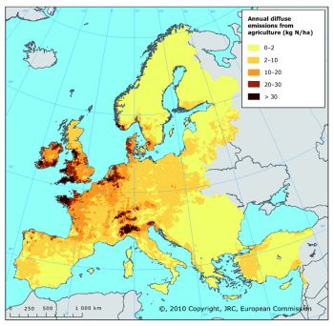
Joint Research Centre, European Commission (2009)
Scope of Nitrate pollution Problem in European Waters
Notes:
Annual diffuse agricultural emissions of nitrogen to freshwater (kg N/ha of total land area)

Slide 3
Effects of Nitrogen Pollution
  Excessive algal growth in estuaries
  Loss of oxygen in water and ammonium toxicity in freshwater systems
  Loss of marine habitat
  Health effects related to nitrate concentration in drinking water
  Very long residence time in groundwater and very extented periods of response to recovery
Notes:
Nutrients in the Lunan Water are affecting the health of the lochs and the North Sea
Nitrogen is mostly from agriculture
Phosphorus is from agriculture, septic systems, loch sediments, sewage treatment works, etc.

Slide 4
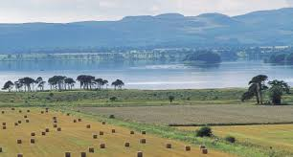

Motivation
Rural Diffuse Pollution is the
largest pollution pressure on the Scottish water resources
SEPA* aims to improve
water quality status in line with EU WFD** and has identified representative priority catchments across the country to address the diffuse pollution issue
**SEPA : Scottish Environmental Protection Agency ** European Union Water Framework Directive

Slide 5
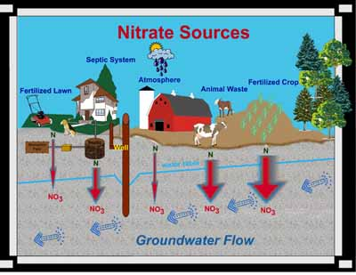
Nitrogen Production in the Region
Notes:
Land use related diffuse rural pollution
Sources; Agriculture, Urban run-off, Forestry, Coal mining, Septic tanks but the main one is the fertiliser use
The widths of the red arrows show relative amounts of nitrate leaching
into groundwater.

Slide 6






















Main characteristics of the model
Transfer coefficients h_{ijt} i.e. what portion of the load reaches some receptor and
At what time it reaches, i.e. nitrogen traveling time τ$ij$

Slide 7
Novelty: dynamic nitrogen transport matrix
Sources
Receptors
Receptors
N load at t=0
Traveling time
From the same N load at t=0, nitrogen traveling time to receptors can reach T-1 (from 10 to more than 100) years. In general, the traveling time is uncertain, depends on soil type, weather conditions, activities, etc.
Notes:
To the case of a dynamic pollution flows incorporating time intervals
A dynamic version of the traditional matrix. Linkages between farms and receptors and corresponding traveling time Ƭiy from sources to receptors is indicated by arrows.
Linkages between farms and receptors and corresponding traveling time Ƭiy from sources to receptors is indicated by arrows.

Slide 8
Sources of Uncertainty
Related to natural processes
- yields in crop cultivation
- livestock raising
  nitrogen transfer in the soil and the groundwater
Price volatility in agricultural markets
Flows in data sets
  activities underreported/estimated by farmers
Notes:
Asymetric information: the individual cost/production functions of each producer can not be fully known by the regulator due to site specific factors. For this reason we assume stoachastic model is more advantegous than a deterministic one in addressing the uncertainities inherit to the topic. Therefore we implement a stoachastic and deterministic model and compare the findings deterministic model is more advantegous in operating with randomness in some components of the model. It is assumed that the sources are cost minimizers and have perfect information on individual costs. In the cost effectiveness of emission standards and ambient charges is discussed for the case where the environmental agency has imperfect information on total cost and individual costs are inherently stochastic. We show that the adjustment mechanism still converges and that ambient charges are both environmentally effective and more cost effective than emission standards.

Slide 9
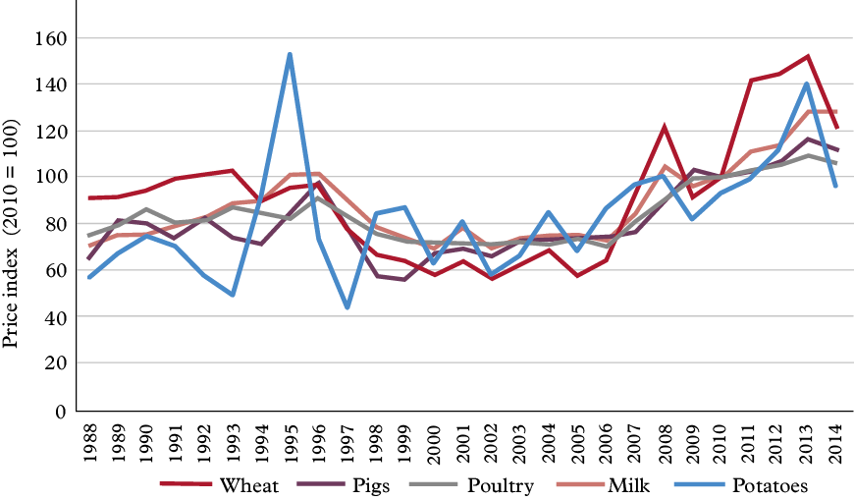
Volatility in Agricultural Production (1)
Commodity Prices
UK Parliement, 2016

Slide 10
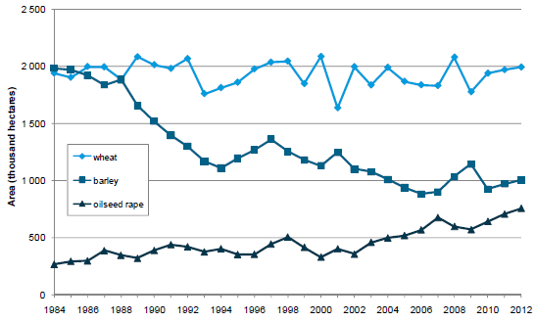
Volatility in Agricultural Production (2)
- Yields
UK Farming Statistics, 2014
Notes:
Complexity
Multi receptors and multi sources
Dynamics of N pollutions
Delay times
Decay
Transfer co-efficient
Uncertainties: data, processes, measurements
Estimation of polluters’ production functions

Slide 11
Method
Stochastic optimisation based modelling framework to be developed inspired by former stochastic WAP model of IIASA
Key publications:
Ermoliev, Y.M., Michalevich, M. and Nentjes, A. (2000). Markets for tradeable emission and ambient permits: A dynamic approach. Environmental and Resource Economics, 15 (1). pp. 39-56.
Ermoliev, Y., Klaassen, G. and Nentjes, A. (1996). Adaptive cost-effective ambient charges under incomplete information. Journal of Environmental Economics and Management. pp. 37-48.
Notes:
The Decentralized Water Pricing and Water Pollution Taxation Model in the Presence of Uncertainties, Incomplete and Asymmetric Information (WAP) generated from the prototype emission trading model in the framework of a joint IIASA project (Ermolieva et al., 2010; Ermolieva et al. 2012) will be used a basis to develop the proposed water pollution trading framework using water quality standards classified in the European Commission’s Water Framework Directive (2005) and further in Scottish legislation as water quality targets (constraints) to safeguard environment. (http://ec.europa.eu/environment/water/water-framework/index_en.html

Slide 12
General dynamic nitrogen trading model
Nested structure of the model
N load at time l = 0
N load at time l = 1
N load at time l = L-1
Loads are produced year-after-year L-1 yeas, l = 0,…, L-1
From each year load, nitrogen transports with delays
Accumulation of nitrogen from different years loads
Aggregate nitrogen loads
(over activities k and load periods l)
Norms at receptors:
Goal function:
maximize net profits over
all years from all activities

Slide 13
Stochastic model for nitrogen trading
In more realistic setting, the transfer coefficients are stochastic, i.e. depending on some stochastic factors
In what sense then ? (*)
The goal function in stochastic case is transformed to:
Indicator defines the so-called down-side risk or probability of exceeding the pollution norm (*) in all uncertainty scenarios , i.e. the safety level of nitrogen pollution
Notes:
uncertainties the decentralized strategy of ambient charges generated by results in lower expected total pollution control costs than a centralized policy of setting emission standards
Fi(xi,vi) cost function of source
vik k is an independent observation of random vector n at step k.
Given the agency expectation Ef x , is a the set of values fi that minimizes aggregate control costs under the emission standard strategy is found by solving the stochastic optimization problem: minimize cost with subject to env. quality norms at source

Slide 14
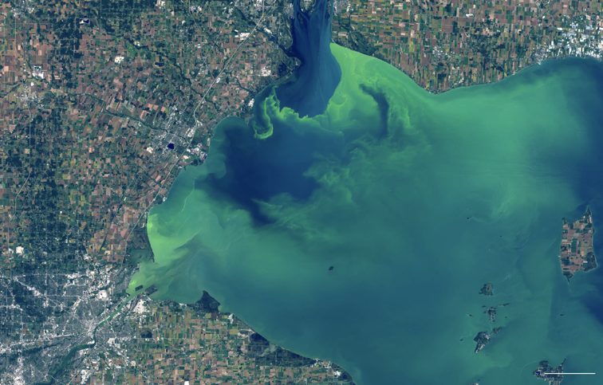
Phosphorus pollution
Lake Erie
Point sources have been eliminated
Non-point sources are a remaining problem and deal with the runoff from agricultural fields

Slide 15
Eutrophication unsolved
impacts
Fisheries
Tourism
Drinking water

Slide 16
Decision making under uncertainty
environmental regulations
land
allocation
fertilizer
application
cover crops
adoption path
Phosphorus in soil
uncertainty
Phosphorus in surface waters

Slide 17
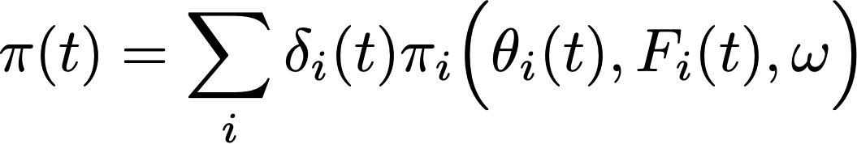
Model definition: Profit function
land allocation
cover crops
fertilizer application

Slide 18
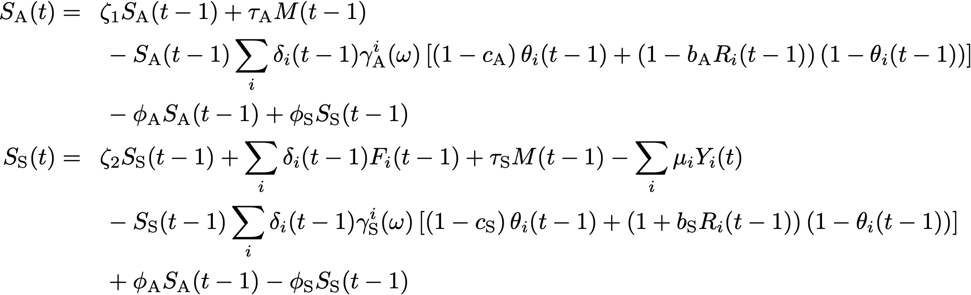
Model definition: State equations
emission rate
runoff
emission rate
runoff

Slide 19
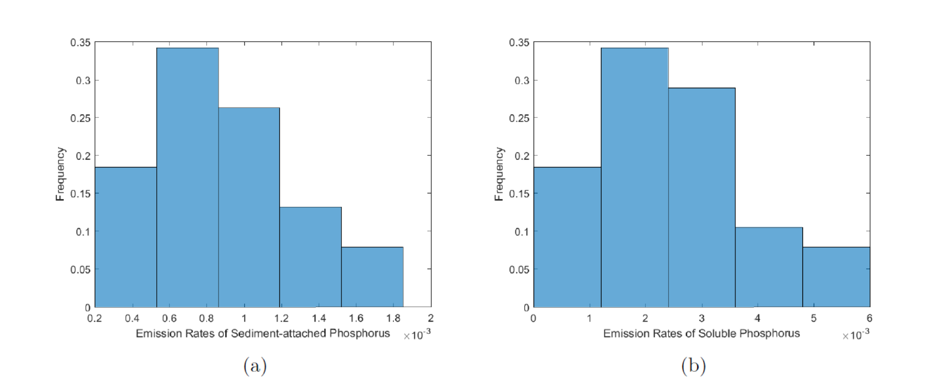
Uncertainty assessment
Emission rates depend on weather events, and cannot be considered constant

Slide 20
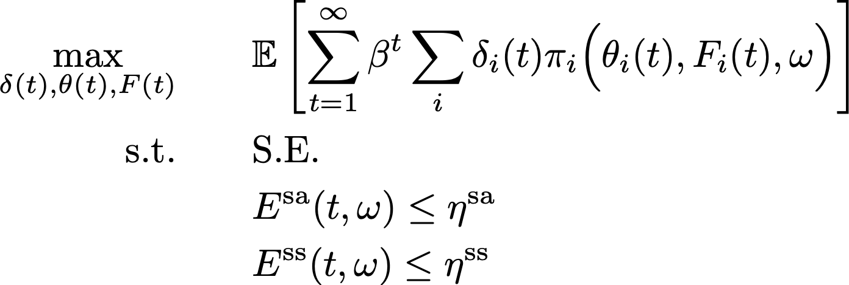
Decision model
aggregated profit
environmental
constraint

Slide 21
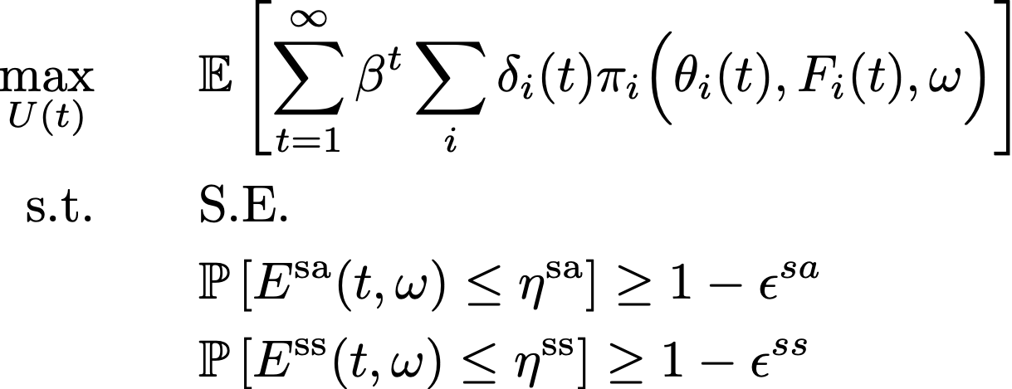
Introducing reliability and risk in decision model
probabilistic constraints

Slide 22
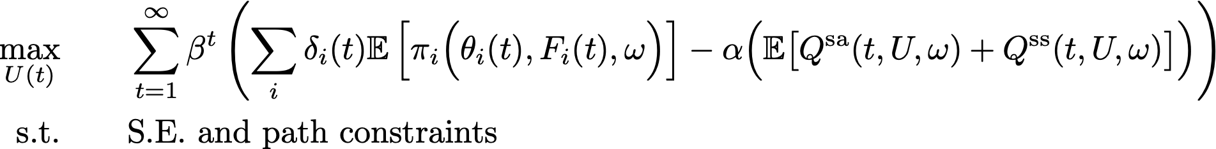
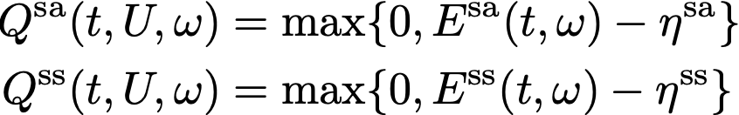
Reformulation into two-stage problem with strategic (ex-ante) and operational (ex-post) actions
profit
environmental cost
Second stage minimizes excess emissions

Slide 23
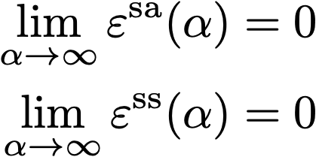
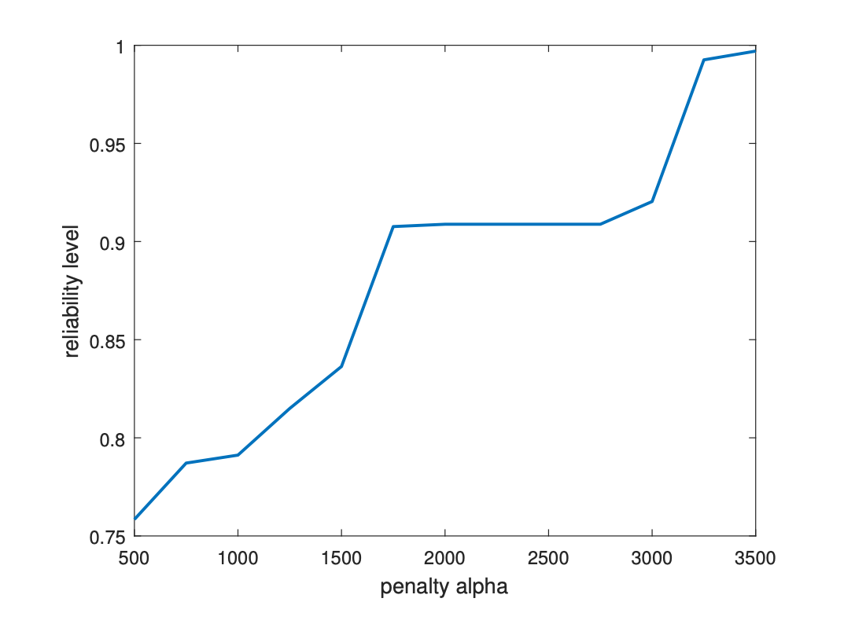
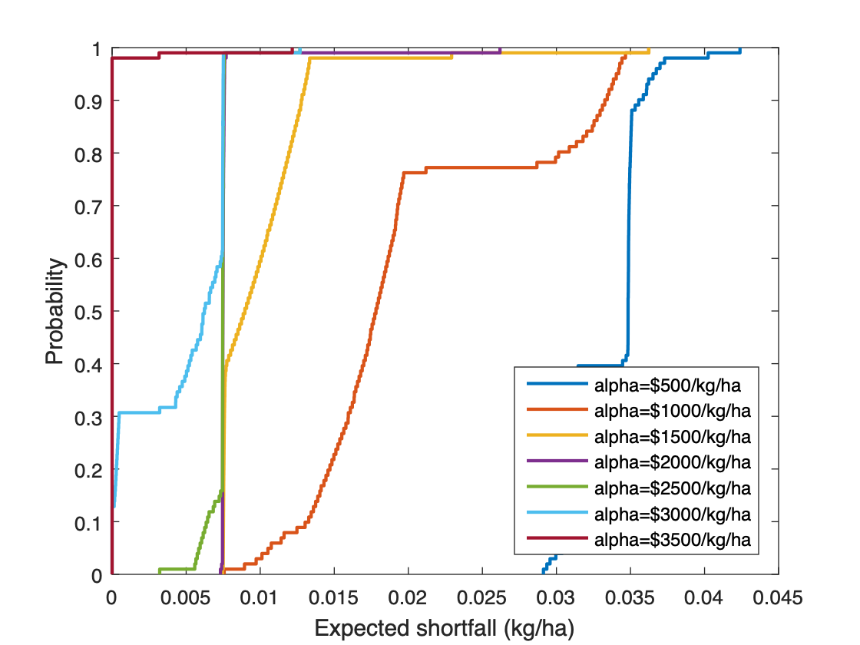
Sensitivity of the cost of excess emissions
cost of excess emissions vs reliability
Distribution of excess emissions as a function of the cost
Instead of working with mean values (certainty equivalent) or variance (as a risk measure), we make use of the full distribution of the uncertainty.
This allows us to link reliability of policy solutions with a cost. There is no one solution, but a multitude of solutions.
Decision-makers should decide on acceptable risk level.

Slide 24
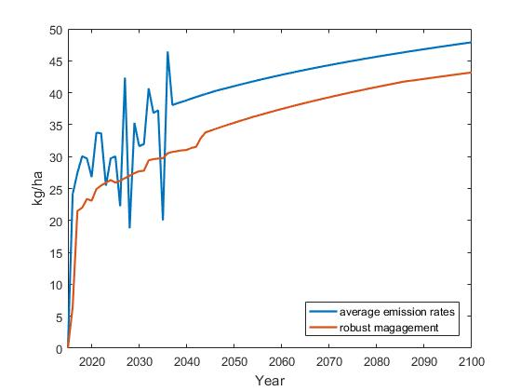
Including uncertainty results in significant tighter guidelines for fertilizer application
16% gap
Fertilizer application based on mean emission rates has historically led to harmful algal blooms
Robust fertilizer application rate 16% lower than application based on mean emission rate
Framework based on Ermoliev, Y.M. and Wets, R.B., 1988. Numerical techniques for stochastic optimization. Springer-Verlag.
P fertilizer application rate over time

Slide 25
Conclusions and outlook
Including uncertainty into the model, we find that 16% less fertilizer should be applied
Also different management policies for cover crops and land allocation. Robust management requires far more stringent adoption of cover crops. Also land allocated to winter wheat is three times larger during the first years.
Stochastic optimization framework can be applied to any existing model. The power of two-stage optimization with ex-ante (strategic forward looking) and ex-post (adaptive) actions lies in the connection between reliability an cost. This has many applications for the design of green bonds, taxing schemes, investment in new technologies, cleanup actions, etc.

Slide 26
Thank you for your time
Any Questions?
Tatiana Ermolieva
ESM/IIASA
ermol@iiasa.ac.at
https://www.iiasa.ac.at/

