Slide 1
IIASA‘s research on disaster risk management
JoAnne Linnerooth-Bayer
Risk and Resilience Program (RISK)
Cross-cutting project on Systemic Risk and Network Dynamics
Notes:
It is a real pleasure to present on subjects so topical in Britain, where much of the history of risk research was and is centered (along I might add with the US) – back to the early Royal Society report Risk: Analysis, Perception and Management in 1992 to of course the recent foresight report.: Innovation: managing risk, not avoiding it. IIASA’s work on risk also goes way way back to 1972, when the topic was public opposition to nuclear power (and still is!). Today I hope to give you a quick overview of some of IIASA’s recent research on risk and foresight. My story line is actually 4 short stories of policy impact at the global, regional

Slide 2
Four short policy stories and the science behind them
Global
Regional
National
Local
Notes:
Hallmark of rpv is our work at the science-policy interface,
Without any attempt to be comprehensive across our publications, I will tell four

Slide 3
Global policy story
Financial protection for vulnerable countries exposed to climate extremes

Slide 4
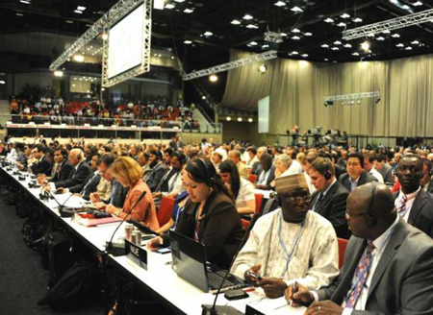
Global policy story
IIASA played a key role in a proposal for a global climate risk insurance facility that became part of the UNFCCC negotiating text, and is now contributing to the agenda of the Loss and Damage Mechanism
Which countries are most vulnerable to weather extremes?
What is the necessary capitalization of a facility that would reinsure governments of these countries?
A global facility that would be financed by developed countries and support the most vulnerable countries in their coping with two layers of climate risk
Layer 1: would „reinsure“ extreme weather risk to public infrastructure;
Layer 2: would support novel risk-transfer instruments, like index-based weather insurance and sovereign catastrophe bonds,to cover less extreme risks.
Notes:
Article 4.8 of the UNFCCC, which calls upon Parties to “consider” insurance, to meet the specific needs of vulnerable developing countries with respect to both the adverse impacts of climate change.
During the negotiations of the UNFCCC, developing country parties repeatedly stressed the need for
instruments to meet the challenge of damage resulting from the impacts of climate change. Although it
was agreed early on
that implementation costs of developing country parties would be met (to some
extent) through a financial mechanism, the issue of who would bear the risk of impacts was left
unresolved (Tol/Verheyen, 2003). Introducing the term “insurance” for the first
t
ime, the Alliance of
Small Island States (AOSIS) suggested at the third session of the Intergovernmental Negotiation
Committee (INC3) in 1991 that a fund should be established to
“
compensate developing countries (i) in
situations where selecting the least
climate sensitive development option involves incurring additional
expense and (ii) where insurance is not available for damage
r
e
sulting from climate change”
(A/AC.237/Misc.1/Add.3). AOSIS specified this demand at INC 4 with a proposal on the creation of
an
"International Insurance Pool" (A/AC.237/15).

Slide 5
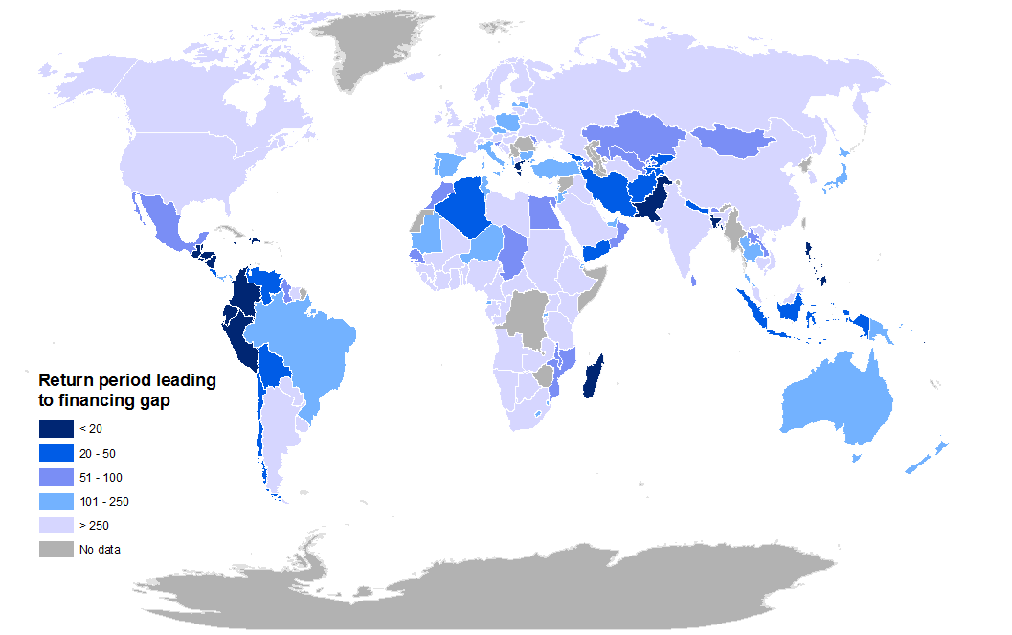

Which countries are most vulnerable to climate extremes?
Less than EUR 10 billion annually to capitalize the global reinsurance facility
Global Environmental Change 2014
Mechler, et al. 2010; Hochrainer et al. 2012 World Development Report
Mechler, et al. 2010; Hochrainer et al. 2012 World Development Report

Slide 6
Global policy story
The Science – The CATSIM model
Country vulnerability
Probabilistic estimate of public sector losses
Government’s post-disaster financing ability
Diversion from budget
Reserve fund
Domestic bonds and credit
International aid
Source: Hochrainer-Stigler et al. 2013
Notes:
IIASA addressed these questions with its CATSIM model, which combines two concepts: the government’s probabilistic losses with it ability to cope with the losses. Using simulation methods, the probability that the governments liabilities do not exceed defined levels is generated. This is combined with the government’s post-disaster financing sources. The losses minus the ability to cope generate the country’s financial vulnerability.

Slide 7
Regional policy stories
CATSIM used for regional policy making

Slide 8
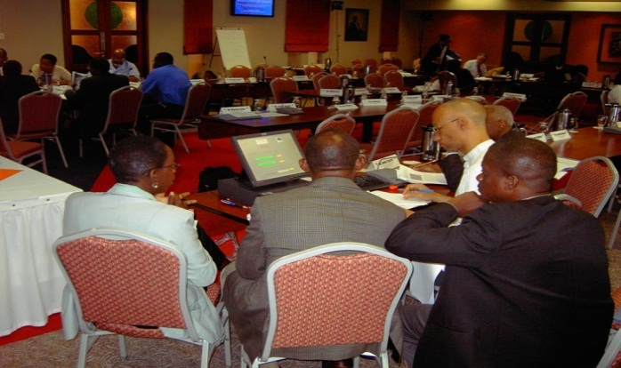
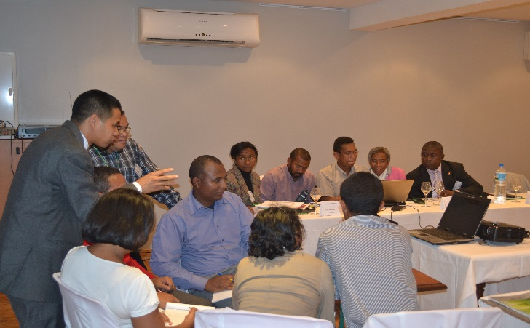
CATSIM has informed regional risk pools
Caribbean Catastrophe Risk Insurance Facility (CCRIF)
Disaster risk management pool for the Indian Ocean Islands
Notes:
CATSIM informed the design of the Caribbean Catastrophe Insurance Facility (CCRIF) in 2007, the first multi-country risk pool that has been supported by the international financial and donor communities. Based on the Madagascar work, CATSIM has become instrumental in considerations to set up a regional disaster risk management platform and pool for the Indian Ocean islands.
Law of large numbers
What if risks are dependent?
We investigated this question in with an application to Europe’s risk pool, the EUSF, with some policy impact

Slide 9
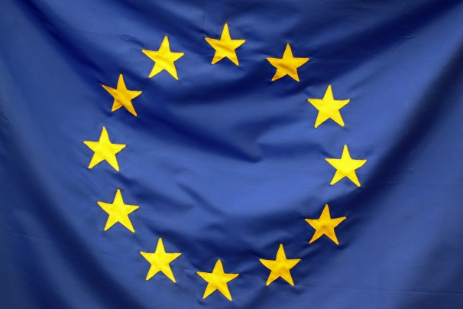

CATSIM used to stress-test the European Union Solidarity Fund (EUSF)
IIASA asked by the EU Parliament to provide expert witness at recent hearings addressing the robustness of the EUSF.
IIASA‘s message:
Taking account of dependencies in flood risks across Europe‘s river basins, there is a sizeable risk of depleting the fund (5-10% annual probability), increasing with climate change.
Jongman, et al, 2014
Notes:
Taking account of dependencies …. Because of sometimes large-scale atmospheric circulations, river basin floods are not independent. Taking account of the dependencies makes a significant difference in the risk estimates. This was IIASA’s unique scientific contribution – as published in NCC.

Slide 10
National policy story
The nexus of financial systemic risk and extreme event shocks

Slide 11


National policy story
Interest at the Austrian National Bank and the Austrian Finance Ministry in
systemic risk facing Austria’s financial system, and
how direct losses from disasters (floods) cascade through the economy as indirect losses

Slide 12
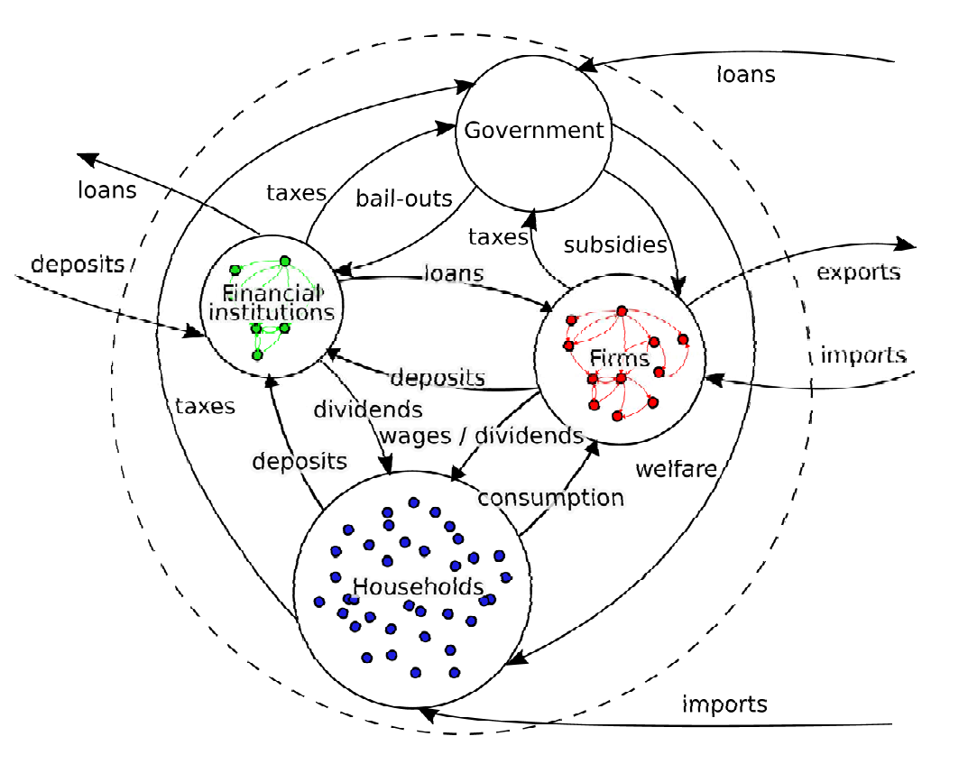
From direct to indirect flood losses
IIASA’s agent-based model of the Austrian economy
Budget deficit
Direct
flood losses
Indirect
flood losses
Even in Austria, floods can have cascading (fiscal) impacts
Notes:
The direct losses (risks), separated into different risk bearers, are used to build a damage scenario generator that provides the input for the agent-based model (ABM). The ABM, in turn, enables assessing the additional indirect losses due to the event, which, as indicated here, can be much larger than the direct losses.

Slide 13
Local policy stories
Designing participatory processes for reconciling stakeholder conflict

Slide 14
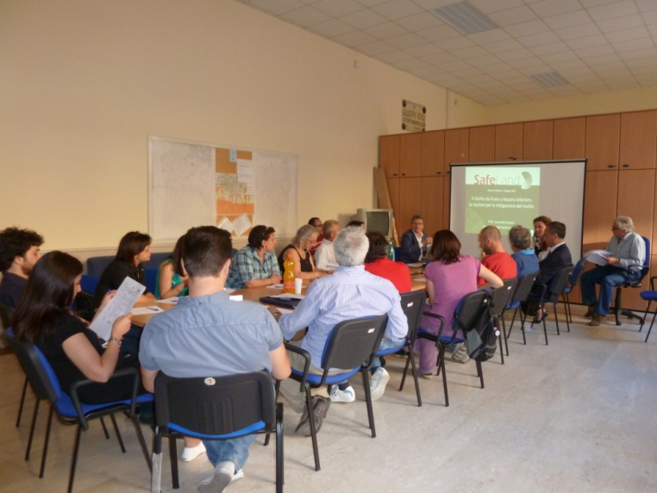
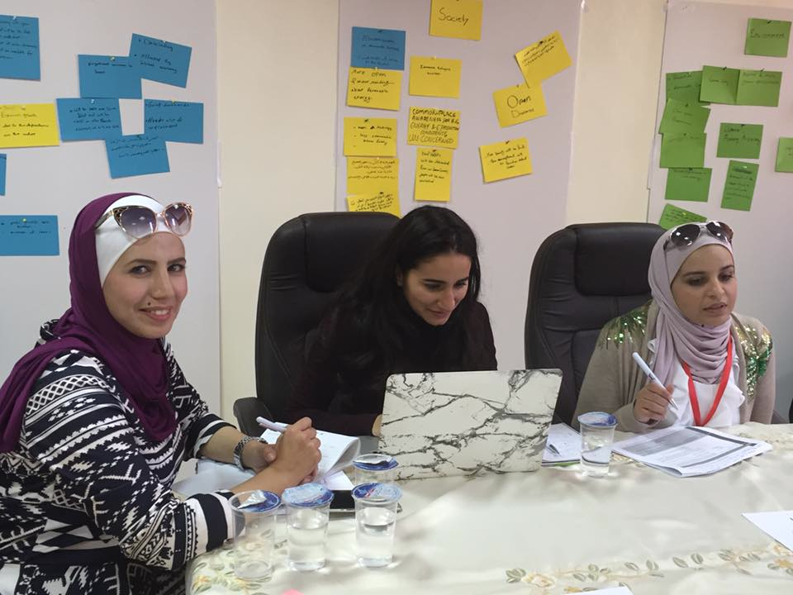
Local policy story
Reducing landslide risk in Nocera Inferiore
Science-based deliberative process
  Co-production of policy options
  Beyond interests to worldviews

Slide 15

Why IIASA?
Neutrality
Interdisciplinarity
Notes:
What is not there: Risk reduction, eg our work on BCA; Work on community flood resilience; Multi-hazard risk assessment; very little of our work on cultural identities (cultural theory).

