Slide 1
A decision–support system for Strategic Robust Adaptation to Climate Change and Systemic Risks in Land Use Systems: Stochastic integrated assessment GLOBIOM model
Tatiana Ermolieva, Petr Havlik, Esther Boere,
Juraj Balkovic, Rostislav Skalský, Christian Folberth,Nikolay Khabarov, Steffen Fritz, Michael Obersteiner, Yuri Ermoliev
EU Conference on Modelling for Policy Support
26-27 November, 2019

Slide 2
Motivation
Different manifestations of climate change:
  Gradual climate change?
  Increasing frequency and variability of natural catastrophes
  Changing seasonal patters of temperature, precipitation, heat waves, etc.
  Persistency in climate
Major losses in land use systems (LUS) associate with natural disasters
Spatial and temporal correlation between losses (impacts)
High uncertainty on when and where a catastrophe occurs
Interdependencies (supply-demand relations) between LUS (and other systems)
Incoherent LUS policies (trade bans, quotas, subsidies) can magnify impacts
Different types of CAP adaptation policies: economic and structural
Economic: insurance, subsidies - taken on a short notice, can be revised and reversed
  Can lead to adverse economic implications (protein crops in EU; corn, beef, etc. in Mexico)
  Can change behaviour of stakeholders
Structural: irrigation infrastructure, storage (water and grain), etc.
  Can lead to sunk costs if climate (e.g. water availability) changes not as drastically as expected
  Can divert money from other projects (e.g. irrigation vs grain storage)
  Can be environmentally unfriendly (e.g. irrigation)

Slide 3
Advanced Analysis of Systemic Threats,
Multi-Dimensional Systemic risks, and Systemic Security
Growing demand vs environmental standards (SDGs); electricity infrastructure innovations and investments; systemic security; increasing returns vs sunk costs;
climate change and uncertainty; strategic- and operational planning; long- vs short-term decisions; competition for resources, etc
Energy Security
Food Security
Energy security and water security; supply standards; Energy & water prices; Diversification of energy supply;
Ex-ante and ex-post risk management; electricity supply security;
global and local threats to electricity supply systems; endogenous risks; cyberattacks;
protection of critical infrastructure
Nested multi-model welfare analysis and systemic security management
Incomes; economic and population growth; demand changes; life and nutrition standards; prices;
Impacts of energy prices on food prices; Dependencies between agricultural and energy markets through bio-fuels; Agricultural subsidies; renewables subsidies, etc.
Water Security
Socio -Economic Security
Control of water resources; reliability vs. disasters; Monitoring of infrastructure reliability; monitoring of water resources vulnerability and accessibility;
Monitoring & control of water contamination;
Notes:
Three fundamental elements (energy) security: ―Physical supply: availability and accessibility; ―Economic: affordability; ―Environmental sustainability: acceptability. Most important factor determining the energy system is risks, which depend on how the system is considered as a whole
emphasis on a systemic approach to risk management: regulating the system as a whole, not just its individual components
Systemic risks is risks in a complex “network” driven by supply-demand-price relations
Framework that can be scaled to capture the key components and relationships at different levels
A tool which helps identify regional energy security gaps and self-sufficiency levels depending on various other factors and areas of priority
A tool which allows to set the priorities and initiate a discussion with decision-makers
International (traditional) energy security frameworks were developed primarily following the crude oil supply disruptions of the 1970s
Significant changes in energy markets over the last 40 years
•Increased diversification of the fuel mix, with oil use displaced by increasing use of coal and natural gas.
•A shift in consumption patterns towards non-OECD emerging economies.
•Changes in the structure of the international crude oil market, from vertically integrated market of the 1970’s to the current segmented and highly specialised market.
•The move from long term contracts to an increasing share of spot transactions and the emergence of oil futures and derivatives markets, increasing the depth and liquidity of the market.
•New causes of imbalance between supply and demand beyond geopolitical shocks to crude oil supply. For example, refinery shutdowns (e.g. Hurricane Katrina 2005), demand surges (e.g. Asia 2013) and the loss of specific types of crude (Libya 2011

Slide 4
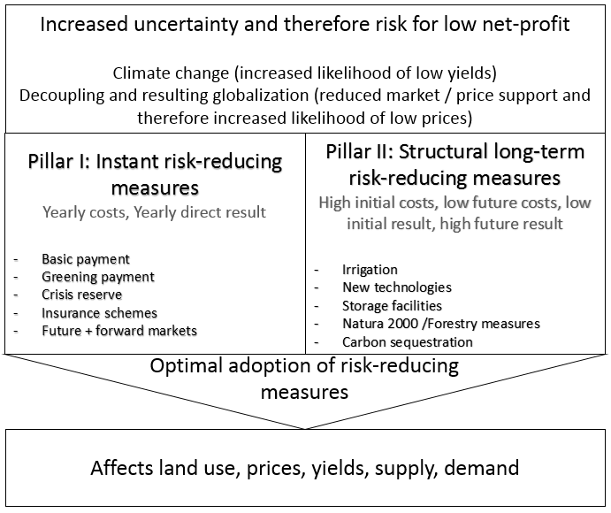
Objective: Appraisal of CAP policies
in face of uncertainty and risk
Need for adaptation (complementing mitigation)
Challenges of CAP implementation:
  Need to take decisions in front of uncertainties
  Possibility of learning about uncertainty some time in the future
  Scenario-by scenario approach can lead to maladaptation: example with two crops
  Scenario-by scenario approach can require more adaptation and costs than necessary
  Robust adaptation with respect to all (uncertainty) scenarios minimizes maladaptation
CAP: Pillar I and Pillar II adaptation policies:
Pillar I: Economic instruments (EI),
create incentives (positive) or disincentives (negative),
effective in short-term. Decrease of EI
may entail additional costs to farmers which they
pass to consumers. Higher EI can lead to increase
of production, environmental implications,
disincentives to invest in structural measures
Pillar II: high upfront investments, can be effective
in long-term, can lead to maladaptation,
impacts-costs-benefits-implications have
to be properly understood (assessed),
often involve public-private partnerships

Slide 5
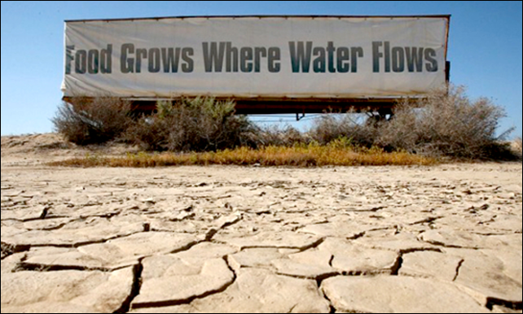
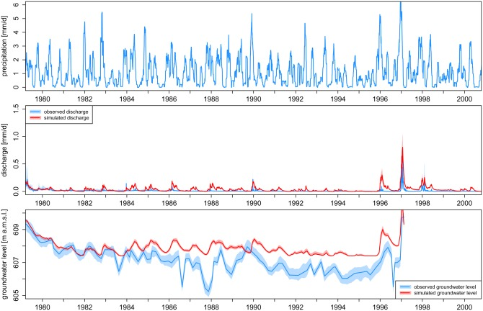
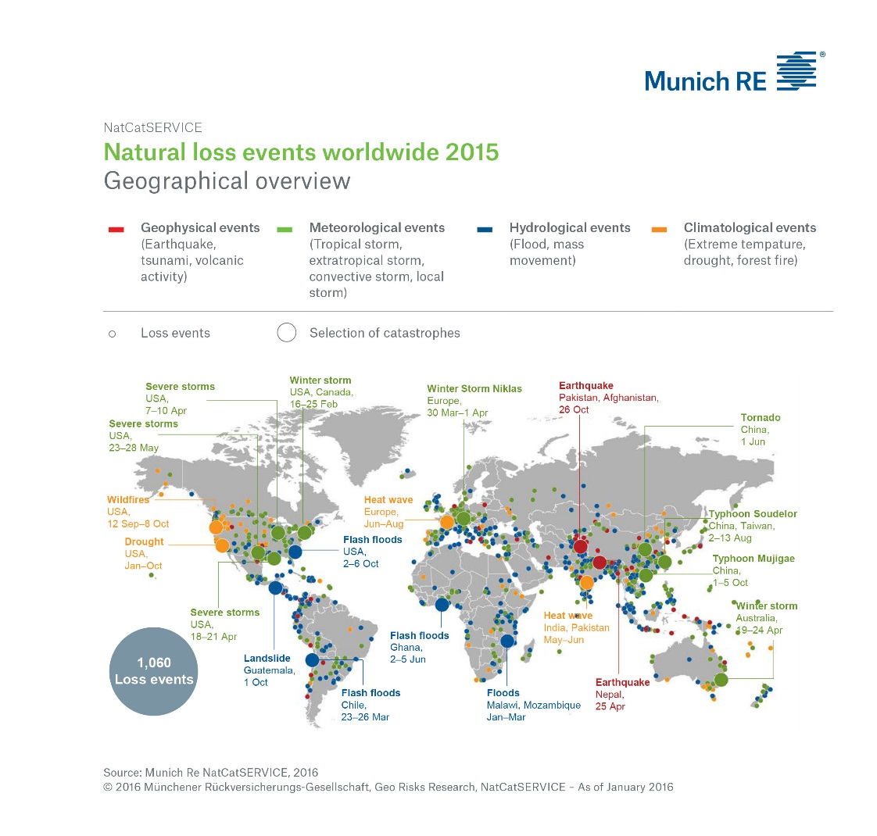
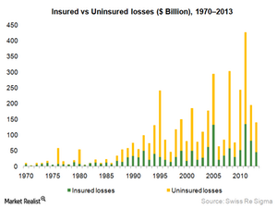
“Natural“ uncertainty
Precipitation uncertainty, observed
Yield uncertainty, observed
.
Uncertainty in economic, technological, demographic drivers, etc.

Slide 6
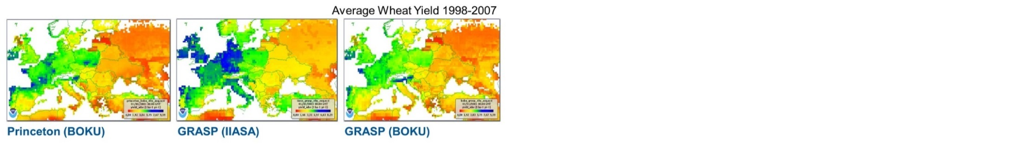
Uncertainty of impacts, costs and benefits
due to structural differences in models
Yield uncertainty from existing biophysical models
Distribution of Social cost of carbon (SCC)
estimated based on DICE (Nordhaus, 2008),
FUND (Anthoff et al, 2009),
and PAGE (Hope, 2006)
Moyer et. al., 2013
Comparison of costs and benefits
performed with alternative IAMs
Nelson et al., 2013.
Climate change effects on agriculture:
Economic responses to biophysical shocks.
PNAS. Vol. 111., pp. 3274-3279.

Slide 7
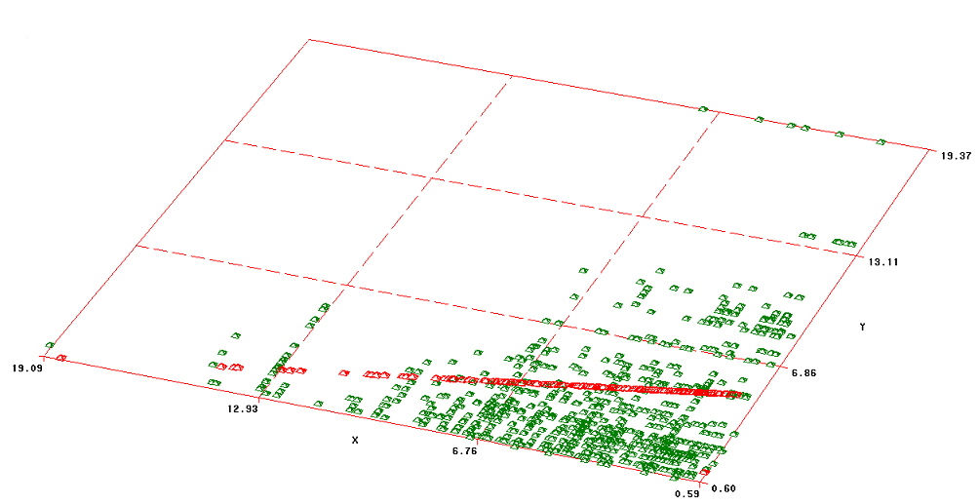
Estimation of multimodal joint density
Scatter plot
Standard least square criteria (line in red) can not capture outliers
In a general decision support problem, the under- or over-estimation of outliers can be associated with costs of under- or over-production supply
2

Slide 8
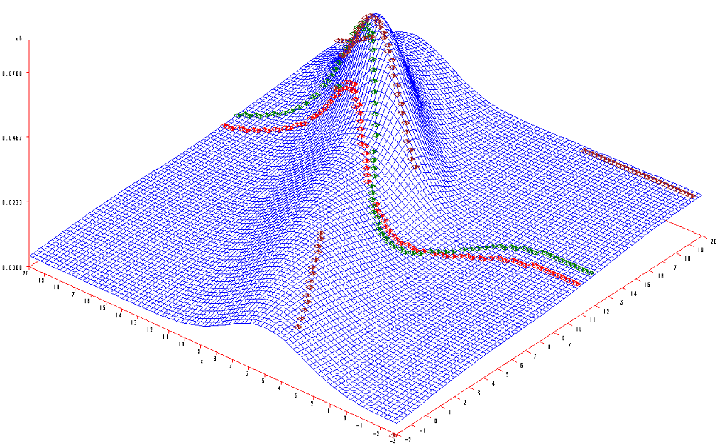
Discontinuous mode and median, continuous mean
Standard regression curves vs probabilistic dependencies
Mean
Median
Mode
x
y
True dependencies are very difficult and cannot be estimated with least square criteria
Differences between Mean, Median, Mode (in Gaussian distribution Mean= Median=Mode)
The need for problem-best criteria, i.e. percentile (probabilistic criteria ) for safety/security/robustness
Nonprobabilistic distributions can be derived by using similarity measures (kernels) and support vector machines
4

Slide 9
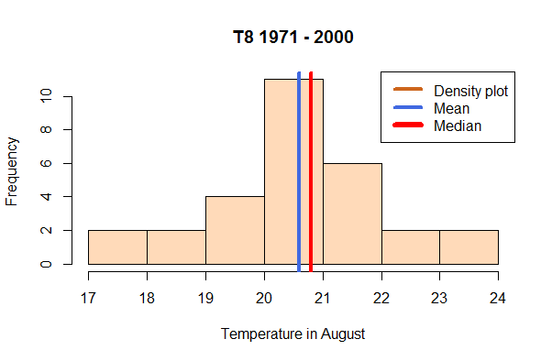
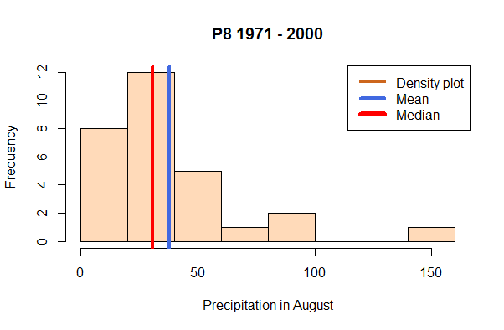
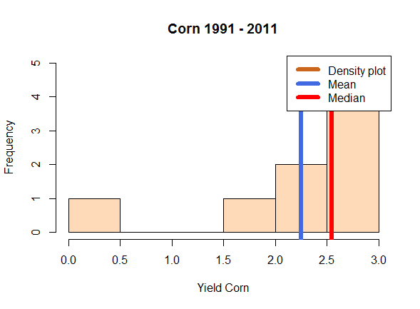
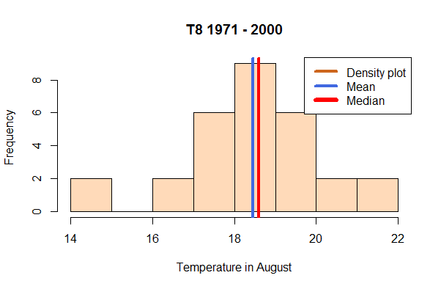
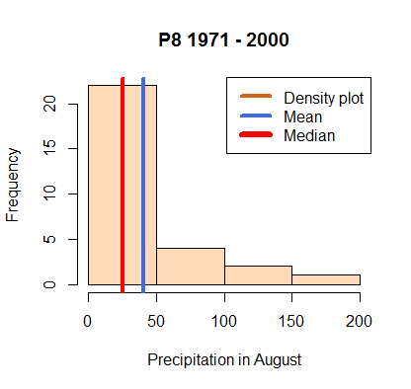
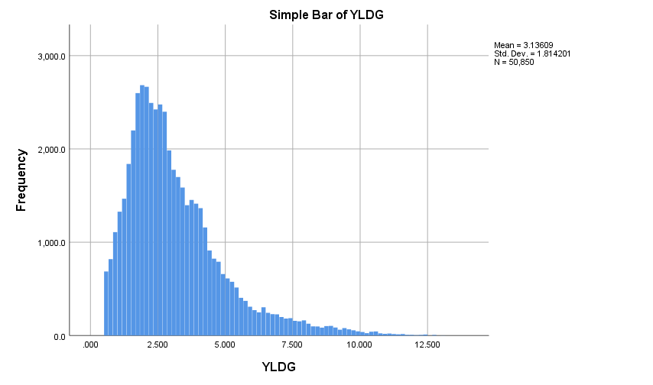
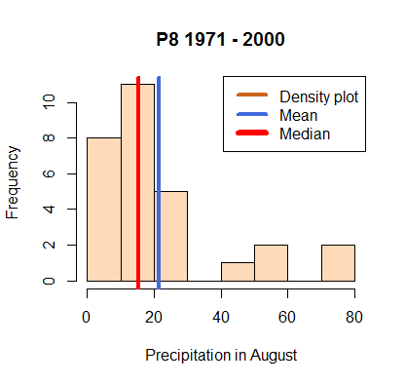
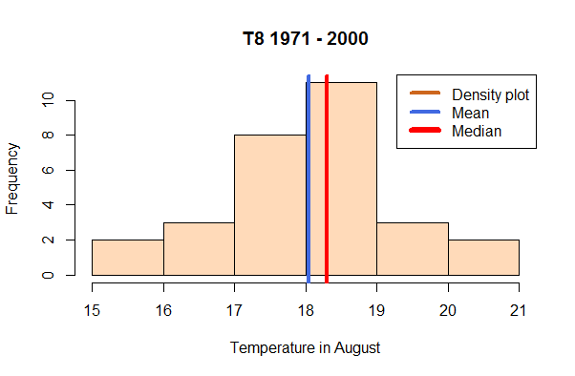
Example of ML and ANN: Stochastic generator of crop yields based on GIS data of
T, P, SPEI, soil, water, EPIC data, Monthly, 1km2 resolution, RCPs
Input (P, T, soil quality, water, nutrients)
Input (weather, climate, bio-physical processes, management)
Transfer/process function, kernels, etc
Predicted output (yield)
Observed yields (losses) are skewed
Goal function:
Percentile/
quantile-based risk measures
Yield loss
Iterative
Revision of estimates
Weights/parameters/transfer functions/etc.

Slide 10
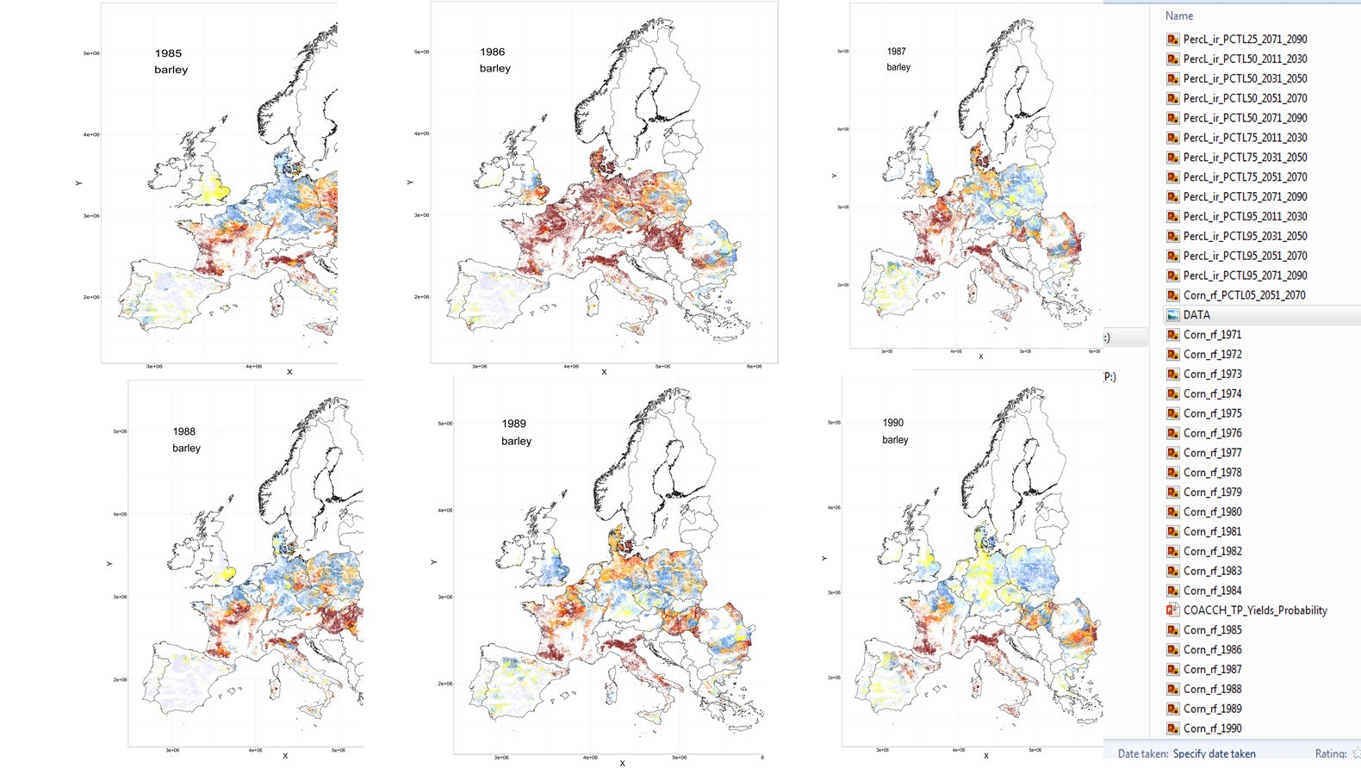
Historical Yields

Slide 11
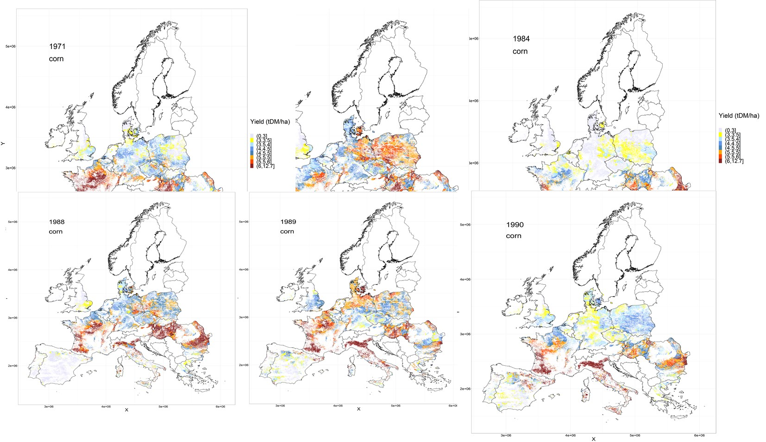

Slide 12
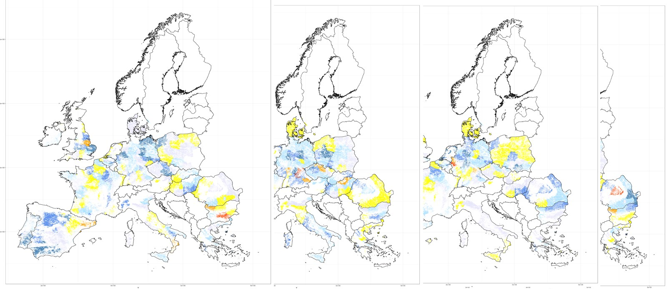
Classification of yield losses:
100*(Yield(Grid)-YieldAv)/ YieldAv
1~-95%, 2~ -75%, 3~ -50%, 4~-25%, 5~-15%, 6~-5%,
7~0, 5%, 15%, …
Multinomial logistic regression:
Probability of yield deviation
from Yield Average or a Yield Percentile
As a function of 12 month T and P
Prob (50% loss (wrt average yield)), 2011-2030
2031-2050
2051-2070
2071-2090

Slide 13

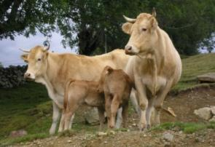
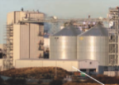

Demand
Drivers: Population, tech. change, F-W-E security targets, GDP, diets, preferences
Food
Fibers
Energy
Industry
Markets
ECONOMIC MARKET + Spatial equilibrium trade → PRICES
2050-2100
Production
RUMINANT
Digestibility model
Feed intake
Animal production
GHG emissions
BIOENERGY
Processing
MJ biofuel
MJ bioelectric
Coproducts
G4M
Global Forest model
Harvestable wood
Harvesting costs
…
18 crops (FAO + SPAM)
Wheat, Rice, Maize, Soybean, Barley, Sorghum, Millet, Cotton, Dry beans, Rapeseed, Groundnut, Sugarcane, Potatoes, Cassava, Sunflower, Chickpeas, Palm Fruit, Sweet potatoes
3 different systems
7 animals
(FAO + Gridded livestock)
Cattle & Buffalo
Sheep & Goat
Pig
Poultry
8 different systems
Land suitable for Poplar
Pillow
Eucalyptus
Productivity from literature
Downscaled FAO FRA at grid level
Area
Carbon stock
Age
Tree size
Species
Rotation time
Thinning
2010
Land use
2000
Land cover
Cropland
Grassland
Short rotation plantations
Managed forest
Natural
forest
Other natural land
Global Land Cover 2000
30 interconnected through international trade

Slide 14
Main advantage:
Systemic interdependencies in GLOBIOM
Notes:
Modeling of internal and external schocks

Slide 15
Main difference between
deterministic and stochastic model
Deterministic, not accounting for risks: Two producers/regions/feedstocks (corn, wheat) P1 and P2 with production costs: c₁ < c₂ < b; d – demand for bioethanol:
minimize
solution
Stochastic, accounting for risks: a₁ and a₂ are random shocks/(yields) to production
minimize
?
Also other constraints, e.g. on emissions, water supply, water pollution, biofuel targets, etc.
Notes:
Production conditions are naturally uncertain – weather events, markets instabilities, interdependencies among sectors which bring additional uncertainties. However production policies are often adopted without accounting for uncertainties and interdependencies.

Slide 16
Emergency of systemic risks and risk sharing
Instead, we require the safety constraint that
minimize
where is the expected storage/import cost if demand exceeds the supply
New system with trade or/and storages!
Ex ante strategic land allocation decisions x, ex post adaptive scenario-specific trade or storage decisions
If only Producer 1 is at risk (yield a₁ is stochastic), the production of
the risk-free Producer 2 depends on the stochasticity of Producer 1,
costs, trade price, demand security, ….
can be chosen to satisfy the safety constraint with required probability, ,
i.e. for a percentage (percentile) of scenarios.

Slide 17
Stochastic yields (shocks)
Dynamics of wheat yield by major grain producers, 1960 – 2012.

Slide 18
Yields variability by major grain producers, 1960 – 2012, FAO

Slide 19
Stochastic GLOBIOM:
goal function and security constraints
Maximize
Production
balance
Food security
Environment security
Bio-energy security

Slide 20
Design of experiments
C1: Deterministic GLOBIOM is run in a scenario-by-scenario manner under food-energy-water-environmental constraints, scenarios are stochastic yields (1960 – 2012) and average yield scenario. Derives scenario-dependent solutions (regarding land use allocation, crop portfolios, technologies, etc.)
C2: Stochastic GLOBIOM is run using all yield scenarios under food-energy-water-environmental constraints. Derives robust strategic solutions (land use allocation, crop portfolios, technologies, etc.)

Slide 21
Comparison of results
Indicators: economic, environmental, vulnerability
Economic: production, demand, prices, …
Environmental: land use changes, water consumption, emissions
Vulnerability: VSS, distribution of prices, demand, supply, reserves, etc.
Value of stochastic solution (VSS)
Measures losses associated with implementation of deterministic model solution in stochastic environment
(We compare two values: the value of stochastic goal function using stochastic solutions and the value of stochastic goal function using deterministic solution)

Slide 22
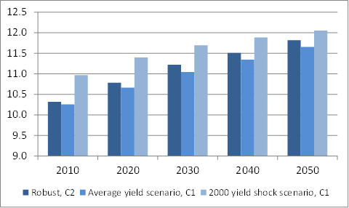
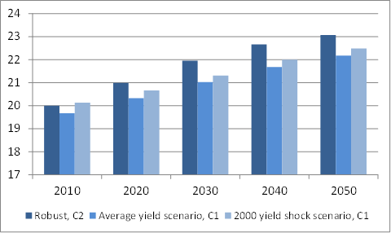
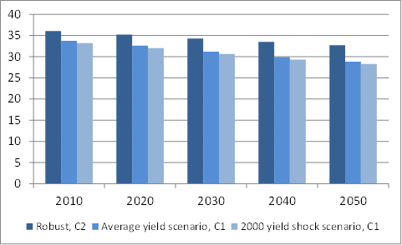
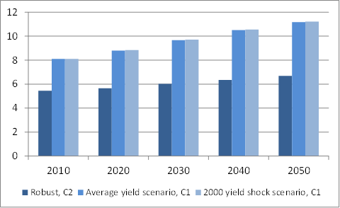
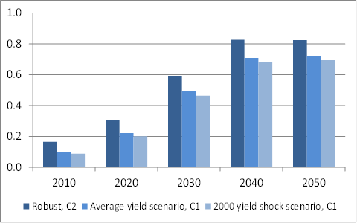
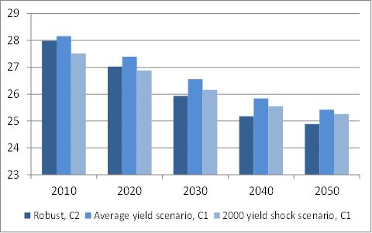
Environmental indicator: land use change
Crop land Grass land Natural forest
Managed forest Planted forest Natural land
In some “extreme shock” scenarios (e.g. 2000, 2005) the demand for land calculated by deterministic GLOBIOM is higher than robust demand calculated by stochastic model using all scenarios.
Stochastic GLOBIOM suggests to use slightly more crop land than in “average yield scenario” calculated by deterministic model.
Robust land demand is somewhere between deterministically calculated demands (more specifically, it is a percentile of the demand distribution)

Slide 23
Pillar I implementation
D1: Direct payments as they were allocated for the average hectare of cultivated land by country.
D2: An alternative allocation based on the same level (flat-rate) of aid per hectare to all farmers in the EU. In the model we calculate the average level of direct payments at the level of EU-27 to be around 150 – 160 EUR/ha (in these studies we exclude grass land from the analysis), i.e. we assume the EU flat rate is about 155 EUR/ha cultivated area (Scheme 2).
Traditional deterministic models argue that production level will not change as a result of D2, only distribution of profits will change
D3: Using production allocation “profile” calculated by stochastic GLOBIOM, we define the so-called Robust (Scheme 3) payment rates per hectare eligible land.

Slide 24
Alternative payment schemes

Slide 25
Pillar II implementation
S1: Grain storage in a region (location) is introduced by accounting for the frequency of potential production shortages vs security constraints, costs, and benefits associated with the introduction of the storage in the region (location). The demand for storages is estimated as a production “shortfall” in locations where current production does not meet the demand (no self-sufficiency) and the trade is either not possible or too expensive.
S2: The demand for irrigation infrastructure (and, in general, water storages), is estimated similar to grain storages, i.e. in locations where water supply does not meet the demand. The water shortfall determines the demand for water saving technologies, storages, etc., able to stabilize production and welfare of farmers at required level.

Slide 26
Distribution of grain storage
Distribution of storage withdrawals, in thousand tons. Frequency refers to the absolute number of withdrawals within a range identified on the horizontal axis. Cumulative refers to the percentage of total of the withdrawals at or below the value on the horizontal axis.

Slide 27
Grain storage
Storages allow to decrease the demand for land in bad yield scenarios. In particular, with storages the demand for irrigated land is by about 5.5% to 7.5% lower than in the scenario without storages.
EU grain reserves of about 240, 10, and 3376 thousand tons of rape, soya, and sunflower, respectively, can avoid investment in irrigation by about 300-400 thousand hectares of agricultural land, at EU level.
Robust grain storages calculated with stochastic GLOBIOM can increase the feasibility of various environmental and (bio)fuel targets. On the other hand, they can also indicate that the targets are too high and can cause grain shortfalls, increase of prices and increase of food security risk.
Feasibility analysis of storages provides insights into optimal allocation (and capacities) of storages in the face of cc uncertainties and risks (including interdependent systemic risks). Thus, in locations where introduction of storages enhances production and increases profits, the rate of Pillar 1 subsidies can be decreased to enable compensation for storage costs (construction and maintenance costs)
Water infrastructure
In this study we do not model optimal Pillar 2 water management (infrastructure) projects. The goal is to show that water provision policies highly depend on other policies and measures, and, therefore, require special analysis of interdependencies (nexus) at local scales.
Robust design of subsidies and availability of grain storages can substantially decrease the overall water demand and the need for irrigation investments, i.e. decrease the demand for water infrastructure, which is especially important in locations with scarce water resources and/or multiple water users.

Slide 28
Conclusions and PIA recommendations
For policy and decision-making, the deliverable develops a framework enabling the analysis of robust policy recommendations for new CAP, which ensure stability of systems and reduce costs of maladaptation and (ir)reversibility. The developed framework allows to investigate and derive policy conclusions regarding the nexus between systems, decisions, and risks. Decision making in front of uncertainties requires two types of interdependent measures – long-term strategic, taken ex-ante in front of uncertainties without knowing real state of nature, and operational ex post measures to adjust initially taken decisions when additional information on uncertainties becomes available. While traditional approaches are able to evaluate either ex ante or ex post decisions, in this study we show how policy makers can do the evaluation of these interdependent decisions simultaneously.
The deliverable defines basic principles for CAP under climate change uncertainties and risks:
Inclusion of risk and uncertainty: Various policy alternatives and their trade-offs have to be accounted for in an IA, e.g. a trade-off between various types of strategic long-term (ex ante in front of uncertainties) and adaptive short term (ex post) after learning about uncertainties. Systemic (dependent) risks, and ways to deal with them, as well as risk criteria have to be included.
Inclusion of interlinkages between systems: Climate change policies are likely to have significant impacts in economic, environmental and social domains and on a wide range of stakeholders. It is therefore essential to take potential side-effects of the policy on other levels into account.
Inclusion of multi-level analysis: A level of analysis for the IA needs to be defined. But the impacts on other level are of also of uttermost importance and need to be included.
Inclusions of multi-time period analysis: Short-medium and long-term impacts of a policy need to be defined. Random horizons of climate change, including possible occurrence of catastrophic events, vs life-spans of adaptation measures has been taken into consideration;
A proper selection for evaluation criteria: Adoption of proper safety, security, reliability and environmental criteria in IAM for practical PIA of climate change adaptation measures, as it has been done in engineering, insurance industry, operations research.
It has been shown how stochastic GLOBIOM can provide a basis for a dialogue with policy makers, stakeholders regarding “impact assessment” of various agricultural adaptation options. The idea is that at the beginning of a time horizon (can be infinite) the model evaluates strategic and operational two-stage decisions. The decisions can be implemented until some random time (stopping time) when important information about climate (climate changes faster) or systemic changes (prices increase) reveals. The new information provides the basis for revision of parameters and uncertainty scenarios perceived at the beginning of the time horizon. With respect to new scenarios, adjusted two-stage robust decisions are derived. The problem can be formally defined as decision making under learning based on dynamic two-stage moving time horizon model, in which reevaluation of decisions occurs when additional information on critical parameters or performance indicators becomes known.

Slide 29
New CAP: 2014-2020
Main difference with previous CAP: moving from product to producers support per hectare
The reform therefore focused on the operational objectives of delivering more effective policy
instruments, designed to improve the competitiveness of the agricultural sector and its sustainability
over the long term
In short, EU agriculture needs to attain higher levels of production of safe and quality food,
while preserving the natural resources that agricultural productivity depends upon
away from product based support towards producer support and considerations for the environment

