Slide 1
organized by
FLOODCITISENSE: AN EARLY WARNING
SERVICE FOR URBAN PLUVIAL FLOODING
Linda See

Slide 2
The FloodCitiSense Project Team
Boud Verbeiren
Solomon Seyoum
Ihab Lubbad
Patrick Willems
Laura Temmerman
Carina Veeckman
Tian Xin
Marie-Claire ten Veldhuis
Andy Johnston
Barry O’Brien
Christian Onof
Lipen Wang
Susana Ochoa-Rodriguez
Nick van de Giesen
Els Veenhoven
Dominique Nalpas
November 27-30
Linda See – FloodCitiSense

Slide 3
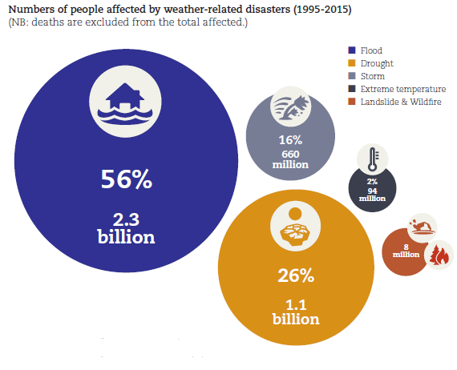
90% of disasters between
1995-2015 have been
weather-related
Flooding is on the increase,
up 35% over the previous
decade (171 events)
Source: CRED & UNISDR: The Human Cost of Weather Related Disasters 1995-2015
November 27-30
Linda See – FloodCitiSense

Slide 4
Types of flooding
Fluvial or river flooding
Pluvial or urban flooding
Coastal or storm surges
More complex with multiple types occurring
Lots of early warning systems for fluvial and storm events
Less focus on EW for pluvial flooding
November 27-30
Linda See – FloodCitiSense

Slide 5
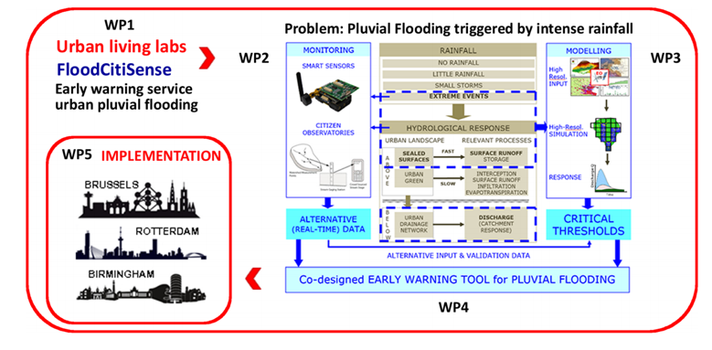
The FloodCitiSense Project
November 27-30
Linda See – FloodCitiSense

Slide 6
Urban Living Labs
Two co-creation workshops in each city
Validate scenarios and technology
Feedback on wireframes
Development of user requirements
Training workshops in each city
Users built their own sensors - ownership
Introduced to prototype of the mobile app
Regular communication with the participants
November 27-30
Linda See – FloodCitiSense

Slide 7
The Early Warning System
Local data platform
Rainfall sensors
HTTP API
Get Request
Data
HTTP API
Get Request
Data
EWS tool
HTTP API Get Request
Web app and front end to EWS tool
Mobile app
HTTP API Get Requests
Alerts/early warnings
Data-driven flood forecasting models
November 27-30
Linda See – FloodCitiSense

Slide 8
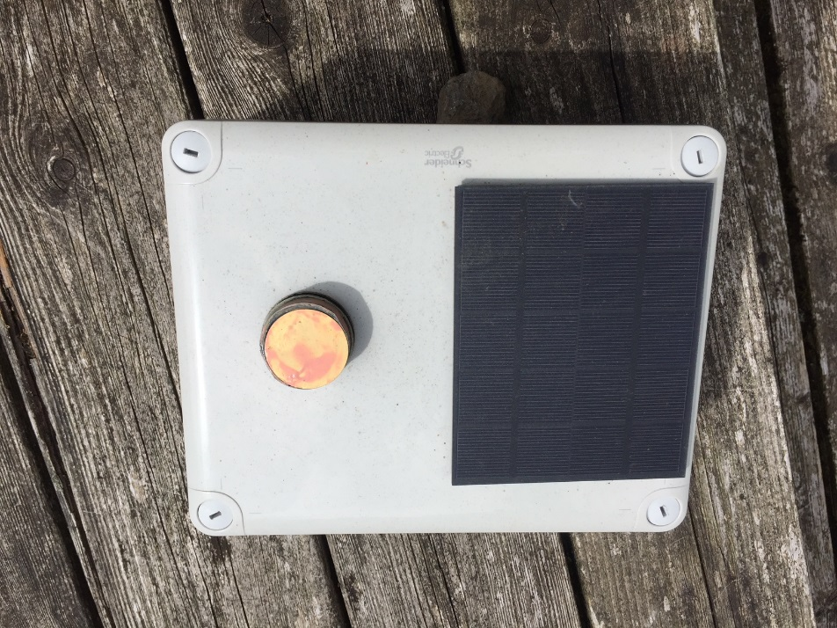
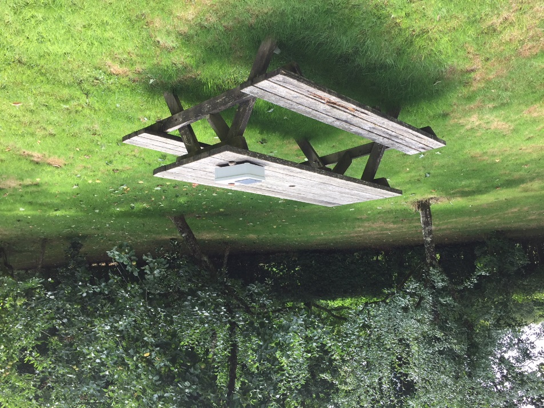
The Rainfall Sensors
Building the sensor: https://www.youtube.com/watch?v=DjLQ7p746hg
Facebook groups to support users in each city
November 27-30
Linda See – FloodCitiSense

Slide 9
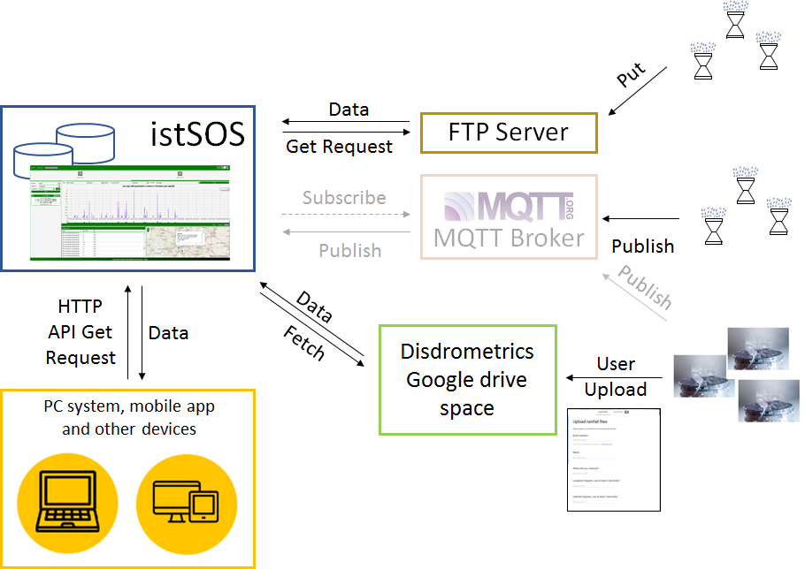
The Local Data Platform
November 27-30
Linda See – FloodCitiSense

Slide 10
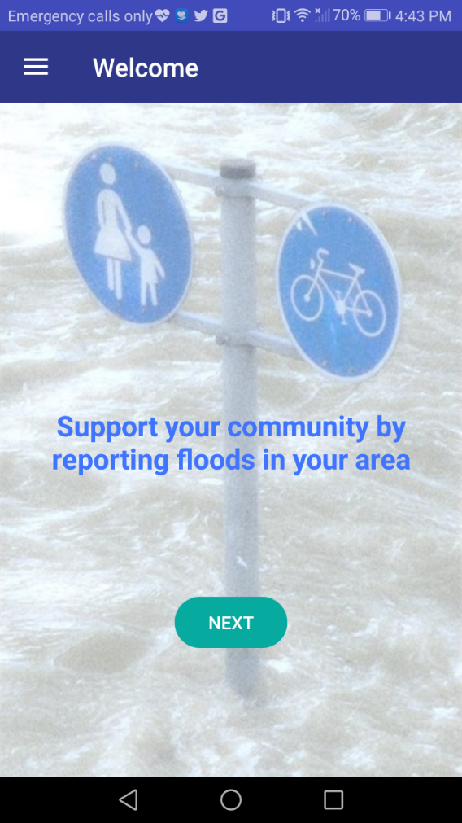
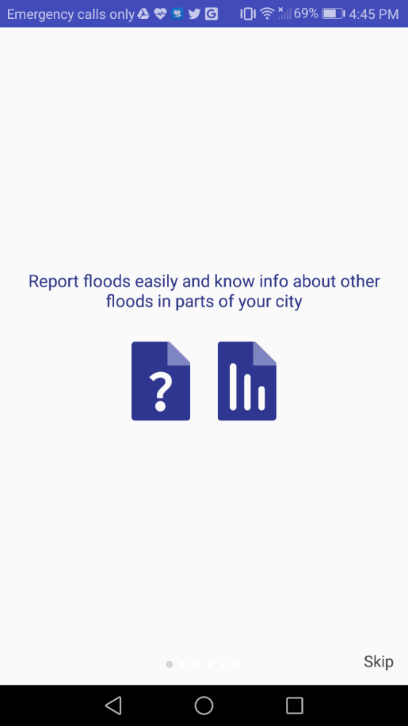
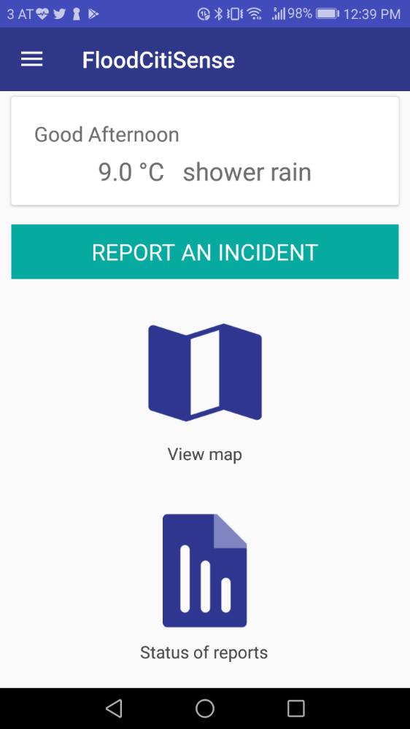
The FloodCitiSense Mobile App
November 27-30
Linda See – FloodCitiSense

Slide 11
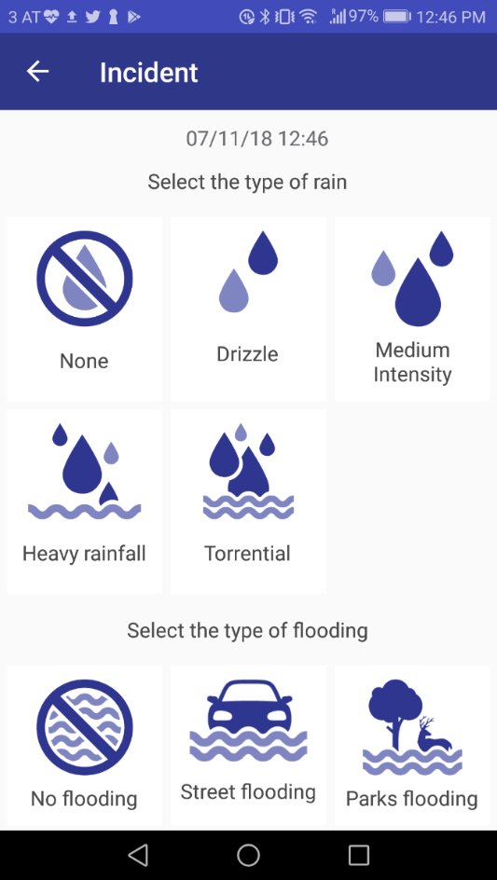
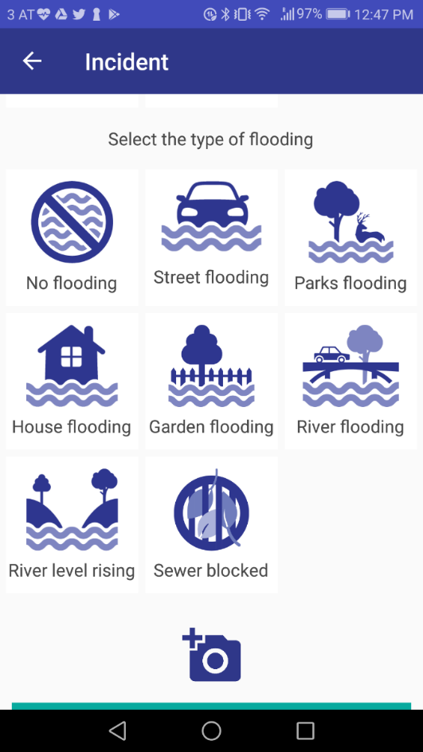
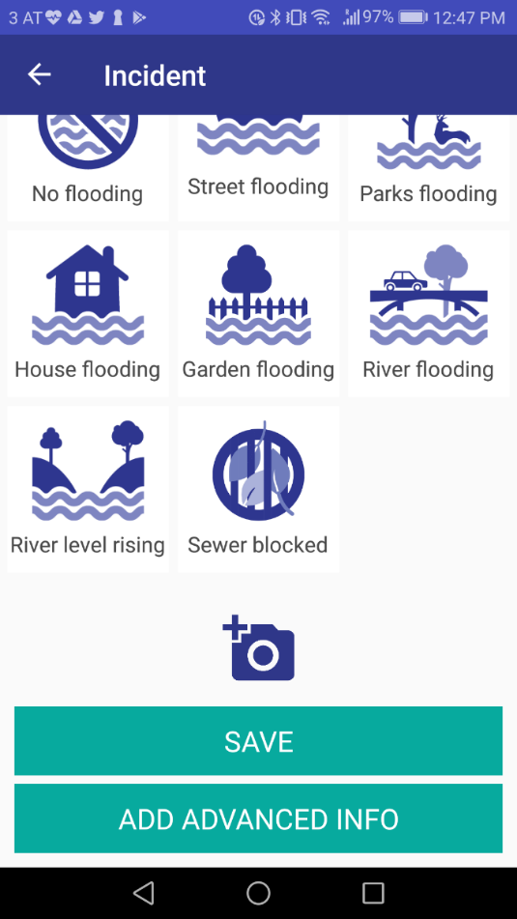
Report an Incident (Simple)
November 27-30
Linda See – FloodCitiSense

Slide 12
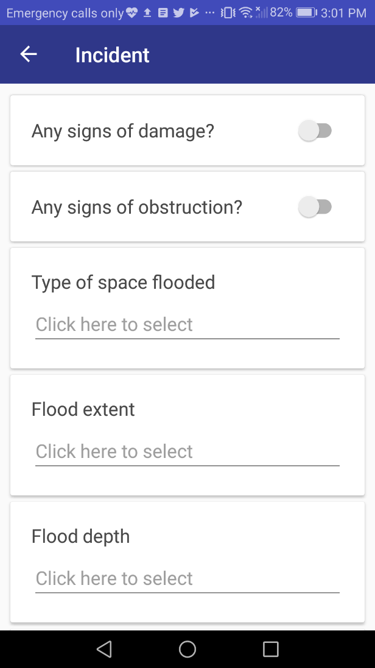
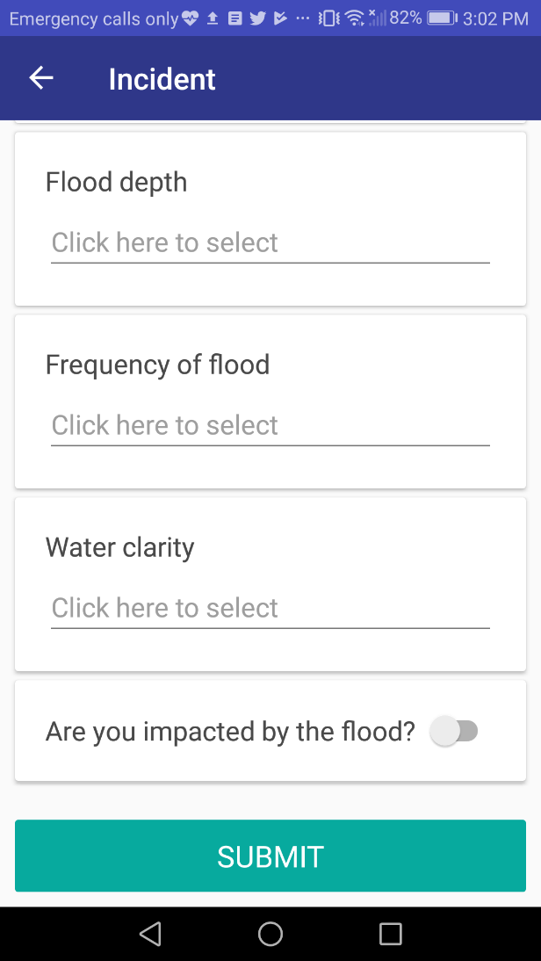
Report an Incident (Advanced)
Private
Public
Both
First time flood
Floods occasionally
Floods regularly
I don’t know
A small part
Half flooded
Completely
flooded
Clear
Muddy
My feet are wet (< 2cm)
Up to my ankles (<10cm)
Up to my shins (<25cm)
Up to my knees (<50cm)
Higher than 50 cm
November 27-30

Slide 13
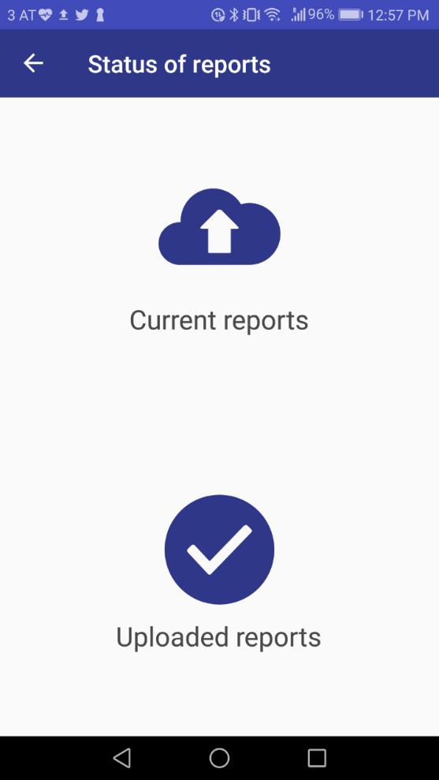
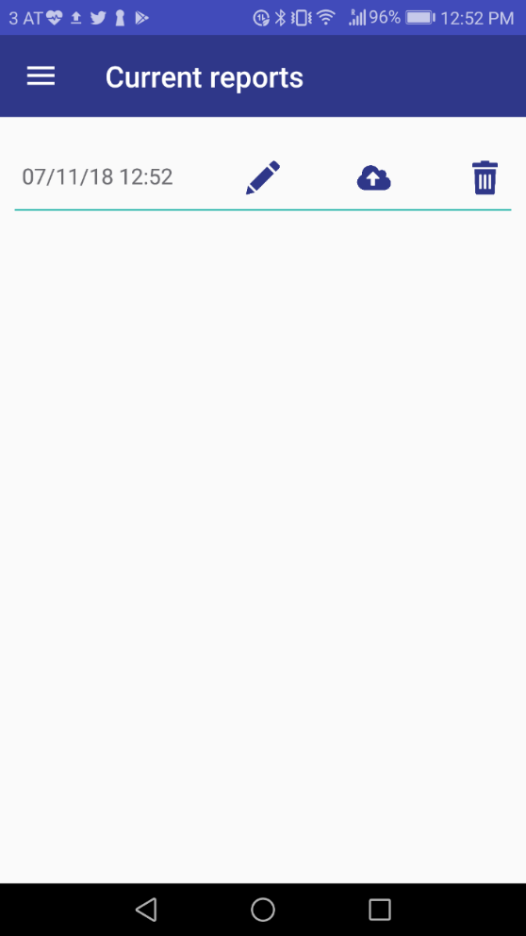
Current and uploaded flood reports
List of reports that you have made
You can delete or upload them
If you click on one, you can edit it or add ‘Advanced information’
List of reports you have uploaded
You can view them
You can filter by time
Pending will change to ‘received’ once read by a local authority
November 27-30
Linda See – FloodCitiSense

Slide 14
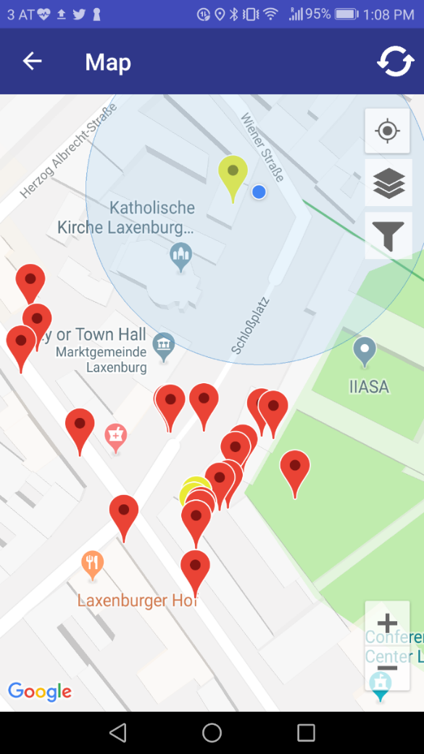
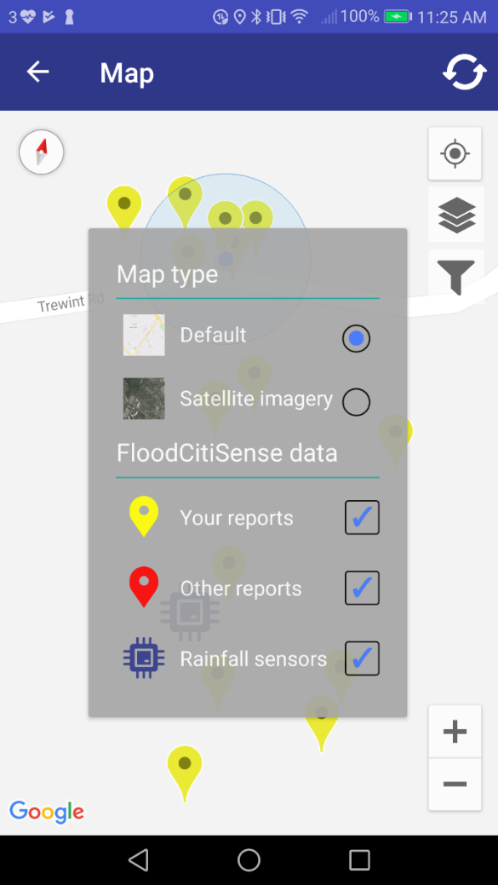
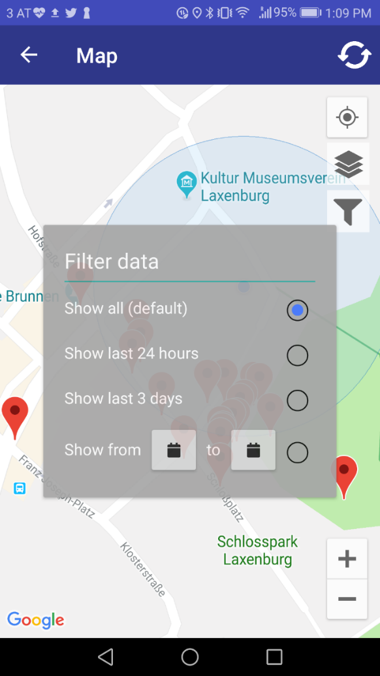
Viewing reports on the map
November 27-30
Linda See – FloodCitiSense

Slide 15
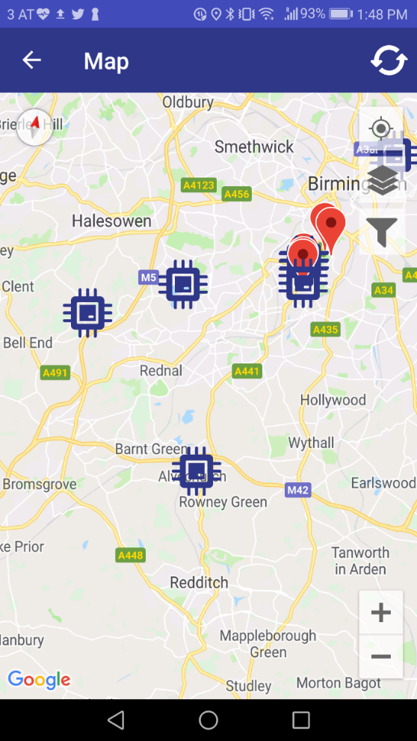
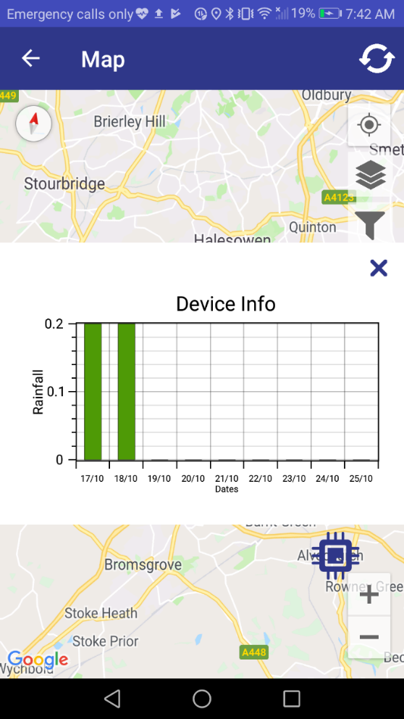
View sensor data (work in progress)
November 27-30
Linda See – FloodCitiSense

Slide 16
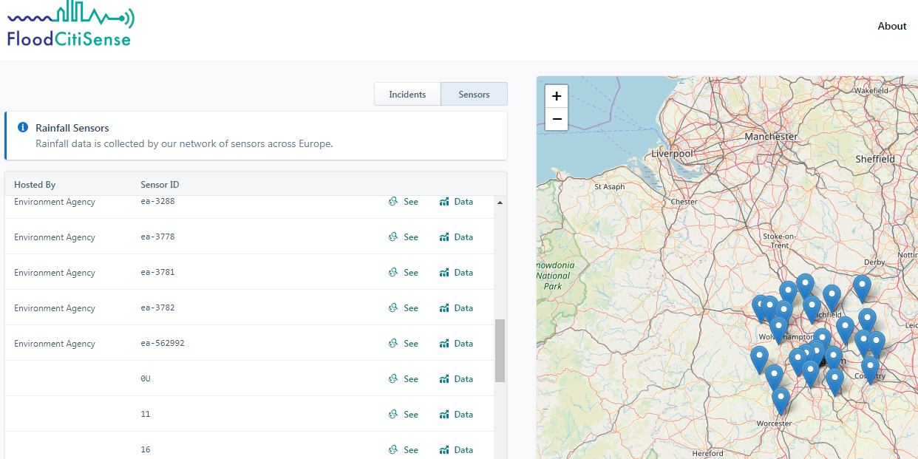
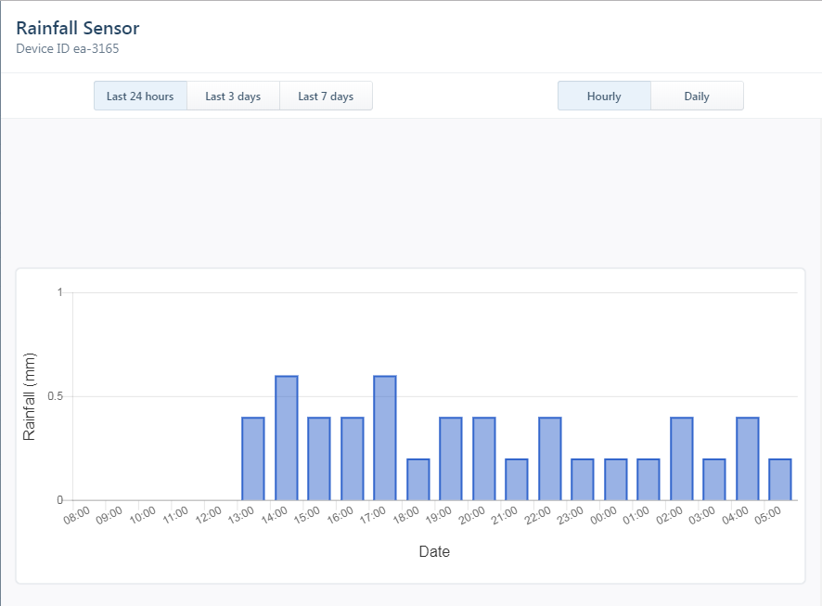
Web Application
November 27-30
Linda See – FloodCitiSense

Slide 17
The Web App and EWS Tool
Still under development
Citizens: same functionality as mobile app
Experts: can validate flood reports of others
Super users: run the flood forecasting model for their city and send alerts
November 27-30
Linda See – FloodCitiSense

Slide 18
The flood forecasting models
City | Data-driven Flood Forecasting Model
Birmingham | Data-driven meta model taking analogue approach to produce gridded probabilities of flood occurrence at a 1 km resolution.
Brussels | Neural-network based model to predict the occurrence of flooding at specific locations in the city.
Rotterdam | Relationship between frequency of rainfall and flood reports to call centers. When rainfall is used as an input, the probability of flooding will be predicted.
November 27-30
Linda See – FloodCitiSense

Slide 19
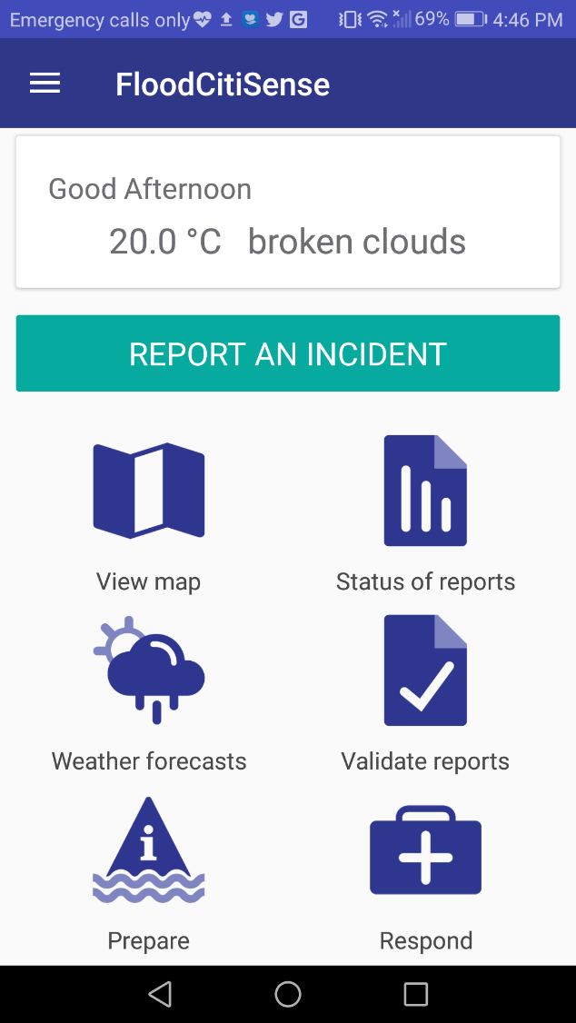
Next Steps
Release version 1 of the app
Add additional functionality v2
Continue testing sensors in the ULLs
Roll out new sensors in spring 2019
Complete the flood forecasting models and EWS tool
Evaluation phase
Expand to other cities
November 27-30
Linda See – FloodCitiSense

Slide 20
Call for abstracts
https://meetingorganizer.copernicus.org/EGU2019/session/31251
November 27-30
Linda See – FloodCitiSense

Slide 21
Thank you!
Questions?
CONTACTS
Dr Linda See
International Institute for Applied Systems
Analysis (IIASA)
E-mail: see@iiasa.ac.at
Tel.: +43 2236 807 423
Dr Boud Verbeiren (Project Coordinator)
Vrije Universiteit Brussel
E-mail: Boud.Verbeiren@vub.be
Tel.: +32 2 629 36 35
November 27-30
Linda See – FloodCitiSense

