Slide 1
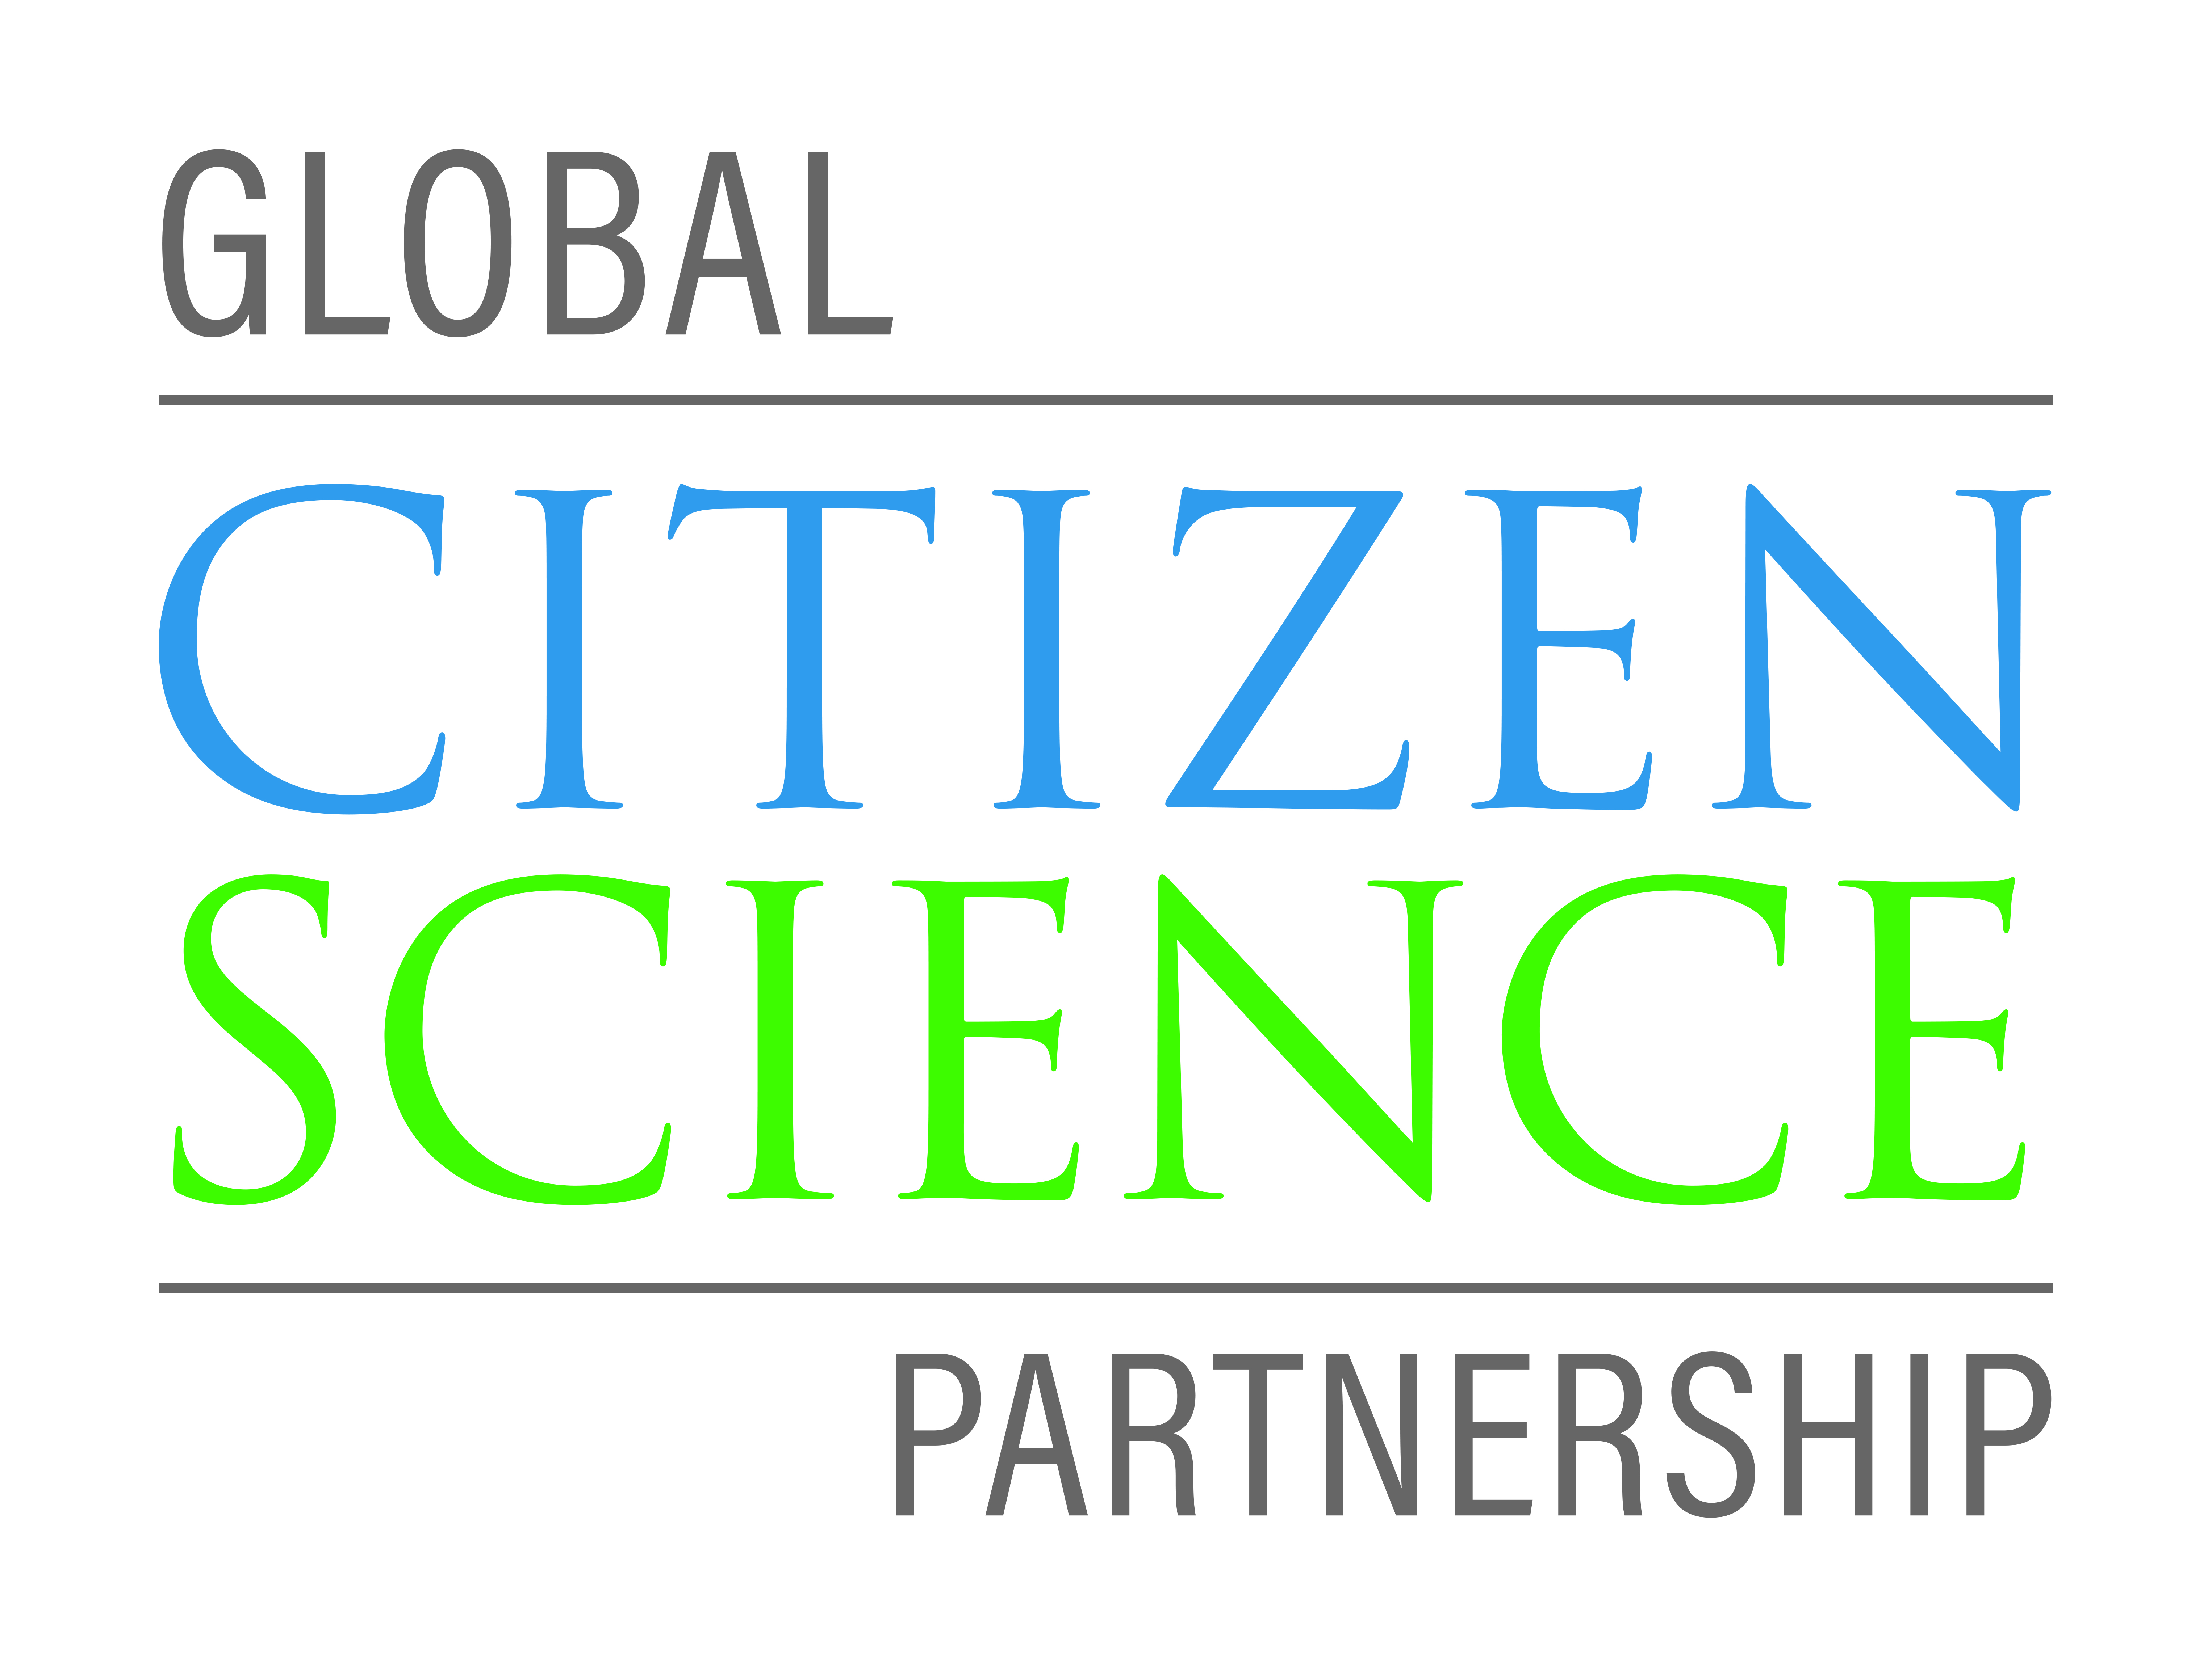
Global Citizen Science Partnership (GCSP)
www.citizenscienceglobal.org
info@globalcitizenscience.org
Twitter/Facebook: @GlobalCitSci
Dilek Fraisl Research Scholar International Institute for Applied Systems Analysis (IIASA) fraisl@iiasa.ac.at
Twitter: dilekfraisl1 www.iiasa.ac.at

Slide 2
Partners of the Global Citizen Science Partnership

Slide 3
A network of networks that seek to promote and advance citizen science for a sustainable world.

Slide 4
www.citizenscienceglobal.org
info@globalcitizenscience.org
Twitter/Facebook: @GlobalCitSci
GCSP Foundational Goals:
Offer a coordinated point of entry for government, NGO, and business partners
Help promote and support networks that advance citizen science, such as the regional Associations
Help promote and support consortia of different citizen science projects conducting research on similar topics,
Support the collection and exchange of open and findable, accessible, interoperable, and reusable (FAIR) data
Realize the potential of citizen science to supporting sustainable development
Dilek Fraisl Research Scholar International Institute for Applied Systems Analysis (IIASA) fraisl@iiasa.ac.at
Twitter: dilekfraisl1 www.iiasa.ac.at

