Slide 1
Robust meta-model for investigating crop yields and Soil Organic Carbon dynamics and probability distributions depending on land use practices, soil characteristics and climate change:
“Soil Physics and Healthy Cropland Cultivation”, August 4-7, Hangzhou, China.
Insights for soil health preservation and
food security
Tatiana Ermolieva¹ *,
Rastislav Skalsky¹, Juraj Balkovic¹, Christian Folberth¹,
Petr Havlik¹, Andrey Lessa-Derci-Augustynczik¹, Stefan Frank¹,
Taher Kahil¹, Gang Wang² , Nadejda Komendantova¹.
¹International Institute for Applied Systems Analysis, IIASA, Laxenburg, Austria
²Department of Soil and Water Sciences, China Agricultural University, Beijing 100193, China

Slide 2
Advanced Analysis of Systemic Interdependencies,
Multi-Dimensional Systemic risks, and Systemic Security:
Linkage of “distributed” systems
Growing demand vs environmental standards (SDGs); electricity infrastructure innovations and investments; systemic security; increasing returns vs sunk costs;
climate change and uncertainty; strategic- and operational planning; long- vs short-term decisions; competition for resources, etc
Energy Security
Land use and Food Security
Energy security and water security; supply standards; Energy & water prices; Diversification of energy supply;
Ex-ante and ex-post risk management; electricity supply security;
global and local threats to electricity supply systems; endogenous risks; cyberattacks;
protection of critical infrastructure
Nested multi-model welfare analysis and systemic security management
Incomes; economic and population growth; demand changes; life and nutrition standards; prices;
Impacts of energy prices on food prices; Dependencies between agricultural and energy markets through bio-fuels; Agricultural subsidies; renewables subsidies, etc.
Water Security
Socio -Economic Security
Control of water resources; reliability vs. disasters; Monitoring of infrastructure reliability; monitoring of water resources vulnerability and accessibility;
Monitoring & control of water contamination;
Notes:
Three fundamental elements (energy) security: ―Physical supply: availability and accessibility; ―Economic: affordability; ―Environmental sustainability: acceptability. Most important factor determining the energy system is risks, which depend on how the system is considered as a whole
emphasis on a systemic approach to risk management: regulating the system as a whole, not just its individual components
Systemic risks is risks in a complex “network” driven by supply-demand-price relations
Framework that can be scaled to capture the key components and relationships at different levels
A tool which helps identify regional energy security gaps and self-sufficiency levels depending on various other factors and areas of priority
A tool which allows to set the priorities and initiate a discussion with decision-makers
International (traditional) energy security frameworks were developed primarily following the crude oil supply disruptions of the 1970s
Significant changes in energy markets over the last 40 years
•Increased diversification of the fuel mix, with oil use displaced by increasing use of coal and natural gas.
•A shift in consumption patterns towards non-OECD emerging economies.
•Changes in the structure of the international crude oil market, from vertically integrated market of the 1970’s to the current segmented and highly specialised market.
•The move from long term contracts to an increasing share of spot transactions and the emergence of oil futures and derivatives markets, increasing the depth and liquidity of the market.
•New causes of imbalance between supply and demand beyond geopolitical shocks to crude oil supply. For example, refinery shutdowns (e.g. Hurricane Katrina 2005), demand surges (e.g. Asia 2013) and the loss of specific types of crude (Libya 2011

Slide 3
Systemic interdependencies: GLOBIOM land use and food security model
Complex interdependencies, tradeoffs, threshold constraints, non-smooth feedbacks
Non-normal uncertainties, possible extreme events, exceedances of vital thresholds
Stochastic events/ generators
Nutrition norms
Stochastic yields
W(s)
s=1,…,n
Environmnetal norms
Stochastic costs
Energy-water-
Etc. norms
Stochastic convertion coefficients
Notes:
Modeling of internal and external schocks

Slide 4
Crop yields - Non-normal probability distributions
Because of:
stochastic precipitation, temperature, soil radiation
dynamically changing soil properties
land use practices, economic factors, etc.

Slide 5
Systemic interdependencies: GLOBIOM land use model
Complex interdependencies, tradeoffs, threshold constraints, non-smooth feedbacks
Food-water-energy-environmental NEXUS and security constraints (FAO definition – in sufficient amounts of high quality at acceptable prices in any circumstances - quality probabilistic constraints)
Non-normal uncertainties, possible extreme events, exceedances of vital thresholds
Stochastic events/ generators
Nutrition norms
Stochastic yields
W(s)
s=1,…,n
Environmnetal norms
Stochastic costs
Energy-water-
Etc. norms
Stochastic convertion coefficients
Notes:
Modeling of internal and external schocks

Slide 6
The Environmental Policy Integrated Climate-based global gridded crop model (EPIC-IIASA)
Analysis of interactions between land use practices, climate change, soil health, land productivity:
  Bio-physical process-based models (e.g., EPIC)
  Statistical and machine learning models
EPIC (The Environmental Policy Integrated Climate-based global gridded crop model) is used to assess the main global agricultural systems in response to management interventions such as cropping practices, fertilization and irrigation practices or conservation and organic agriculture options, and changing environment, including climate change and soil degradation.
Furthermore, EPIC-IIASA is used to compare cropland management systems and their effects on environmental indicators like water availability, nitrogen and phosphorus levels in soil, and greenhouse gas emissions.

Slide 7
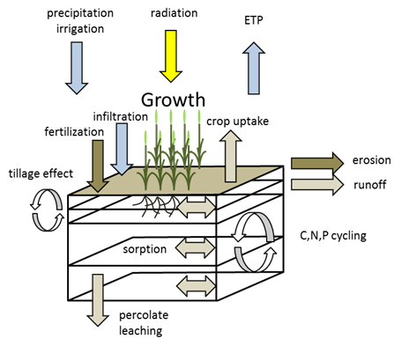
EPIC (Environmental Policy Integrated Climate)
Climate change
Land-soil practices
complex agro-ecosystem model developed by USDA (Williams et al. 1996)
mechanistic model operating on daily basis using data on weather, site, soil, and crop management

Slide 8
Soil properties and productivity under climate change
Soil formation is driven by natural and anthropogenic forces:
  climate, relief, parent materials, …,
  land use and land management practices, …
Climate is one of the most important factors affecting soil characteristics
Climate change is manifested, e.g., in changing patters of temperature and precipitation events or even anomalies
More frequent and less severe (or more severe and less frequent) can affect:
  soil structure,
  stability,
  topsoil water holding capacity,
  nutrients balance (loss, leaching, availability)
  erosion

Slide 9
Soil productivity and soil health preservation, soil conservation and nutrients management
Soil productivity is essential for food security;
The potential for increased erosion due to higher precipitation events (i.e., water erosion) or extreme droughts (i.e., wind erosion) caused by climate change is significant;
Erosion can compromise soil health and reduce soil productivity. Soil productivity can be reduced by 4–30% per every 10 cm of soil lost, and that the loss of productivity from the next 10 cm of soils that is then lost, will be much higher since the most productive and healthy soils are at the surface (Bakker et al., 2004);
On average, soil productivity is reduced with depth, since the lower soil layers have lower soil organic matter and nutrient content;
Conservation practices, including reduced tillage, residues recycling, cover crops, crop rotation are critical for soil and water conservation to have an opportunity to adapt to a changing climate while maintaining food security;
Optimal portfolio of cost-effective land use and soil practices

Slide 10
Soil productivity and soil health preservation, soil conservation and nutrients management
Conservation tillage, plant residues recycling
Retaining crop residue reduces wind and water erosion, runoff, or particulate matter and nutrient loss, resulting in benefits for water and air quality.
Conservation tillage is recognized to protect soil resources by increasing soil organic carbon (SOC) and thereby sustainable agriculture
Conservational tillage (e.g., no-tillage) often reduces soil disturbance and soil erosion, thus enhancing soil aggregate formation and stability, which may subsequently improve SOC accumulation (Zhang et al., 2012).
In addition to tillage practices, cropping systems and fertilization schemes, coupled with soil and climate conditions, contributed to the changes of soil C pools by influencing SOC inputs and turnover (Luo et al., 2010).

Slide 11
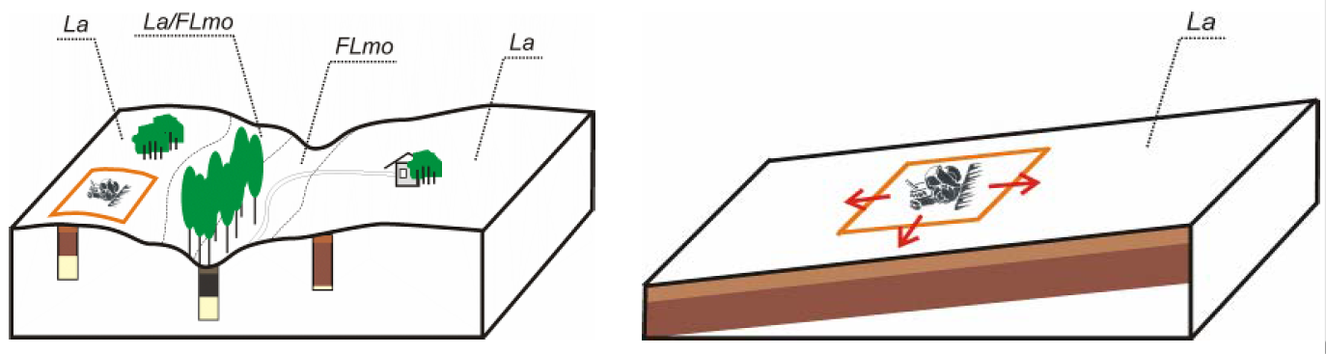
EPIC upscaling (Global/Regional Gridded Crop Model)
Real agricultual land:
  variable soils and terrain
  different land-cover patches
  different land uses
GCM concept of a ’representative’ field :
  dominant soil and terrain
  crop management (BAU and scenarios)
  field impacts extrapolated to the entire grid

Slide 12
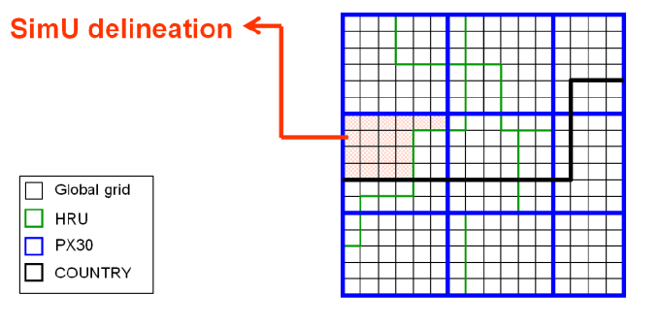
EPIC upscaling (Global/Regional Gridded Crop Model)
SimU (simulation units) for running EPIC within the global/regional spatial domain
Intersection of spatial data on:
  Weather
  Topography
  Soil
  Admin boundaries
Default grid 0.5° x 0.5°
➔ approx. 35’000 units globally
Enhanced grid
➔ 126’000 units
High-res grid 5’ x 5’ (soil, site, topography)

Slide 13
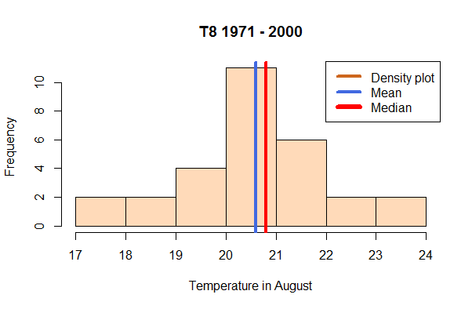
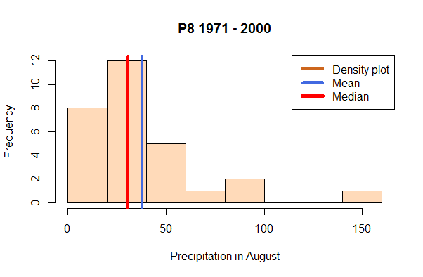
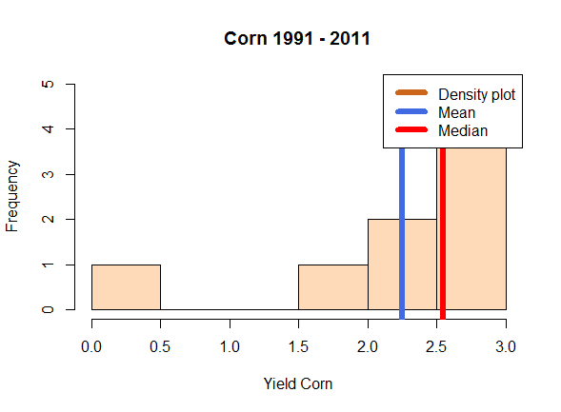
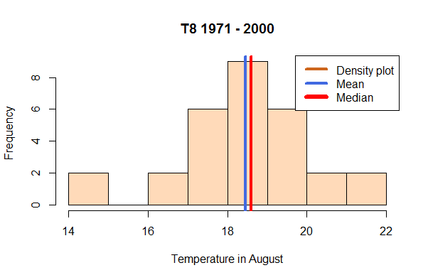
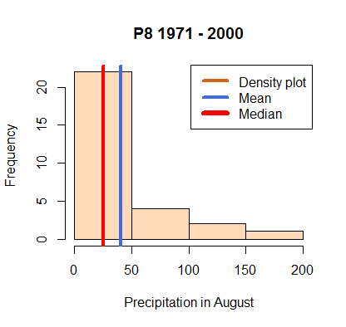
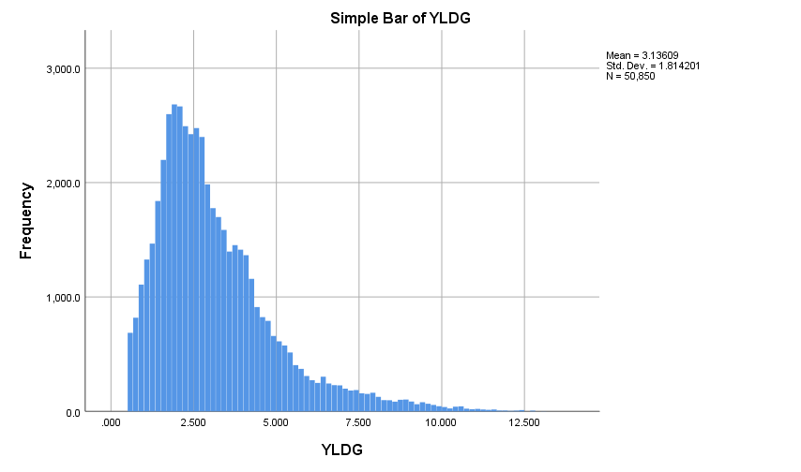
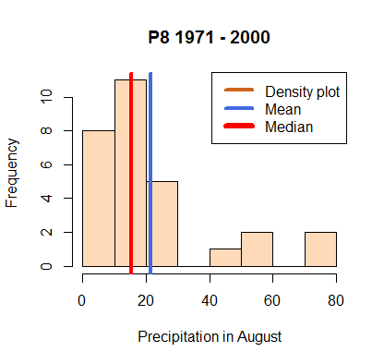
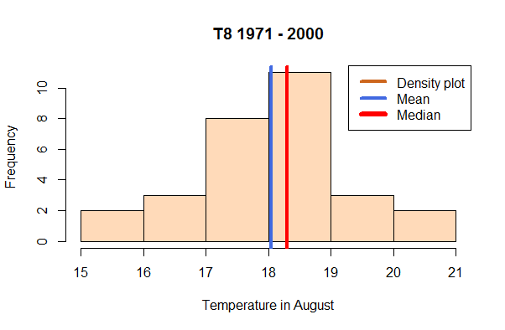
Robust EPIC-based meta-model: generating stochastic crop yields and SOC
EPIC is a complex model to be directly linked/integrated with GLOBIOM
Statistical and Machine Learning Meta-model using EPIC and historical data
Input (P, T, soil quality, water, nutrients)
Input (weather, climate, bio-physical processes, management)
Transfer/process function, kernels, etc
Predicted output (yield)
Observed yields (losses) are skewed
Goal function:
Percentile/
quantile-based risk measures
Yield loss
Iterative
Revision of estimates
Weights/parameters/transfer functions/etc.

Slide 14
India
Australia
Droughts

Slide 15
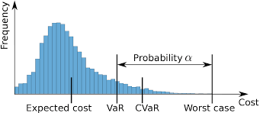
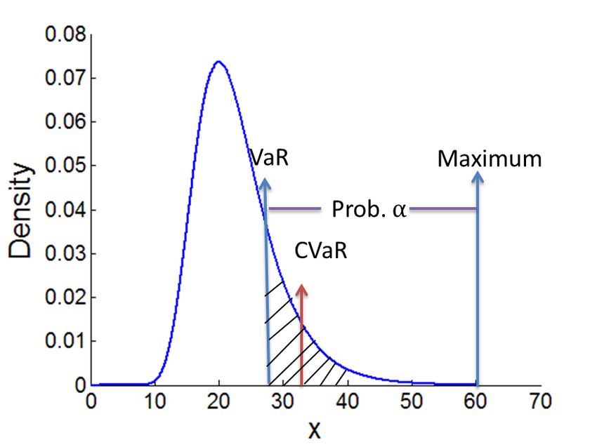
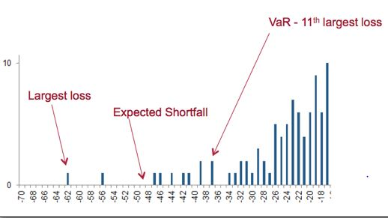
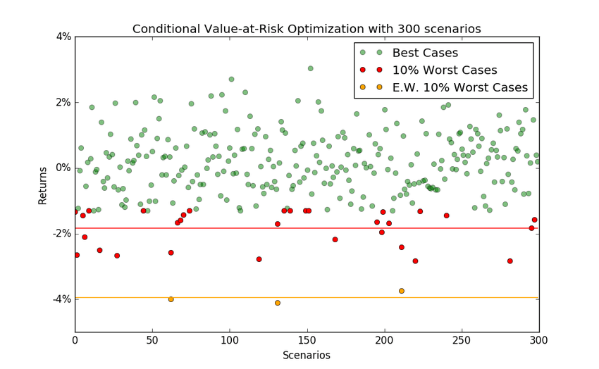

Slide 16
Input variables
Data content: Selected site and soil characteristics for European simulation units (EU SimU dataset v.2), subset for Corine LC classes 210 (Arable land) and 240 (Heterogenous agricultural areas), N = 88054 SimU (table records)
Contact person (EU SimU dataset v.2): Juraj Balkovic, BNR/AFE group, balkovic@iiasa.ac.at; Rastislav Skalsky, BNR/AFE group, skalsky@iiasa.ac.at
Table descriptor:
Field Type Description
SimUID Number identification number of the simulation unit (SimU), unique identificator
SimU String alpha-numerical ontological code of simulation unit (SimU), unique identificator
YLAT Number y-coordinate (WGS, decimal degree) of the SimU centroid (SimU geometry = multi-part polygon, spatial aggregation of N 1k spatial resolution grid cells)
XLONG Number x-coordinate (WGS, decimal degree) of the SimU centroid (SimU geometry = multi-part polygon, spatial aggregation of N 1k spatial resolution grid cells)
ELEV Number mean altitude of the SimU (m)
SLOPE_PERC Number dominat slope of the SimU (%)
PROFILE_DEPTH Number soil profile depth (cm), sum of topsoil and subsoil layers, set to 100 cm for all soils
TOP_DEPTH Number depth (cm) of topsoil layer lower boundary (measured from mineral soil surface), set to 30 cm for all soils
SUB_DEPTH Number depth (cm) of subsoil layer lower boundary (measured from mineral soil surface), set to 100 cm for all soils
EFFECTIVE_PRF_DEPTH Number effective soil profile depth (cm), soil profile depth lowered by volume of stones (i.e. inert volume not holding water, not conaining nutrients, and with no roots)
AWC_PROF Number available water capacity of the soil profile (mm), effective soil depth assumed, potential amount of water in soil which is availble for plants and which can soil hold over periods without rainfall
SAND_TOP Number sand content (%) in topsoil layer
SAND_SUB Number sand content (%) in subsoil layer
SILT_TOP Number silt content (%) in topsoil layer
SILT_SUB Number silt content (%) in subsoil layer
CLAY_TOP Number clay content (%) in topsoil layer
CLAY_SUB Number clay content (%) in subsoil layer
BD_TOP Number bulk density (g.cm-3) of topsoil layer
BD_SUB Number bulk density (g.cm-3) of subsoil layer
VS_TOP Number volume (%) of stones in topsoil layer
VS_SUB Number volume (%) of stones in topsoil layer
OC_TOP Number concentration (%) of soil organic carbon in topsoil layer
OC_SUB Number concentration (%) of soil organic carbon in subsoil layer

Slide 17
Multivariate regression and MSE – mean responses

Slide 18
Multivariate Quantile regression – estimating quantiles and probability distributions of crop yields

Slide 19
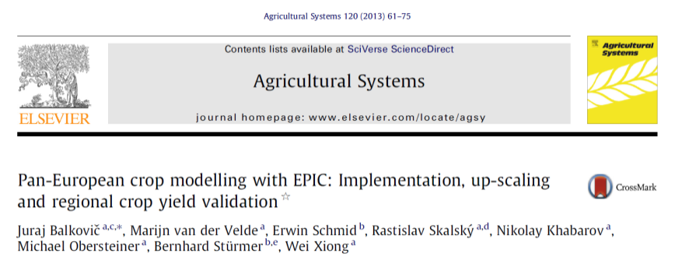
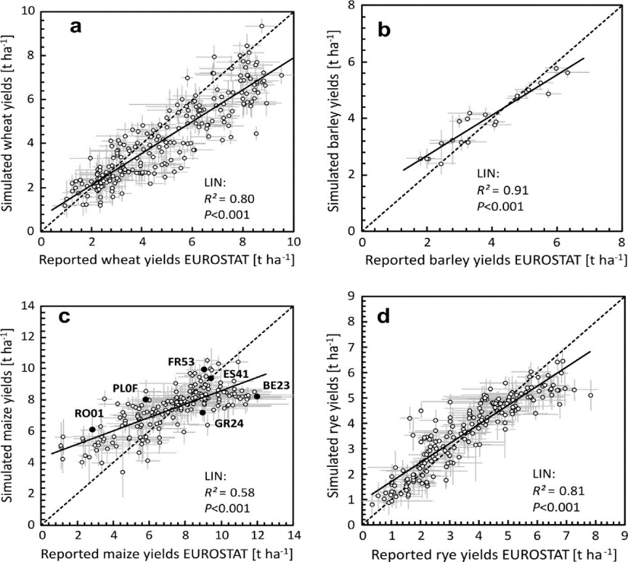
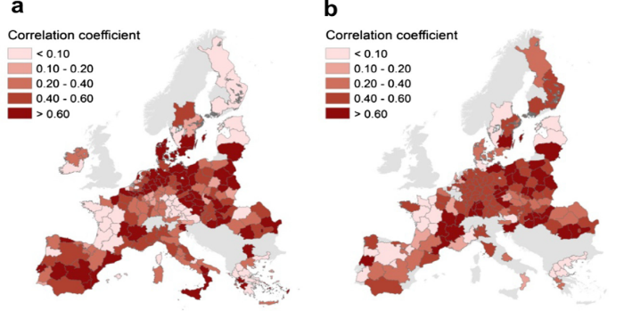
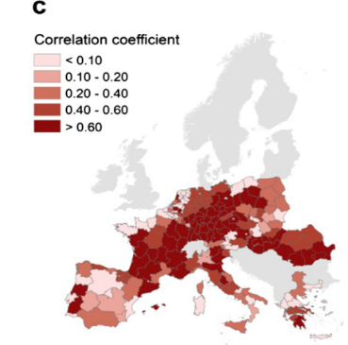
IIASA EPIC (application: actual crop yield validation)
Validation of simulated regional yields against reported yields is a prerequisite for IIASA EPIC applications
Spatial:
Temporal:
Fig. 1. Scatter plots with means and ± one SD of simulated versus reported regional crop yields (average of 1997–2007) for (a) winter wheat, (b) spring barley, (c) maize, and (d) winter rye
Fig. 2. Correlation between time series of simulated and reported yields calculated for (a) winter wheat, (b) winter rye, and (c) maize; r > 0.60 is statistically significant at P < 0.05.

Slide 20
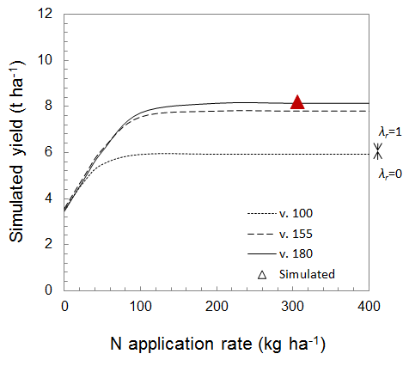
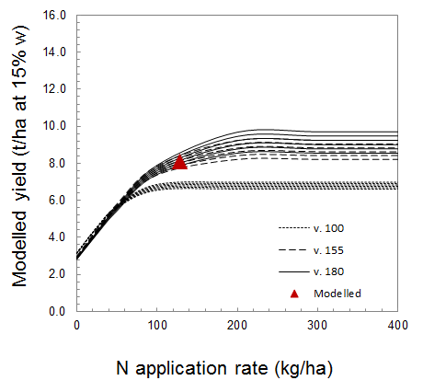
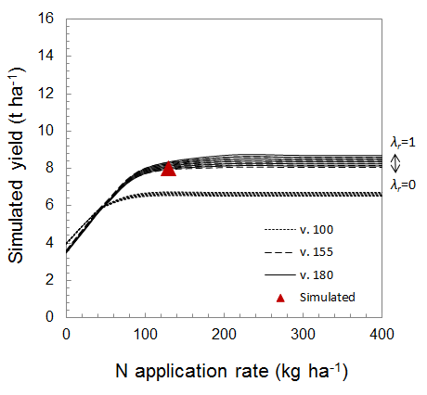
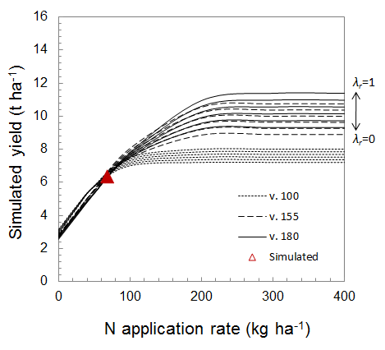
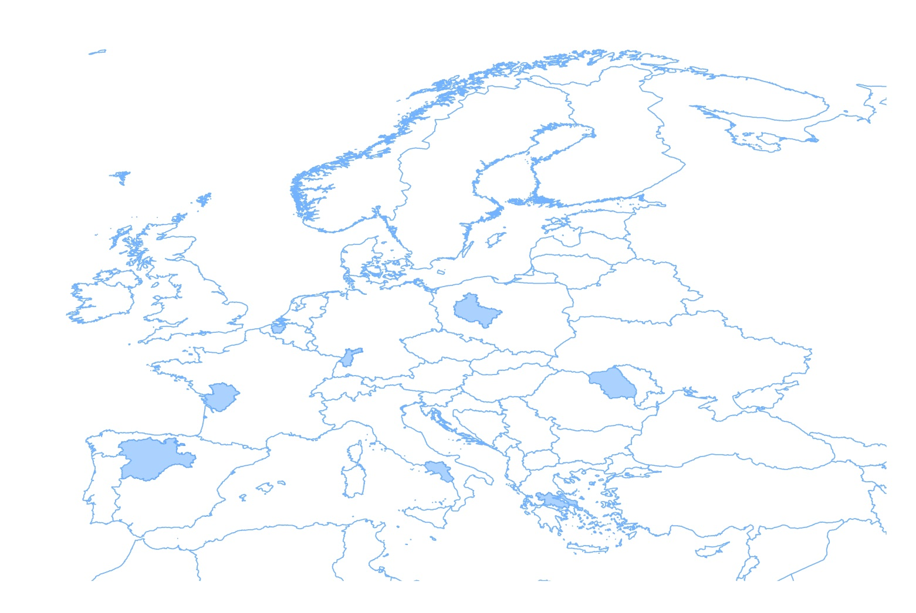
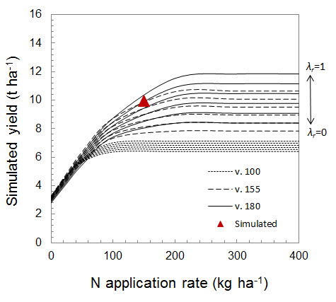
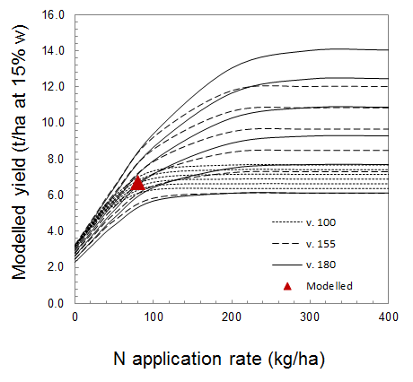
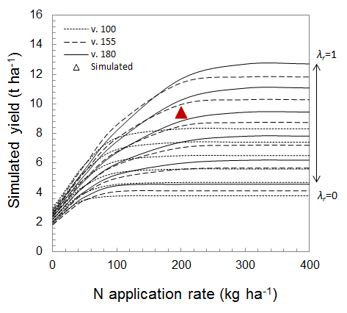
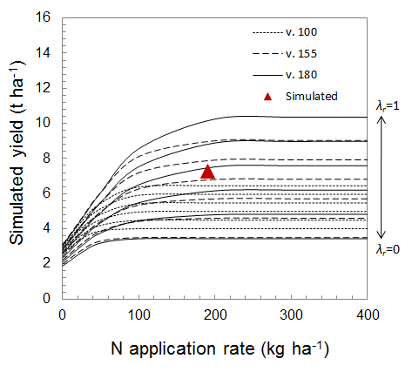
IIASA EPIC (operability – yield response functions)
Belgium - Oost-Vlaanderen
Germany - Karlsruhe
Poland - Wielkopolskie
Romania - Nord-Est
France - Poitou-Charentes
Italy - Campania
Spain - Castilla y León
Greece - Sterea Ellada
IIASA EPIC: analysing management plasticity for filling up the yield gaps assuming different cultivars, nutrient and water application rates (corn, EU)

Slide 21
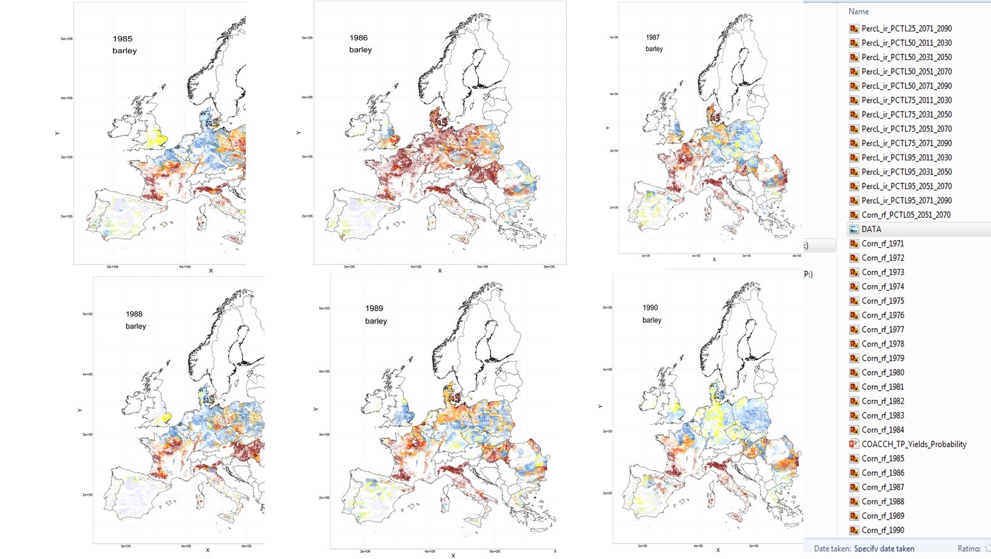
Historical Yields

Slide 22
Indicators response to land management: Nutrients and residue retention share
Fertilization and crop residues recycling scenarios
NBAU_30, NBAU_60, NBAU_90,
N50_30, N50_60, N50_90,
N100_30, N100_60, N100_90,
N250_30, N250_60, N250_90

Slide 23
SOM and SOC: Indicators of soil health
Soil organic matter (SOM) improves soil quality through water holding capacity, soil stability, nutrients storage and turnover, oxygen holding capacity
SOM is important as the habitat for the soil fauna and microflora
SOM is susceptible to land use and management, soil temperature and moisture
SOM is primarily made of carbon (58%), with the remaining mass consisting of water and other nutrients such as nitrogen and potassium;
SOC is part of the SOM fraction in the soil, about 58% of it;
A 1% increase in SOC equates to about 2% increase in water holding capacity

Slide 24
Selected results
The data for the statistical model were harmonized at the resolution of about 120,000 EPIC SimUs. The SimUs are represented, as a rule, by one area with “representative” characteristics for soil, topography, and present weather. Since crops have different needs for water, temperature, solar radiation, and other weather parameters in different stages of their development, the weather data was aggregated to monthly resolution.
If data are sufficiently available, the quantile regression can be estimated at the level of grids/SimUs. For the analysis of crop yield dependencies on climatic characteristics, the estimation can be performed at the level of agro-ecological zones (AEZs), i.e., geographical areas exhibiting similar climatic conditions that determine their ability to support rainfed agriculture.
The results are presented for EU countries at the level of EU NUTS administrative regions.
The NUTS classification lists 92 regions at NUTS 1, 242 regions at NUTS 2 and 1166 regions at NUTS 3 level. In other words, for each NUTS region, the quantile regression dependencies between crop yield and weather and soil parameters were estimated based on SimUs level data within the bounds of the respective NUTS region.

Slide 25
Probability distributions of crop yields and SOC in different years are analyzed according to their critical quantiles (5th, 25th, 50s, 75th, 95th) as well as mean values in these years.
Often, the critical crop yield quantiles (percentile) (or quantiles of other critical variables, e.g., pollutant concentration level) can be defined by the so-called break-even analysis of the crop producer, e.g., specifying the costs associated with production excess and shortage (shortfalls)
The results are displayed for the years from 2000 to 2050 with a10 years timestep (for crop yields).
In general, the meta-model results are available for all years to 2100, for different crops and RCP scenario, to characterize probability distributions of crop yields for different climatic scenarios.

Slide 26
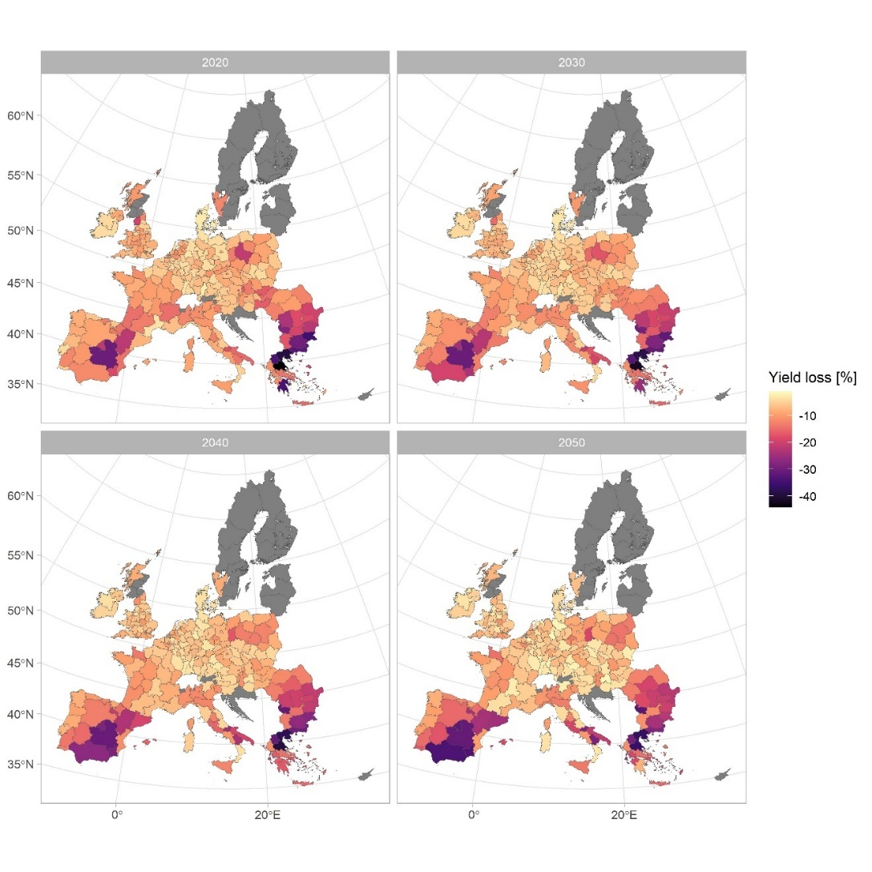
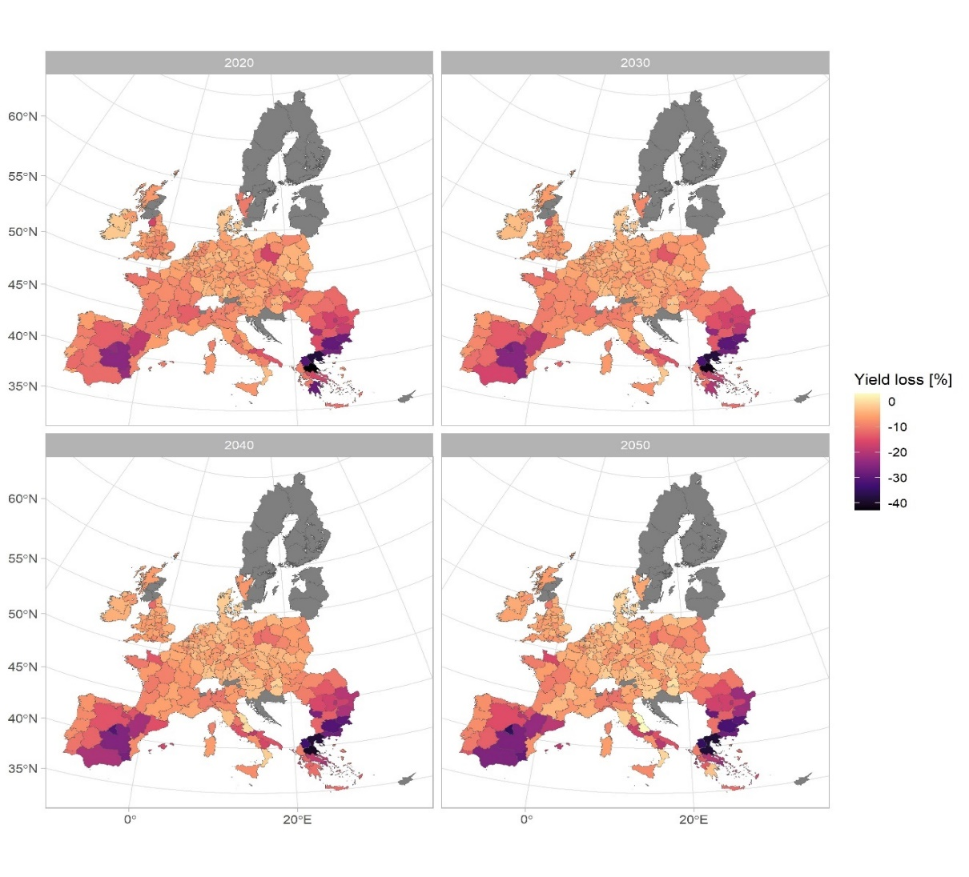
Crop yield loss as the difference between the 25th and the median of the crop yield (a), and as the difference between the 25th and the average of the crop yield (b), from 2000 to 2050, in percentage terms, for rainfed maize, RCP26

Slide 27
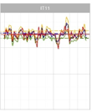
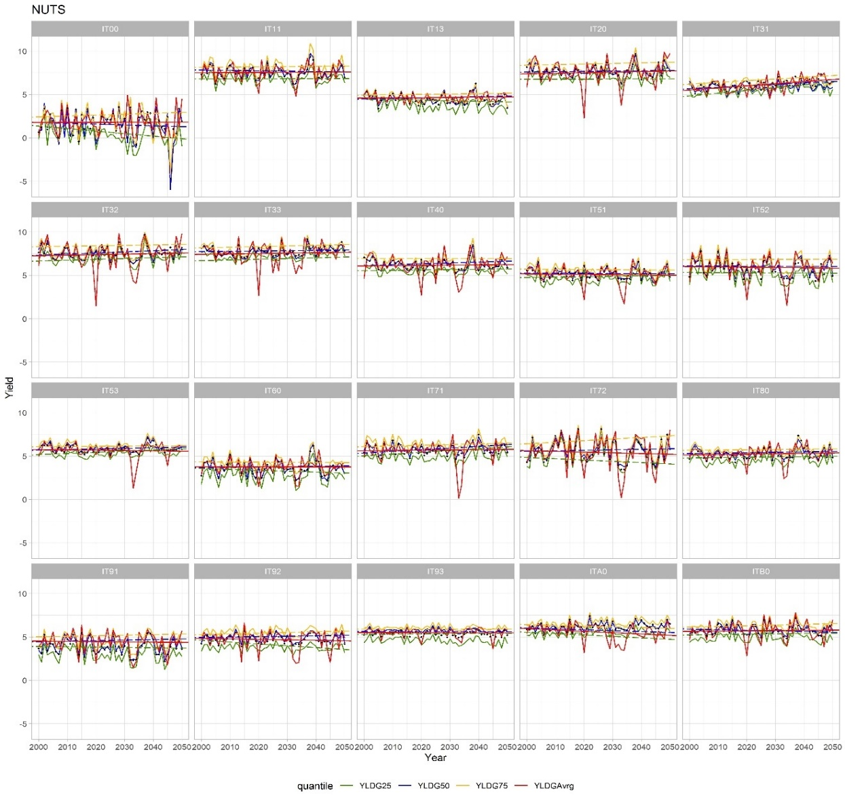
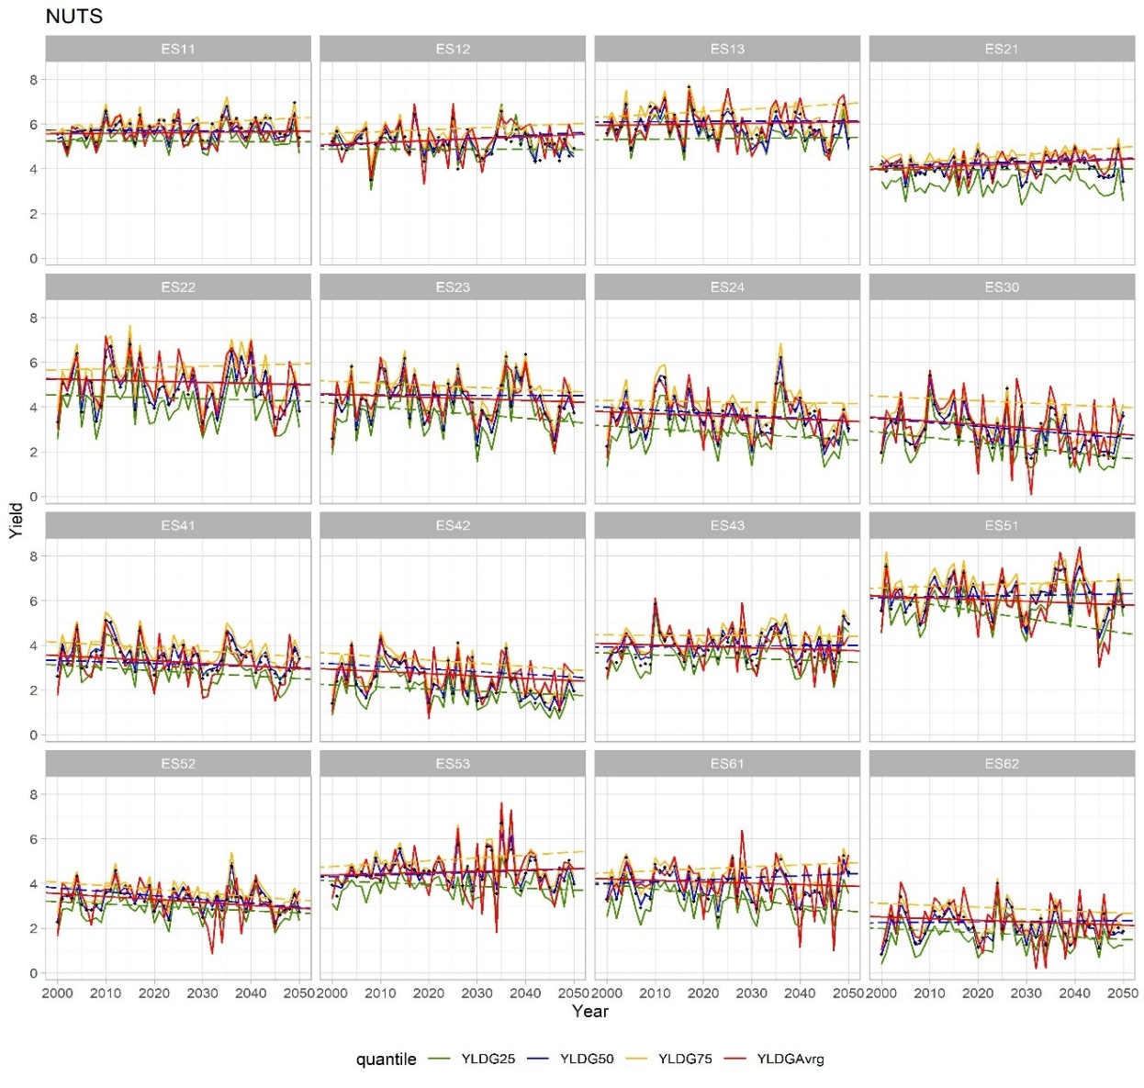
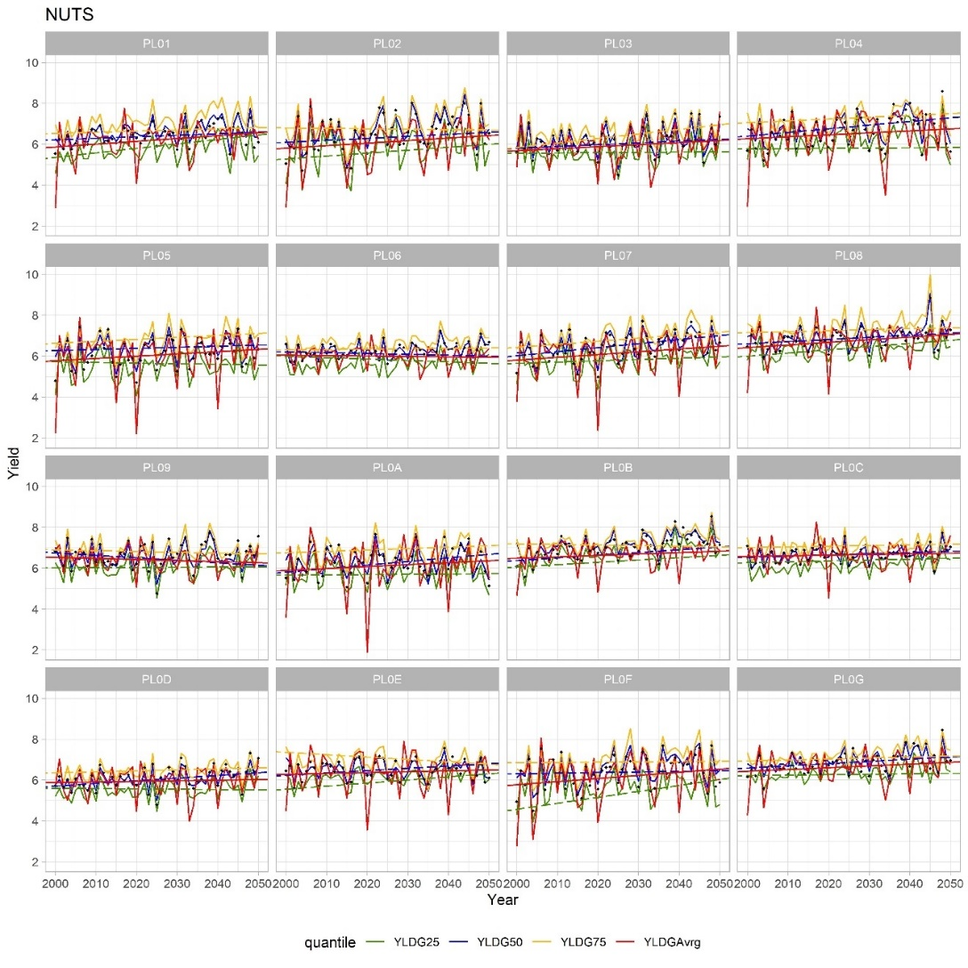
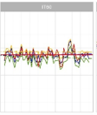
Selected results: the dynamics of crop yields quantiles

Slide 28
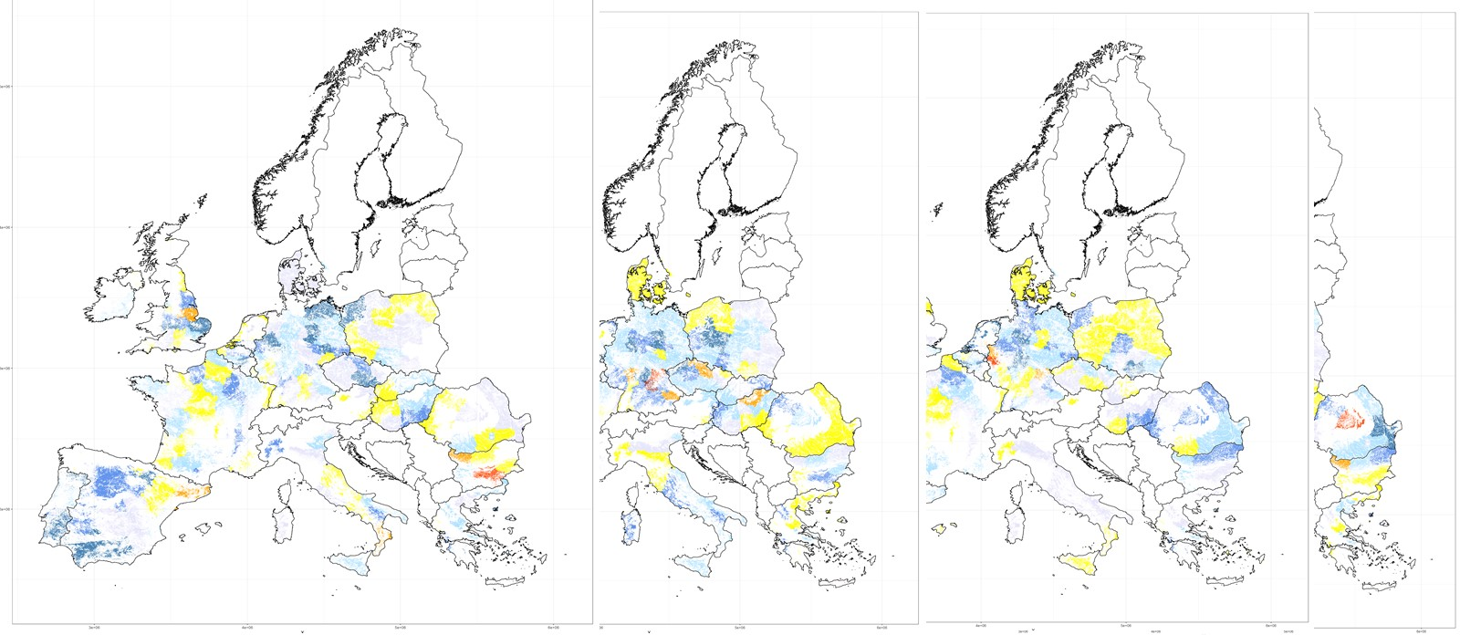
Classification of yield losses:
100*(Yield(Grid)-YieldAv)/ YieldAv
Quantile regression:
Probability of yield deviation
from Yield Average or a Yield Qunatile
As a function of 12 month T and P, soil characteristics
Prob (50% loss (wrt average yield)), 2011-2030
2031-2050
2051-2070
2071-2090

Slide 29
SOC quantile regression - soil parameters
Available water capacity of the soil profile (mm), effective soil depth assumed, potential amount of water in soil which is available for plants, and which can soil hold over periods without rainfall;
Elevation - mean altitude of the grid/SimU (m)
Bulk density (g.cm-3) of topsoil layer;
Effective soil profile depth (cm), soil profile depth lowered by volume of stones (i.e., inert volume not holding water, not containing nutrients, and with no roots);
Sand and clay content;
Concentration of soil organic carbon in top soil;
Etc.

Slide 30
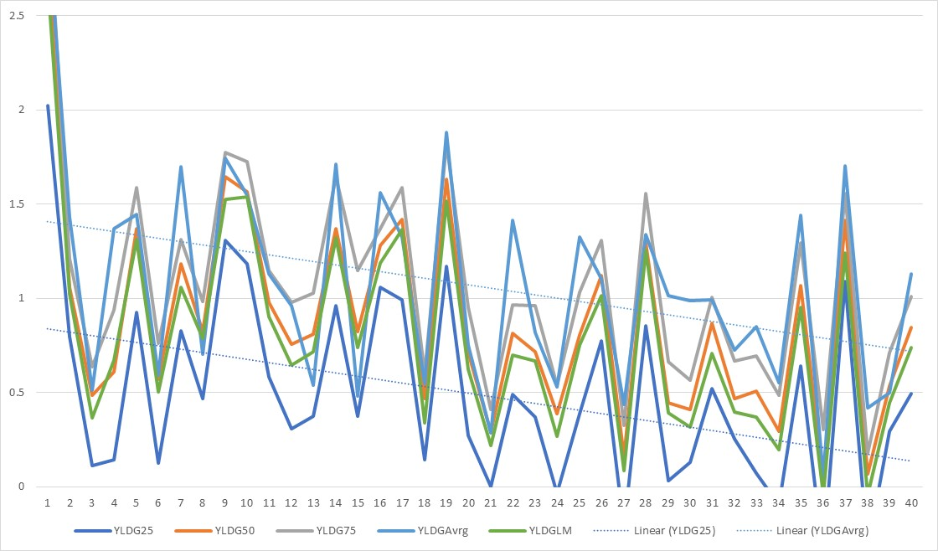
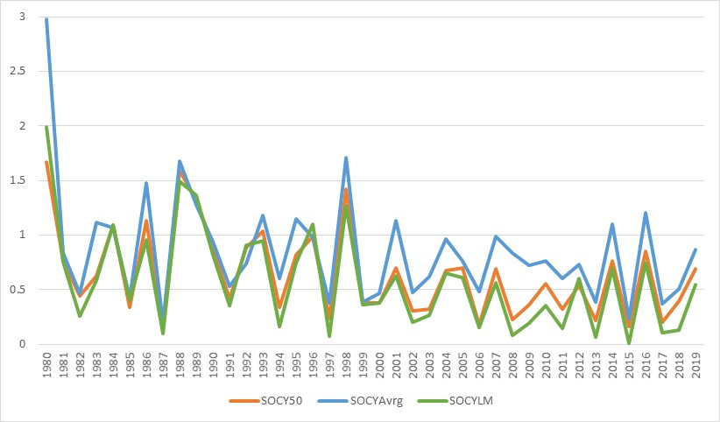
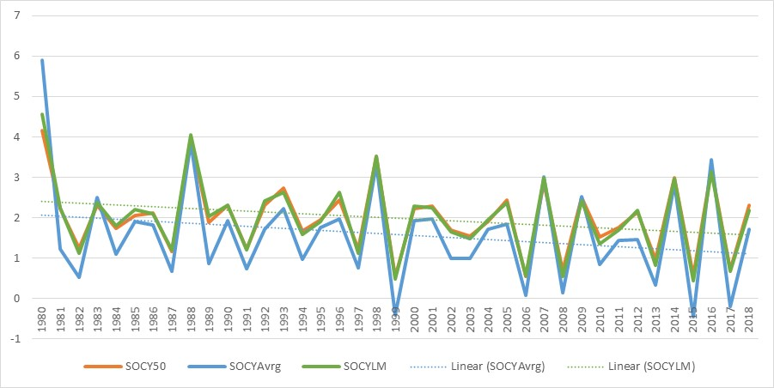
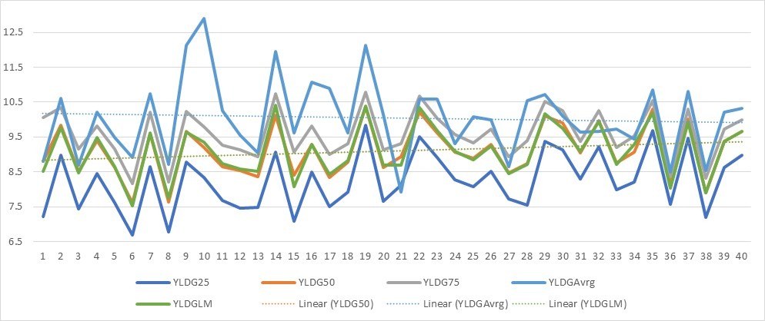
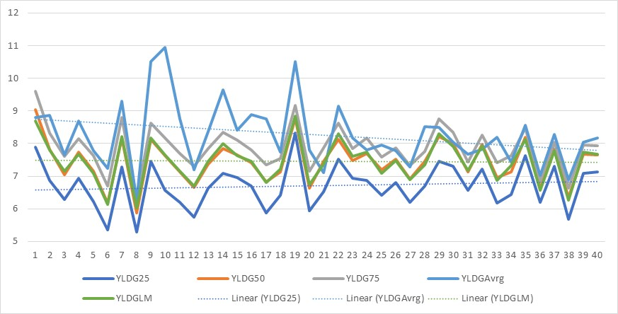
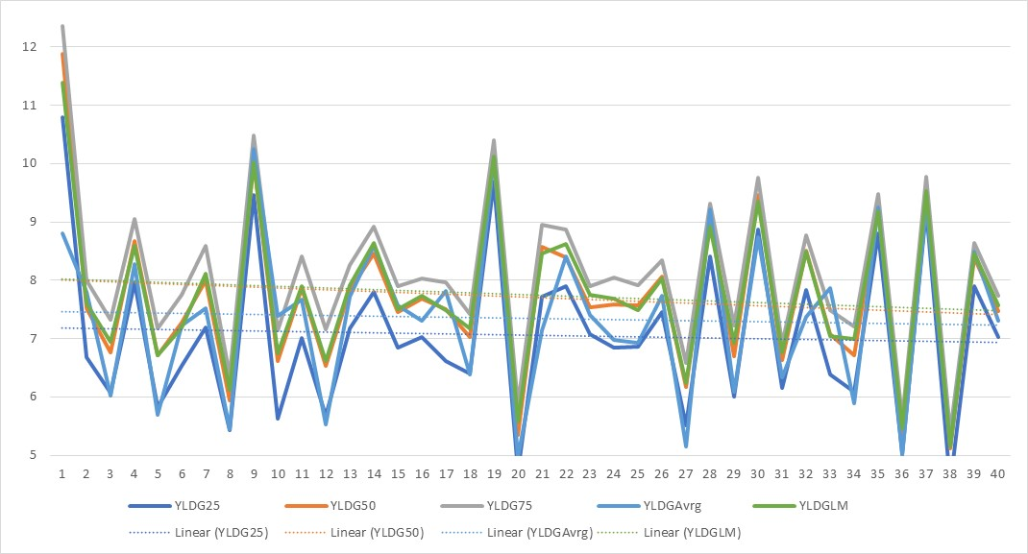
Selected results: Soil organic carbon (a) and Yield (maize) (b) t/ha, in a grid cell
(a)
(b)
BAU_30 N100_R30 N100_90

Slide 31
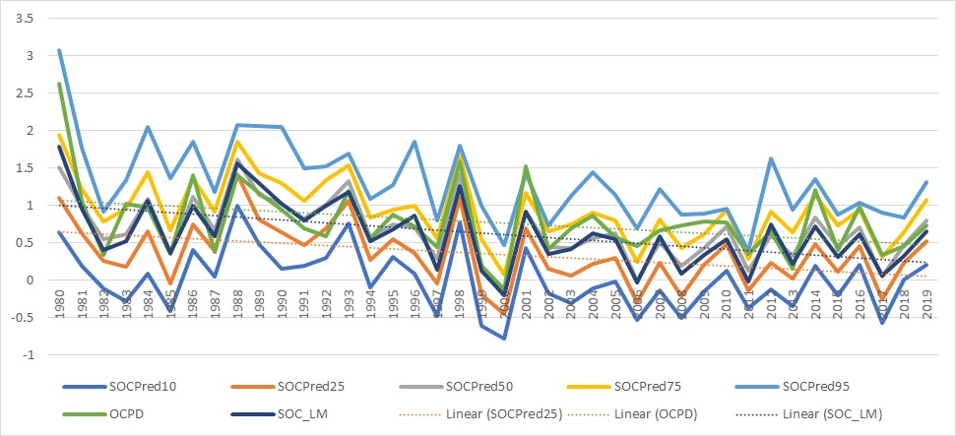
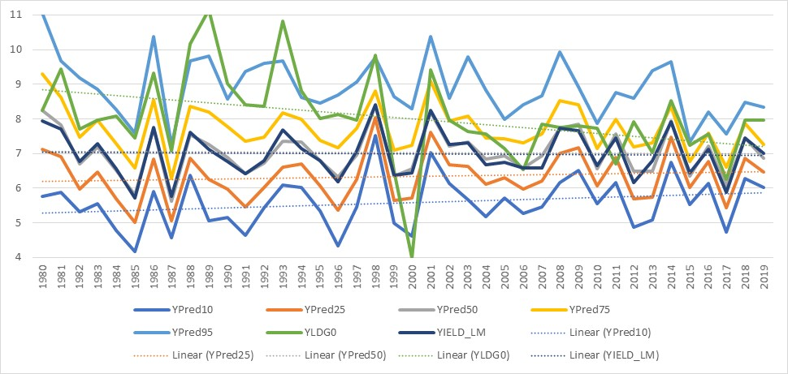
Yield and SOC, grid cell level
N100_30, AUT, SimUID = 54

Slide 32
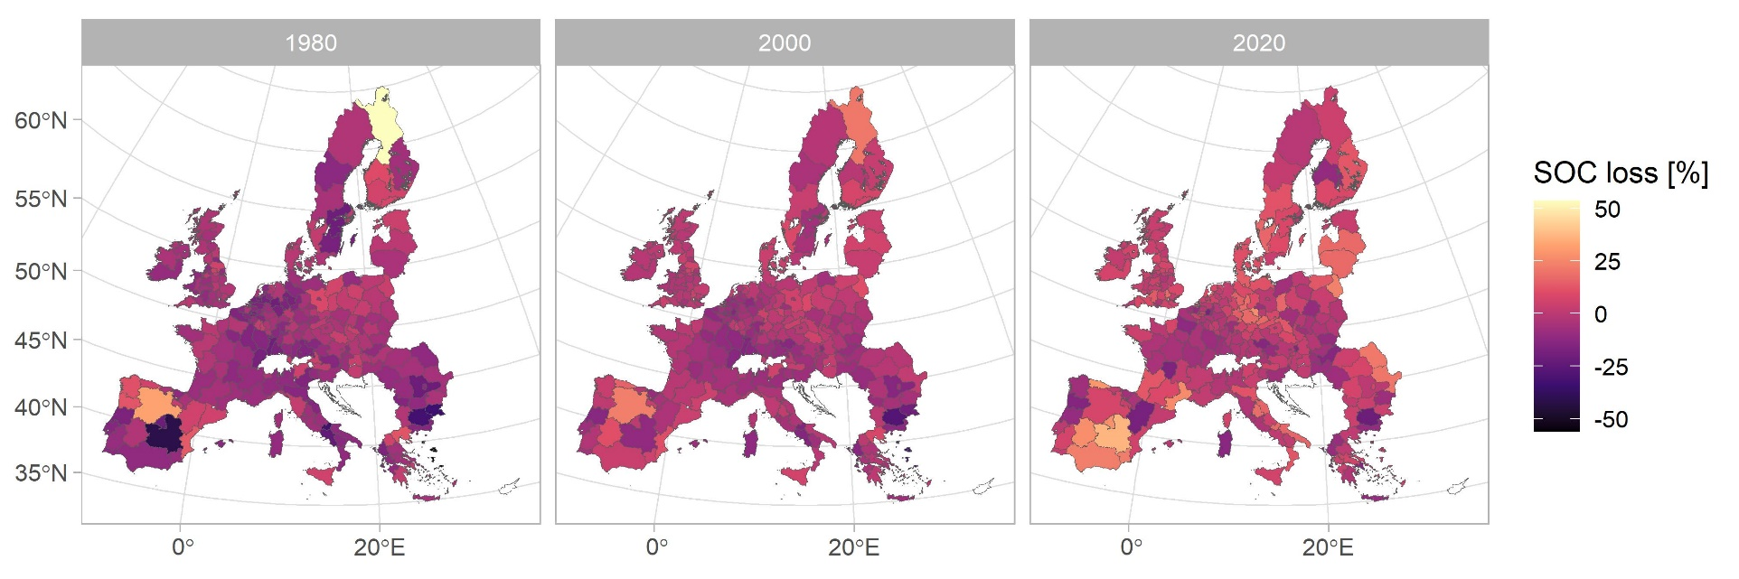
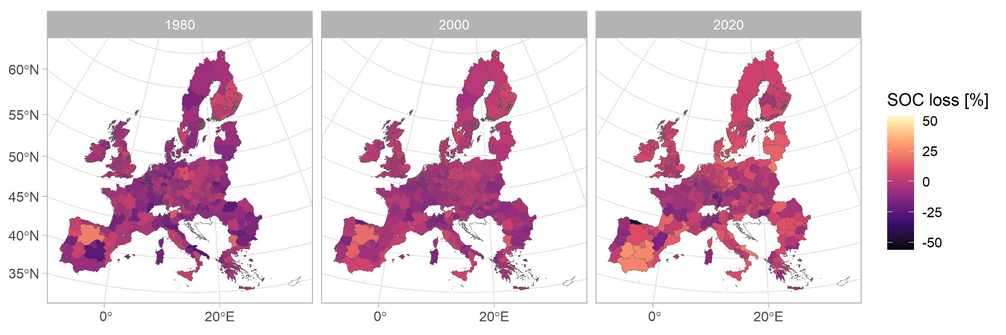
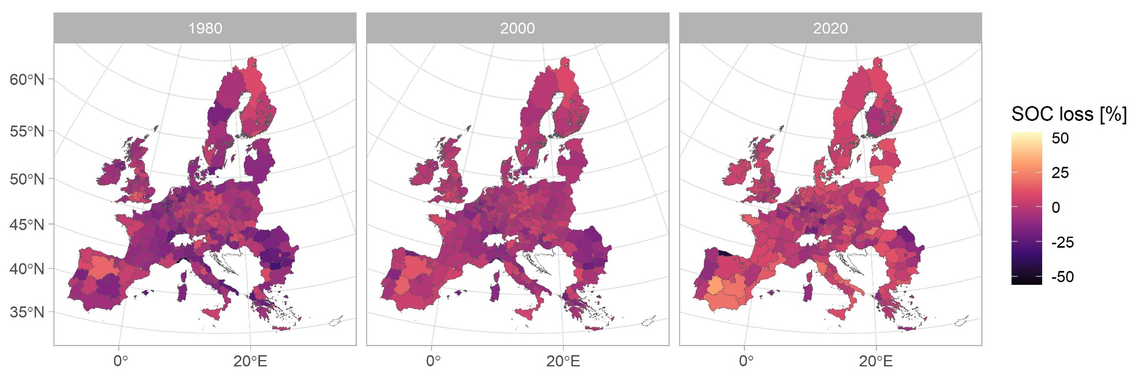

Slide 33
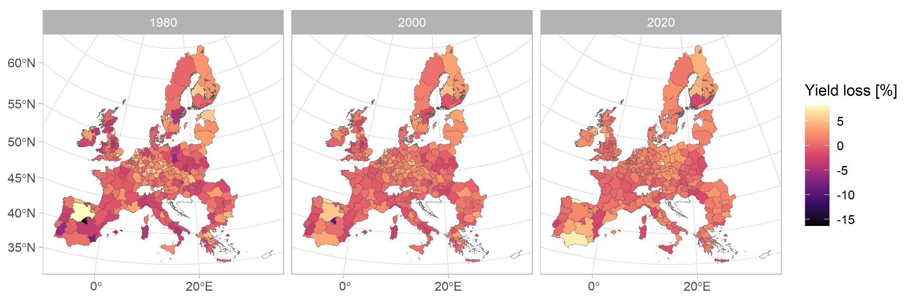
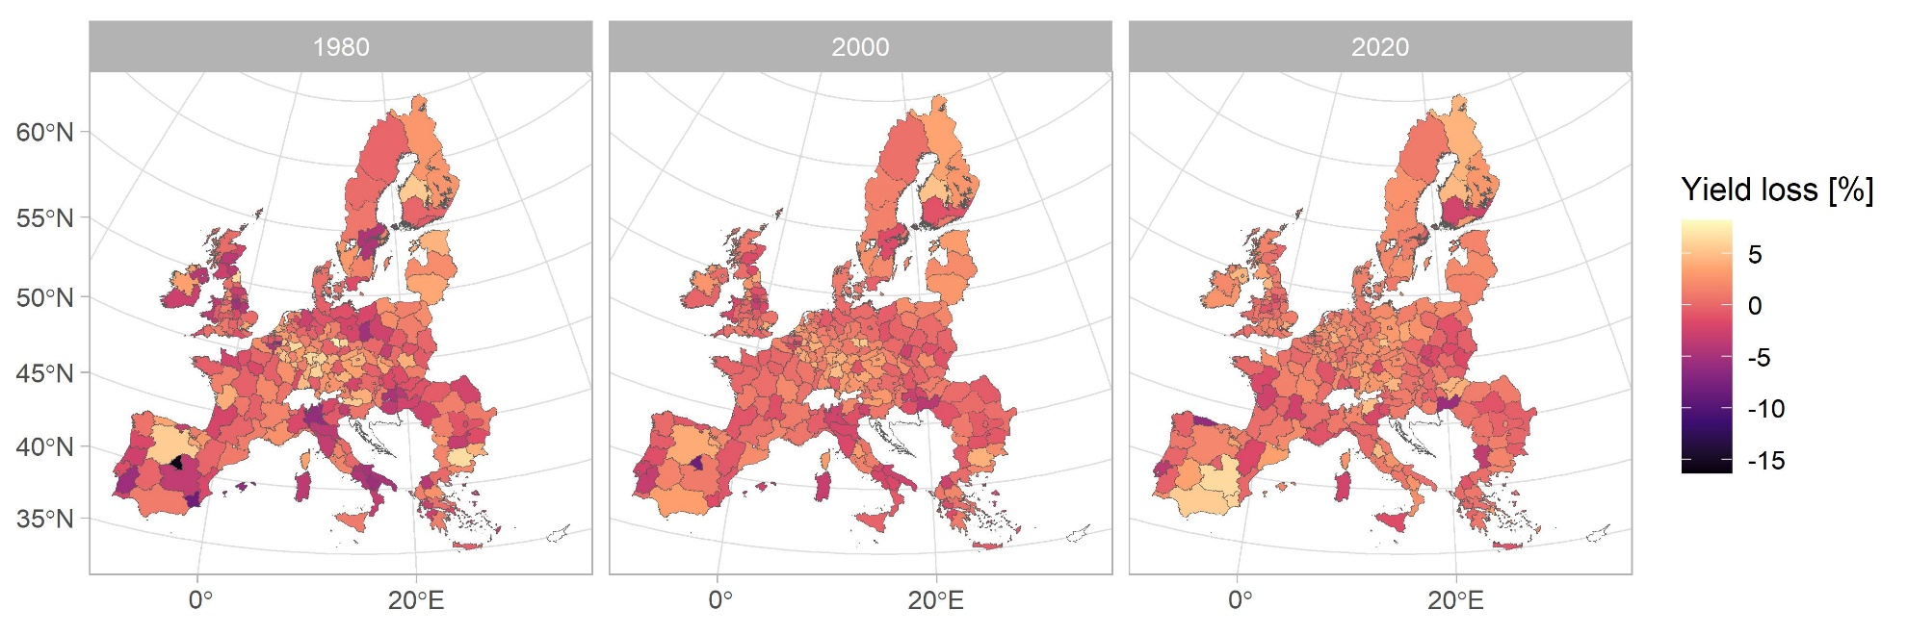


Slide 34

Summary statistics

Slide 35
Effects of climate change on soil properties
Climate change affects soil structure, stability, topsoil water holding capacity, nutrients availability and soil erosion;
The loss of soil carbon can be accelerated by the temperature increase and changing precipitation patterns;
More extreme and persistent weather conditions may not allow soils to recover from the single extreme;
Indirect impacts – growth rates, water use efficiency, etc.
Assuming constant inputs of carbon to soils from vegetation, different estimate predict that expected changes in temperature, precipitation and evaporation will cause significant change in organic matter turnover and CO2 dynamics;
Increased productivity can lead to greater inputs of carbon to soil, increase of organics

Slide 36
Climate change: changing patterns of temperature and precipitation
Areas under increased rainfall can lead to increased peat formation and methane release;
Areas under decreased rainfall can undergo peat, CO2 loss, increased moisture deficit affecting foraging patterns, reproduction and survivability of soil invertebrates;
Under increased CO2 concentration, increase productivity can be expected, greater inputs of carbon to soil, increasing SOM;
How changes in temperature and precipitation (moisture) affect SOM turnover and SOC accumulation
However, socio-economic and land use practice trends can have a dominating role in soil health, its recovery, stability, resilience

Slide 37
Soil structure
The nature and quality of the soil structure is influenced by the amount of organic matter present, inorganic constituents of the soil matrix, cultivation methods and natural physical processes
Decline in SOM leads to a decrease in soil aggregate stability, infiltration rates, susceptibility to compaction and erosion, etc.
Texture is the representation of the sand-silt-clay percentages in the soil

Slide 38
Soil water and temperature
Soil temperature is one of the important drivers of the soil processes
Soil water is a fast-changing indicator, it depends on precipitation, temperature (evapotranspitation), and the land use practices;
Warmer soil temperature causes decomposition of organic matter, increased microbiological activity, faster nutrients release, increase nitrification rate

