Slide 1
Cost-effective emission reductions to improve air quality in South Asia Pallav Purohit, Markus Amann, Gregor Kiesewetter, Wolfgang Schöpp, Fabian Wagner, Zbigniew Klimont, Chris Heyes, Adriana Gomez-Sanabria, Parul Srivastava, and Jens Borken-Kleefeld EGU General Assembly 2024
15 April 2024

Slide 2

The GAINS Model
(Greenhouse gas - Air Pollution INteractions and Synergies)
Exogenous projections
Global
  IEA WEO/ETP,
  MESSAGE/SSP,
  GCAM,
  POLES
Regional
  PRIMES,
  AIMS
National/local partners
Energy activity projections
Decision making on air quality and GHG management
National emission ceilings
Emission control options: ~2000 measures,
co-control of 10 air pollutants and 6 GHGs)
Emissions
Costs
Optimization
Atmospheric dispersion
Health, ecosystems and climate impact indicators
Policy targets

Slide 3
There is large diversity in ambient levels of PM_{2.5} across the region

Slide 4
Natural and human sources contribute to PM_{2.5} in ambient air
PM_{2.5} from natural sources (soil dust, sea salt)
Primary PM_{2.5} from human activities (soot, fly ash, mineral and road dust)
Secondary PM_{2.5} from human (formed from SO₂, NO_{x}, NH₃ and VOC emissions)
For comparison: WHO Guideline for PM_{2.5}: 5 µg/m³, WHO Target Level 1 for PM_{2.5}: 35 µg/m³

Slide 5
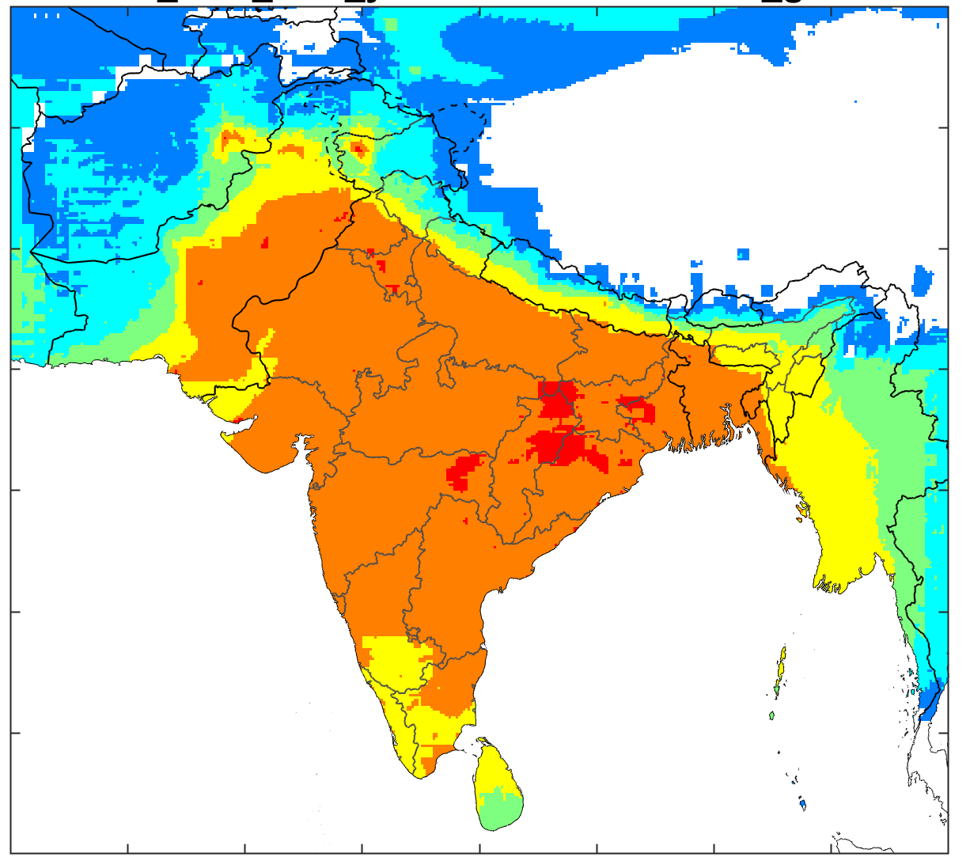
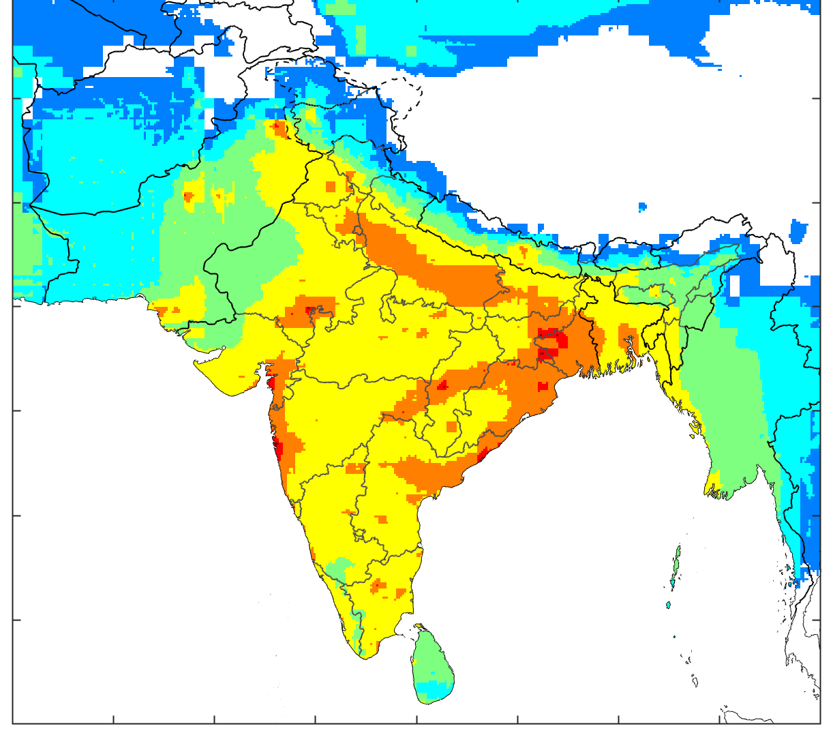
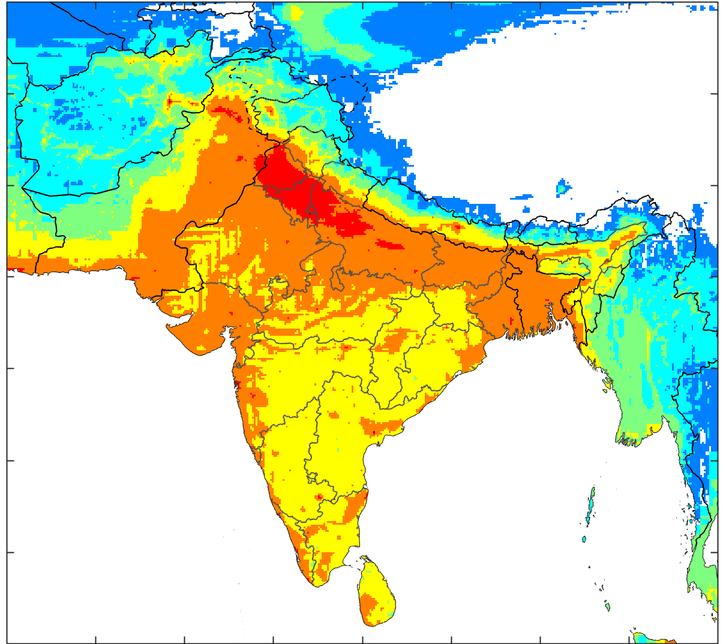
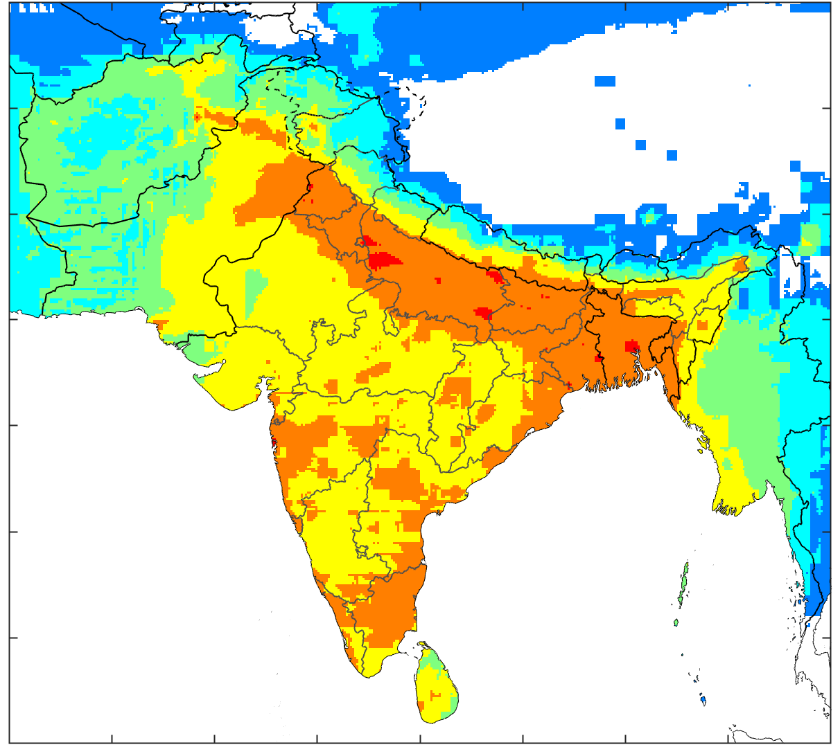
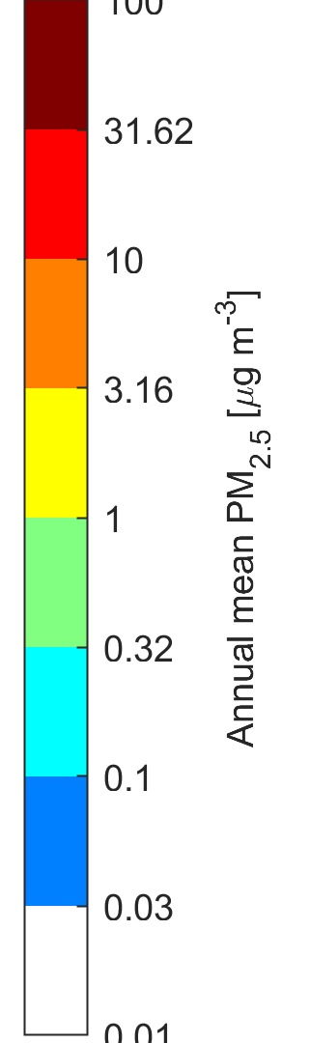
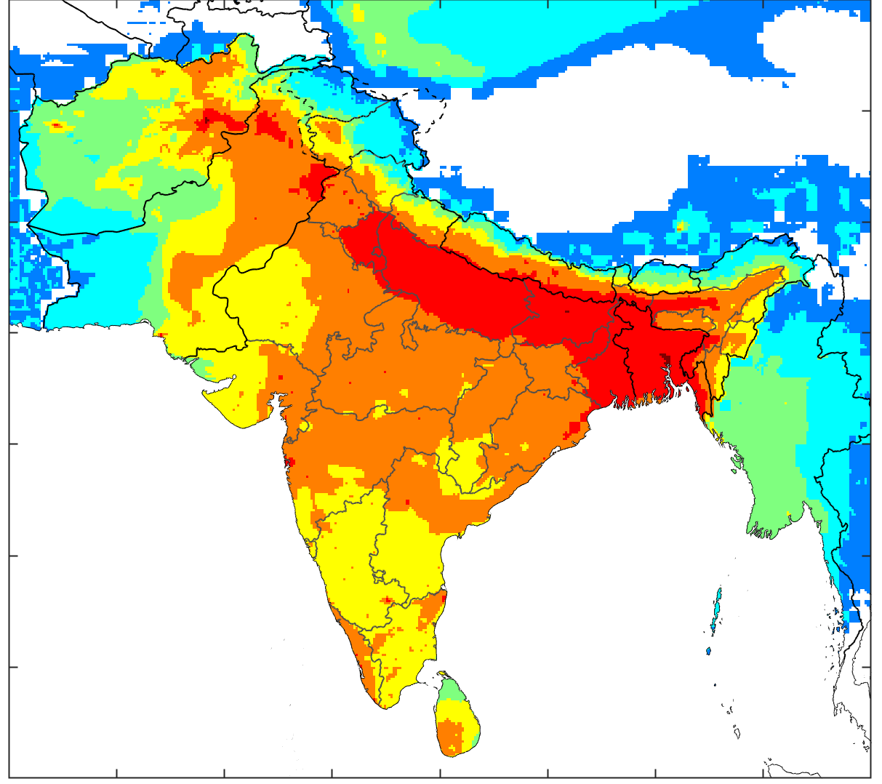
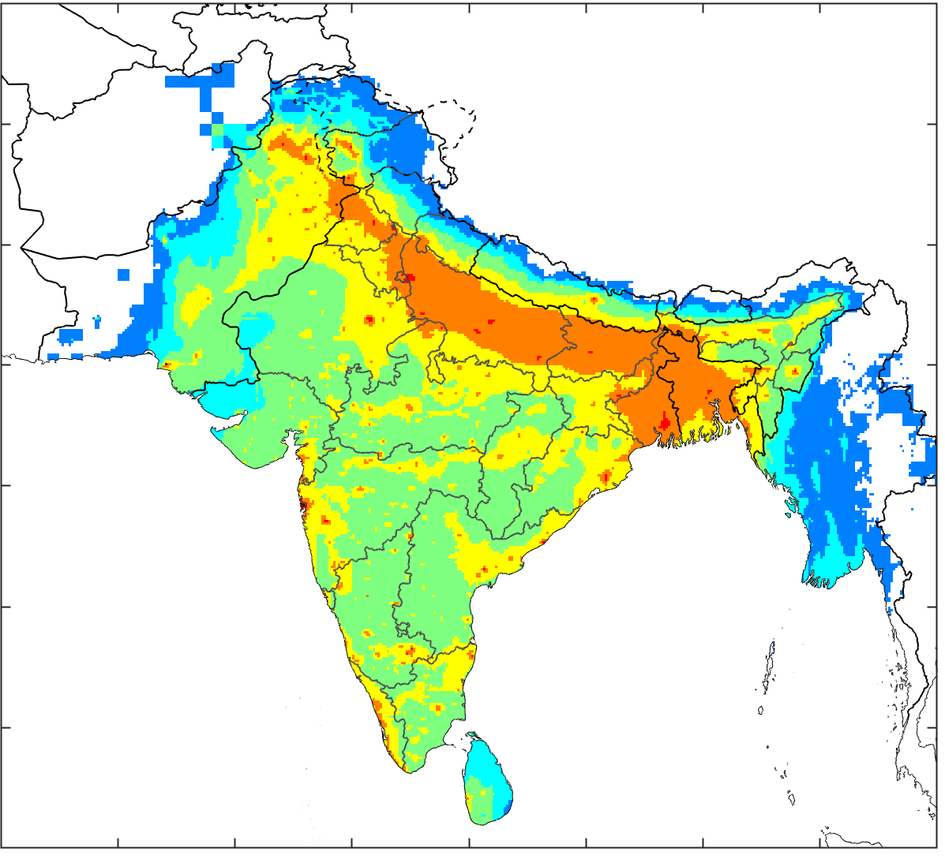
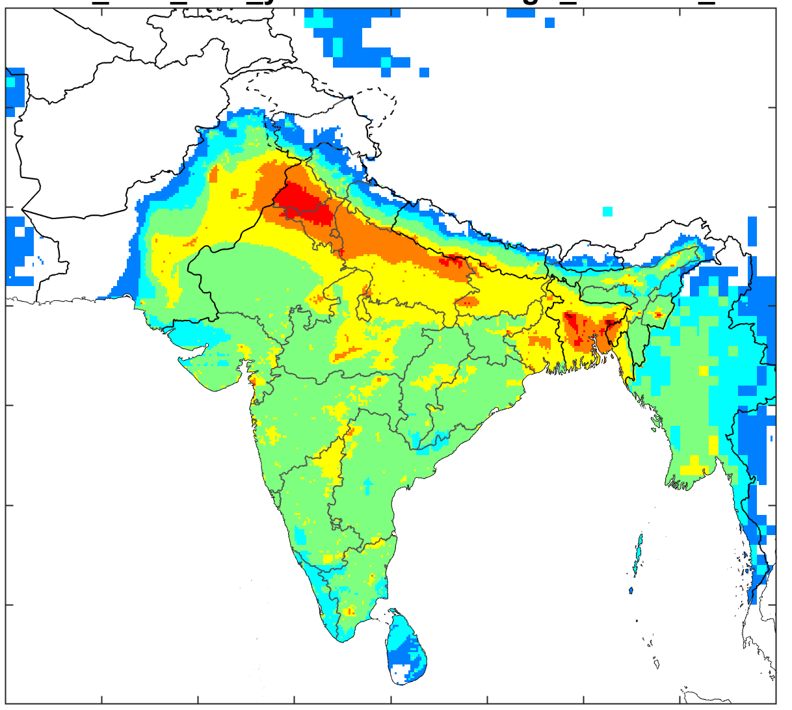
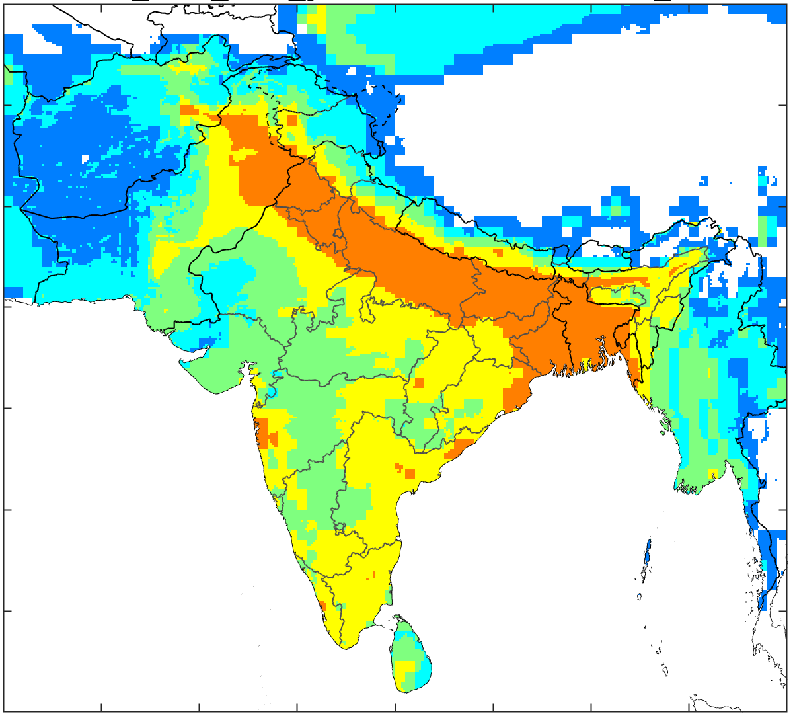
PM_{2.5} pollution originates from many different sectors
Sectoral contributions to PM_{2.5} in ambient air - 2018
Power generation
Small industries
(incl. brick kilns)
Large industries
Mobile sources
Residential and commercial
Open burning of
municipal waste
Open burning of agricultural residues
Fertilizer use and livestock

Slide 6
Future air quality will be determined by policy interventions and their enforcement
India - IGP |  | India – non-IGP |  | Other countries
2030
2018
2018 Contributions from natural sources
2030 - Avoided through economic policies and 2015 legislation Reductions from full implementation of 2018 legislation

Slide 7
Technical potential for additional exposure reductions in 2030
India - IGP |  | India – non-IGP |  | Other countries
2030
2018 Contributions from natural sources
Avoided through economic policies and 2015 legislation Reductions from full implementation of 2018 legislation
Technical potential from further measures within the same State Scope for further technical measures in other regions

Slide 8
Costs and population exposure of further measures in 2030
Towards WHO Interim Targets:
Move everywhere 90% towards the next lower
WHO Interim Target
Ad-hoc selection of measures:
Further controls of large point sources, LPG programs, electric cars, etc.
WHO Interim Target 1:
Bring exposure below WHO IT 1 (35 µg/m³) everywhere

Slide 9
‘Towards WHO Interim Targets’: Impacts of key measures on exposure
Note: this includes the impacts of measures taken in other regions
India IGP India – non-IGP

Slide 10
Priority cost-effective measures for the ‘Towards WHO
Interim Targets’ option
(ranked by decreasing exposure reduction potential in SAR)
Sector |  | Key emission reduction measure
Household cookstoves | IGP, BD, PK | Access to electricity, LPG in remote areas
Solid waste management | IN, BD, PK, NP, LK | Enforced ban of open trash burning Improving collection efficiency Recycling of paper, plastics
Large industries | IND, PK Non-IGP, PK | High efficiency well-maintained PM filters, control of fugitive PM emissions, SO₂ and NO_{x} controls
Residential and commercial -other sources |  | Access to electricity and replacement of kerosene lamps with LED lamps, PM filters in restaurants, electric cremation, etc.
Electricity supply | PK PK, IN, BD | Flue gas desulfurization Fewer blackouts, modern diesel generators
Agriculture | IGP, PK IGP, PK, BD, NP | More efficient application of urea fertilizer Ban of open burning of agricultural residues
Brick kilns | PK | Replacement of traditional kilns with Zig-Zag and vertical shaft brick kilns

Slide 11
Five key messages
Many different sources contribute to PM_{2.5} pollution in ambient air
- thus, cost-effective AQM needs to balance across these sources.
There is limited scope for cities and States to achieve major reductions of PM_{2.5} on their own.
Recent environmental policies will decouple emissions from GDP growth,
but will not be sufficient to deliver large reductions in ambient PM_{2.5} in the South Asia Region.
There is scope for further measures beyond current policies that could approach the WHO Interim Targets (IT-1) for PM_{2.5}.
Cost-effective approaches can achieve significant cost savings compared to conventional approaches; however, they require cooperation within airsheds.

Slide 12
Thank you!
E-mail: purohit@iiasa.ac.at

