Slide 1
Network resilience and systemic risk Methodological approaches to address network resilience and opinion dynamics
Matthias Wildemeersch, Nikita Strelkovsky, and
Sebastian Poledna
Advanced Systems Analysis Program (ASA) – IIASA
March 30, 2016
EMCSR

Slide 2
Introduction
ASA Strategy and Methods

Slide 3
IIASA mission
“IIASA provides insights and guidance to policymakers worldwide
by finding solutions to global and universal problems through applied systems analysis in order to improve human and social wellbeing and to protect the environment.”

Slide 4


ASA Strategy
Goal:
Advance as a research program in systems analysis methodology and exploratory applications of systems approach to areas of global change science
Means:
Exploratory applied mathematics
Transfer of methods
Promotion
Dialogues with systems analysis community
Dialogues with applied scientists and end-users
Implementation:
Problem-oriented small-scale exploratory research projects in collaboration with applied scientists (IIASA, outside) & end-users (experts, decision-makers)

Slide 5

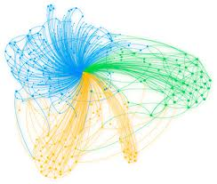

ASA: Methods for contemporary systems analysis
Optimal behavior of systems
Interactions within systems
System transitions and resilience of systems
  Dynamic systems
  Agent-based modeling
  Game theory
  Optimal control
  Foresight
  Participatory planning
  Multi-criteria analysis
  Simulations
Information theory
  Stochastic optimization and robust solutions
  Artificial intelligence
Network analysis
  Data analysis

Slide 6
Domain 1: Optimal behavior of systems
Traditionally decision support tools are based on the principle of optimization of a utility, costs or other objective function in a stylized modeling framework; in many cases multiple objectives should be considered; coupled human-earth systems in dynamic setting are typical examples
Major ASA Topics
Size-structured population dynamics and tradeoffs between economic and ecological objectives
Drivers and impacts of economic growth
Food-energy-water nexus: Robust solutions
Notes:
Example: optimal allocation of land for producing certain crops and growing certain livestock given the uncertain weather conditions. Stochastic optimization techniques allow produce scenarios of production which are robust (insensitive) to a particular realization of weather (be it dry or vet year, for example). Special methods used here give more optimal solutions than scenario-by-scenario based methods

Slide 7
Domain 2: Interactions within systems
Treating natural and human-made systems as networks allows to address interdependence in holistic way; considering dynamic networks allows to address the issue of systemic risk, investigate resilience and define patterns of ‘collapse’ and ‘safe’ behavior
Main ASA Topics
Systemic risk in financial systems
Role of indirect effects in ecological and economic systems
Game-theoretic approach for social interactions
Notes:
This plot shows that all analyzed global trade networks are overredundant compared to the natural systems (food webs) which are more efficient. Over-redundant means that they have too many paths.

Slide 8

Domain 3: Systems transitions and resilience of systems
Qualitative methods as well as simulations address system’s resilience by systematic exploration of possible shock/stress scenarios; novel methods of data analysis identify general patterns and precursors of certain events via learning from the past
Main ASA Topics
Agent-based modeling for regional economic development
Role of uncertainty in climate science and meeting sustainability constraints
Data analysis revealing behavior patterns
Reconciling uncertainty of multiple-model ensembles
Risks and opportunities of interregional economic integration

Slide 9
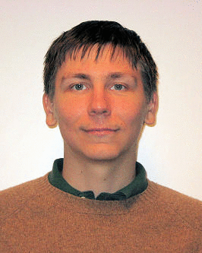


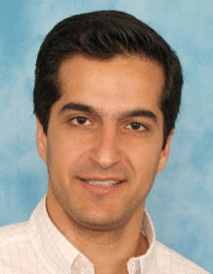


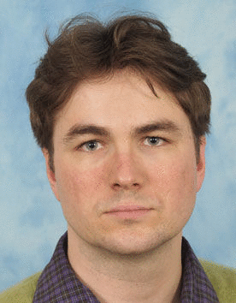
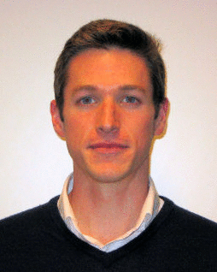








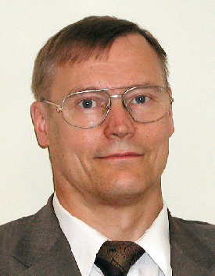
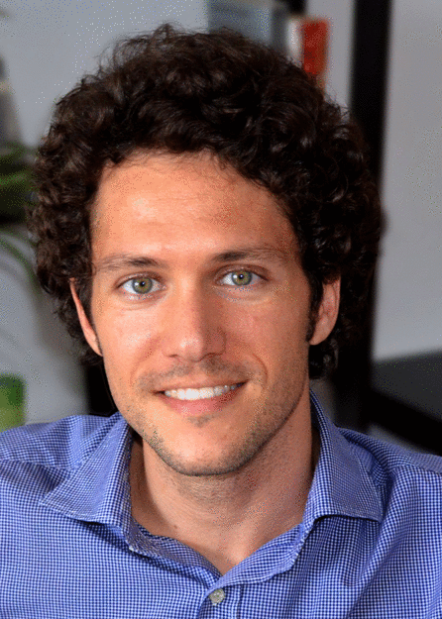



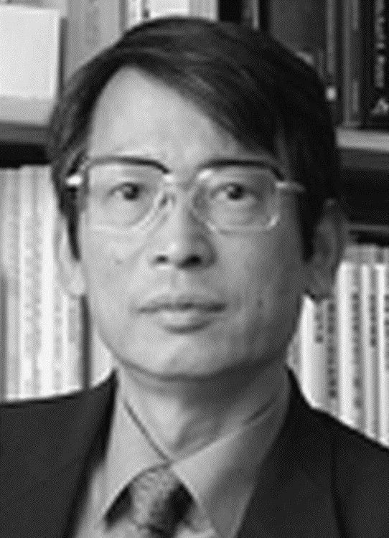

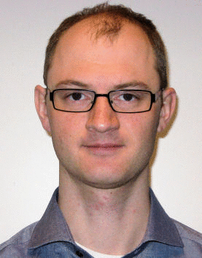

ASA Team
25 researchers (some work part-time) coming from Austria, Finland, Belgium, Germany, Iran, Japan, Poland, Russia, Ukraine, USA
Disciplinary backgrounds: applied mathematics, ecology, social sciences, economics

Slide 10

Facts and figures
Number of publications in 2015: 92
Journals:
  SIAM Journal on Optimization
  PNAS
  Journal of Financial Stability
  Ecology and Society
  etc.

Slide 11
Opinion dynamics and network control
Matthias Wildemeersch

Slide 12
Contribution
State of the art
  Multi-agent networks
  Markovian updating
  Discrete/continuous time updating
  Symmetric and unweighted graphs
Contributions
  Asymmetric and weighted graphs
  Different update rules
  Exogenous inputs
Generic probabilistic framework for diffusion
in multi-agent networks
Notes:
Classification of networks according to conservative and non-conservative update protocols: focus is on two special linear update rules and their effects on the stability and convergence.
Representation by means of ODE’s
Stability and convergence results for homogeneous equation
Extend to inhomogeneous equation allowing for external inputs: two relevant examples
Stubborn agents
Dynamic learning
Tools that will be of interest in this work are (i) probability theory (Markov chains and Markov decision processes), (ii) spectral graph theory (special matrices and their eigenvalue distribution), (iii) control theory and ultimately optimal control

Slide 13
Opinion dynamics
Total amount of the property present in the network is variable
Convex update rule
The dynamics of the expected property for a network applying (P1) are defined by
Notes:
- Convex update rule corresponds to a weighted sum
Extending to an affine update rule makes the analysis very complicated
We can again make an explicit link between the update rule and the transition rate matrix

Slide 14
Stability and convergence – an example

Slide 15
Enabling network control
To model the addition and subtraction of property to and from the network, we include an inhomogeneous term
For linear, time-invariant systems, the solution is given by
Notes:
Can be solved if invertible; if not invertible, then more complex solution based on Jordan form

Slide 16
Opinion control through stubborn agents
Case of stubborn agents:
Reduction of the state space
Network state converges to
Stubborn agents allow to steer the consensus value as wanted
Notes:
Global asymptotic stability can be proven based on the Lyapunov theory; need to devise special Lyapunov functions for non-symmetric matrices

Slide 17
Understanding network resilience

Slide 18
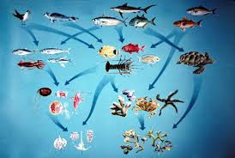
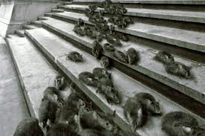
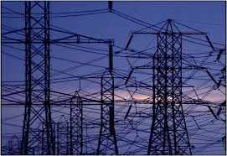

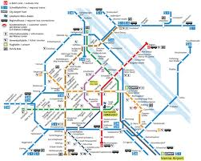
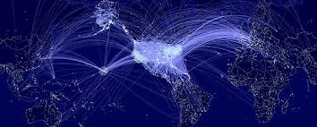
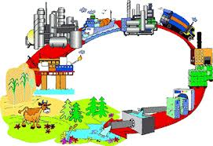
Systemic risk, resilience, and critical transitions in networked systems
Global systems are increasingly interdependent
Network effects arise in a broad variety of seemingly disparate systems
Negative consequences of cascading failure can be profound, and therefore it is crucially important to gain insight in the sustainability, resilience, and critical transitions in networked systems.
Resilience is the ability to recover from a shock or disturbance
Ecosystems
Disease contagion
Electric grids
Social interactions
Transport systems
World Wide Web
Economic systems, Supply chains

Slide 19
Resilience of economies
Leena Ilmola and Nikita Strelkovsky

Slide 20
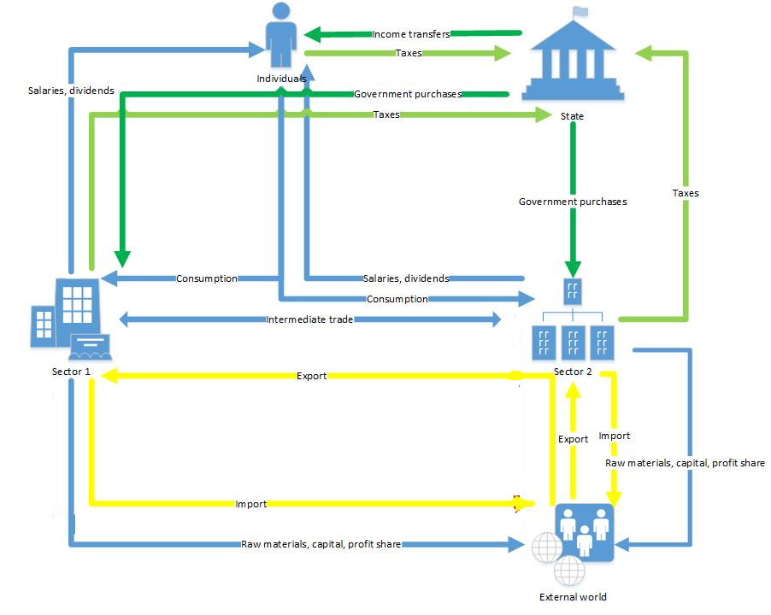
Agent-based modeling for assessing regional/national resilience to external shocks
Leena Ilmola et al.
Goals
Study of the economy dynamics under exogenous and endogenous shocks (i.e., energy availability increase, shifts of migration flows, dramatic increase of suicides among young population in Korea etc.)
Testing of different government policies potential effects (change of the retirement age, decrease of defense spending etc.)
There is no goal of accurate forecasting of the future economic and demographic situation
Methods:
Agent-based modeling is an approach relying on simple behavioral rules of multiple interacting agents which emerge into a complex systems behavior

Slide 21
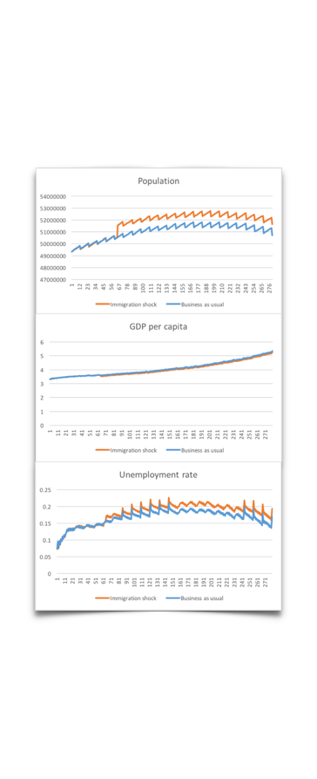
Results – Scenario analysis
1 million Chinese move to Korea. Korea will get a very cheap loan from IMF for support of immigrants; each immigrant will have 30% of the average income as a social transfer for 3 years.
Direction of research:
Social and political behavior
Comparison of different economies and societies
Use as a foresight tool
Reference
L. Ilmola and N. Strelkovsky. Applications of Systems Thinking and Soft Operations Research in Managing Complexity: From Problem Framing to Problem Solving, chapter Soft Social Systems and Shocks: An Experiment with an Agent Based Model, pages 269–290. Springer International Publishing, Cham, 2016.

Slide 22
Financial systemic risk
Sebastian Poledna, Stefan Thurner

Slide 23
Financial systemic risk
Sebastian Poledna et al.
Systemic risk
describes the likelihood of cascading failures in networks
Can be sparked by even very small deviations from business-as-usual functioning modes
Can result in non-smooth transitions to unwanted paths
Measurements of financial systemic risk
Goal: systemic risk-value for every financial institution
Google faced similar problem: value for importance of web-pages
  page is important if many important pages point to it
  number for importance
  PageRank
Expected Systemic Loss
a measure for systemic risk of countries, financial institutions, and individual transactions
  Based on DebtRank – a measure of systemic importance of nodes in financial networks with an economically meaningful number
  Takes explicit knowledge of the underlying networks, capitalization and probability of default of financial institutions into account
Combined economic value
Default probability
DebtRank

Slide 24

Management of systemic risk in financial networks
Management of systemic risk
Systemic risk is a network property to large extent
Systemic risk changes with every transaction
huge difference of systemic risk contribution of transactions of similar sizes
Manage systemic risk: re-structure financial networks such that cascading failure becomes unlikely, ideally impossible
Systemic risk tax (SRT)
Idea: tax financial transactions according to their systemic risk contribution in order to create an incentive for low (systemic) risk transactions
  Agents look for deals with agents with low systemic risk
  Liability networks re-arrange
  Eliminates cascading failure
Test SRT with CRISIS Model
Comparison of three schemes
  No systemic risk management
  Systemic Risk Tax (SRT)
  Tobin-like tax (0.2% on all transactions)

Slide 25
Management of systemic risk in financial networks (2)
Systemic risk is a network property – endogenously created
Systemic risk can be measured for each institution /transaction
Systemic risk can be eliminated by Systemic Risk Tax (SRT); networks don’t allow for cascading
SRT should not be paid! – evasion restructures networks
SRT does not reduce trading volume
Tobin tax reduces risk by reducing trading volume
(S. Poledna and S. Thurner. Elimination of systemic risk in financial networks by means of a systemic risk transaction tax., Quantitative Finance, 2016 (in press))

Slide 26
References
Poledna, S., Molina-Borboa, J. L., Martínez-Jaramillo, S., van der Leij, M., & Thurner, S. (2015). The multi-layer network nature of systemic risk and its implications for the costs of financial crises. Journal of Financial Stability, 20, 70-81.
Poledna, S., & Thurner, S. (2014). Elimination of systemic risk in financial networks by means of a systemic risk transaction tax. Quantitative Finance, 2016 (in press)

Slide 27
Strategic investment in protection in networked systems
Matt Leduc

Slide 28
Motivation
Notes:
Another problem we’ve been studying is strategic investment in protection in network systems.
Consider some examples: In early 2015, a measles epidemic spread across the western part of the Unites States. It was reported that one of the causes was the unwillingness of parents to vaccinate their children. Indeed, some people may want to avoid the perceived risks of a vaccine’s side effects and free-ride on the “herd immunity” provided by the vaccination of other people. This raises the following question: what are the incentives to vaccinate against a contagious disease?
The same type of question can be asked about other systems subject to the risk of contagion. What are the incentives to invest in computer security solutions to protect against the spread of malware? What incentives do airports have to invest in security equipment/personnel?
How does the structure of interactions between individuals, computers or airports affect those incentives?

Slide 29
Model and research question
Notes:
In this project, we develop a framework to study the incentives that agents have to invest in protection in networked systems.
A set of interconnected agents can each fail individually or as a result of contagion. Depending on the application, failure can mean a human being contracting an infectious disease, a computer being infected by a virus or an airport being exposed to a security event (e.g. a suspicious luggage or passenger being checked in or being in transit).
Each agent must decide on whether to make a costly investment in protection against cascading failures. This investment can mean vaccination, investing in computer security solutions or airport security equipment, to name a few important examples.

Slide 30
Strategic Investment in Protection in Networked Systems
Methods: Use tools from game theory to describe equilibrium behavior
Results: Relate behavior to:
(i) changes in how agents are interconnected
(ii) type of investment in protection (vaccination vs. airport security)
Reference
Leduc M.V., Momot, R., “Strategic Investment in Protection in Networked Systems”, in Proceedings, "Web and Internet Economics", 11th International Conference, WINE 2015.
Notes:
We solve for strategic equilibrium behavior using the tools of game theory.
We relate equilibrium behavior to changes in the network structure, the type of application (vaccination vs. airport security) and other parameters.

