Slide 1
Session 455
Measuring the resilience of communities to climate impacts and using this knowledge to adapt
Teresa M. Deubelli-Hwang (IIASA) & Daniela Donia (Plan International)

Slide 2
a unique, non-governmental partnership supporting communities in strengthening their resilience to flood risk
Introduction
The FRMC
Basics
Roles
and Responsibilities
Advance & share knowledge…
Develop expertise…
Design strategies…
Our vision: floods have no negative impact on peoples’ ability to thrive
2

Slide 3
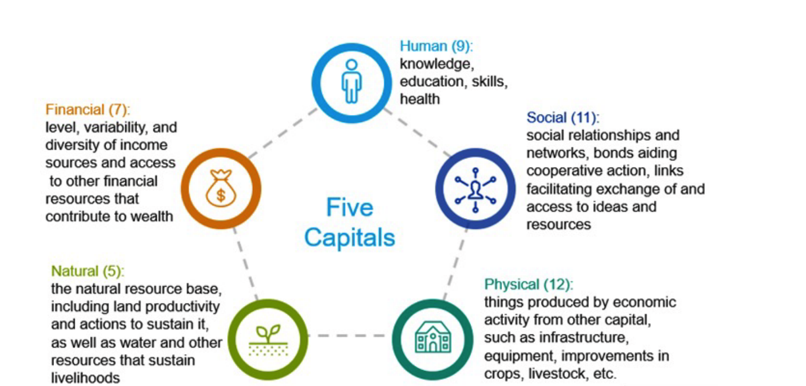
Flood Resilience Measurement for Communities (FRMC) Tool

Slide 4
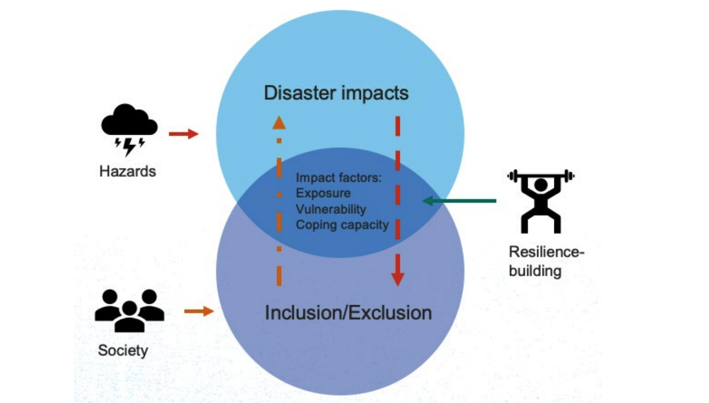
Why does inclusion matter for resilience?
Developing gender and inclusion specific local questions for the FRMC​

Slide 5
Our project: Inclusive Flood Resilience Measurement for Communities (FMRC): Insights from Manila and Navotas (Philippines)

Slide 6
The project: Flood resilience in Manila and Navotas (Philippines)
Project duration: July 2021 to December 2024
Implemented in seven barangays in two cities, Manila and Navotas
Both cities are exposed to sea level rise and coastal flooding
Focus on youth-centered urban disaster risk reduction
Key intervention areas:
Capacity building in climate-smart, risk-informed planning at government and community level: This includes improving understanding of technical details for governing bodies and creating inclusive and age-appropriate learning materials for communities.
Livelihood support and protection to prevent people from becoming more vulnerable.

Slide 7
Developing gender and inclusion specific local questions for the FRMC
SAD disaggregated baseline data can help us understand the pre-existing socio-economic situation, assets and capacities that underpin resilience.
12 inclusive local questions were piloted in the 7 barangays across two cities, Manila and Navotas.
Six used household survey as the data collection method and six used focus groups and key informants.
In Manila a total of 360 household surveys were completed and in Navotas 520 household surveys were completed.

Slide 8
Overview of Local Questions
Inclusion of indigenous and local knowledge in disaster decision-making
Children and youth flood response knowledge
Resilience education capacity
Resilience education for children and youth
Early warning
Access and control of savings
Youth employment opportunities
Climate change action
Intra-community equity
Community safety
Family violence
Support for parents/guardians of young children

Slide 9
Objectives of the Gender & Inclusion Local Questions Pilot Project
Strengthen the analysis of community flood resilience by ensuring that the FRMC process and outcomes are gender and children and youth (CAY) inclusive.
Contribute to our ongoing endeavour of understanding urban gender and age dynamics.
To test whether the local inclusive indicators may support the development of gender and CAY transformative flood resilience interventions.
Positively impact on the lives of women and CAY in flood-prone communities using the FRMC.
Learn from and refine the pilot local questions and feedback into FRMC/CRMC recommendations for gender and CAY inclusive sources.

Slide 10
Analysis overview
Theme 1: Equity, safety, and access to finances
Indicate underlying factors that impact on the distribution of opportunities and risks for groups in normal times and in times of disaster
Less tangible, perception-based aspects of the system
Theme 2: Climate and disaster resilience capacity.
Inclusiveness of the early warning system and capacity to act
Disaster risk reduction capacity and awareness

Slide 11
Equity, safety, and access to finances: findings
Relatively consistent views on equity between age and gender groups. One notable difference is that men are more likely to strongly agree that people get paid fairly.
High level of concern about safety, especially within groups of people with diverse gender identities and those in older age groups.
Men have more access to control over savings.
This signals that broadly targeted strategies for flood preparedness and response may not address the specific concerns, needs and support of different groups. Including provision for prevention for gender-based violence.
Further investigation in relation to safety and crime both in normal times, and in relation to flooding, would be an important area of interest for resilience building in these barangays.

Slide 12
Climate and disaster resilience capacity: findings
Vulnerable people may be inhibited from taking protective actions due to several factors, including the lack of inclusivity provisions in early warning systems (EWS) and evacuation centres.
Risk of family violence is not sufficiently accounted for in DRR plans or training of disaster response personnel. This disproportionally puts women and children at risk in a disaster.
A priority area for disaster resilience is to ensure that resources, training, and opportunities are made relevant, available, and actionable to young people and other community members. Key area of opportunity for more inclusive and child friendly EWS through consultation with different groups.
Further SAD and socio-economic analysis could be undertaken in these barangays to identify the factors that enable or hinder actions in different types of households to take protective actions.

Slide 13
Key take aways
Promoting financial empowerment of women shows promising prospects for reducing vulnerabilities and increase resilience.
Enhancing livelihood opportunities and financial resilience holds potential for reducing interconnected vulnerabilities of marginalized groups.
Promoting contextualized education on climate and disaster risks offers opportunities to empower Manila’s youth to act risk informed.
Enhancing the inclusiveness and accessibility of Early Warning Systems increases their effectiveness.
Integrating provisions for preventing violence and strengthening socio-economic cohesion in flood-prone areas to enable more effective flood evacuation strategies.

Slide 14
Translating the take aways into action: Insights from the project
The results provided guidance for more gender responsive and inclusive intervention design in the project
Youth engagement (disaster preparedness trainings, youth councils, child friendly spaces)
Child-centered community based DRR and management trainings
Inclusive EWS
Community planning
Community savings groups
Provided insights into interventions that need more support or should be advocated for more – child protection and gender-based violence
Inform interventions of future phases

Slide 15
Thank you!
Teresa M. Deubelli-Hwang (IIASA) & Daniela Donia (Plan International)
deubelli@iiasa.ac.at & ddonia@plancanada.ca

