Slide 1
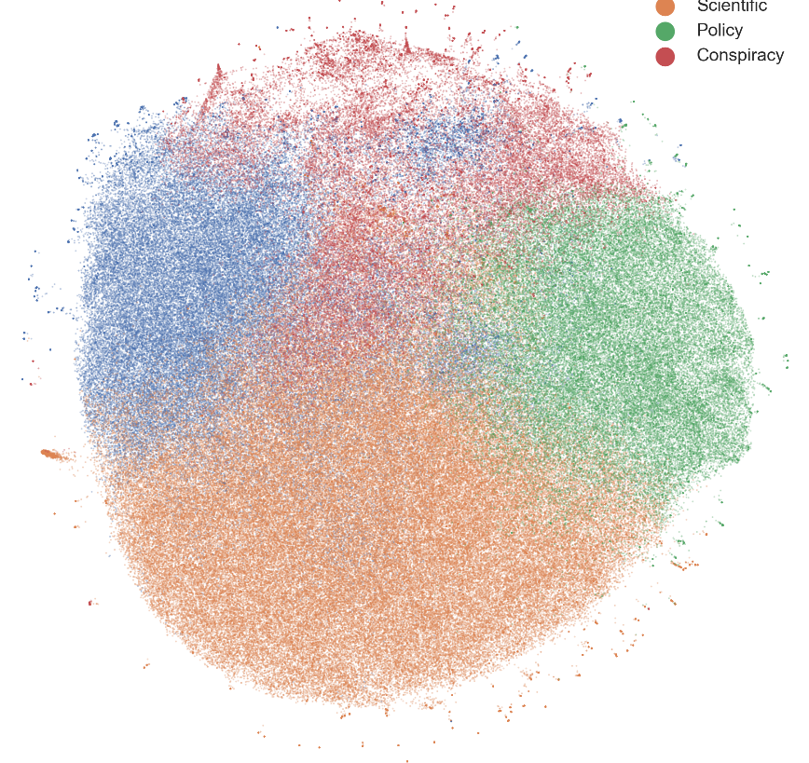
Implications of Scientists’ Perceptions of Climate Change Narratives for Public Engagement
Abraham (Avi) Yosipof, Or Elroy, and Nadejda Komendantova
Faculty of Information Systems and Computer science, The College of Law & Business, Ramat-Gan, Israel
International Institute for Applied Systems Analysis, Laxenburg, Austria
EGU General Assembly 2025, Vienna, Austria, 30/04/2025

Slide 2
Summary
Scientists play a critical role in shaping public understanding of climate change.
This study explores the perceptions of scientists regarding climate change narratives on social media.
Through a survey, we examined scientists' responses and levels of agreement with twenty climate change-related statements from social media.

Slide 3
Summary
There are notable differences in scientists' perspectives influenced by their education, age, and expertise.
Narratives that emphasize the need for policy actions, tend to be supported by scientists
Design targeted communication strategies that leverage the expertise of the scientific community.

Slide 4
Implications of Scientists’ Perceptions of Climate Change Narratives for Public Engagement
Abraham (Avi) Yosipof, Or Elroy, and Nadejda Komendantova
Faculty of Information Systems and Computer science, The College of Law & Business, Ramat-Gan, Israel
International Institute for Applied Systems Analysis, Laxenburg, Austria
EGU General Assembly 2025, Vienna, Austria, 30/04/2025

Slide 5
Introduction
Scientists play a critical role in shaping public understanding of climate change.
This research examine the perception of scientists on various narratives in the discussion of anthropogenic climate change on social media.
Research question: How do demographic characteristics and levels of expertise among scientists influence their perceptions and agreement with different narratives about climate change on social media?
Analysis of a survey composed of climate change-related statements.

Slide 6
Method
Survey two main sections:
(1) Demographic variables.
(2) Twenty climate change-related statement (selected from a dataset of ~300K English tweets).
40 Scientists
Principal Component Analysis to group the questions into variables. Five variables: Policy and Science; Conspiracies and Anthropogenic; Indirect Solutions; Indecisive Causes; and Financial Cause

Slide 7
Results
Narratives that emphasize the need for policy actions, tend to be supported by scientists
Scientists identifying as moderate, high or leading experts endorse policy and science based statements strongly and reject conspiracy narratives.
PhD candidates or scientists that hold PhD demonstrated statistically significantly higher agreement with Policy and Science narratives compared to Master’s or Bachelor’s degree scientists.
Young scientists introduced significantly higher agreement regarding Policy and Science statements than older scientists
Scientists show lower agreement with Indirect Solutions to climate change

Slide 8
Implications for Public Engagement and Policy Co-Production
Transparent evidence-based discourse based on scientific research
Link scientific expertise with community-based action:
Education/training programs
Translate scientific findings into actionable steps
Incorporate scientifically supported narratives into policy frameworks

