Slide 1
Breaking Barriers with Patterns
Integrating Distributional Justice into Global Mitigation Scenarios
Karl Scheifinger, EGU25

Slide 2
Scenarios perceived as unfair fail to motivate collective action.
Notes:
Scenarios are developed to guide action in the present, often collective action.
We know, that perceived justice/ fairness is an important predictor of whether people support any action
Specific to IAMs: global mitigation scenarios labelled as unjust, because they are said to not pay attention to justice considerations
Special concern in scenario development: distributional justice - just allocations between actors

Slide 3
Developing fair scenarios is challenging, partly because people talk about justice and fairness differently.
Policy makers
Justice scholars
Scenario developers
Wider public
Notes:
Different communities are talking about justice differently & a shared language on fairness and justice is missing
Justice scholars: forms, patterns, dimensions of justice
(Quantitative) Scenario developers: Input, set-up, output
Policy makers: sustainable development, CBDR, loss & damages
Wider public: fairness
Objective: propose a shared language on distributional justice directly linked to justice theory and legible for quant. scenarios & the general public
Because quant. scenario most often focus on distributional justice
RQ: How can distributional justice theory be translated into a shared language for scenario development?
Main idea: Direct distributional justice theories towards trajectories
What did we do? Translate 5 distributional justice principles into trajectories, and used them to evaluate existing scenarios and elicit stakeholder preferences

Slide 4
Developing fair scenarios is challenging, partly because people talk about justice and fairness differently.
Policy makers
Justice scholars
Scenario developers
Wider public
Notes:
Different communities are talking about justice differently & a shared language on fairness and justice is missing
Justice scholars: forms, patterns, dimensions of justice
(Quantitative) Scenario developers: Input, set-up, output
Policy makers: sustainable development, CBDR, loss & damages
Wider public: fairness
Objective: propose a shared language on distributional justice directly linked to justice theory and legible for scenarios & the general public
More transparent + accessible
RQ: How can distributional justice theory be translated into a shared language for scenario development?
Main idea: Direct distributional justice theories towards trajectories
What did we do? Translate 5 distributional justice principles into trajectories, and used them to evaluate existing scenarios and elicit stakeholder preferences

Slide 5
Aggregate Utilitarian
Group A
Group B
Notes:
Variable of interest: ideally per capita, e.g. energy consumption, risk to flooding, access to green spaces

Slide 6
Prioritarian
Group A
Group B
Notes:
Variable of interest: ideally per capita, e.g. energy consumption, risk to flooding, access to green spaces

Slide 7
Egalitarian
Group A
Group B
Notes:
Variable of interest: ideally per capita, e.g. energy consumption, risk to flooding, access to green spaces

Slide 8
Sufficientarian
Sufficientarian Threshold
Group B
Notes:
Variable of interest: ideally per capita, e.g. energy consumption, risk to flooding, access to green spaces

Slide 9
Limitarian
Group A
Limitarian Threshold
Notes:
Variable of interest: ideally per capita, e.g. energy consumption, risk to flooding, access to green spaces

Slide 10
All patterns combined
Group A
Group B
Notes:
Variable of interest: ideally per capita, e.g. energy consumption, risk to flooding, access to green spaces

Slide 11
Applications in scenario research: Evaluating existing scenarios
Final Energy Housing in AR6 scenarios
Temperature Target
Notes:
Assumptions:
Mitigation Strategies based on Primary Energy consumption; Renewables (renew > fossil_bio); CDR (fossil>renew)
Prioritarian: lowest 50% of global population improve
Sufficientarian: regional thresholds based on SDP Economy-driven Innovation, no energy deprivation with regards to housing
Limitarian: SSP2-NPi scenario, which assumes no additional climate action
Egalitarian: Same GINI as SDP EI, which is 0.23. SDP EI’s narrative includes inequality reduction; current GINI is around 0.45

Slide 12
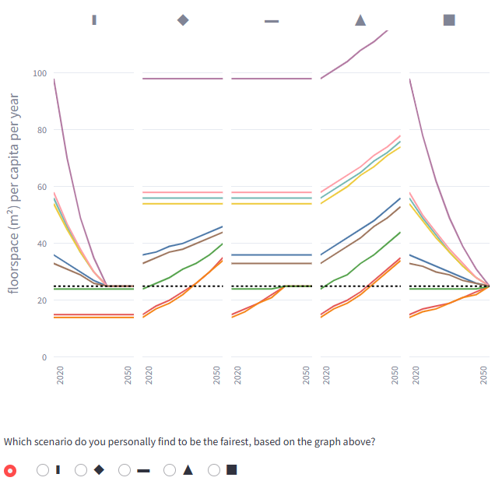
Applications in scenario research: Co-creating scenario narratives
North America
Pacific OECD
China+
Europe
Latin America
Reformed Economies
Middle East
Africa
India+
Notes:
Justice theories exist independent of normative judgment – they can be perceived as fair or unfair
Stakeholder fairness perception changes depending on i) metric, ii) threshold

Slide 13
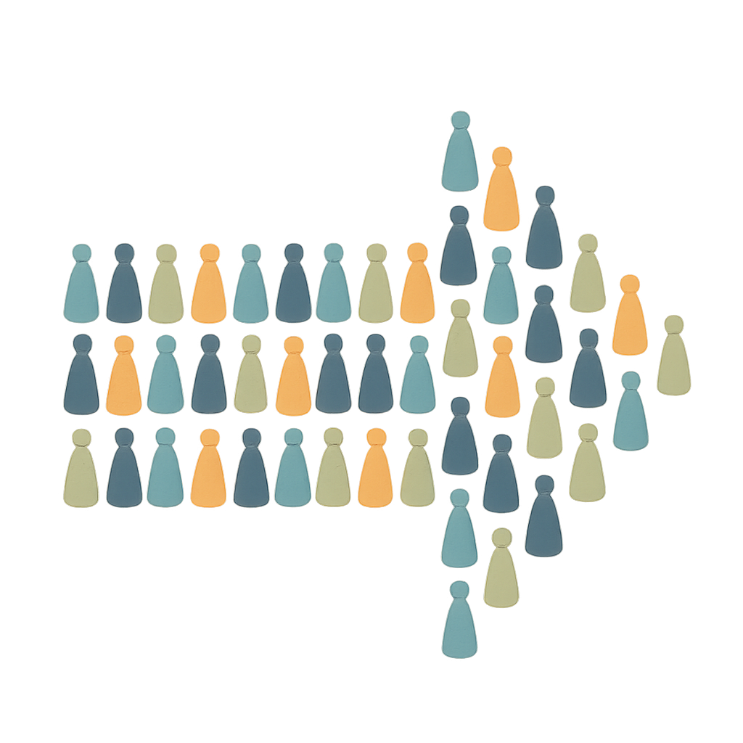
Justice patterns can act as a shared language on distributional justice.

Slide 14
Justice patterns can act as a shared language on distributional justice.
Evaluate existing scenarios.
Co-create new scenario narratives.

Slide 15
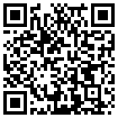
Thank you for your time.
Abstract link
Karl Scheifinger Centre for Environmental Policy, Imperial College London & Energy, Climate, and Environment, IIASA scheifinger@iiasa.ac.at @karlscheifinger.bsky.social

