Slide 1
Horizon 2021 101093864
Combining quantitative and qualitative risk aspects for adaptive and flexible climate risk assessment Michaela Bachmann, Reinhard Mechler, Oscar Higuera Roa, Anna Pirani, Jeremy Pal, Gloria Mozzi, Dana Stuparu, and Maurizio Mazzoleni
1st of May | 2025 | Vienna, EGU Conference 2025
Notes:
Michaela Bachmann, researcher @ IIASA
Colleagues in CLIMAAX Project
Developed an adaptive and flexible CRA Framework which combines quantitative and qualitative risk aspects

Slide 2
CLIMATE RISK ASSESSMENTS
FOR EVERY EUROPEAN REGION
ℹ️CLIMAAX Project Webpage
🛠️CLIMAAX Handbook
2 | Combining quantitative and qualitative risk aspects for adaptive and flexible climate risk assessment
Notes:
You can find more information on the CLIMAAX project via these two QR codes

Slide 3
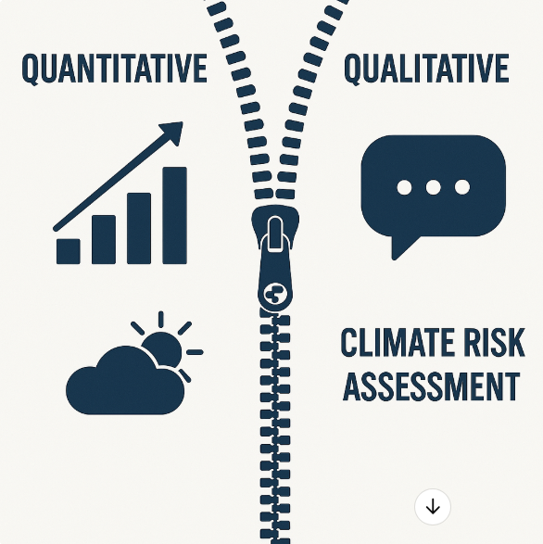
The growing challenge of assessing Climate Risk
Quantitative input
Qualitative input
3 | Combining quantitative and qualitative risk aspects for adaptive and flexible climate risk assessment
Notes:
Climate risks are increasing in frequency and severity across Europe, demanding better Climate Risk Management (CRM). Effective CRM relies on robust, inclusive, and high-quality Climate Risk Assessments (CRAs). Many CRAs struggle to effectively combine rigorous quantitative data with crucial qualitative insights gained from experts, stakeholders, and vulnerable groups. This integration gap hinders comprehensive understanding and the development of truly relevant and accepted adaptation strategies.

Slide 4
The CLIMAAX Framework for Climate Risk Assessment
5 step methodology
Conceptual underpinnings
Standardised flexibility
4 | Combining quantitative and qualitative risk aspects for adaptive and flexible climate risk assessment
Notes:
To address this gap, within the EU Horizon project CLIMAAX, we developed a comprehensive CRA framework tailored for European regions and communities. The five step methodology builds an iterative cycle for CRA with conceptual underpinnings to guide the practical steps. Our core aim: To unite quantitative approaches with qualitative input through participation. Finally, the heterogeneity of risk contexts in European regions and communities requires a certain degree of flexibility for the framework, which is however backed by agreed standards in CRA – therefore providing standardized flexibility.

Slide 5
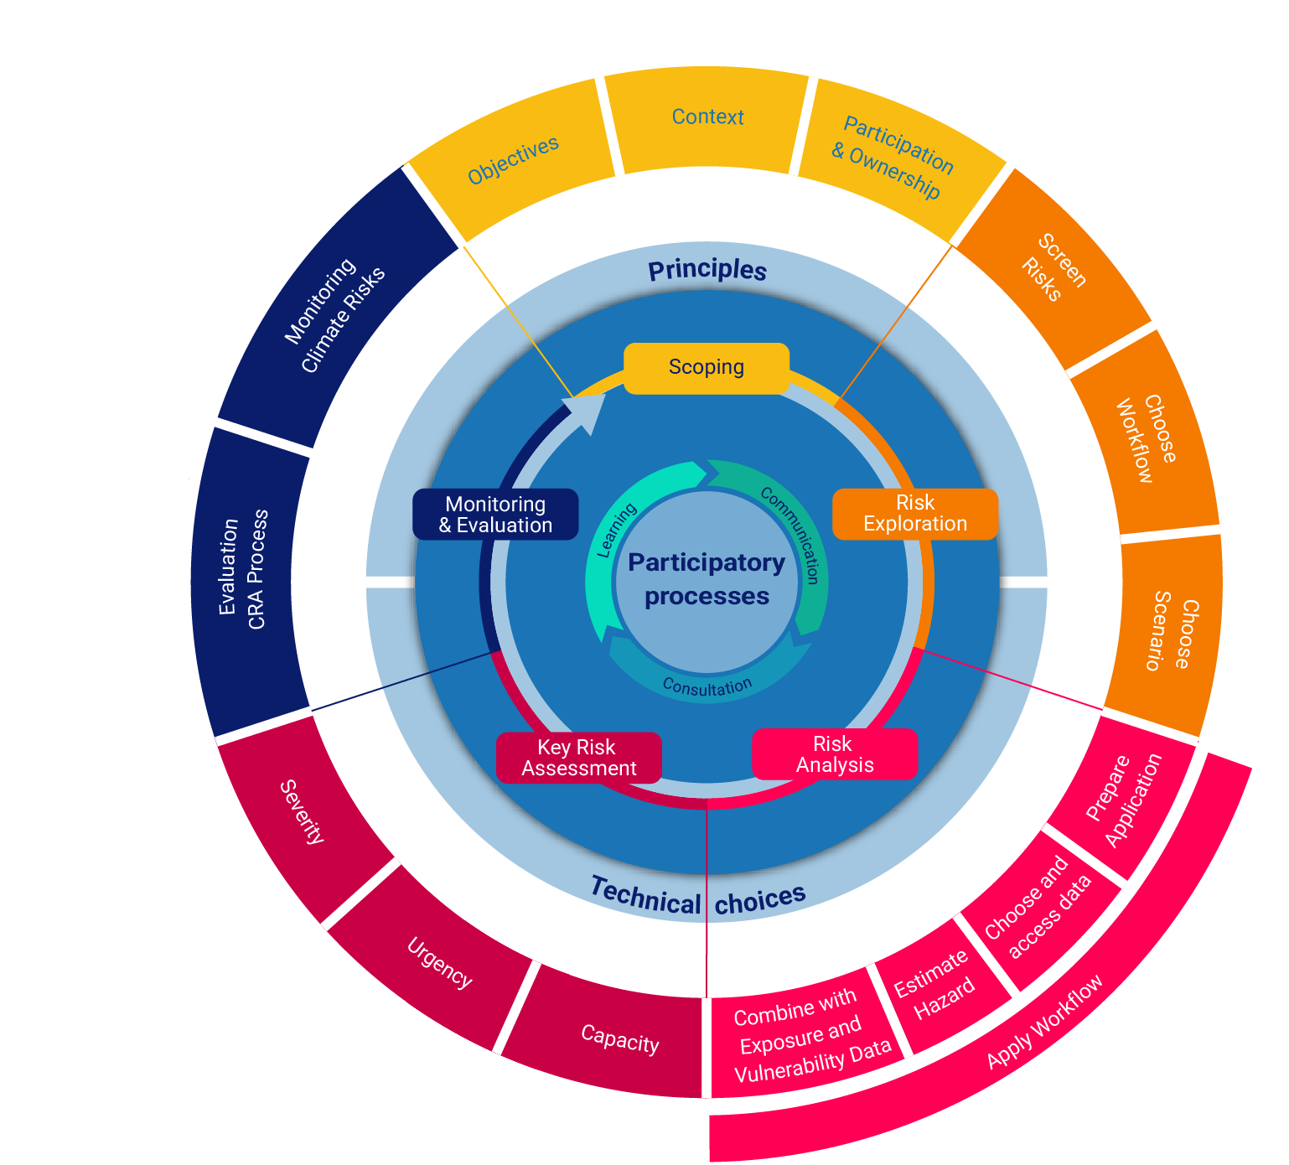
The CLIMAAX Framework for Climate Risk Assessment
You can find more detailed information on
the CLIMAAX Framework steps here!
5 | Combining quantitative and qualitative risk aspects for adaptive and flexible climate risk assessment
Notes:
The framework is operationalized through a 5-step adaptive cycle:
Scoping: Defining objectives and context of the CRA as well as participation and ownership (qualitative input)
Risk Exploration: First screening of risks to understand risk environment (qualitative input e.g., local knowledge)
Risk Analysis: Quantifying risk components (quantitative focus: using risk workflows)
Key Risk Assessment: Evaluating & prioritizing risks (integrating quant & qual insights; perceived risks and social construction of risk)
Monitoring & Evaluation: Evaluation of CRA process and monitoring of climate risks
This cycle is underpinned by principles like social justice, equity, and participatory processes.

Slide 6
Bridging the Gap between Risk Quantification and the Social Construction of Risk
2
1
6 | Combining quantitative and qualitative risk aspects for adaptive and flexible climate risk assessment
Notes:
I would like to focus a bit more on these two steps, Risk Analysis and Key Risk Assessment which, together, allow to bridge the gap of risk quantification and the social construction of risk.

Slide 7
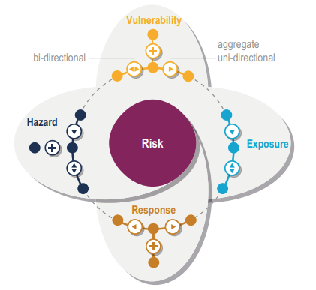
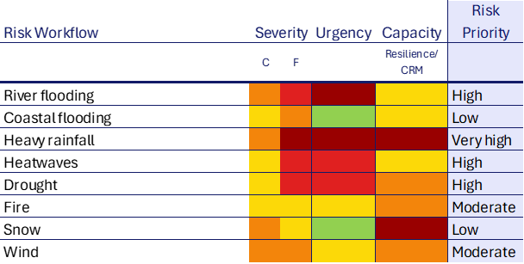
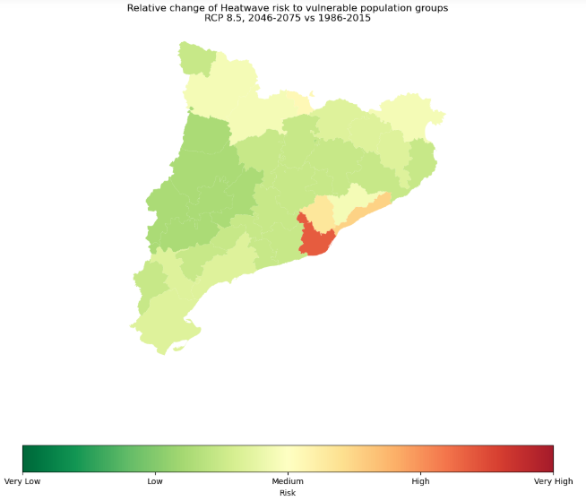
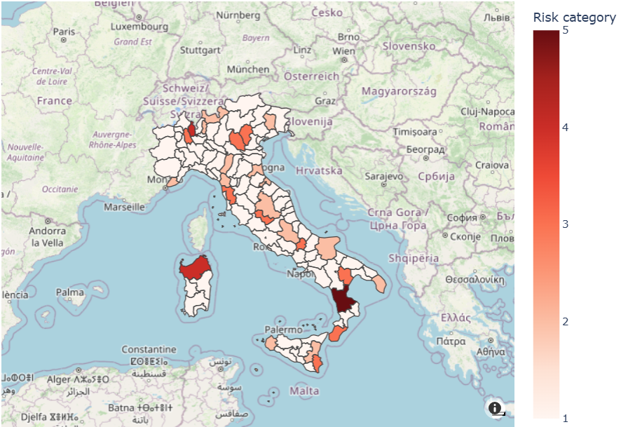
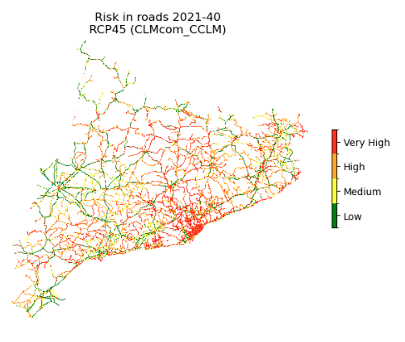
Integrating quantitative and qualitative risk insights
1
Risk Analysis (R = H x E x V)
2
Key Risk Assessment
Ara Begum et al. 2023
Source: CLIMAAX Consortium
Source: CLIMAAX Consortium. Adapted from EUCRA 2024 Mechler & Bouwer 2015
7 | Combining quantitative and qualitative risk aspects for adaptive and flexible climate risk assessment
Notes:
The innovation lies in how we integrate: While Risk Analysis heavily utilizes quantitative risk workflows developed in CLIMAAX, Key Risk Assessment qualitatively evaluates the risk outcomes and thus translates them in a risk prioritization scheme, covering risk severity, urgency and the capacity of a region to tackle the respective risk.

Slide 8
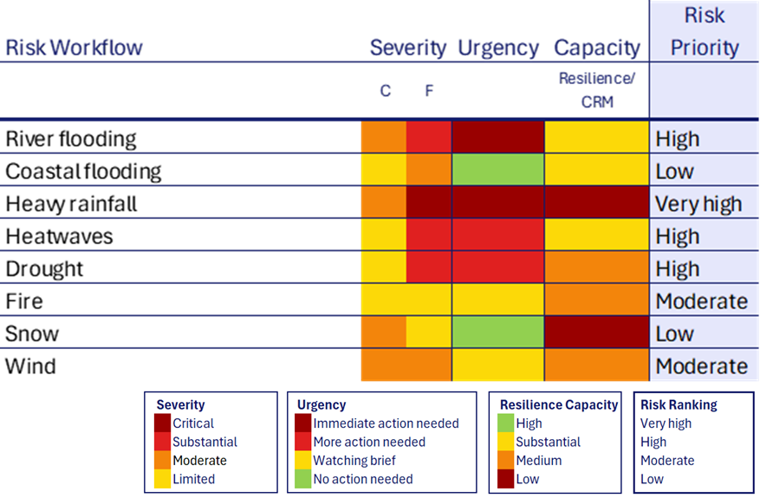
Key Risk Assessment in practice
Description
Considerations
Source
Severity
Contextualizes (quanti-tative) risk analysis (risk perception)
Magnitude, thresholds, irreversibility, cascading or delay effects
O’Neill et al., 2022; Magnan, O’Neill and Garschagen, 2023; Renn and Klinke, 2015.
Urgency
Temporal dimension of hazard
Severity; persis-tence; timing of hazard occurrence; hazard accelera-tion trends
Renn and Klinke, 2015; Magnan et al., 2021; O’Neill et al., 2022; Zebisch et al., 2023; European Environment Agency, 2024.
Capacity
Physical, social, financial, human, and natural capacity to respond to risk
Generic and specific capacities to respond to risk
DFID, 1999; Ara Begum et al., 2022; Folke et al., 2010.
Stakeholder workshop for risk evaluation (stakeholders, experts, representatives from vulnerable groups, etc.)
8 | Combining quantitative and qualitative risk aspects for adaptive and flexible climate risk assessment
Notes:
Evaluating climate risk relies on inclusion and participation. This may happen through a stakeholder workshop or in any suitable participatory process that engages with affected people and communities.
How can the stakeholders evaluate climate risk?
Severity: Contextualisation and perception of risk through subjective judgement of the severity of the respective risk outcome.
Urgency: relates to the temporal dimension of HAZARD with timing of hazard occurrence, persistence of hazard or hazard acceleration trends
Capacity: may be considered within physical, social, financial, human and natural capacities. Considerations of general resilience as a broad spectrum capacity of a society to absorb shocks, as well as specific resilience through the implementation of specific CRM measures to tackle the risk can be evaluated.
Together, severity, urgency and capacity, can be harnessed to evaluate the respective risk and to qualitatively assign risk priorities.

Slide 9
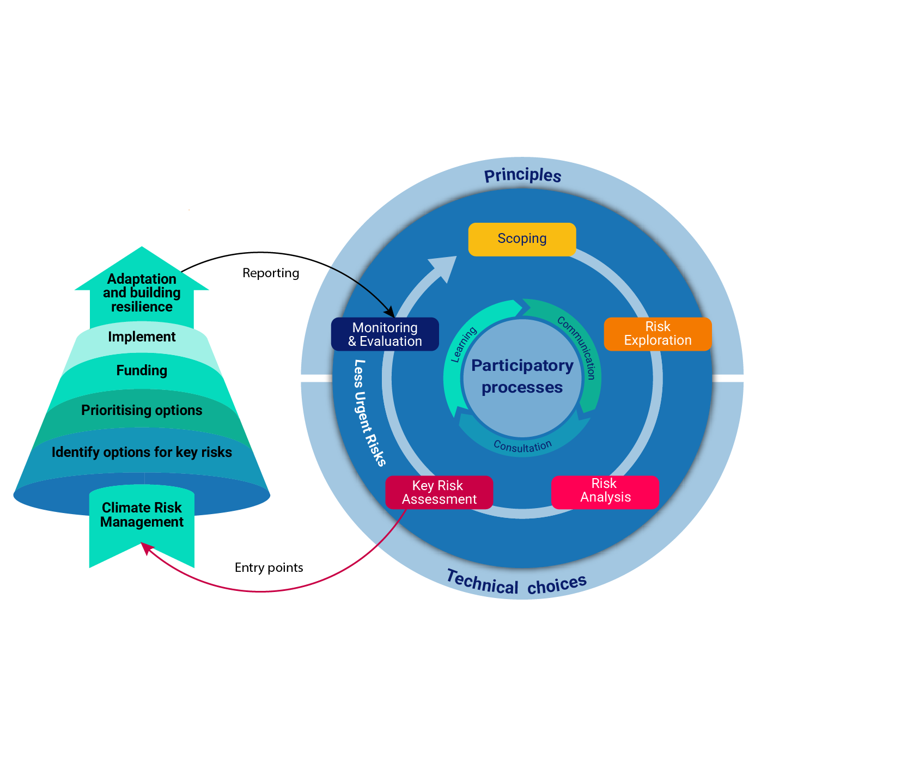
Towards Climate Risk Management
9 | Combining quantitative and qualitative risk aspects for adaptive and flexible climate risk assessment
Notes:
Evaluating risk in the previous key risk assessment step connects qualitative with quantitative risk inputs. Through the stakeholder process, risk evaluation is not only being democratized more but also generates better risk ownership and with this an ideal basis for risk-informed, inclusive and just CRM measures.

Slide 10
Outlook & Key Takeaways
Indicator development
Validation, testing and application
Refinement in translating CRA to CRM measures
10 | Combining quantitative and qualitative risk aspects for adaptive and flexible climate risk assessment
Notes:
What are our next steps?

Slide 11
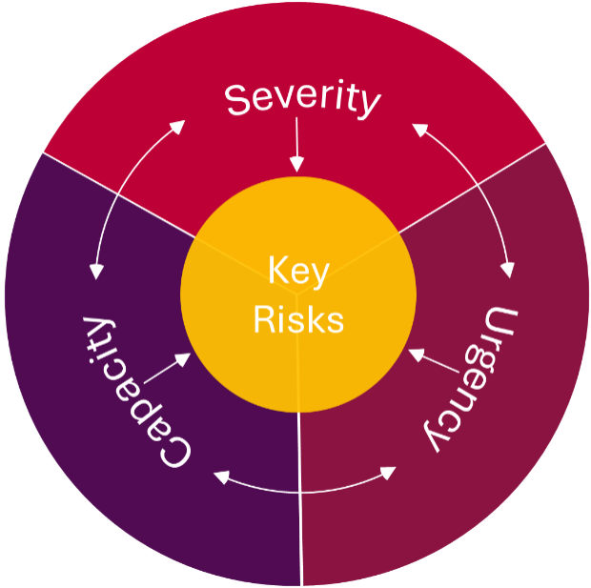
Outlook & Key Takeaways
Combining quantitative and qualitative approaches is a crucial endeavour for comprehensive CRA
Evaluating climate risks supports bridging the gap between CRA and CRM
⇄
11 | Combining quantitative and qualitative risk aspects for adaptive and flexible climate risk assessment
Notes:
Combining quantitative and qualitative approaches is a key for comprehensive CRA
Key Risks can be defined by evaluating severity, urgency and the capacity of a region to tackle a respective risk.
Evaluation of climate risk supports the translation gap between CRA and CRM

Slide 12
Sources
Ara Begum, A. et al. (2022) ‘Point of Departure and Key Concepts.’, in H.-O. Pörtner et al. (eds) Climate Change 2022: Impacts, Adaptation and Vulnerability. Contribution of Working Group II to the Sixth Assessment Report of the Intergovernmental Panel on Climate Change. Cambridge, UK and New York, USA: Cambridge University Press, pp. 121–196.
DFID (1999) Sustainable Livelihoods Guidance Sheets. Livelihoods Centre. Available at: https://www.livelihoodscentre.org/documents/114097690/114438878/Sustainable+livelihoods+guidance+sheets.pdf.
European Environment Agency (2024) European Climate Risk Assessment. EEA Report 01/2024. Luxembourg: Publications Office of the European Union.
Folke, C. et al. (2010) ‘Resilience thinking: integrating resilience, adaptability and transformability.’, 15(4).
Magnan, A.K. et al. (2021) ‘Estimating the global risk of anthropogenic climate change’, Nature Climate Change, 11(10), pp. 879–885. Available at: https://doi.org/10.1038/s41558-021-01156-w.
Magnan, A.K., O’Neill, B.C. and Garschagen, M. (2023) ‘Further understanding “severe” climate risk’, Climate Risk Management, 42, p. 100538. Available at: https://doi.org/10.1016/j.crm.2023.100538.
Mechler R. and Bouwer, L. (2015). Reviewing trends and projections of global disaster losses and climate change: Is vulnerability the missing link? Climatic Change 33 (1) : 23-35
O’Neill, B. et al. (2022) ‘Key Risks Across Sectors and Regions’, Climate Change 2022: Impacts, Adaptation and Vulnerability. Contribution of Working Group II to the Sixth Assessment Report of the Intergovernmental Panel on Climate Change. Edited by H.O. Pörtner et al. Cambridge, UK and New York, USA: Cambridge University Press. Available at: https://doi.org/10.1017/9781009325844.025.2412.
Renn, O. and Klinke, A. (2015) ‘Risk Governance and Resilience: New Approaches to Cope with Uncertainty and Ambiguity’, in U. Fra.Paleo (ed.) Risk Governance. Dordrecht: Springer Netherlands, pp. 19–41. Available at: https://doi.org/10.1007/978-94-017-9328-5_2
Zebisch, M. et al. (2023) ‘Climate Risk Sourcebook’. Bonn: Deutsche Gesellschaft für Internationale Zusammenarbeit (GIZ).

Slide 13
Thank you.
bachmann@iiasa.ac.at

