Slide 1
The contributions of citizen science to SDG monitoring
Dr. Dilek Fraisl
Senior Research Scholar
International Institute for Applied Systems Analysis (IIASA)
Managing Director
Citizen Science Global Partnership
Email: fraisl@iiasa.ac.at
Twitter: dilekfraisl1
LinkedIn: dilekfraisl
Web: www.iiasa.ac.at

Slide 2
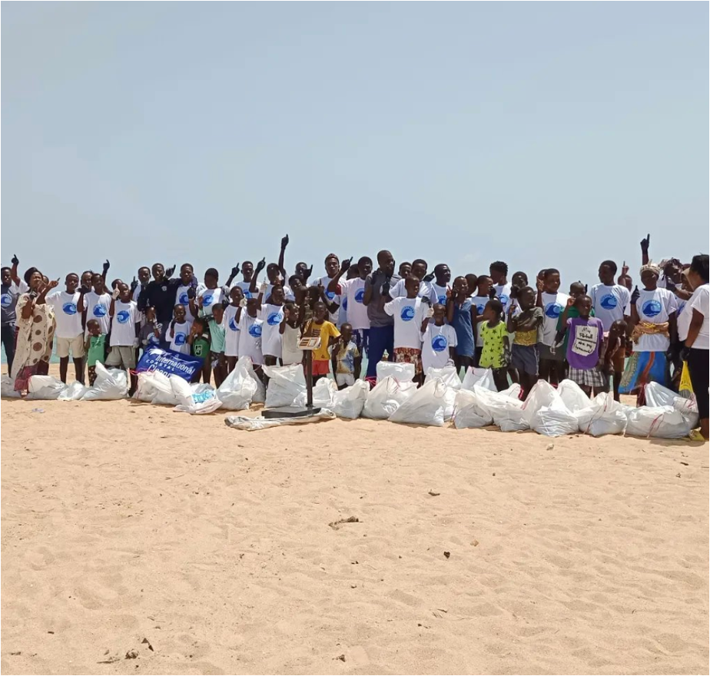
GLOBAL RECOGNITION AND IMPACT
Ghana has become the first country to integrate existing citizen science data on marine plastic litter into their official statistics, as well as SDG monitoring and reporting
The results have been used in Ghana’s Voluntary National Review of the SDGs, and reported on the UN SDG Global Database
The results are also informing the integrated coastal and marine management policy in Ghana, currently under development
The initiative has helped to bridge local data collection efforts with global monitoring processes and policy agendas by leveraging the SDG framework
Partnerships with citizen science networks that are gathering these data in Ghana have been built to ensure sustainability of data and the approach, led by the Ghana Statistical Service (GSS)
Other countries, such as Siera Leone and Colombia, are also learning from Ghana and have engaged in knowledge exchange workshops with the (GSS)
@Smart Nature Freaks Youth Volunteers Foundation

Slide 3
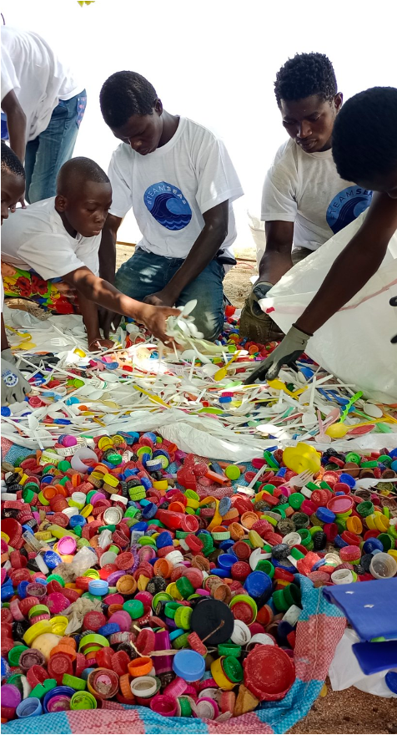
GLOBAL RECOGNITION AND IMPACT
Mentioned in the UN SDG Reports published by the UN Statistics Division (UNSD) (both in 2023 & 2024 editions)
Showcased on the UNSD website as a best practice model
Mentioned in the UN Statistical Commission - Secretary General’s Report (Statistical Commission Fifty-sixth session, 2025)
Influenced other UN agencies (e.g., UNDP’s work on SDG 16 citizen satisfaction indicator
Won the Group on Earth Observations (GEO) SDG Award, including its second phase (drones, citizen science and AI integration to produce litter density maps)
Featured by the UNSD Citizen Data Collaborative across sessions, publications, and best practice platforms
Featured in a recent Nature Sustainability perspective piece, which was then highlighted in a Nature editorial
Presented at the UN World Data Forum, UN Statistical Commission, UN Environment Assembly, UN Big Data and Data Science for Official Statistics Conference, and other major UN events, and scientific conferences; published on the World Bank blog
@Smart Nature Freaks Youth Volunteers Foundation

Slide 4
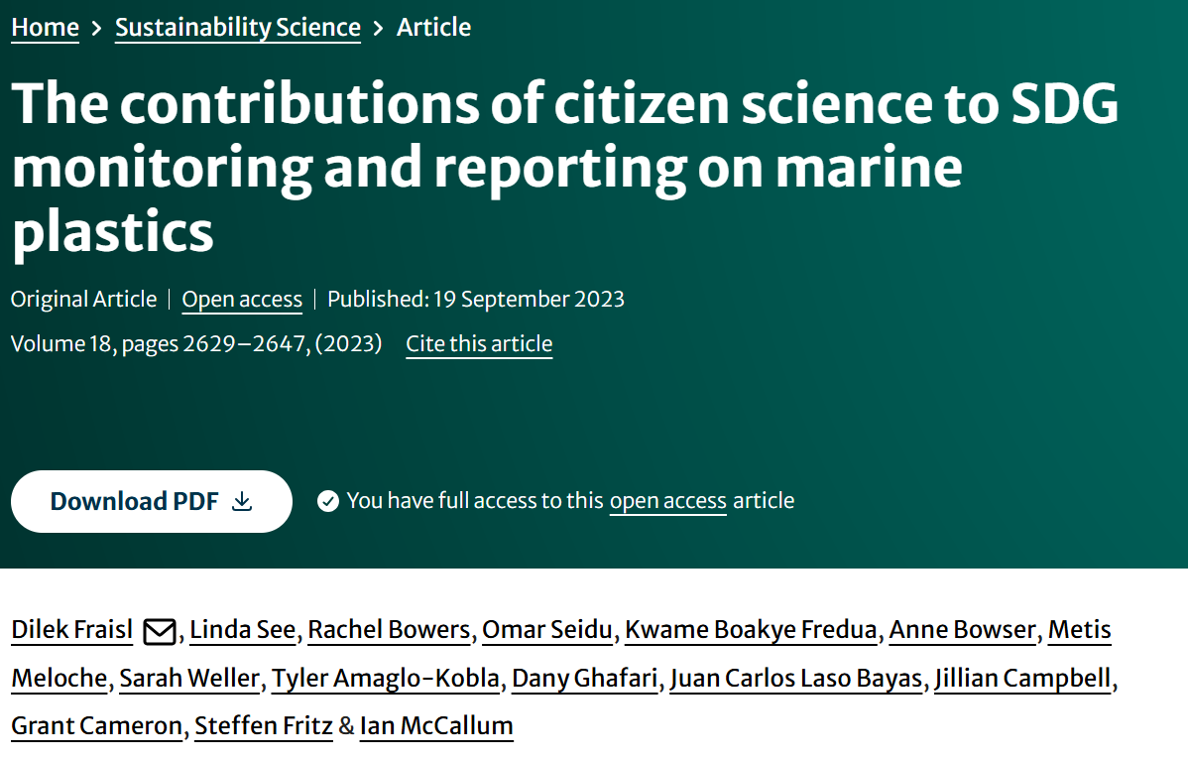
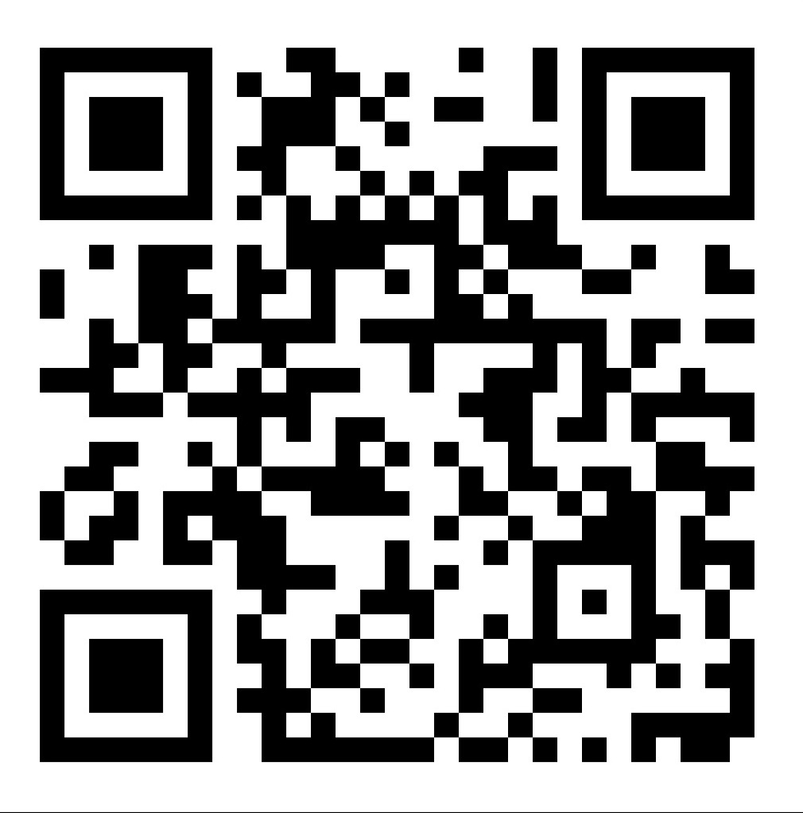
If you want to learn more, here is the scientific paper, which won the Best Paper Award 2024 among 144 papers published in the journal Sustainability Science!

