Slide 1
Transatlantic Digital Engagement: Mapping US-EU Public Interest through Google Trends
Dmitry Erokhin, PhD; Nadejda Komendantova, PhD
International Institute for Applied Systems Analysis
Laxenburg, Austria

Slide 2
Introduction
Overview: This project explores how online search behaviors reflect transatlantic relations from 2004 to 2025.
Focus: Examining the most relevant and trending search topics between the United States, 27 EU countries, and the UK, as observed through Google Trends data.
Purpose: To uncover patterns, shared interests, and cultural distinctions in digital engagement, offering valuable perspectives for transatlantic studies.
Relevance: By systematically analyzing cross-continental search data and leveraging AI-driven topic grouping, this research provides nuanced insights into the evolving dynamics between the US and Europe.

Slide 3
Methodology
Data extraction: Collected related search queries and entities (numeric, breakout, %) for the USA from all 27 EU countries and the UK, and vice versa, covering 2004-2025.
AI-powered topic grouping: Utilized OpenAI API (gpt-4o-mini) to group extracted queries and entities into broader, meaningful topics.
Temporal and geographic analysis: Analyzed search trends across time and compared patterns between different countries.
AI-assisted country descriptions: Used GPT-4o-mini to generate annual and longitudinal country-specific descriptions, and to create cross-country and within-country comparisons.

Slide 4
Limitations
Search data bias: Google Trends reflects only online searches, which may not capture the full scope of public sentiment or offline interests.
Language & regional variations: Differences in language and terminology may affect results and topic grouping accuracy.
Temporal dynamics: Data may be influenced by short-term events or media cycles, potentially skewing long-term interpretations.
AI grouping constraints: Automated topic grouping, while efficient, can introduce classification errors or miss nuanced context.

Slide 5
US search for Europe

Slide 6
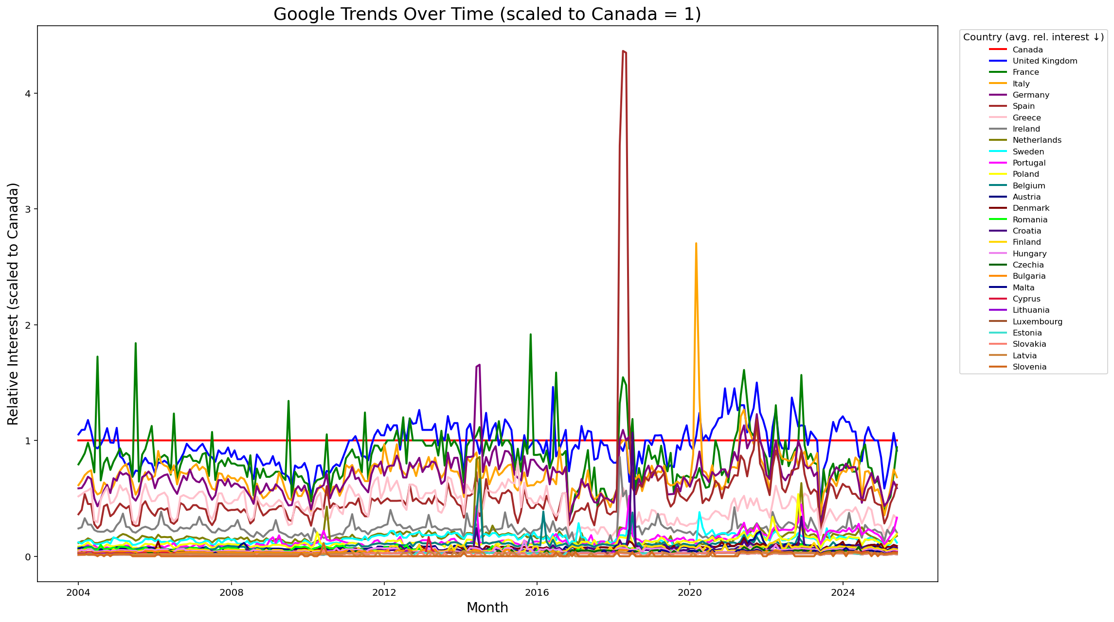

Slide 7
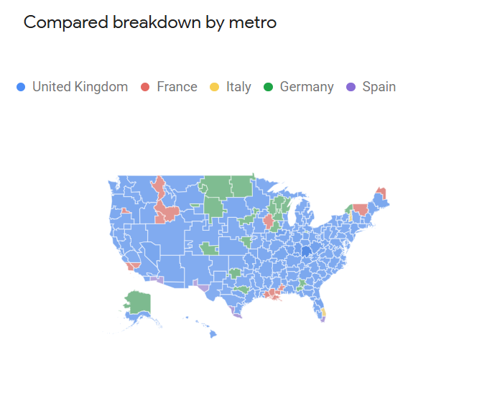

Slide 8
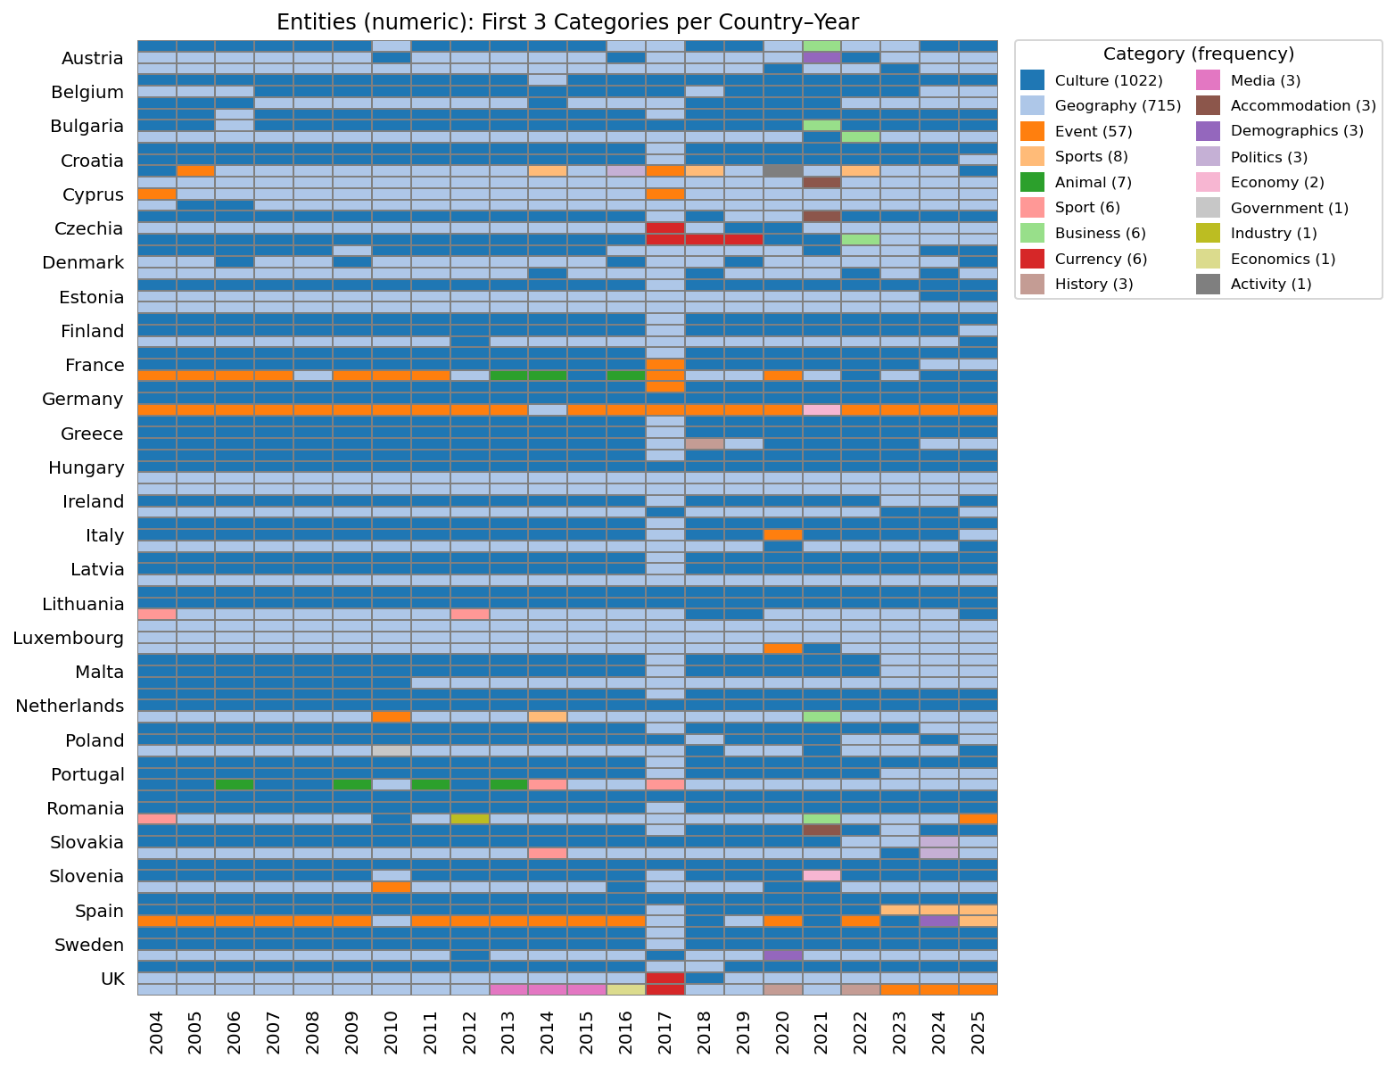

Slide 9
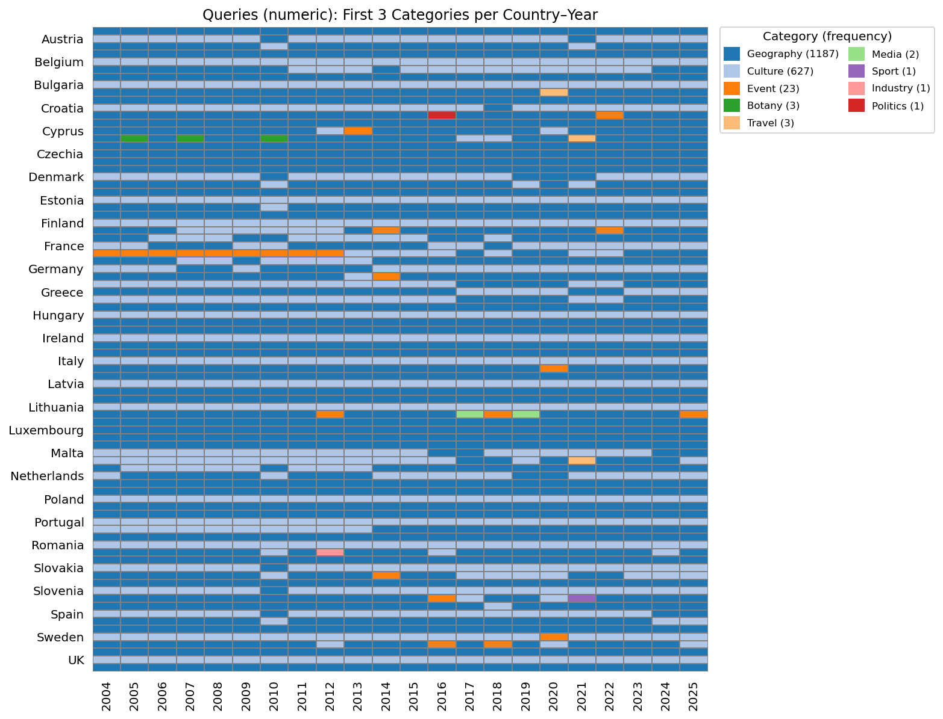

Slide 10
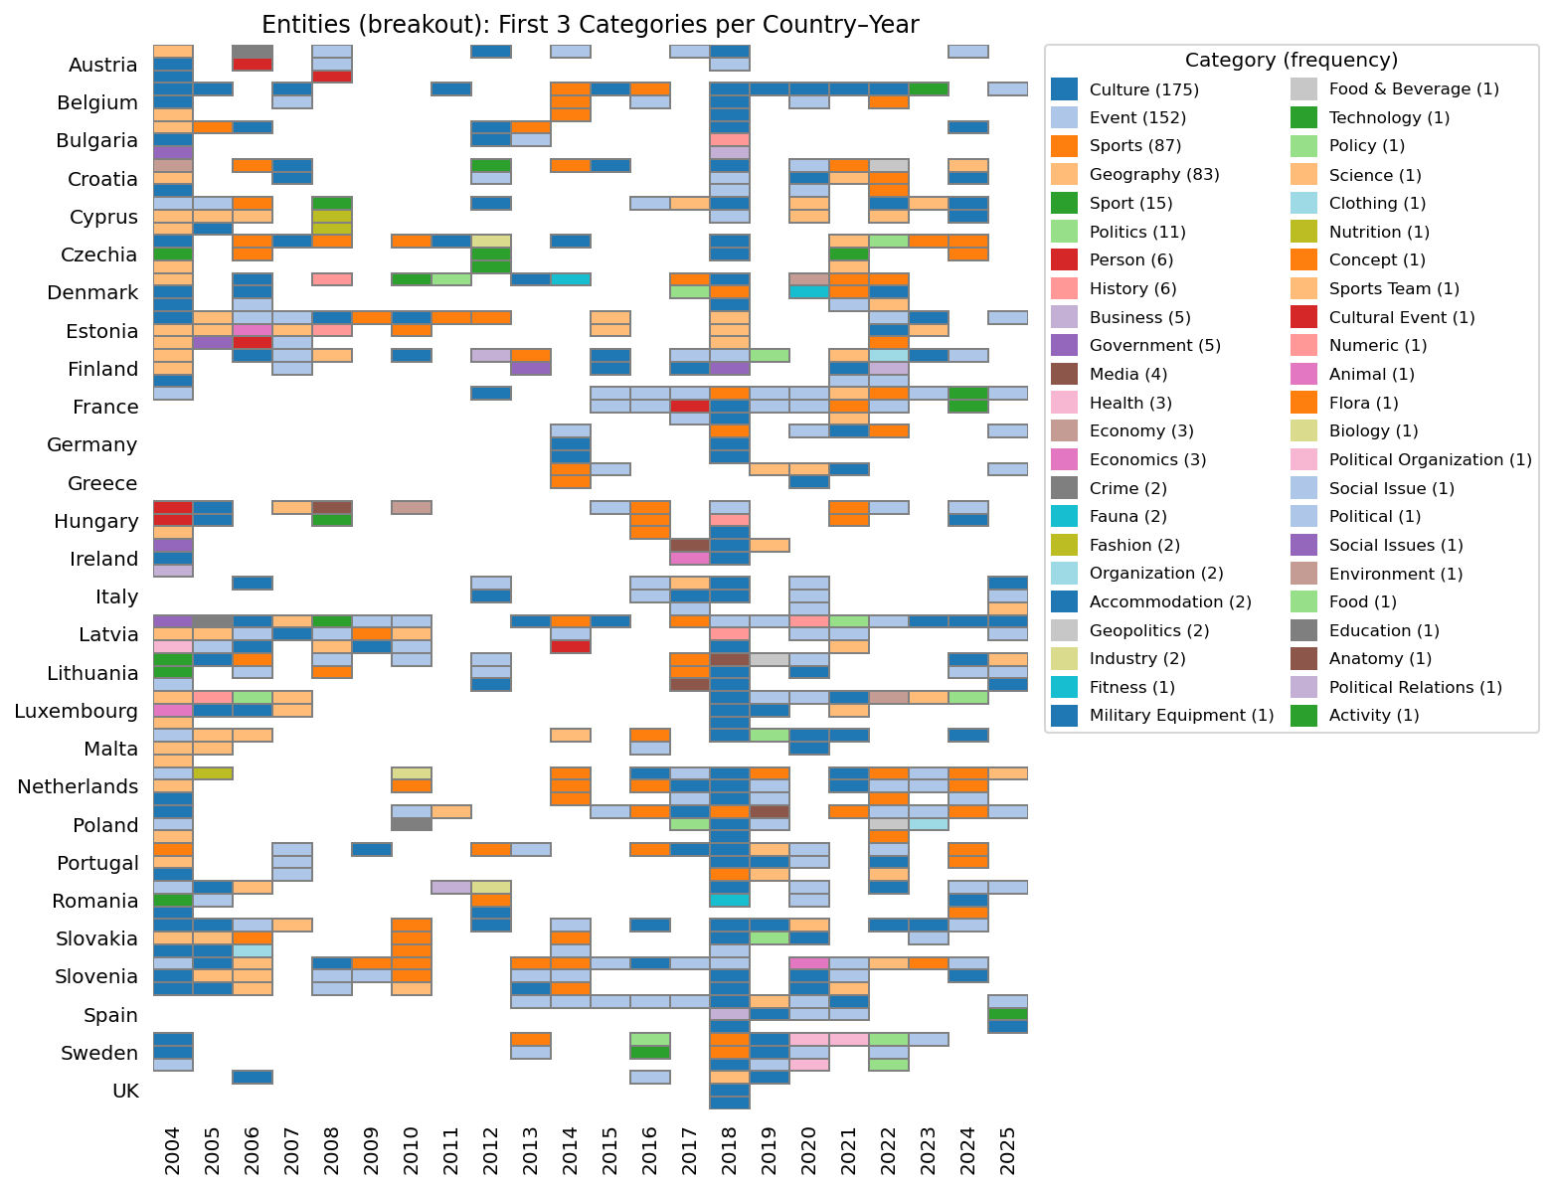

Slide 11
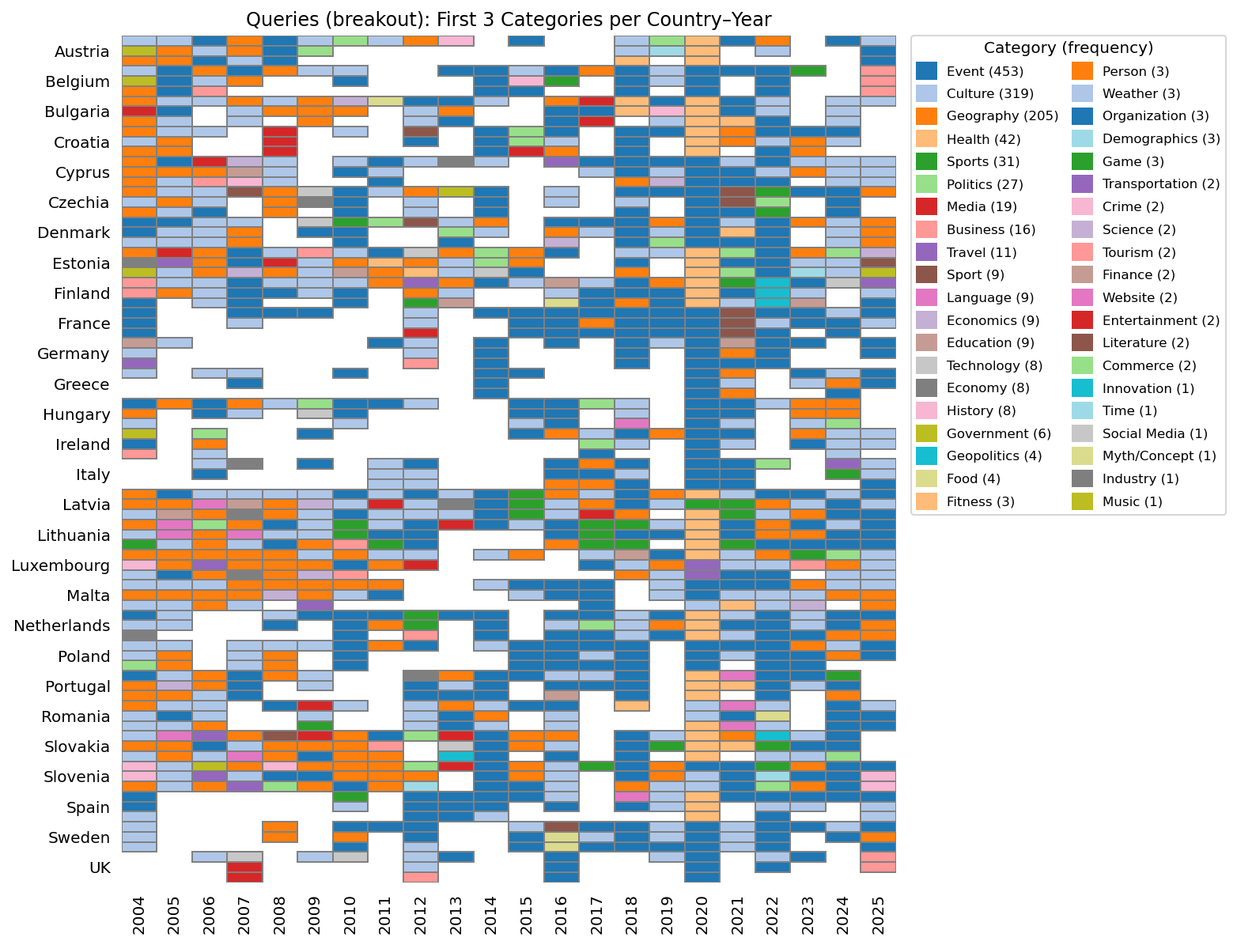

Slide 12
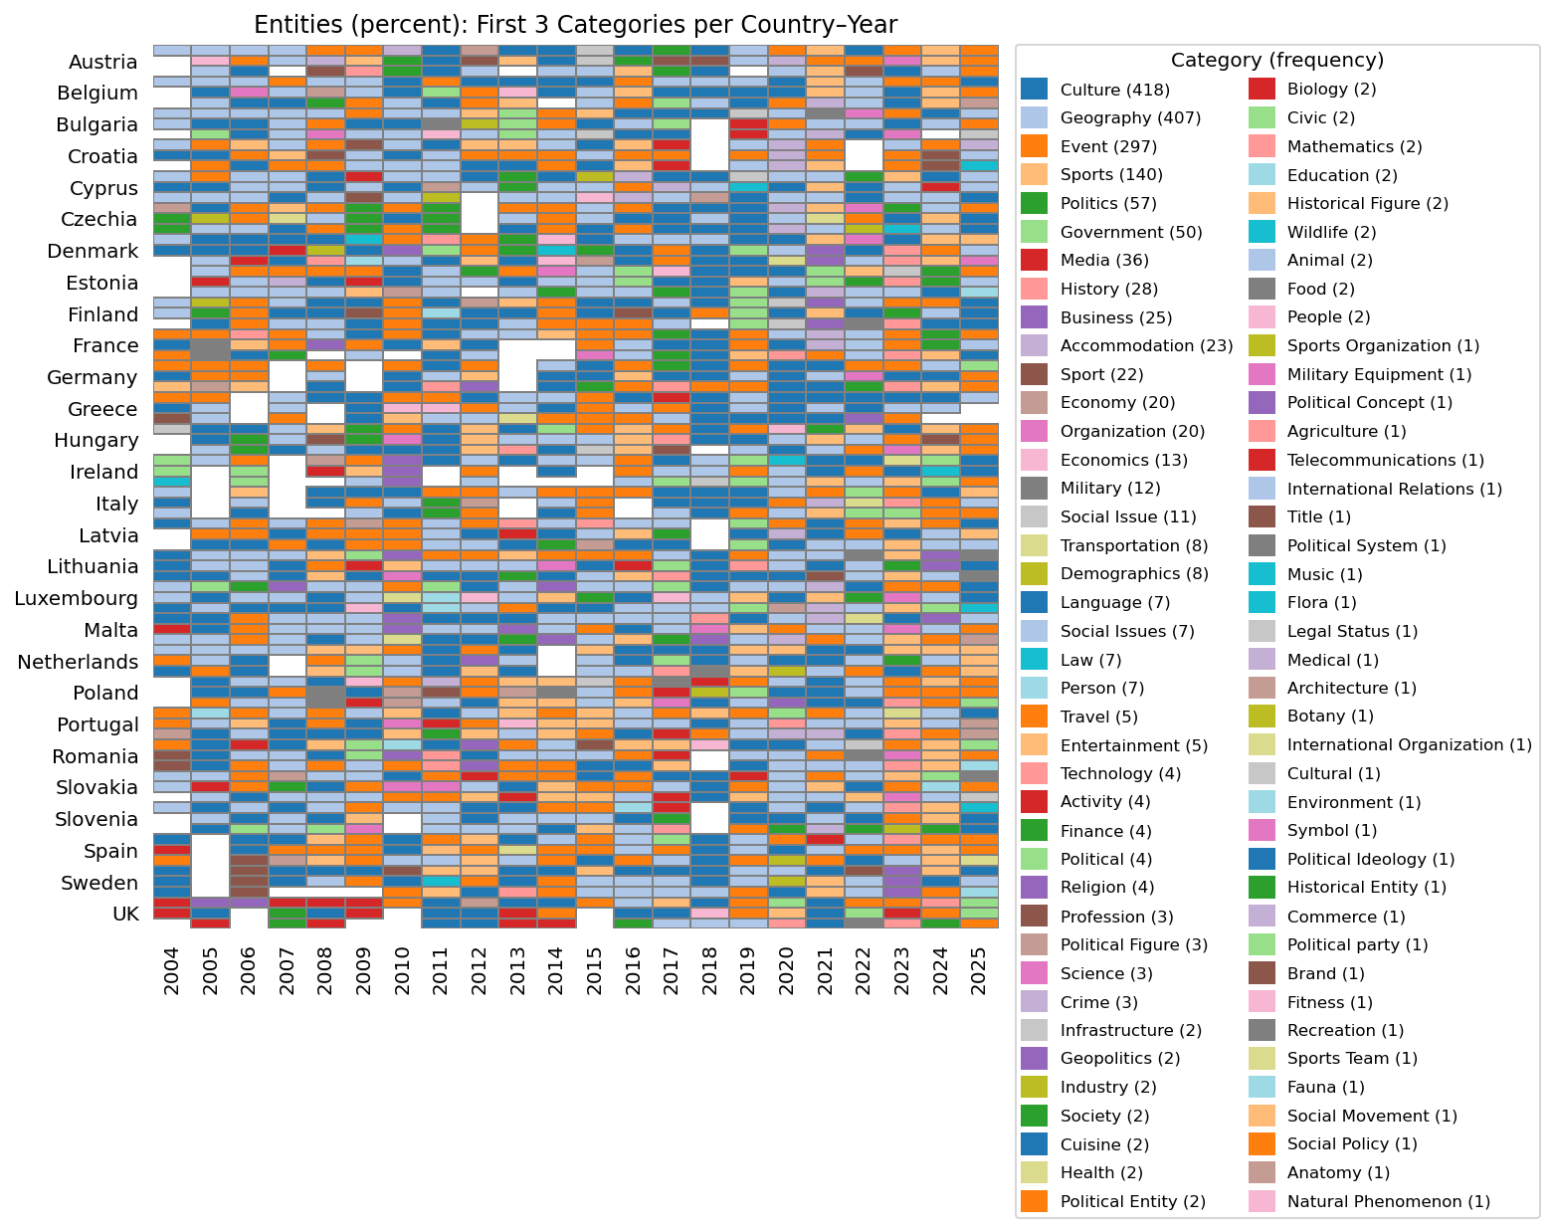

Slide 13
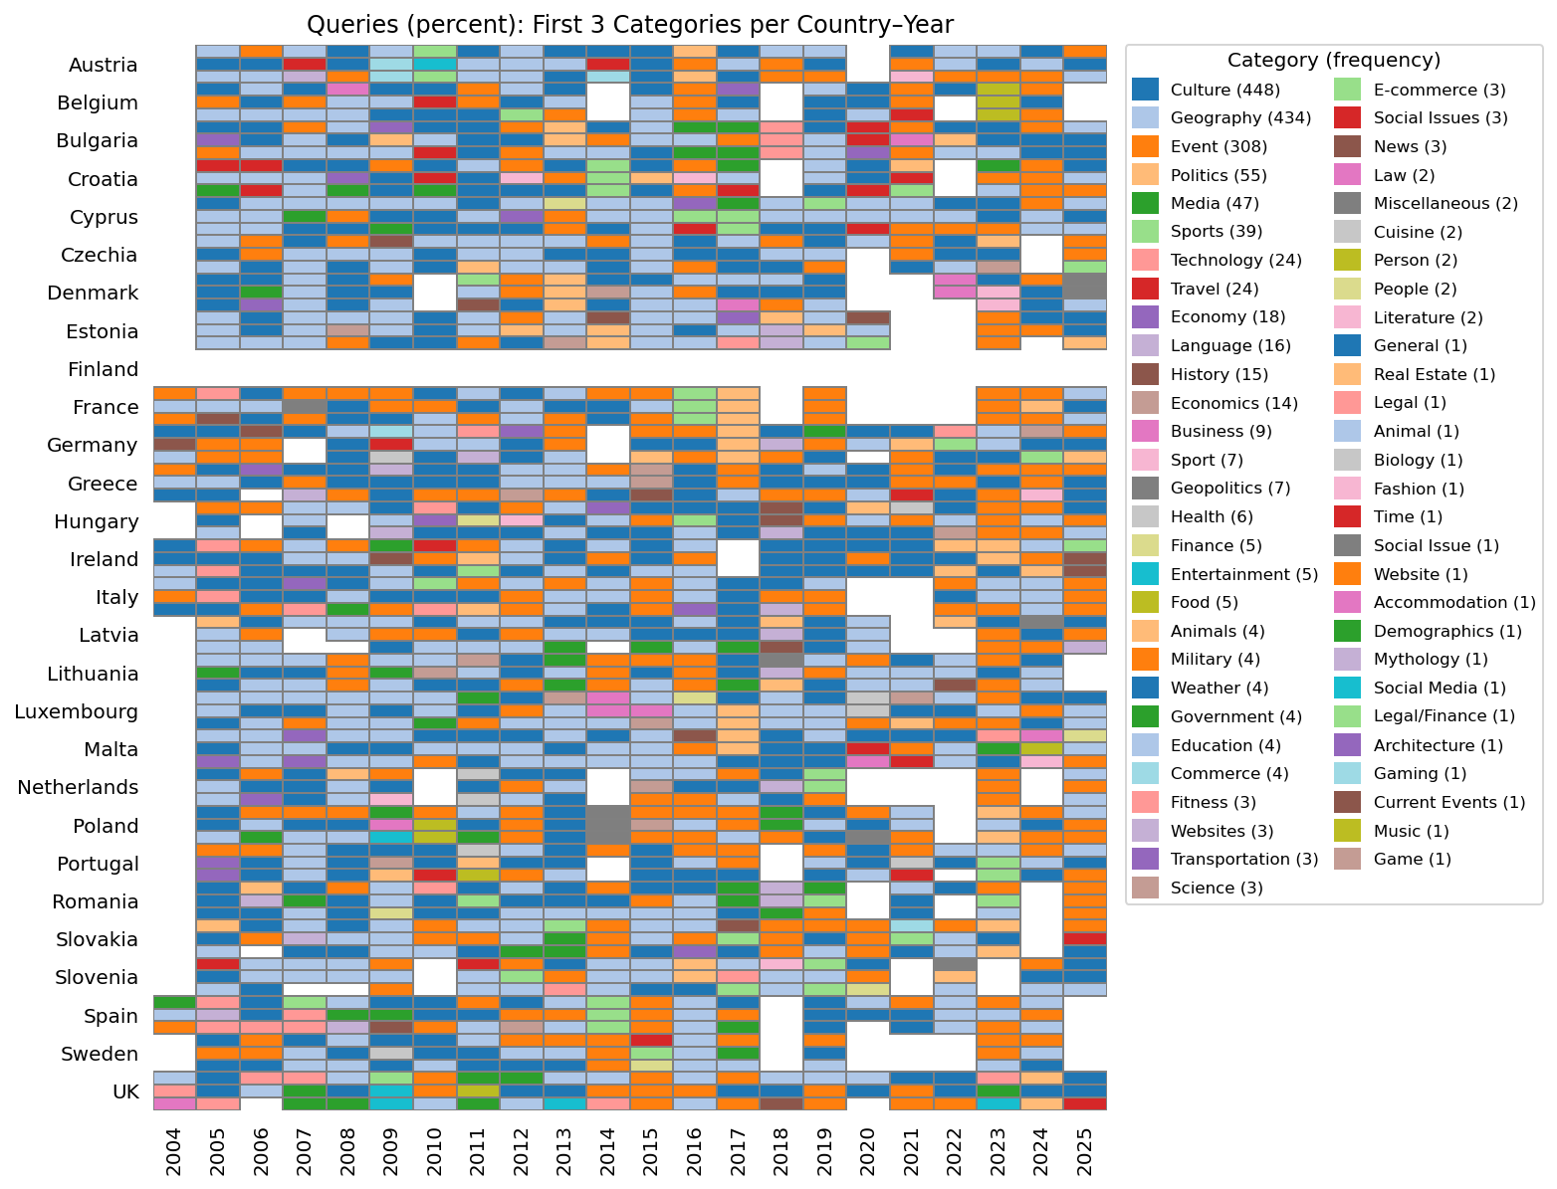

Slide 15
USA interest in Austria encompasses a wide range of topics, with a significant focus on its capital, Vienna, and notable cities like Salzburg. Queries often include geographical and cultural aspects, such as maps, tourism, and comparisons with neighboring countries like Germany and Italy. Additionally, searches related to COVID-19 and the German language highlight contemporary concerns and cultural connections.
USA searches related to the UK reveal a strong interest in various aspects of British culture, governance, and geography. Key entities include the British royal family, major news outlets like the BBC and The Guardian, and significant historical references such as the British Empire. Popular queries often focus on specific locations like London and England, as well as current events like COVID-19 in the UK, indicating a blend of cultural curiosity and practical information-seeking.
USA interest in Portugal has been marked by a focus on its cultural and geographical aspects, with significant searches related to cities like Lisbon and Porto, as well as the Portuguese language and cuisine. The 2018 World Cup and comparisons with neighboring Spain also drew attention, alongside queries about travel, weather, and visa information. Additionally, the popularity of the Portuguese Water Dog reflects interest in the country's unique dog breed.
USA interest in Germany encompasses a wide range of topics, prominently including its capital, Berlin, and major cities like Munich and Frankfurt. The country is frequently associated with its national football team and historic events such as World War I and World War II. Queries reflect a curiosity about the German language, culture, and geography, alongside significant sporting events like the World Cup, particularly in relation to Brazil. Overall, Germany's cultural, historical, and sporting significance resonates strongly with American search interests.

Slide 16
Portugal over years
Consistent themes: Throughout the years, certain themes remained consistently popular, including interest in Portuguese culture, geography, the capital city Lisbon, and the Portuguese Water Dog. The connection to Spain and Brazil also persisted as a recurring topic.
Cultural and linguistic focus: Interest in Portuguese culture and language has been a constant, but it appears to have gained more prominence over the years, especially in the later years (2010-2025). Searches increasingly reflect a curiosity about Portuguese cuisine, travel opportunities, and the Portuguese national football team.
Travel interest: There is a noticeable increase in travel-related queries from around 2019 onward. This shift indicates a growing interest in Portugal as a travel destination, with specific inquiries about travel logistics, weather, and tourism-related topics becoming more prevalent in 2020 to 2025.
Impact of sports: The prominence of the Portuguese national football team was particularly highlighted during years of major tournaments, such as 2014 (World Cup) and 2018, reflecting how international sporting events can spike interest in the country. This sports-related interest appears to be more pronounced in the later years compared to the earlier ones.
Comparative interest: The comparisons with Spain have been a consistent feature, but the frequency and context of these comparisons seem to have evolved. While earlier years (2004-2010) focused more on general regional curiosity, later years (2012-2025) often contextualize these comparisons within travel and cultural exploration.
Geographical focus: The focus on specific cities, particularly Lisbon and Porto, became more pronounced in the latter years (2017 onward), indicating a shift towards a more detailed exploration of urban centers rather than just the country as a whole.
Emerging trends: By 2020 and beyond, there is a notable increase in practical inquiries related to travel logistics, reflecting a response to global events such as the COVID-19 pandemic. This suggests that search behavior adapted to include more practical considerations for potential travelers.

Slide 17
Country comparison (I/II)
Cultural vs. geographical focus
Cultural interests: Countries like Italy, Spain, and Greece show a strong emphasis on cultural aspects, including cuisine, historical landmarks, and national identities. For example, searches for Italy often revolve around major cities and culinary traditions, while Greece is heavily associated with its mythology and ancient history.
Geographical interests: Countries like Austria, Bulgaria, and Slovakia reflect a more pronounced interest in geographical context, with searches frequently including maps and inquiries about their locations within Europe.
Historical context
Historical events: Countries like Germany, Poland, and Romania have a significant focus on historical events, particularly related to World War II. Searches often include references to specific historical events, such as the Invasion of Poland or the impact of the war on these nations.
Cultural heritage: In contrast, countries like Portugal and Malta emphasize their cultural symbols (e.g., the Portuguese Water Dog, the Maltese cross) and tourism, indicating a focus on contemporary cultural identity rather than historical events.
Sports influence
Sports as a cultural connector: Countries like Spain, Italy, and Lithuania prominently feature sports, particularly football (soccer) and basketball. The interest in national teams and major sporting events (e.g., FIFA World Cup) reflects how sports can enhance cultural identity and international interest.
Less emphasis on sports: Conversely, countries like Austria and Bulgaria mention skiing and winter sports, but do not exhibit the same level of sports-related searches as seen in Mediterranean countries.

Slide 18
Country comparison (II/II)
Regional context
Neighboring countries: Many countries, such as Hungary, Slovakia, and Romania, show a clear interest in their neighboring countries, indicating a regional curiosity that influences search behavior. For instance, searches for Slovakia often include comparisons with Czechia and Hungary.
Isolation in searches: In contrast, countries like Austria and Belgium maintain a more standalone focus, with less emphasis on their neighbors.
Language and identity
Language searches: Countries like Sweden, Finland, and Estonia show significant interest in their languages, with searches often including terms like Swedish, Finnish, and Estonian.
Cultural symbols: Countries such as Malta and Portugal exhibit a fascination with cultural symbols and heritage (e.g., the Maltese cross, Portuguese cuisine), indicating a focus on national identity rather than linguistic aspects.
Current events and geopolitical context
Geopolitical awareness: Recent years show a heightened interest in geopolitical contexts, particularly for countries like Ukraine, Poland, and the Baltic states due to ongoing conflicts and historical tensions with Russia. This reflects a contemporary awareness influencing search behavior.
Less political focus: In contrast, countries like Italy and Spain maintain a more cultural and historical focus, with fewer searches related to current political events.

Slide 19
European search for the US

Slide 20
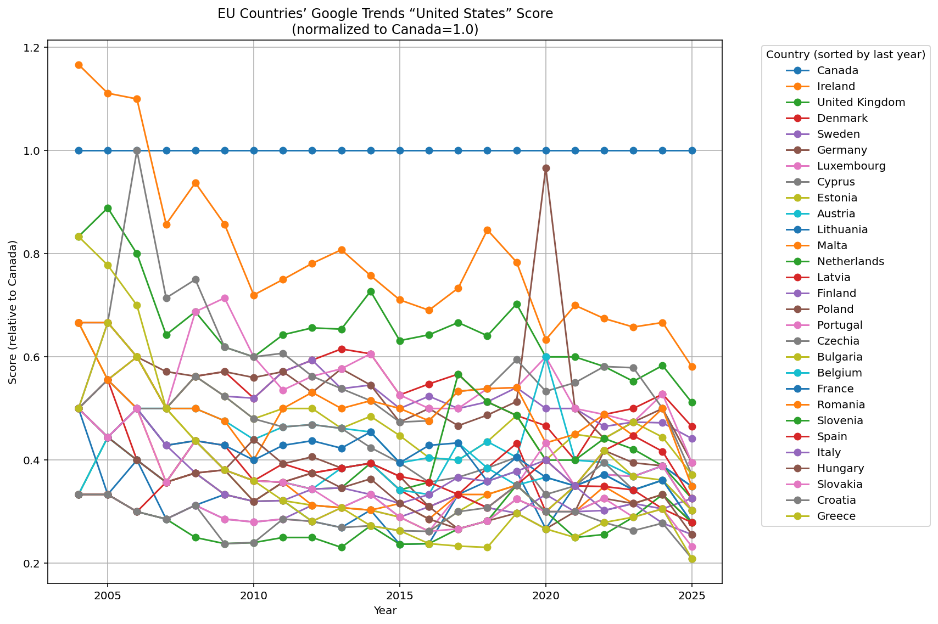

Slide 21
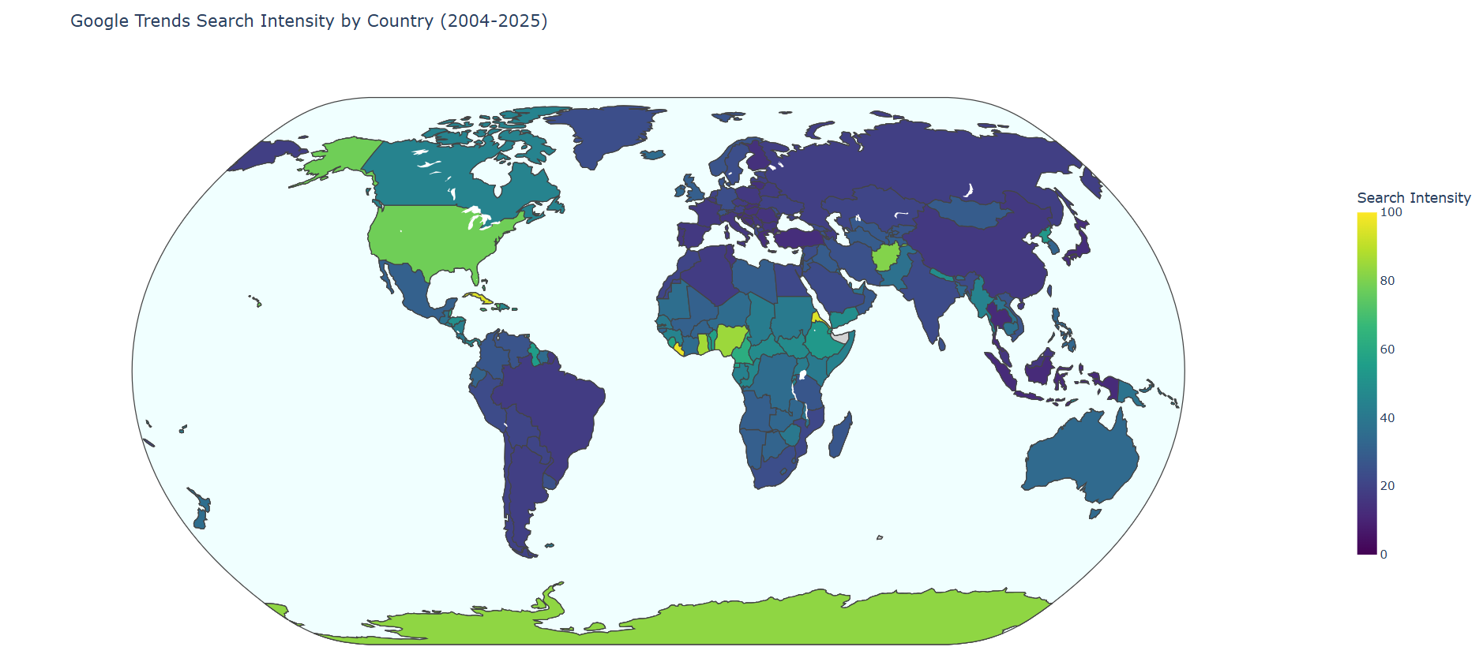

Slide 22
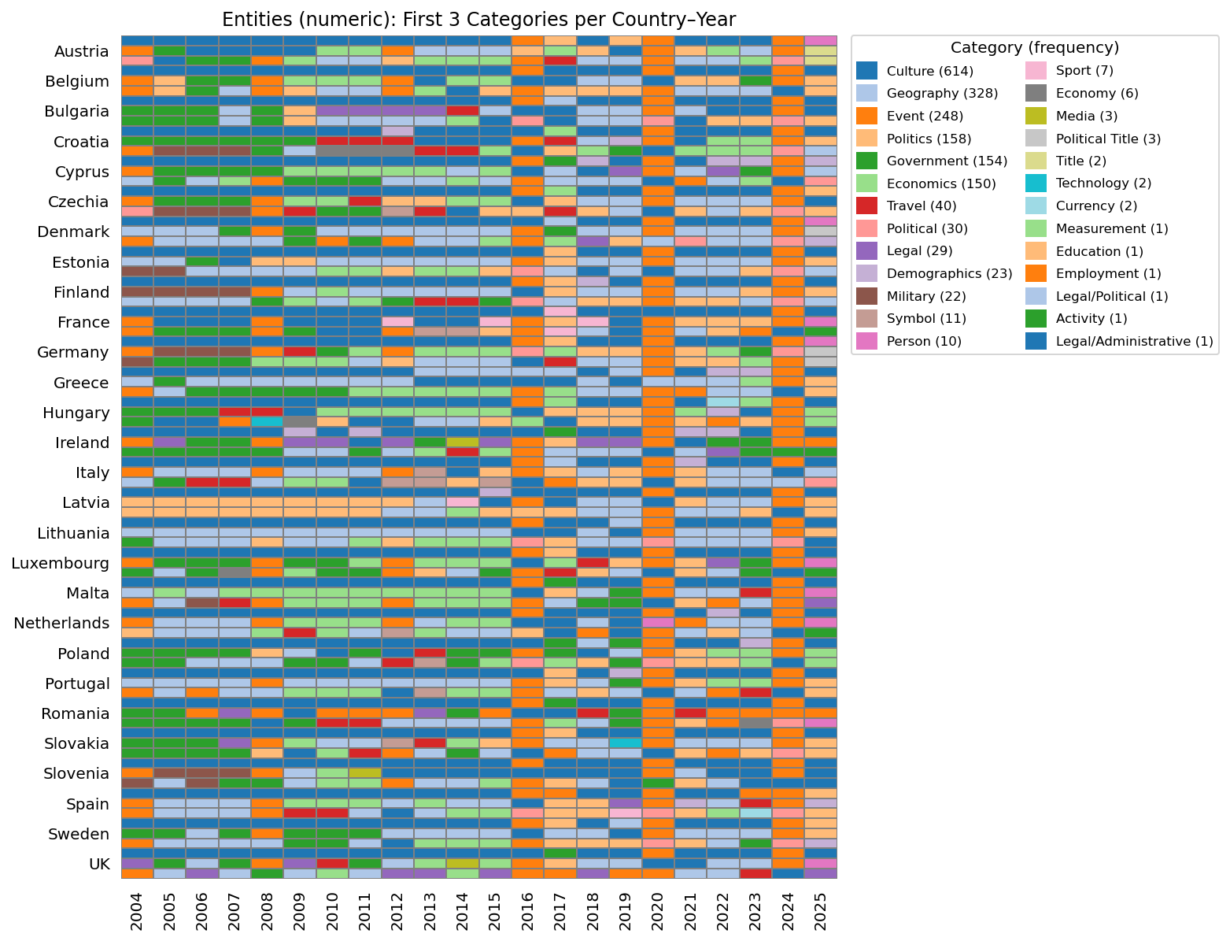

Slide 23
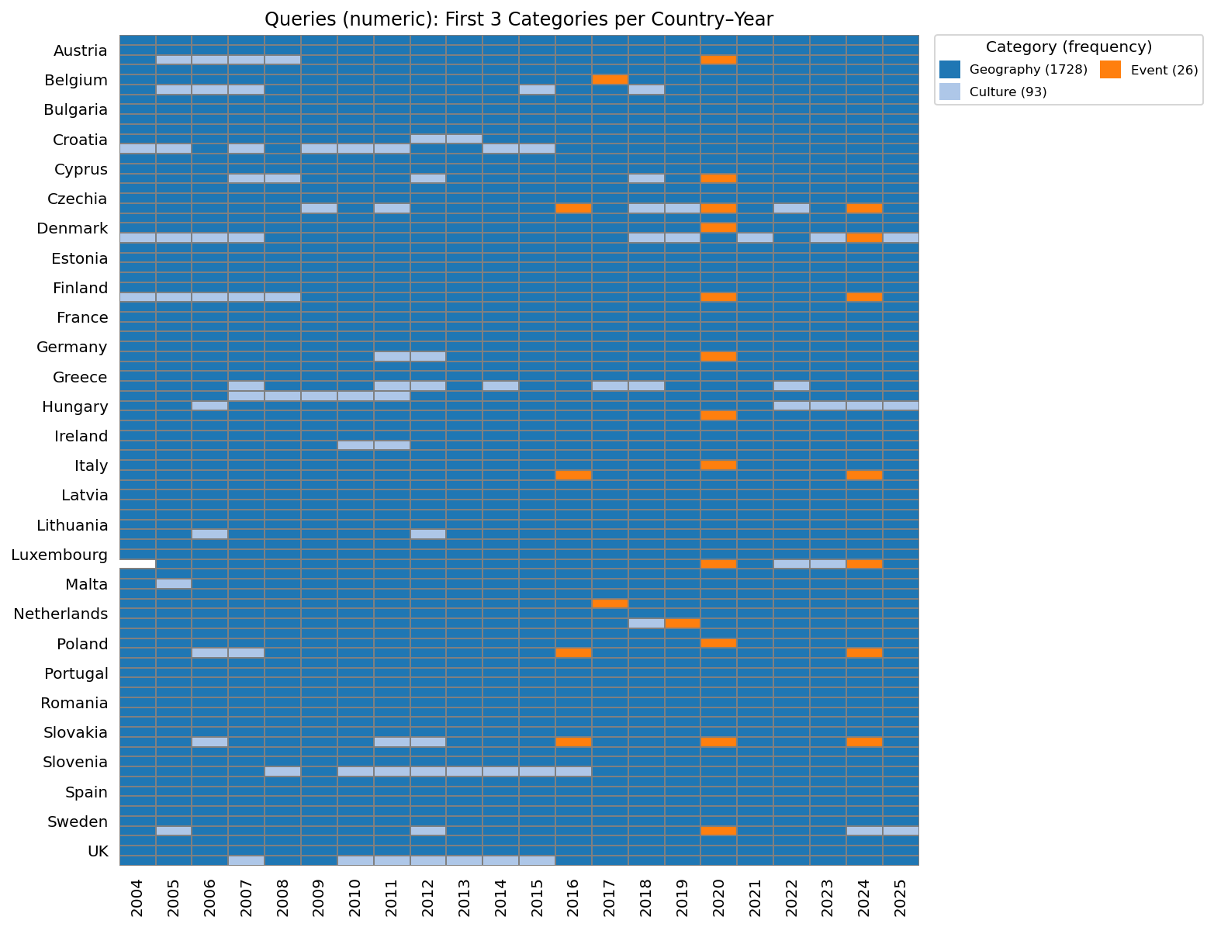

Slide 24
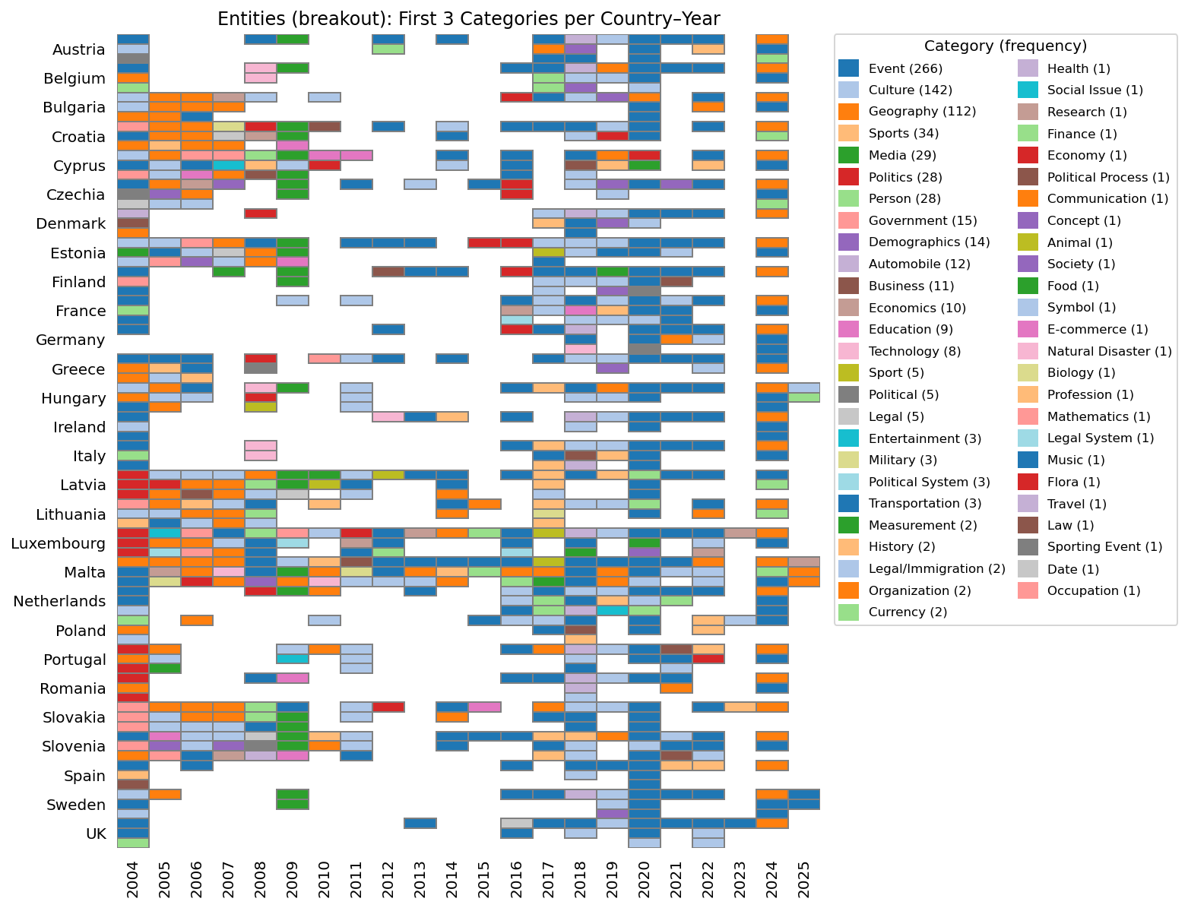

Slide 25
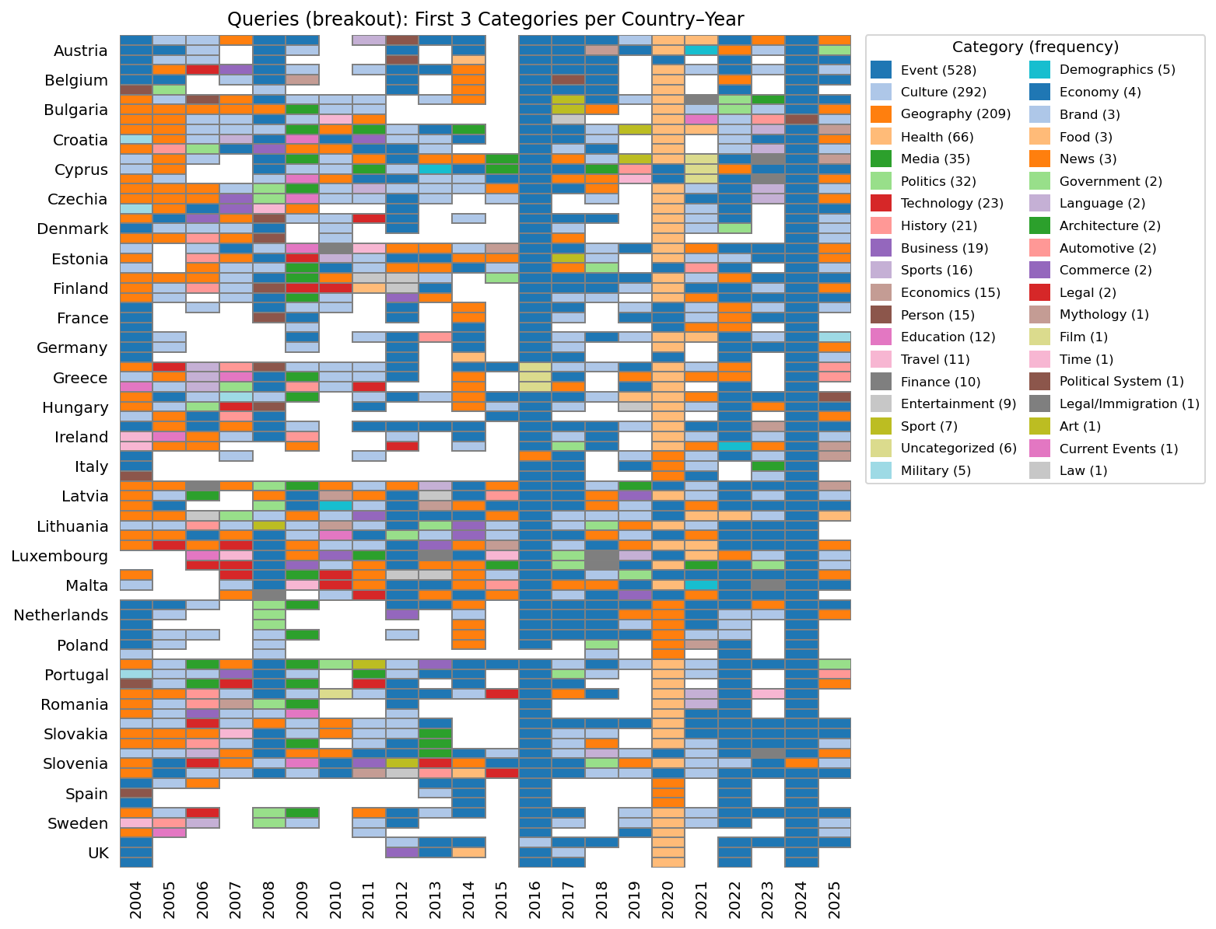

Slide 26
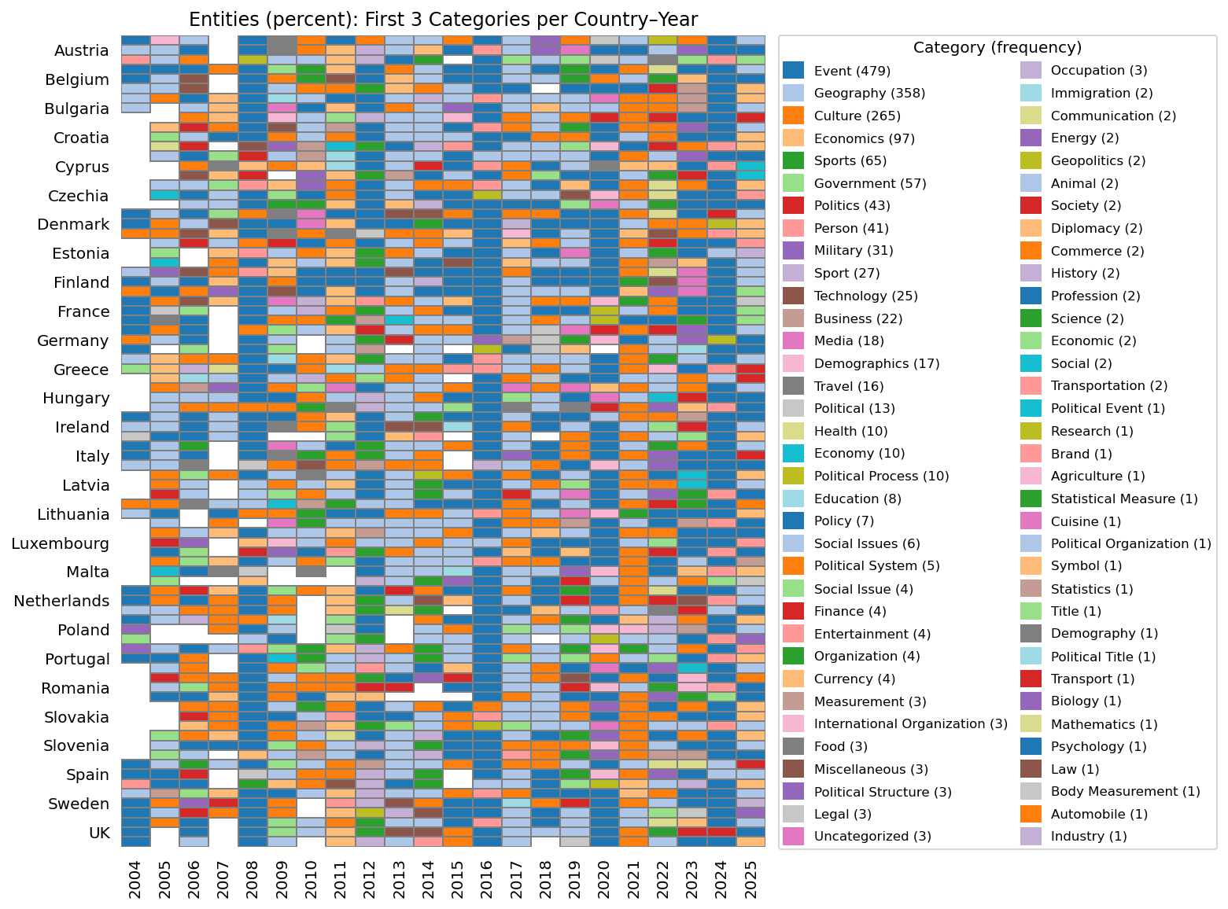

Slide 27
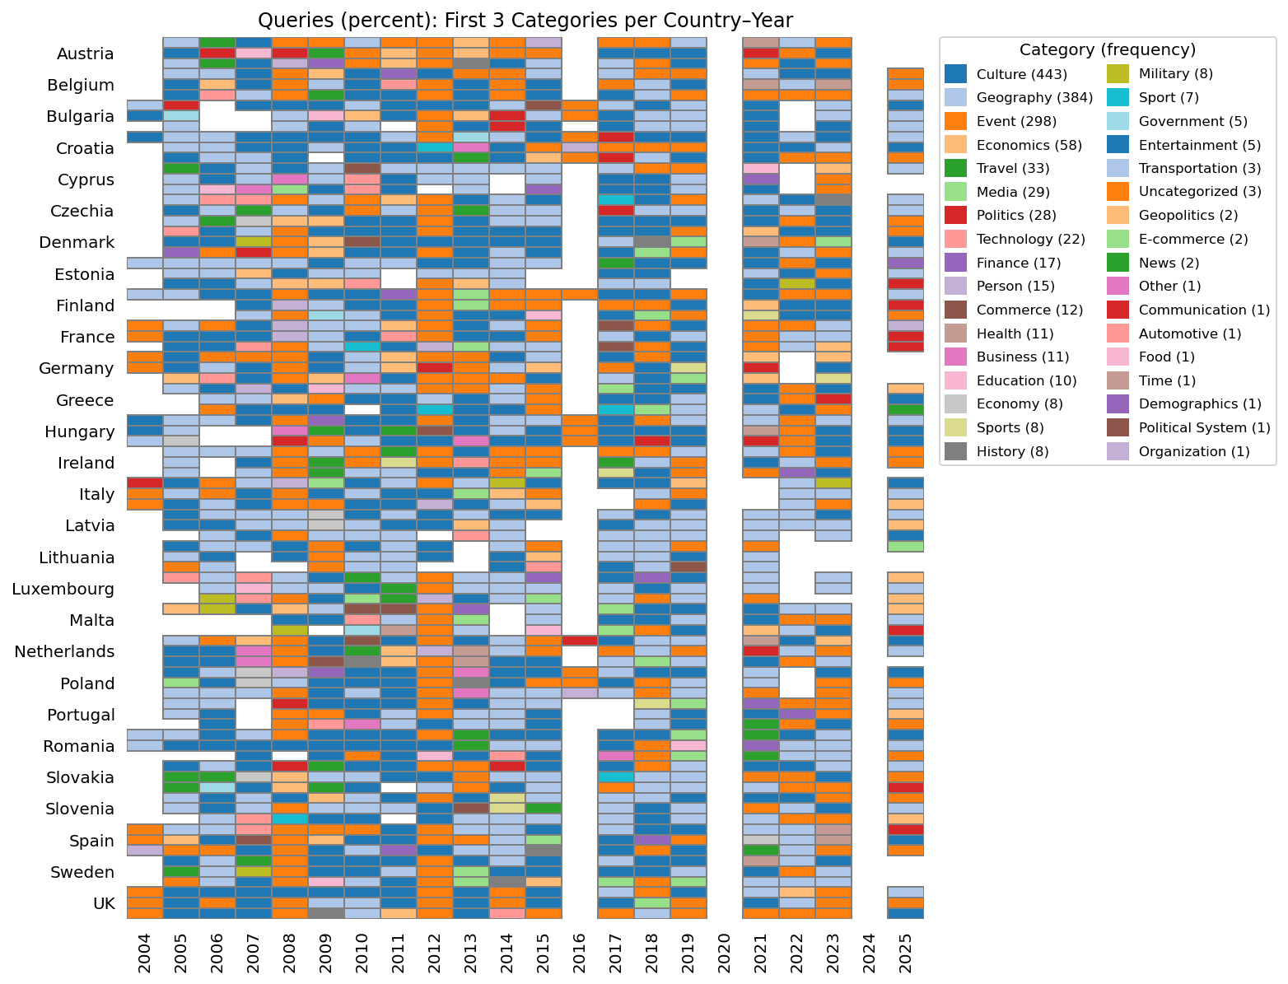

Slide 29
Austria's interest in the USA spans a variety of topics, prominently featuring political events such as the presidential elections, particularly the 2020 and 2024 elections, and figures like Donald Trump. Economic concerns are reflected in queries about the U.S. dollar and tariffs, while cultural interests include American sports, particularly through ESPN. Additionally, there is a significant focus on international relations, with searches related to countries like China, Iran, and North Korea, as well as health issues such as COVID-19.
The UK's interest in the USA spans a variety of topics, prominently featuring political events such as the 2016 and 2024 United States elections. Popular cultural references include American football and Netflix, while practical concerns revolve around travel, visas, and the economy, particularly the US dollar. Queries often reflect a desire for geographical information and current news related to the USA, indicating a broad engagement with American society and politics.
Portugal's interest in the USA encompasses a range of topics, prominently including the political landscape, particularly the presidential elections, with significant searches related to the 2024 and 2016 elections. Other notable entities include cultural references to Americans and American life, as well as geographical queries about the United States and its states. Additionally, there is a keen interest in international relations, as seen through searches related to the U.S. Embassy and diplomatic ties.
Germany's interest in the USA spans a variety of topics, prominently featuring political events such as the presidential elections, particularly the 2024, 2016, and 2020 elections. Economic concerns are also significant, with searches related to the U.S. dollar and tariffs, alongside cultural interests like American football and poker. Additionally, queries reflect a focus on international relations, notably with China, Iran, and North Korea, as well as practical matters such as travel visas and entry requirements.

Slide 30
Similarities across countries
Political focus
Presidential elections: Virtually all countries show strong interest in US presidential elections, especially the 2024 election and past elections (notably 2016 and 2020). Donald Trump is the most commonly mentioned political figure, with Joe Biden occasionally highlighted.
Broader political landscape: Many countries are interested in US domestic politics, including governance, policy changes, and political controversies.
Cultural curiosity
American sports: There’s broad engagement with American sports, especially basketball (Belgium, Croatia, Slovenia), American football (France, Hungary, Luxembourg, Ireland, UK), and high-profile athletes (Conor McGregor, Floyd Mayweather Jr.).
Entertainment: Reality TV (e.g., "America’s Next Top Model" in Estonia and the Netherlands), American movies, actors, and music are common cultural touchpoints.
Cuisine: Several countries (Denmark, Bulgaria) search for American food or culinary traditions.
Travel and practical concerns
Visas and embassies: Almost every country has practical queries about US visas, embassies, travel requirements, and airline tickets.
Currency and economy: The US dollar is a frequent topic, with searches about exchange rates and economic trends.
International relations and security
Geopolitics: Many countries (Austria, Germany, Italy, Spain, Greece) show interest in America’s relations with major global powers like China, Russia, Iran, and North Korea.
Military: Some countries (Croatia, Slovenia) mention US military presence or engagement.
COVID-19 and health
The COVID-19 pandemic features in searches, reflecting interest in the US response or impact (Finland, Denmark, France, Ireland).
Geography and demographics
Many are interested in the geography of the US like maps, states, cities (Estonia, Czechia, Latvia, Greece, Spain).

Slide 31
Differences across countries
Specific cultural interests
Unique sports or figures:
Belgium, Latvia, Lithuania, Slovenia, Netherlands focus more on specific sports celebrities (McGregor, Mayweather).
Romania is interested in American high school experiences and the “American Dream”.
Food and lifestyle: Some countries are more curious about American cuisine (Denmark, Bulgaria) or lifestyle.
Economic focus
Some countries (Austria, Germany, Luxembourg, Malta) show heightened interest in the US economy, tariffs, and inflation, sometimes more than cultural or political aspects.
Education and work
Cyprus searches for US universities and educational opportunities.
Lithuania and Romania look for job opportunities in the US.
Social issues and laws
Sweden stands out for interest in US social issues, like abortion, in addition to politics.
France and Italy show special interest in comparisons between their country and the US.
Geographical proximity & diaspora
Ireland shows a particular curiosity about American cities with strong Irish ties, like Boston and New York.
Portugal and Spain focus on the US’s global role and diplomatic ties.
Regional differences in focus
Central and Eastern Europe (Bulgaria, Hungary, Slovakia, Romania, Poland): A bit more focused on practical engagement (visas, jobs, American cars) and US-Russia relations.
Nordic countries (Finland, Sweden, Denmark): Broader coverage including politics, social issues, and American sports, often mentioning US relations with other Nordic countries (Finland-Canada).

Slide 32
Conclusions and implications
Understanding public interest: Mapping search trends helps identify what captivates audiences on both sides of the Atlantic, revealing shared interests and unique national priorities.
Informing policy and diplomacy: Insights can guide policymakers in addressing public concerns, targeting cultural diplomacy, and enhancing transatlantic cooperation.
Soft power & cultural exchange: Highlighting the importance of culture and events demonstrates potential for soft power initiatives and mutual understanding.

Slide 33
Thank you!

