Slide 1
Citizen science and Earth Observation Data for “Rescuing” the SDGs
Dilek Fraisl, Linda See, Steffen Fritz, Ian McCallum
Dr. Dilek Fraisl
Senior Research Scholar l International Institute for Applied Systems Analysis (IIASA)
Managing Director l Citizen Science Global Partnership (CSGP)
Email: fraisl@iiasa.ac.at
BlueSky: dilekfraisl.bsky.social
LinkedIn: dilekfraisl
Web: www.iiasa.ac.at l
EGU25, Vienna

Slide 2
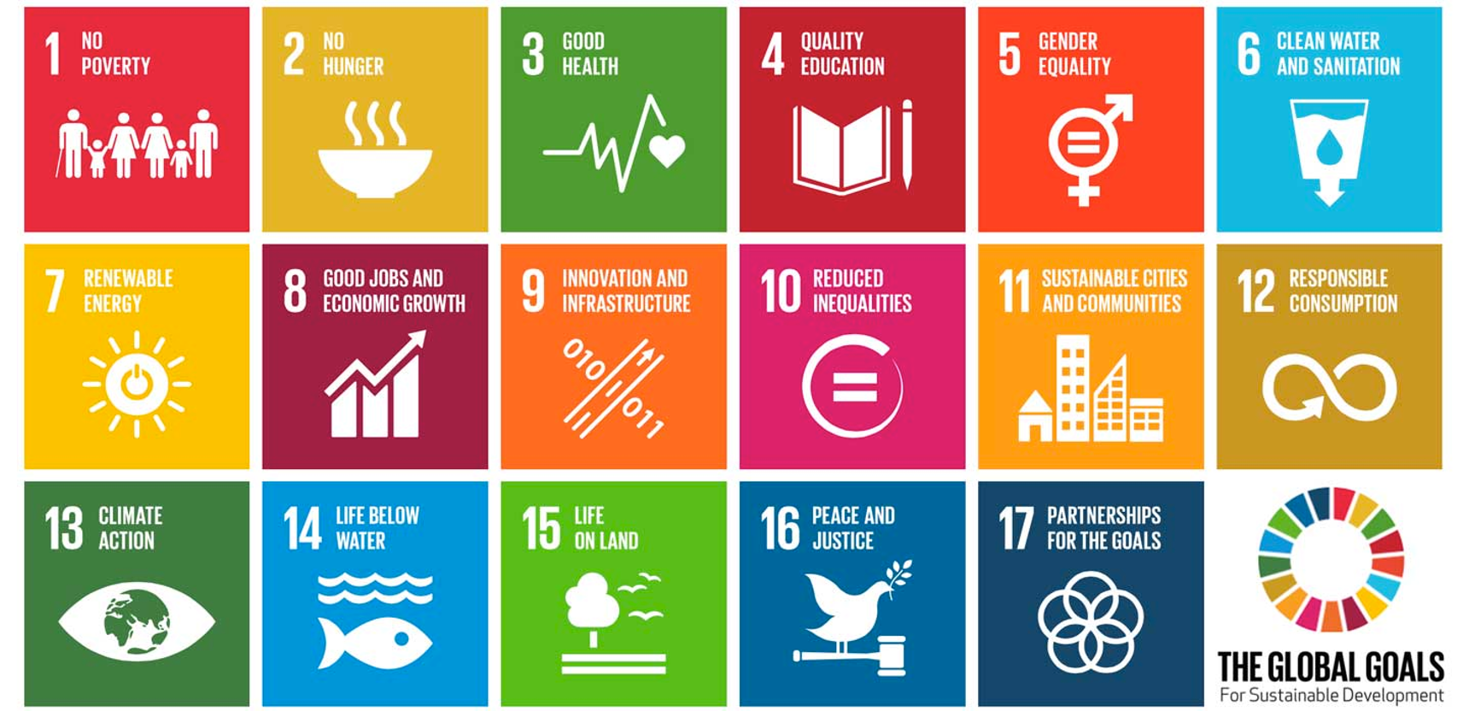

Slide 3
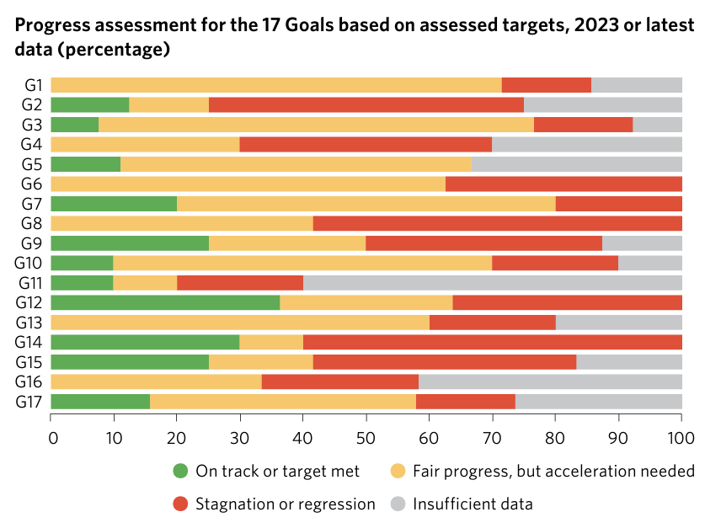
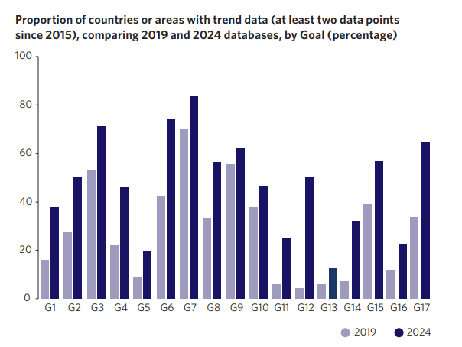
DATA GAPS
Almost half of the 92 environmental SDG indicators lack data
Notes:
The variance in country data coverage plays out differently across the Goals, with major shortfalls in priority development areas, such as gender equality (Goal 5), climate action (Goal 13), and peace, justice and strong institutions (Goal 16). Moreover, data timeliness remains a challenge. Approximately one third of indicators lack data for the past three years, hampering the ability of policymakers to make timely informed decisions and course corrections.

Slide 4
Role of citizen science and participatory approaches in GBF
The GBF Framework is “…a framework for all - for the whole of government and the whole of society. Its success requires political will and recognition at the highest level of government and relies on action and cooperation by all levels of government and by all actors of society”
The GBF Monitoring Framework “…invites Parties and relevant organizations to support community-based monitoring and information systems and citizen science and their contributions to the implementation of the monitoring framework for the Kunming-Montreal Global Biodiversity Framework”
HOW?

Slide 5
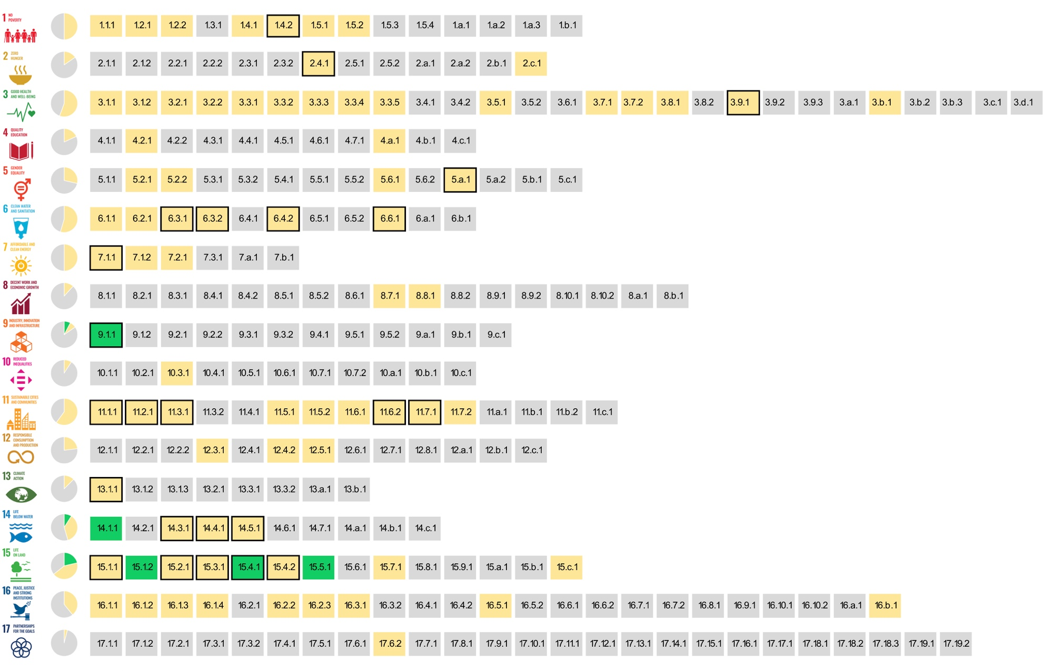
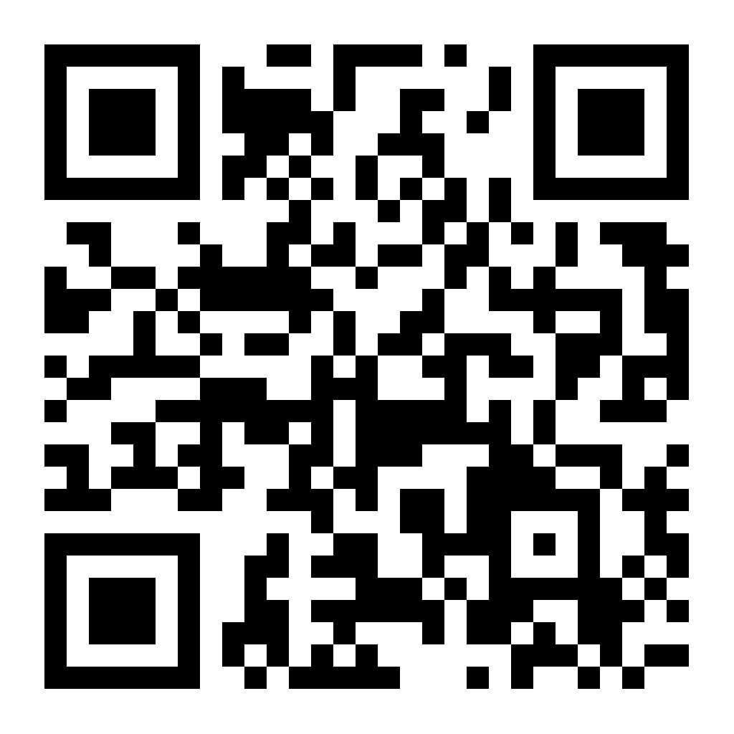
The SDG indicators where citizen science projects are ‘already contributing’, ‘could contribute’ or where there is ‘no alignment'
Fraisl, D., Campbell, J., See, L. et al. Mapping citizen science contributions to the UN sustainable development goals. Sustain Sci 15, 1735–1751 (2020). https://doi.org/10.1007/s11625-020-00833-7
Notes:
Our analysis identified overlap between contributions from citizen science and EO based on the mapping exercise undertaken by GEO (2017) (Fig. 2). Of the 29 indicators identified by GEO (2017), our assessment shows that citizen science could support 24 out of the 29 indicators, which cover 11 of the SDGs. Hence there is potential for citizen science and EO approaches to complement each other.

Slide 6
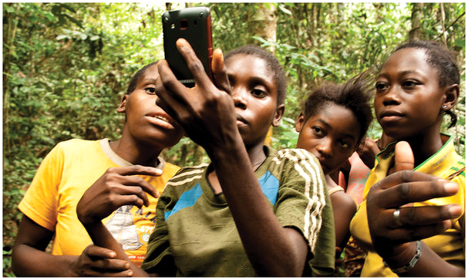
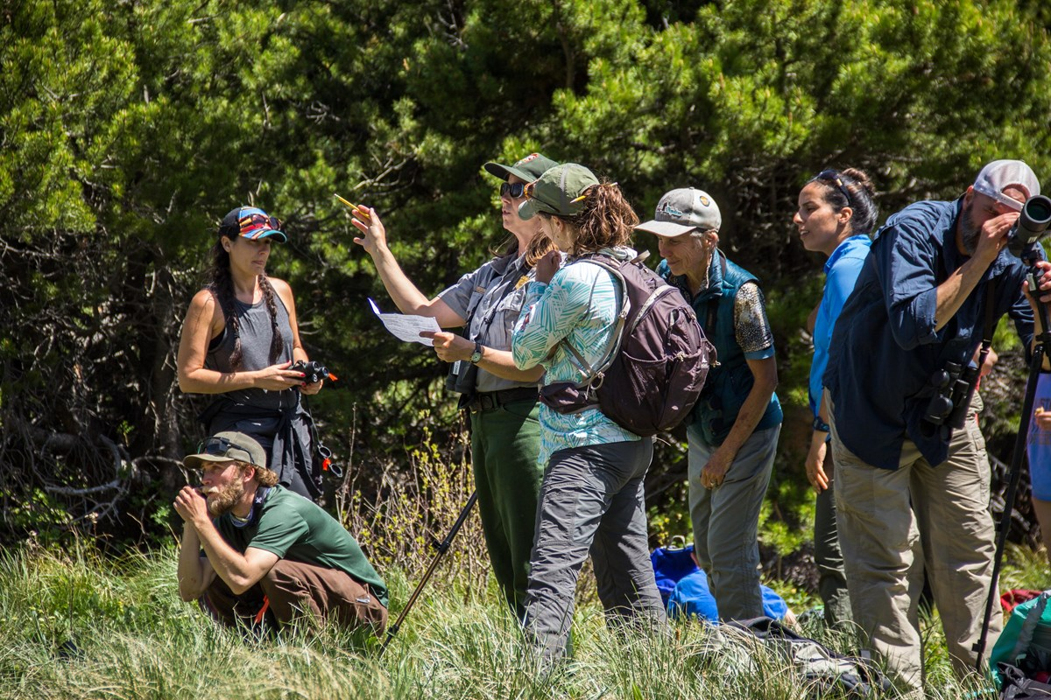



Gill Conquest, EXCITES, UCL
Citizen science
ID 77165835 © James Kirkikis | Dreamstime
Renata Harrison/NPS
Public Participation
Knowledge production
Voluntary contributions

Slide 7
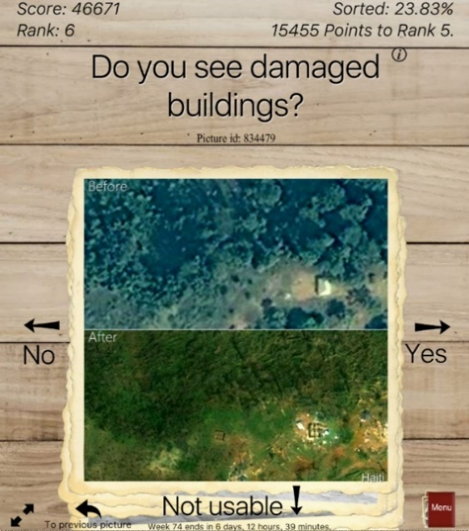
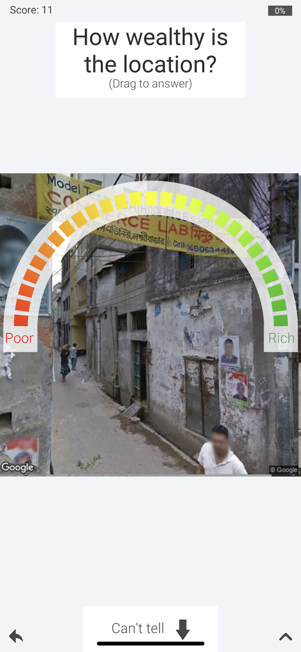
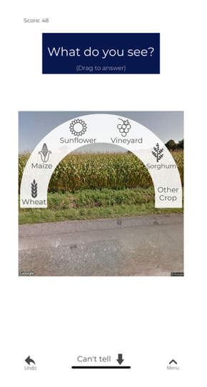
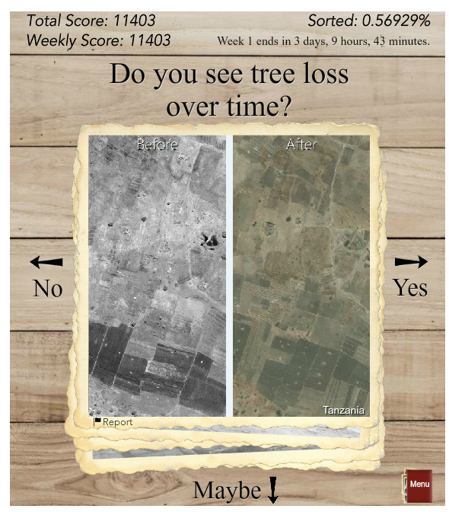
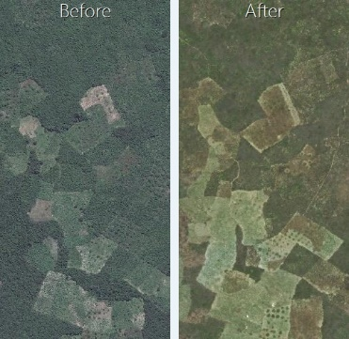
Picture Pile
Pairs of images for change detection
Wilderness, deforestation, building damage assessment
Yes/No/Maybe mechanic
Yes/No/Maybe mechanic modified for categorical and continuous variable data collection
Could contribute to the monitoring of 15 SDG indicators (SDGs 1, 2, 11, 13, 14, 15)
Fraisl D, See L, Sturn T, et al (2022b) Demonstrating the potential of Picture Pile as a citizen science tool for SDG monitoring. Environmental Science & Policy 128:81–93.
https://doi.org/10.1016/j.envsci.2021.10.034

Slide 8
11.7.1 on the built-up area of cities that is open space for public use
Notes:
My final example is the City Oases project for the indicator 11.7.1 on the built-up area of cities that is open space for public use.
Measuring how much public space a city has is only one part of measuring whether people are actually benefiting from it according to the metadata of the indicator. This is where CS approaches could come in to complement remote sensing, as it could help collect additional information on the perception of these open public spaces. Btw, satellite imagery is the data source suggested in the methodology of this indicator. City Oases aims to improve the database of open urban spaces and their usage in Vienna (initially)! The app looks like on the slide (which is in German now). The users could add new spaces to the app, upload photos, rate this open space and answer questions on how safe they find this public space or whether it was clean and some other questions. The project is a partnership between IIASA, University of Natural Resources and Life Sciences Vienna and City of Vienna. So City of Vienna plans to use of the results of the project to improve its database in open public spaces and identify people’s perceptions on these spaces.

Slide 9
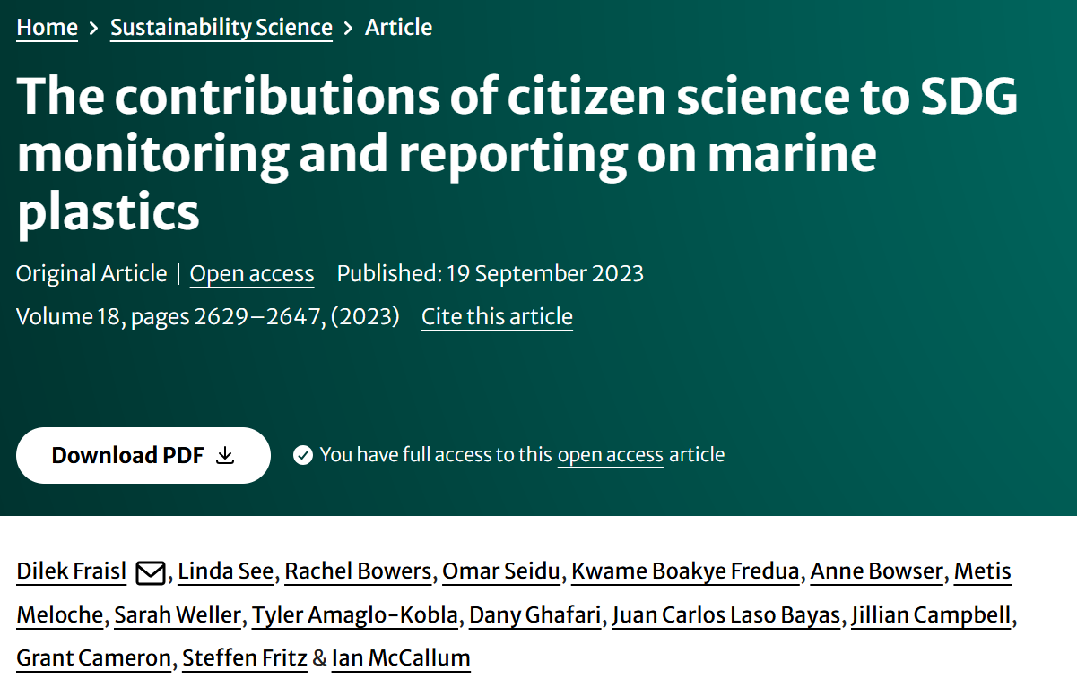
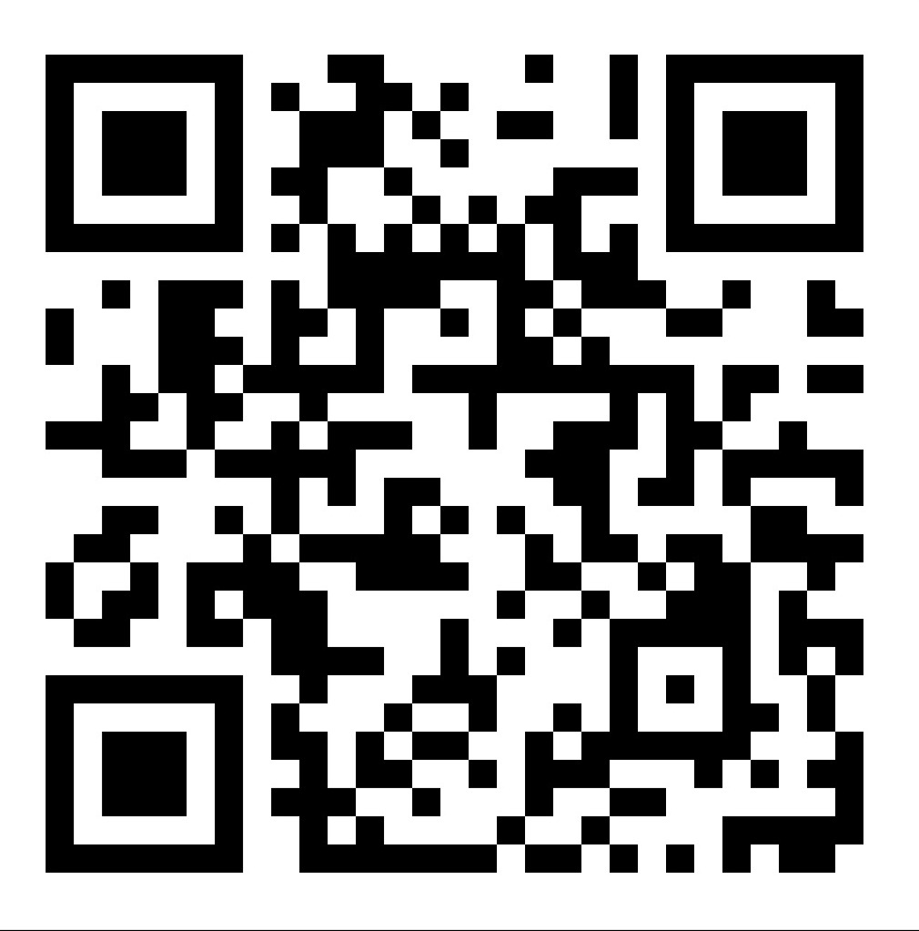
Fraisl, D., See, L., Bowers, R. et al. The contributions of citizen science to SDG monitoring and reporting on marine plastics. Sustain Sci 18, 2629–2647 (2023). https://doi.org/10.1007/s11625-023-01402-4

Slide 10
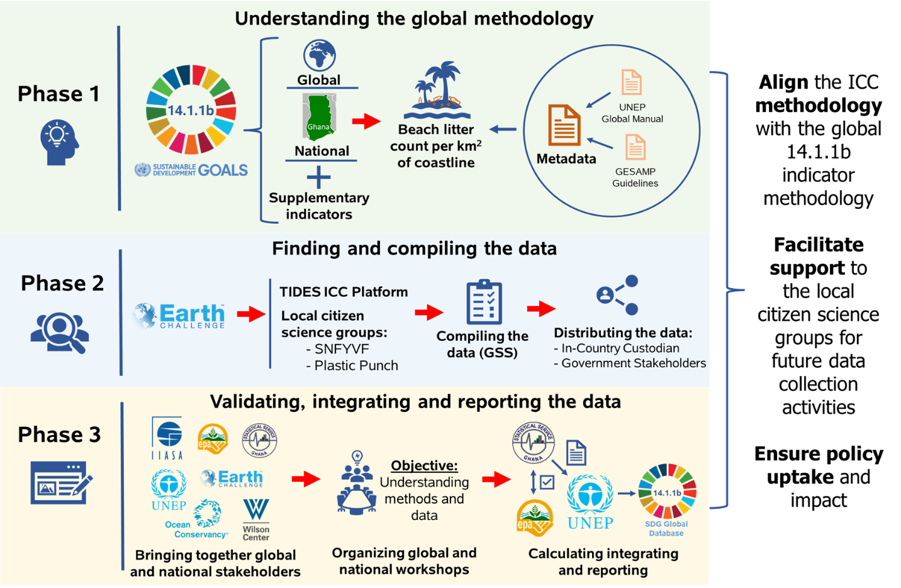
The process of integrating citizen science data on marine litter for SDG indicator 14.1.1b reporting in Ghana

Slide 11
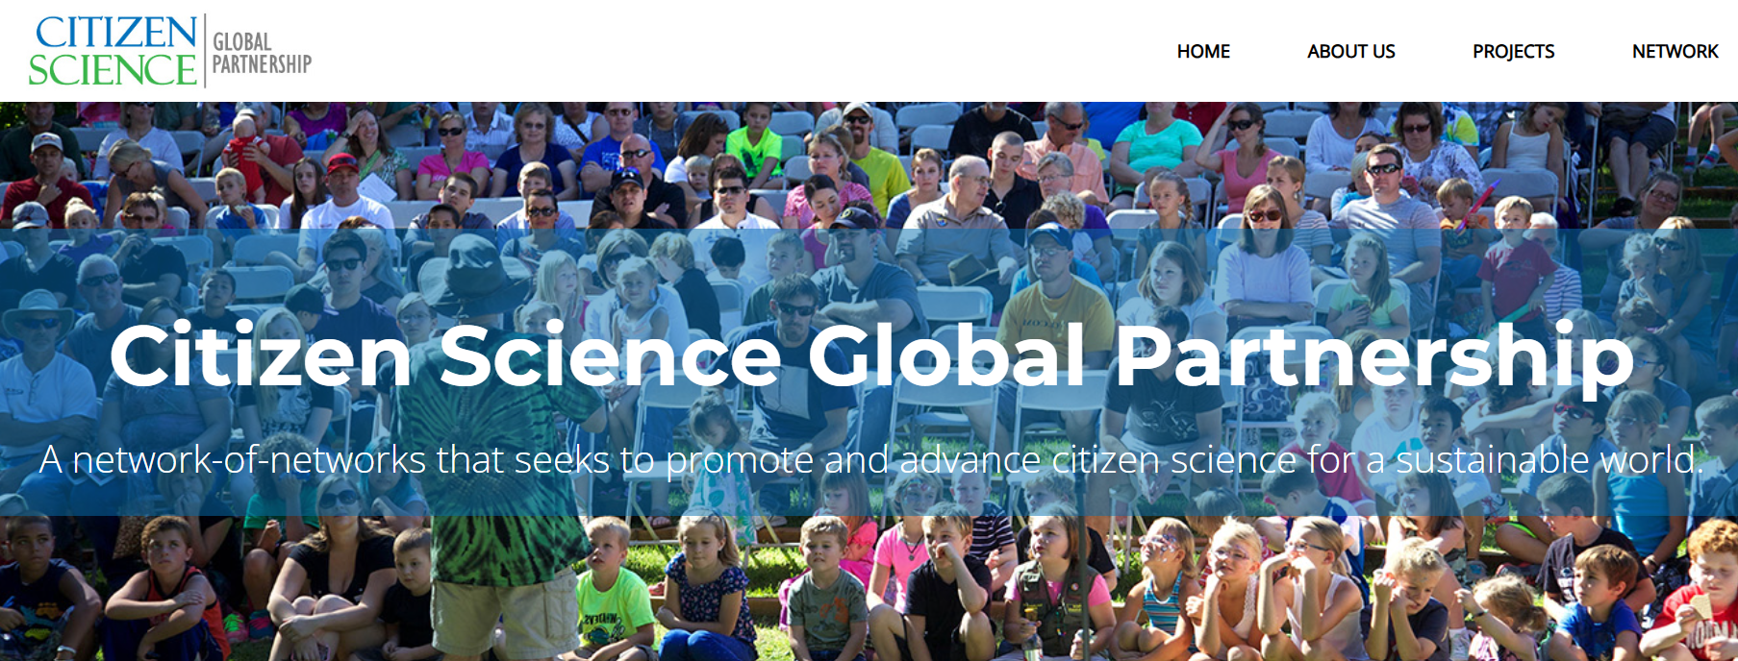

Slide 12
CROPS
Curating, Replicating, Orchestrating and Propagating
Citizen Science across Europe
January 2024 – December 2026

Slide 13
Thank you!
Dilek Fraisl, Linda See, Steffen Fritz, Ian McCallum
Dr. Dilek Fraisl
Senior Research Scholar l International Institute for Applied Systems Analysis (IIASA)
Managing Director l Citizen Science Global Partnership (CSGP)
Email: fraisl@iiasa.ac.at
BlueSky: dilekfraisl.bsky.social
LinkedIn: dilekfraisl
Web: www.iiasa.ac.at l
EGU25, Vienna

