Slide 1
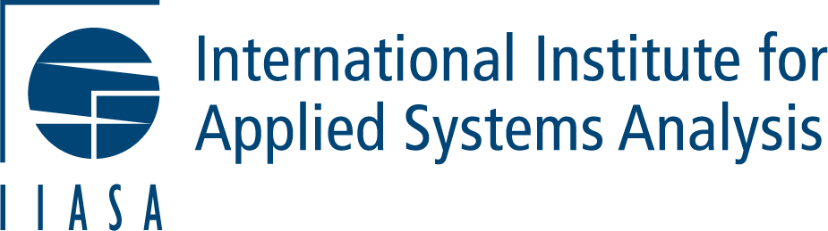

Towards a Pan-European Research Infrastructure for Excellent Citizen Science/Data
Dr. Dilek Fraisl
Citizen Science Global Partnership (CSGP)
International Institute for Applied Systems Analysis (IIASA)
fraisl@iiasa.ac.at

Slide 2
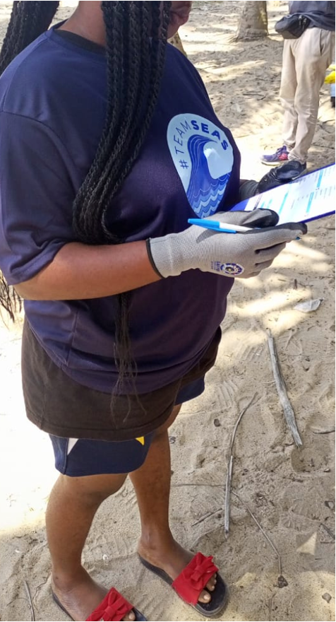
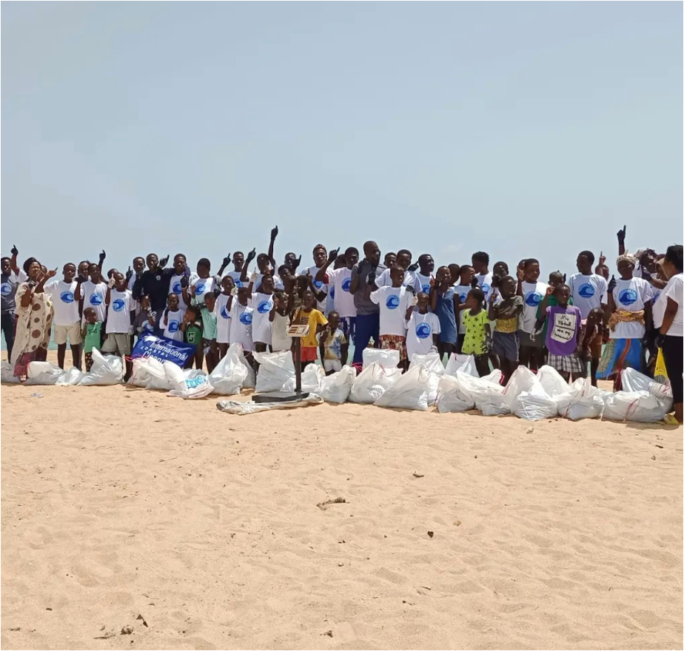
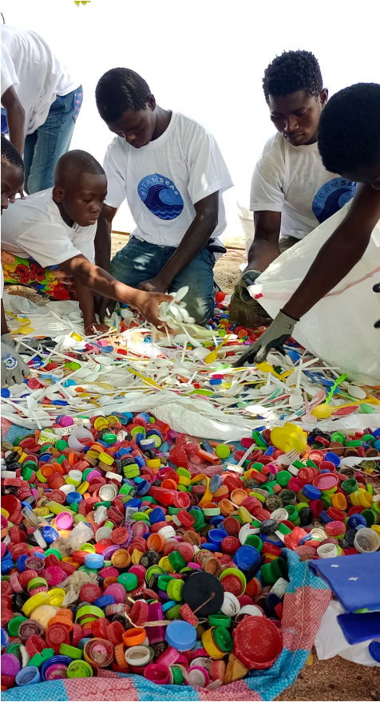
Bridging local data collection efforts with global monitoring processes by leveraging the SDG framework
Ensure inclusiveness through meaningful engagement of all stakeholders
Create time and space for these stakeholders to meet and connect
Listen and understand the motivations, interests and concerns
Be transparent about citizen science results and methodologies, especially how these methodologies were implemented
Citizens and communities are no free labor to close government data gaps; they should receive a share of the benefit from participating
@Smart Nature Freaks Youth Volunteers Foundation

Slide 3
Why there are different terms??
Citizen science, citizen-generated data, indigenous knowledge, community-based monitoring, crowdsourcing, volunteered-geographic information, participatory action research…..
Emphasizes different goals and contexts (science vs advocacy)
Emerged in different institutional and disciplinary settings (universities, research institutes vs civil society)
Responds to different audiences and purposes (scientific audiences vs awareness raising = achieve policy change and societal impact)
Indicates evolving thinking about knowledge and expertise (what counts as knowledge, and who can produce it, has diversified. It signals an ongoing negotiation over legitimacy, expertise, and participation in the knowledge economy)
There is an increasing convergence in both communities toward more participatory, equitable, co-created, and ethical approaches to data collection and scientific practice: toward science that is deeply connected with relevant to society.
    SCIENCE THAT IS CONNECTED TO, AND RESPONSIVE TO, SOCIETY.
    OFFICIAL STATISTICS THAT IS CONNECTED TO, AND RESPONSIVE TO, SOCIETY.

Slide 4
RIECS-Concept
Funded by Horizon Europe, it gathers 14 partners across Europe.
RIECS aims to design the first-ever Research/Data Infrastructure dedicated to Excellent Citizen Science/Data, linking existing data, tools, and communities under an open, federated system connected broader platforms/frameworks.
  A Research Infrastructure means a singular facility providing shared, long-term scientific services and resources—data systems, technologies, and expertise—available to support communities.
  Compared to the existing infrastructures, we aim to address the top level of infrastructures. We are talking about linking existing tools, data platforms, and expertise from both the citizen science/data ecosystem and citizens.

Slide 5
RIECS-Concept
The citizen science/data ecosystem is growing and performing excellence in many cases, but fragmented and there is a lack of infrastructural solutions.
The research/data infrastructure aims to connect existing platforms and improve data quality, interoperability and visibility.
The infrastructure does not only have technical layers (data, software, hardware), but also non-technical ones (governance, ethics, sustainability).
RIECS aims to strengthen knowledge production with society. It will deliver top-quality services to citizen data communities. It will help validate and make data generated by the members of the public widely usable for science, knowledge production, official monitoring and policy.
It will work under open governance, where design choices are made collaboratively through workshops like this one. So, this is an opportunity for all of us to shape the future of citizen data.
Notes:
Inform them, again, that, if they agree, their names may appear in the final list of contributors to the conceptual design outputs.

Slide 6
RIECS-Concept
The way we would like to organize ourselves today as part of this workshop is that we share our experiences, visions, plans, expectations and needs, either personal or institutional, through user stories:
  “As an NSO representative, I want to understand data quality of a specific citizen data project so that I can understand whether my institution can use it for official statistics”
Notes:
Your stories will remain anonymous and will be collectively analyzed.

Slide 7
RIECS-Concept
“What have you learned when using (or building) infrastructures/data platforms for citizen data or gathering citizen data?”
“What worked or didn’t work?”
“What’s your vision for a citizen data infrastructure?”
Breakout Groups: (3–4 participants per group):
  Citizen data practitioners/producers (CSOs, NGOs, academia, individuals/communities, etc.)
  NSOs, IOS (potentially using the data for official statistics, decision-making, etc.)
  Remember, it’s not only technical…
    Participation and inclusion
    Policy and sustainability

Slide 8
RIECS-Concept
  Each group identifies needs, barriers, and opportunities
  Each group identifies a facilitator/rapporteur from each table to take notes during the conversation about the main input shared.
  Rapporteurs present key takeaways.

Slide 9
RIECS-Concept
  Actor: “As an NSO representative…”
  Needs: “…I want to validate the quality of a data set from a citizen data project on air quality”
  Expected Outcomes: “…so that I can address the data gaps we’re facing on this issue and understand what kind of policies are needed”
  Barriers: “…It’s difficult to secure buy-in from the NSO staff and to use citizen data”
  Opportunities: “…The endorsement of the Citizen Data Collaborative and its framework by the UN Statistical Commission is making it easier for us to work with/explore/use citizen data for official statistics”
  Additional Notes: “…It would be very helpful if this initiative producing these data revises its methodology to better align with the methodologies that we have to follow for SDG monitoring/reporting”.

Slide 10
THANK YOU!!
Dr. Dilek Fraisl
Citizen Science Global Partnership (CSGP)
International Institute for Applied Systems Analysis (IIASA)
fraisl@iiasa.ac.at

