Slide 1
Leveraging Citizen Data to Improve Public Services and Measure Progress Toward Sustainable Development Goal 16
Dilek Fraisl, Mariana Neves | Omar Seidu | Cyrus Kwesi Darpoh | Aparna Basnyat | Fatma Usheva | Basil Tungbani | Dieudonnee Ankamah | Linda See | Arvinn Gadgil
Dr. Dilek Fraisl
Senior Research Scholar
International Institute for Applied Systems Analysis (IIASA)
fraisl@iiasa.ac.at

Slide 2
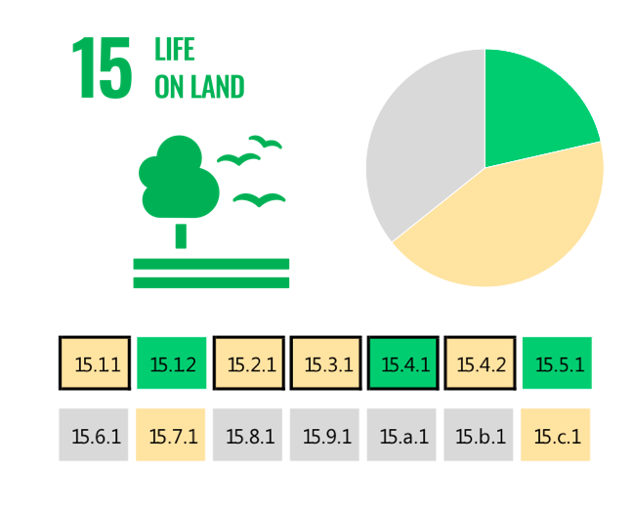
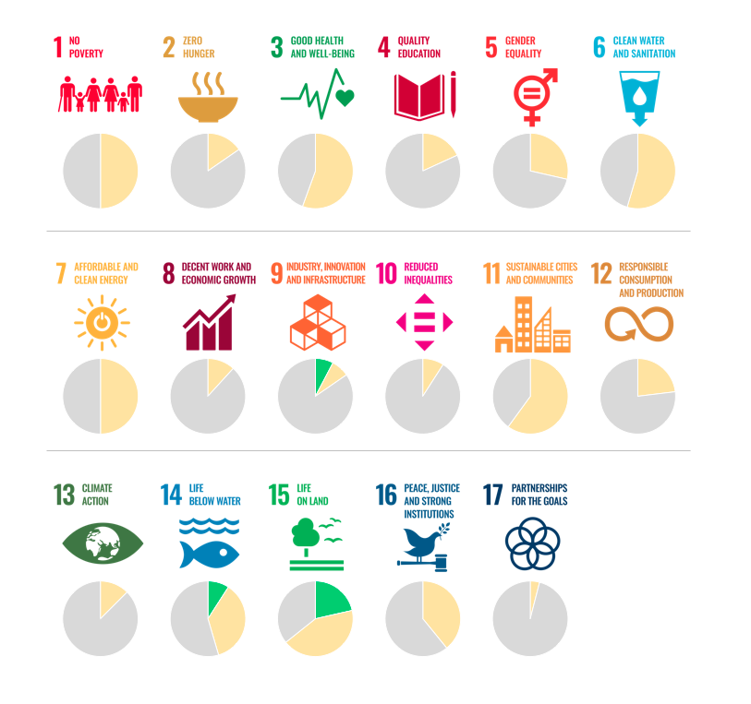
The SDG indicators where citizen science projects are
‘already contributing’ (GREEN), ‘could contribute’ (YELLOW) or where there is ‘no alignment’ (GREY)
Citizen science and the SDGs
Fraisl, D., Campbell, J., See, L. et al. Mapping citizen science contributions to the UN sustainable development goals. Sustain Sci 15, 1735–1751 (2020). https://doi.org/10.1007/s11625-020-00833-7

Slide 3
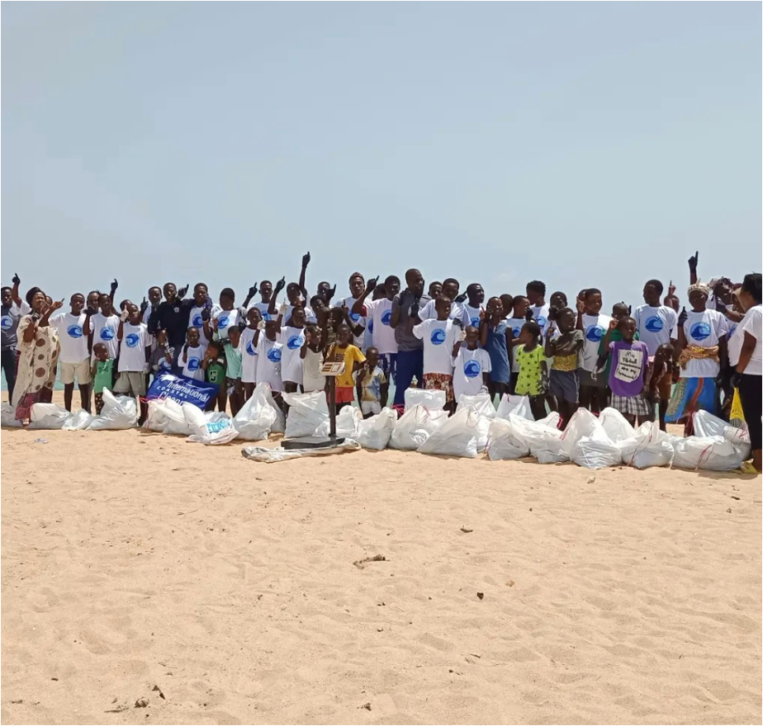

CITIZEN SCIENCE MARINE PLASTICS DATA FOR SDG REPORTING: GLOBAL RECOGNITION AND IMPACT
Ghana has become the first country to integrate existing citizen science data on marine plastic litter into their official statistics, as well as SDG monitoring and reporting
The results have been used in Ghana’s Voluntary National Review of the SDGs, and reported on the UN SDG Global Database
The results are also informing the integrated coastal and marine management policy in Ghana, currently under development
The initiative has helped to bridge local data collection efforts with national and global monitoring processes and policy agendas by leveraging the SDG framework
Partnerships with citizen science networks that are gathering these data in Ghana have been built to ensure sustainability of data and the approach, led by the NSO
Other countries, such as Siera Leone and Colombia, are also adopting the approach and have engaged in knowledge exchange workshops with Ghana aimed at replicating the model and process
Showcased on the UNSD website as a best practice model
Won the Group on Earth Observations (GEO) SDG Award, including its second phase (drones, citizen science and AI integration to produce litter density maps)
@Smart Nature Freaks Youth Volunteers Foundation

Slide 4
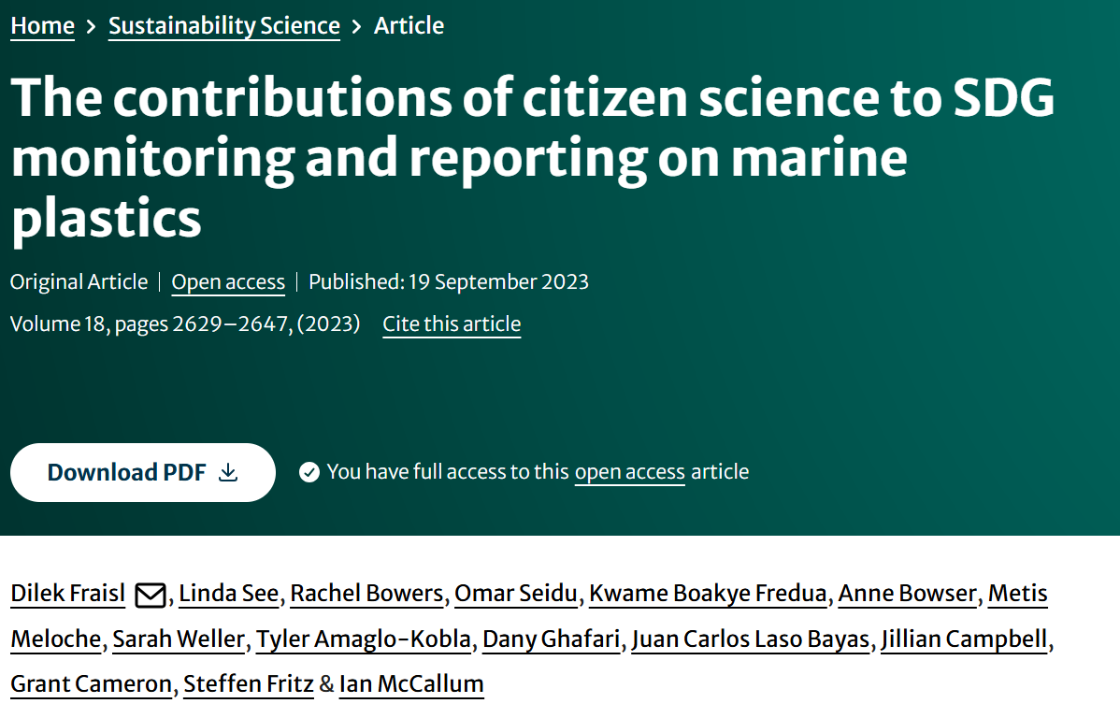
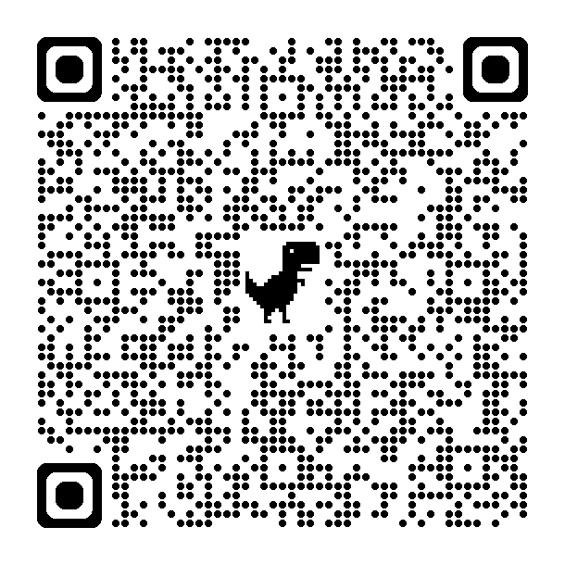
Best Paper Award 2024, Springer Nature, Sustainability Science

Slide 5
State of SDG 16
SDG 16: Promote peaceful and inclusive societies for sustainable development, provide access to justice for all and build effective, accountable and inclusive institutions at all levels:
SDG 16 is critically important for achieving all the other SDGs: covering topics related to human rights, violence, corruption, responsible and inclusive decision-making, and accountable and transparent institutions.
As of 2025, none of the SDG 16 targets are on track or had been fully achieved. Less than one fifth showed moderate progress but need acceleration to meet the targets, while the remainder showed marginal progress, stagnation and even regression.

Slide 6
Objectives:
To improve the production, timeliness, and use of statistics on citizen satisfaction with public services at subnational and national levels by engaging with individuals and communities, particularly those harder to reach, and not represented in official statistics because of that
To improve public service delivery and implement targeted interventions and policy adjustments based on data insights to enhance overall satisfaction and public service effectiveness
Build statistical capacities nationwide focused on citizen data approaches,
Co-create technological solutions for data gathering with relevant stakeholders to complement existing data sets that can help improve governance and policy, and foster a sense of voice, buy-in, and ownership of results among all actors involved, including citizens and communities,
Advocate for the use of local data in decision-making,
Building an evidence base by documenting the learnings

Slide 7
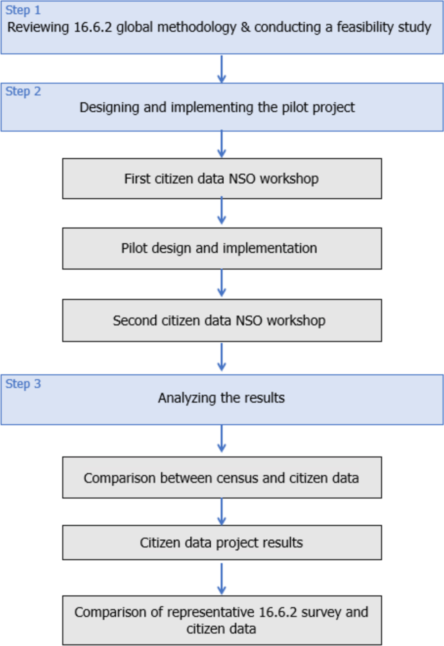
If the aim is SDG monitoring and reporting as official statistics, aligning with the global methodology is necessary:
Education
Health
Public services
Representative population surveys conducted by NSOs, which capture specific aspects (access, affordability, quality facilities, equal treatment for everyone, courtesy and treatment) citizen satisfaction with public services based on experiences rather than general perceptions.

Slide 8
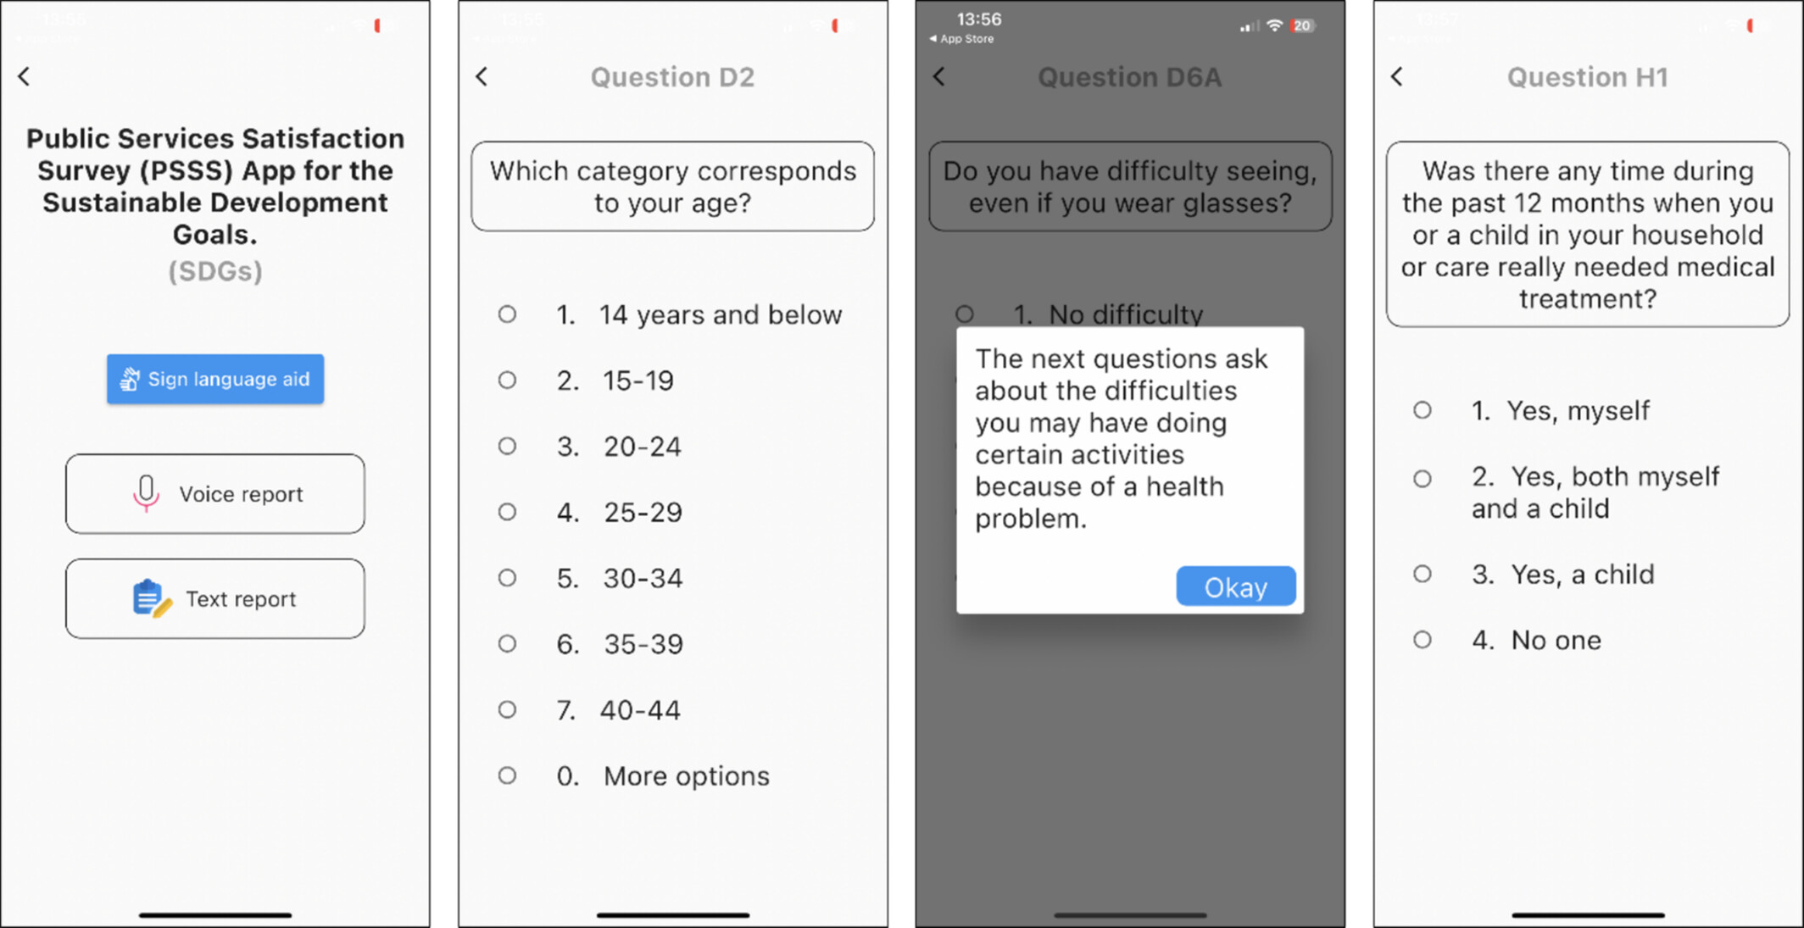

Slide 9
Technology & Implementation
The pilot and mobile application design prioritized inclusivity from the start to ensure that everyone interested could actively participate, including persons with disabilities:
Co-design process both for the project and app development,
Unstructured Supplementary Service Data (USSD) option, a basic phone feature that works like text messages, for those without smartphones or internet access
Local languages, the app offered English, Twi, and Ga as options for participants reflecting the primary languages spoken in the pilot districts
The app included features such as a text reader, a sign language interpreter, and dark and light mode options. For potential literacy barriers, it incorporated a voice recording option for answering the survey in Twi, Ga, and English
Respecting data privacy: data collected via the app were kept confidential and then aggregated for reporting purposes.

Slide 10
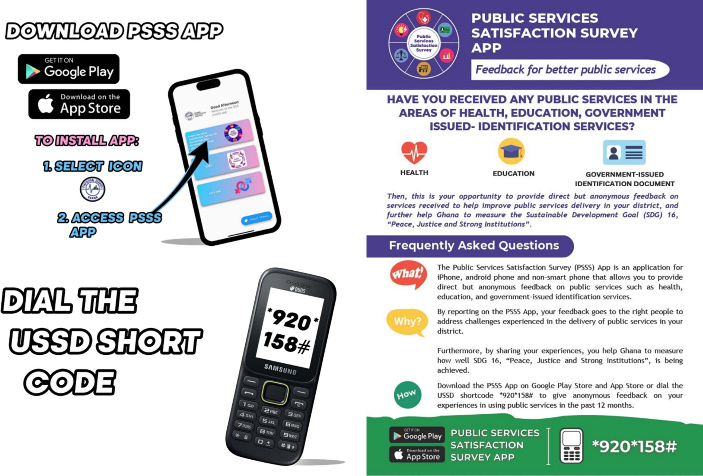

Slide 11
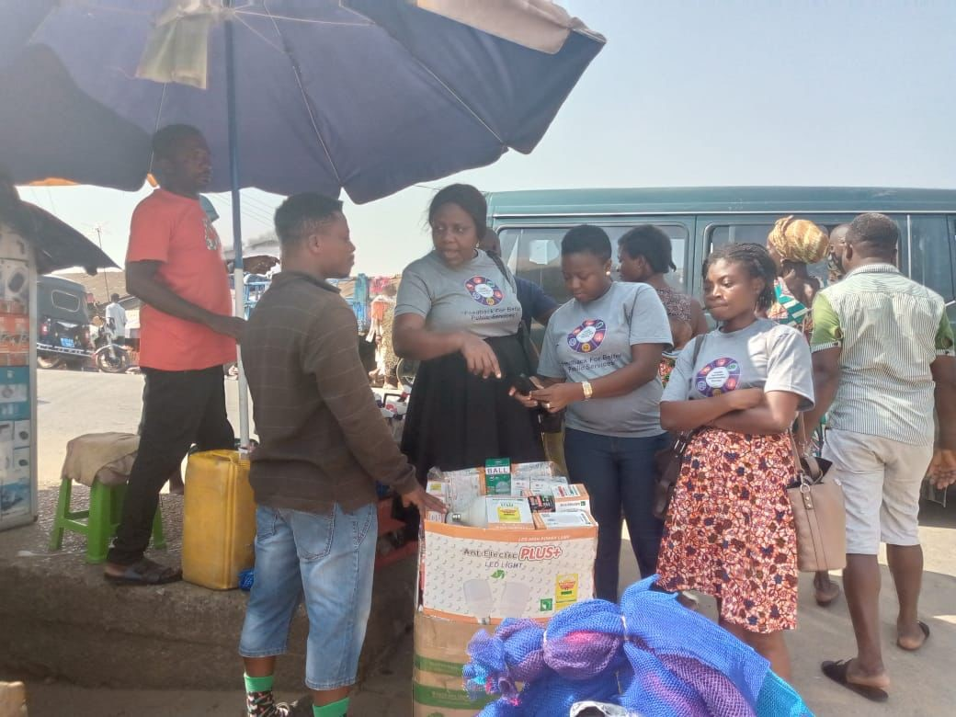
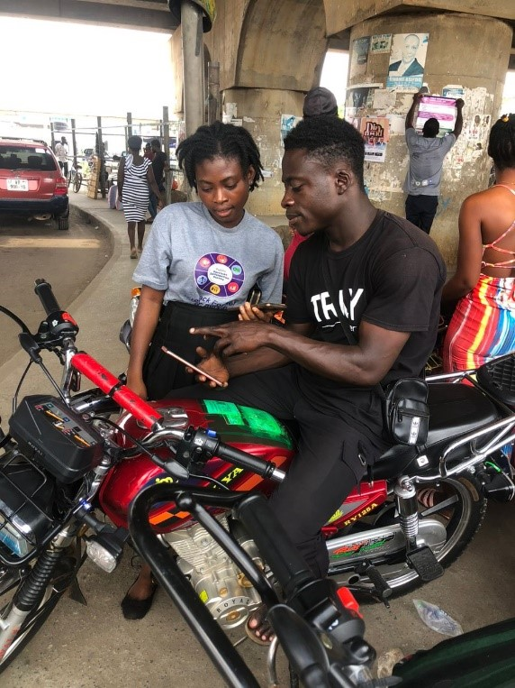
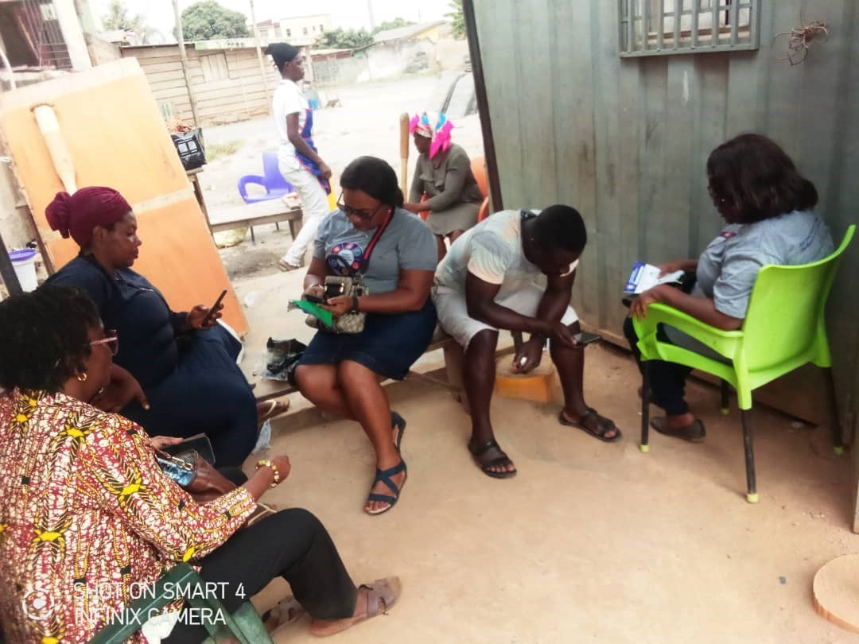
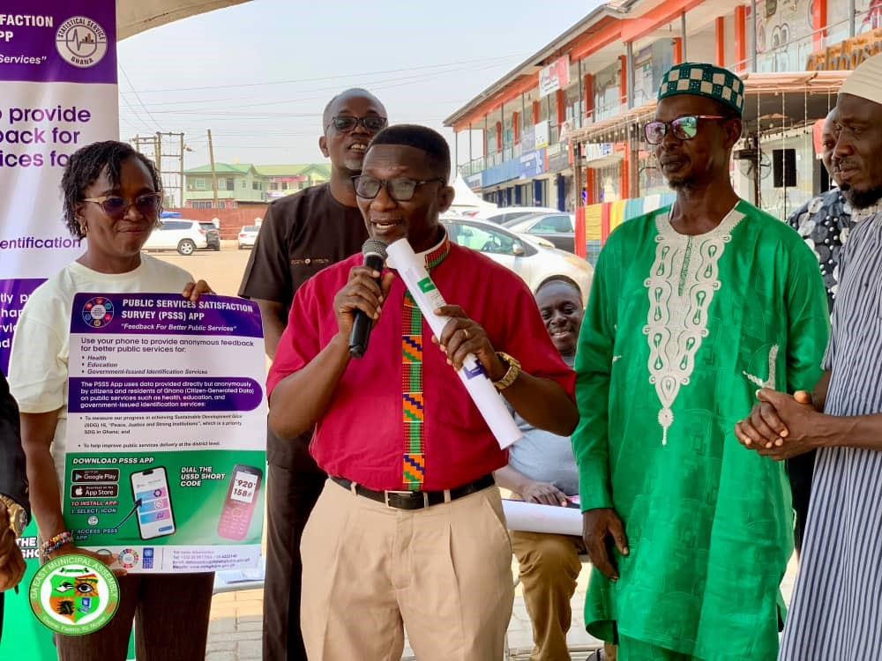
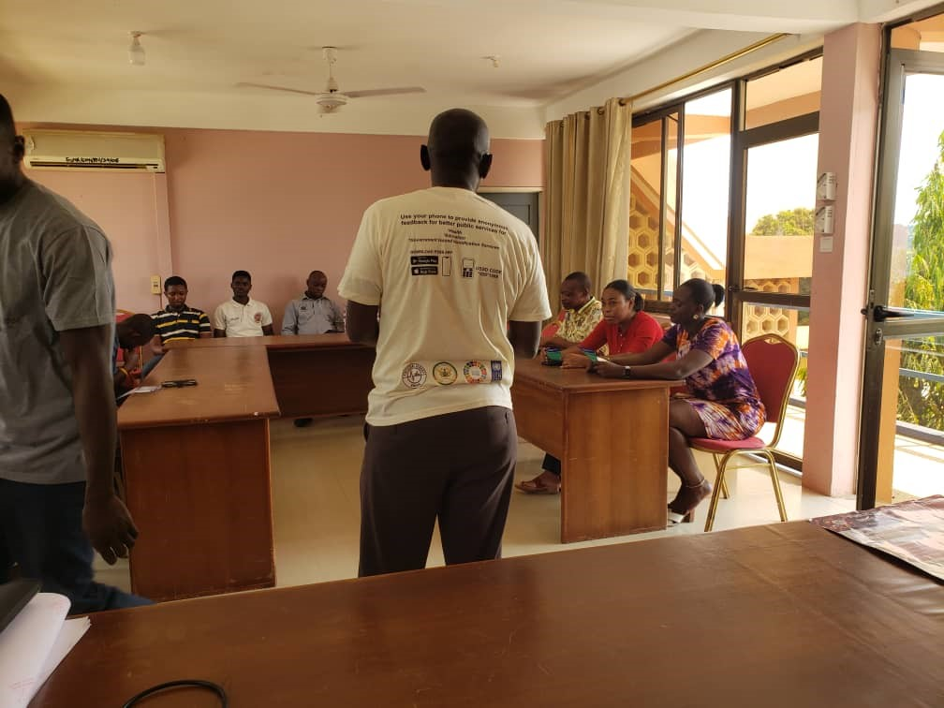

Slide 12
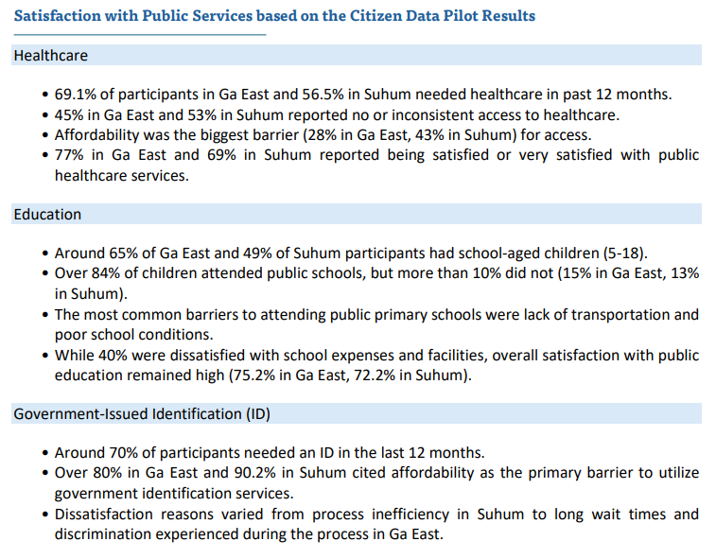
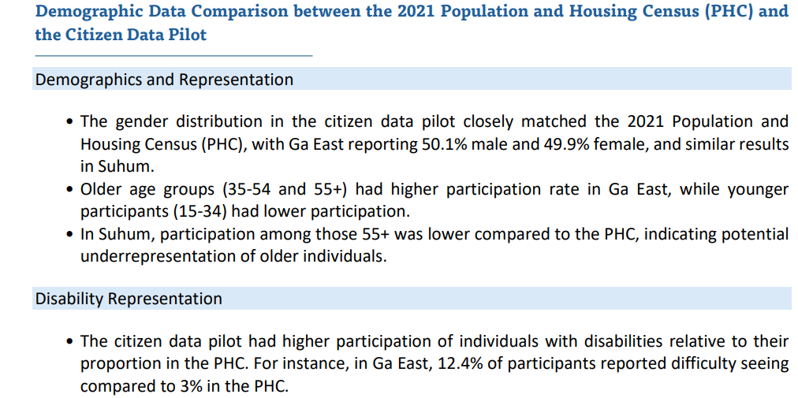
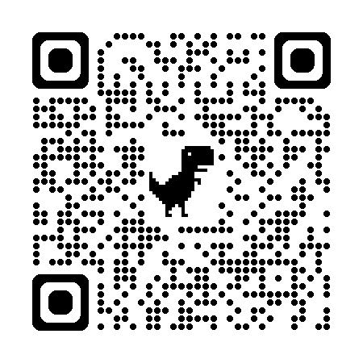
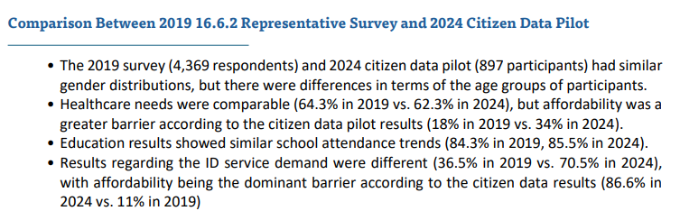
Results & UNDP Policy Brief

Slide 13
Example on the results on government services
70% attempted to obtain an ID or passport in the previous 12 months.
Over 80% cited high cost as a major barrier, while many reported long waiting times and unfair treatment.
Participants in rural Suhum faced greater challenges with travel distance and inefficiency, whereas those in urban Ga East pointed to communication gaps and perceived bias.
A shared demand emerged for faster, more affordable, and regionally available services.
Compared with the 2019 GSS survey which was conducted to measure the same indicator, demand for IDs rose from 36.5% to 70.5%, while affordability concerns jumped from 11% to 86.6%, reflecting both growing need and mounting frustration.

Slide 14
In addition to official statistics and SDG reporting impact, POLICY IMPACT achieved: Ghana’s most comprehensive passport reform package to date was launched!
Establishment of passport application centers in all 16 regions by December 2025.
Deployment of e-tracking systems, 24-hour operations at the Passport Head Office, and courier delivery through Ghana Post and Troskit.
Reduced processing time to 15 working days (standard) and 5 days (expedited).
Passport fees reduced from GH₵500 to GH₵ 350 (effective November 2025).
Integration of mobile and online payment systems for user convenience.

Slide 15
Follow-Up Engagement and Institutionalization
Ghana Statistical Service, as coordinator of the National Statistical System, is institutionalizing citizen data projects and initiatives under the National Strategy for the Development of Statistics Round 3 (NSDS III, 2026–2030) to strengthen performance monitoring and ensure continued feedback between citizens and government.
Creation of a Community of Practice among National Statistical Offices on citizen data for governance
Calls for national legal frameworks on ethical data use and privacy protection.
Proof that citizen data complements official surveys by capturing hard-to-reach populations (e.g., persons with disabilities- 12.4% of participants versus 3% in the 2021 Population and Housing Census
Demonstration that citizen data provides faster, more inclusive, and lower-cost feedback for improving public services.

Slide 16
Thank you!
Dilek Fraisl, Mariana Neves | Omar Seidu | Cyrus Kwesi Darpoh | Aparna Basnyat | Fatma Usheva | Basil Tungbani | Dieudonnee Ankamah | Linda See | Arvinn Gadgil
fraisl@iiasa.ac.at

