Slide 1
Designing User-Centered Protocols for Scaling Citizen Science: Five Project-Based Personas and Strategies from the CROPS Initiative
Dilek Fraisl, Todd Harwell, Lindsay Crocket, Inian Moorthy, Vanessa Boas and all
Dr. Dilek Fraisl on behalf of the CROPS IIASA team
Senior Research Scholar
International Institute for Applied Systems Analysis (IIASA)
fraisl@iiasa.ac.at

Slide 2
Objective
Develop design protocols on how to scale citizen science projects
Potential practical, technical, and conceptual challenges for scaling of citizen science projects and factors that can support or hinder scaling are key considerations
The protocols will be adaptable and easy to implement in different contexts, and consider various meanings, approaches and strategies for scaling rather than a one size-fits-all approach.

Slide 3
CROPS definition of “scaling citizen science”
Driving institutional changes through citizen science initiatives, such as policy integration;
Replicating or expanding projects across multiple dimensions, including geographic regions, timeframes, research scopes, participants, data volume, and methodologies;
Promoting cultural shifts and lasting change by transforming values and beliefs such as enhancing trust in science;
Pursuing meaningful outcomes by intentionally scaling down or simplifying projects; and
Striving to implement two or more of these strategies simultaneously.

Slide 4
CROPS Protocols
Developed based on the five strategies outlined in our definition.
Applied user-centered design approach to create practical, action-oriented protocols (guidelines) that can help citizen science projects scale effectively.
Undertook a persona development process, involving five project-based personas instead of traditional human-centered personas, each representing a citizen science initiative aligned with one of the five scaling strategies and EU Missions.
Used an iterative co-design process of workshops, interviews, and presentations involving citizen science practitioners and experts from around the world.

Slide 5
Co-design Process
  In addition to several literature reviews and a comprehensive exercise to identify 500 projects aligned with the EU Missions, followed by selecting 80 projects that are especially well-positioned for scaling and analyzing them and their contexts, we have undertaken the following:
  14 project interviews with selected projects, more coming
  5 persona development workshops with consortium members;
  2 conference sessions (ECSA and AAPS) to gather feedback;
  6 expert interviews with leading scientists, practitioners, and authors of the MLE report, on the first round, second round will begin;
  2 joint workshop with the sister project ScienceUs engaging 18 projects that are selected to be supported by ScienceUs in their journey to scaling.
  Input from project Advisory Board members, which includes successfully scaled projects (e.g., Plastic Pirates, etc.)
  Input from the Mission, JRC and other policy representatives;
  Input from the Project Special Interest Groups and built communities
  Webinar, interviews, sessions at events, dedicated workshops…

Slide 6
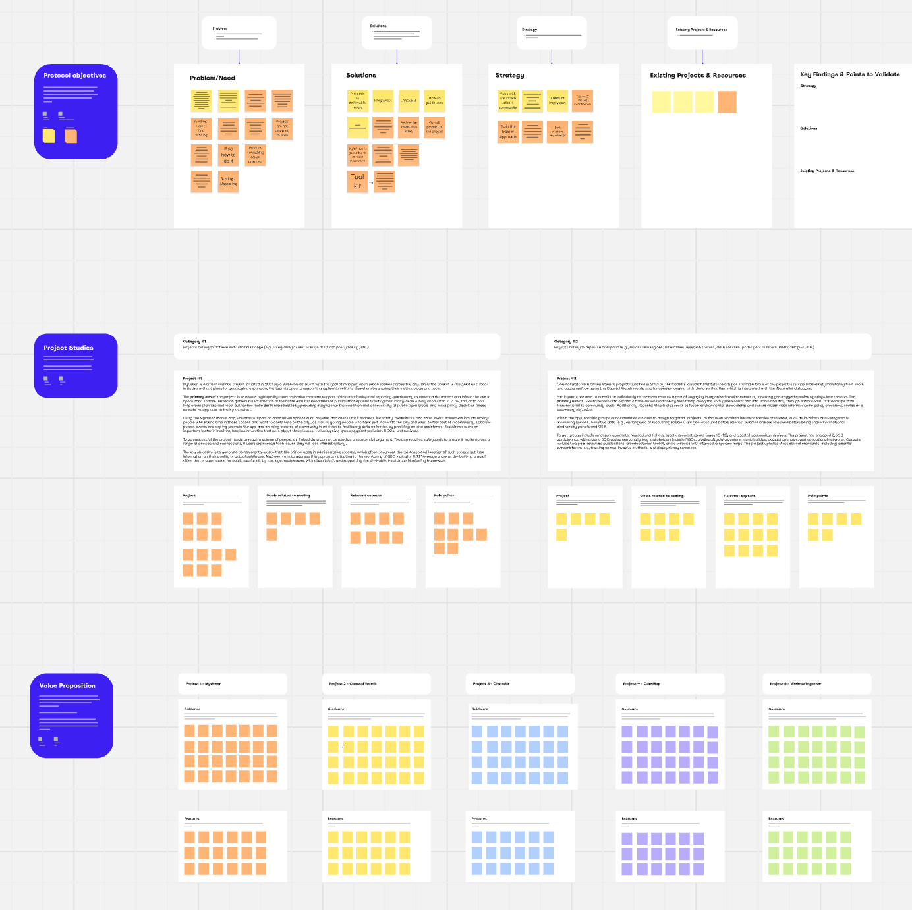
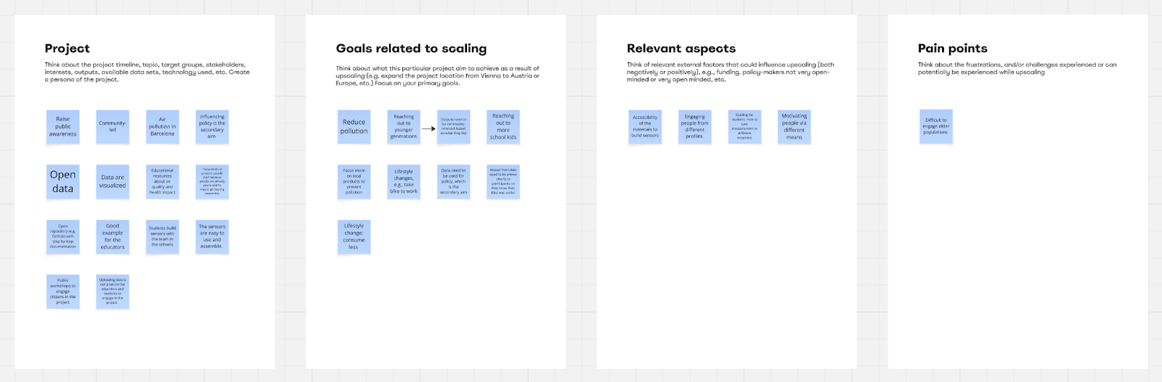
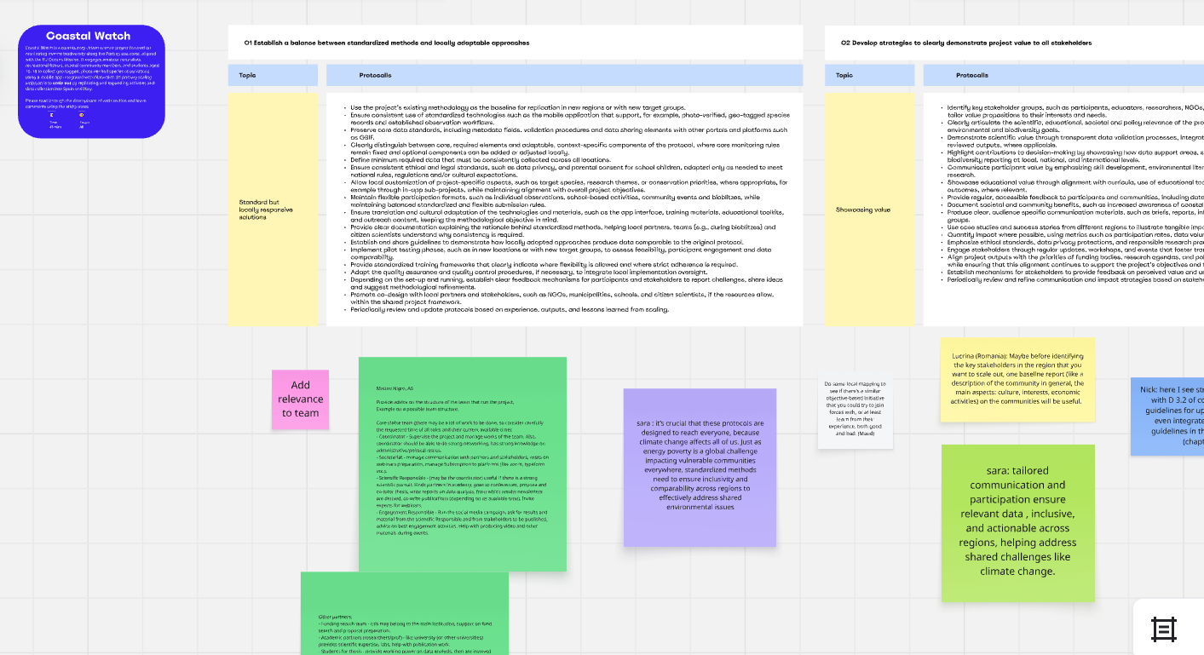
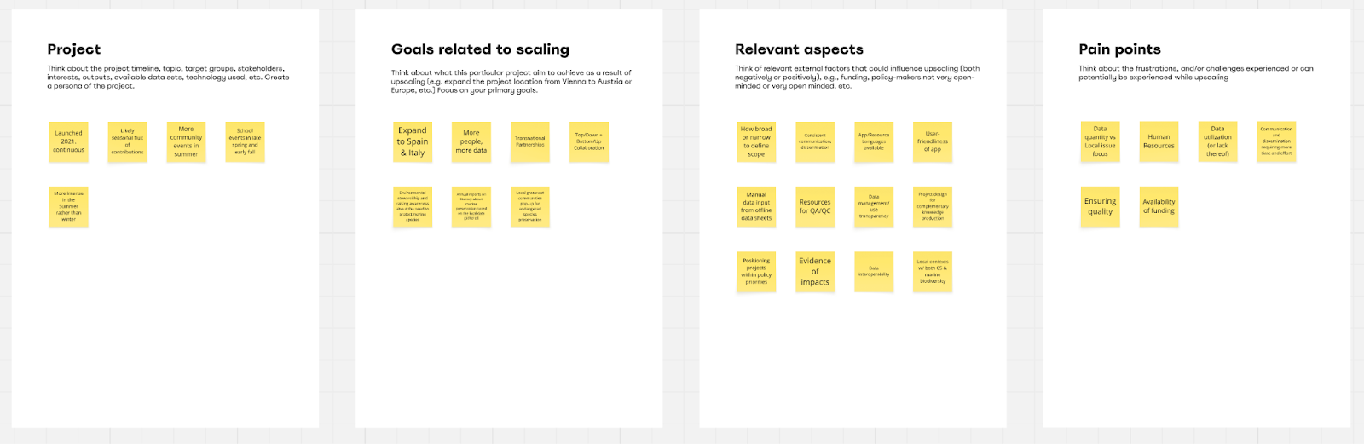
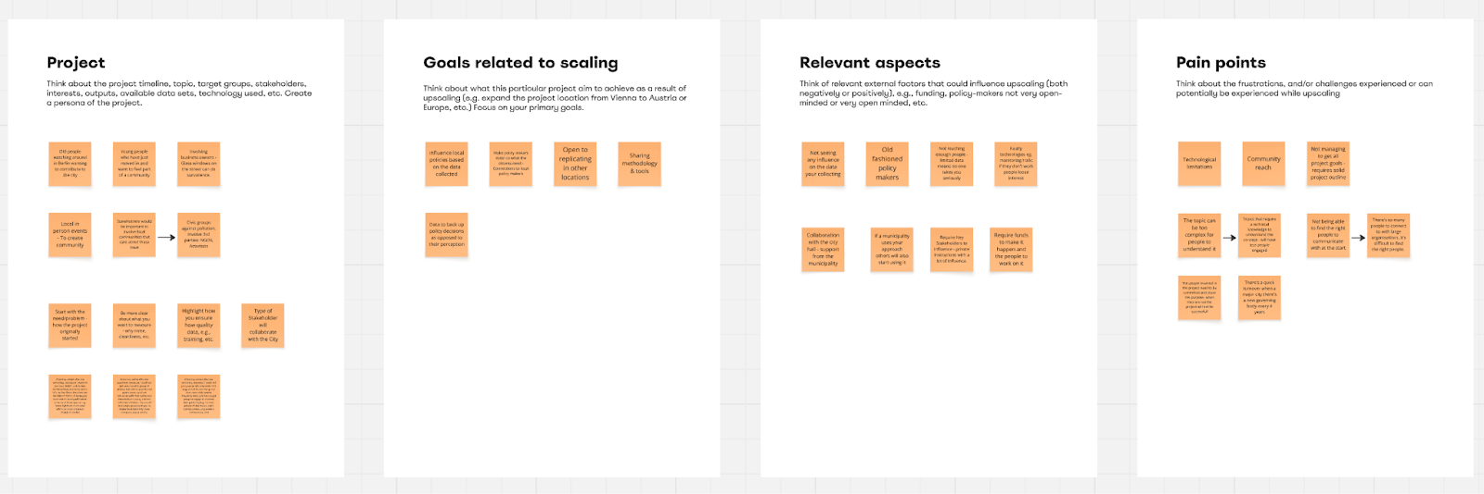

Slide 7
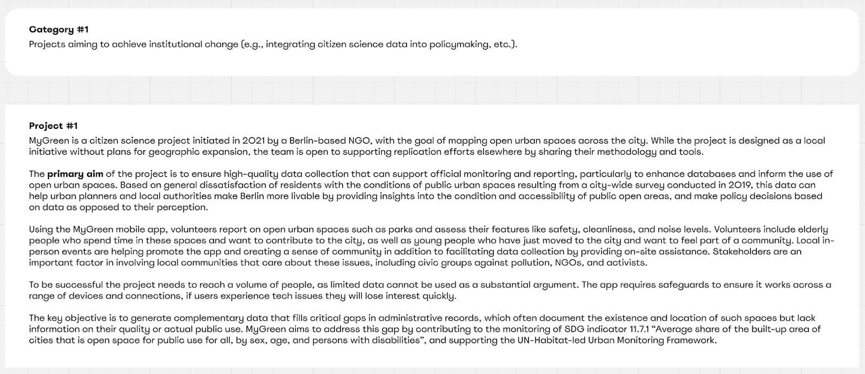
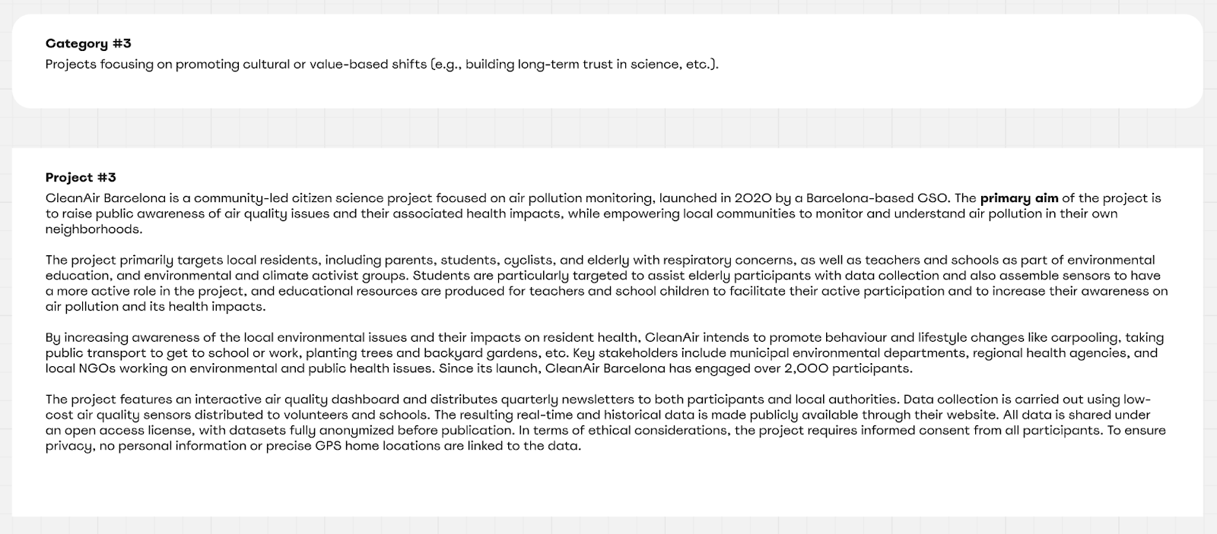
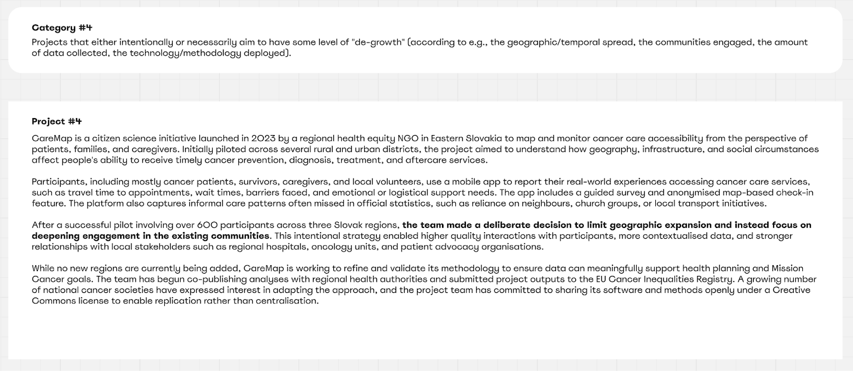
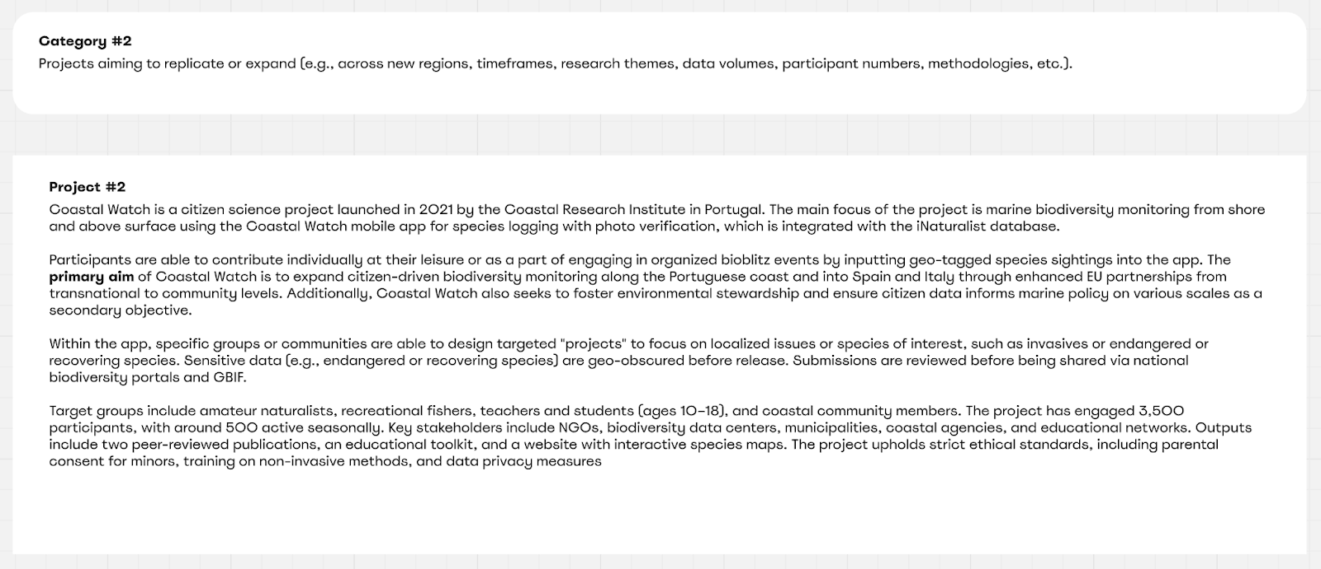
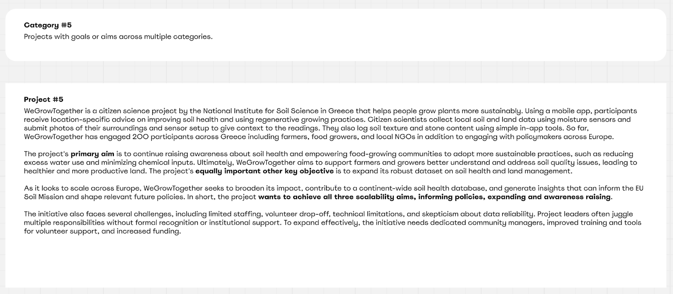

Slide 8
CROPS PERSONAS - Project #1
Title: MyGreen
Type of scaling to be achieved: Scaling up: Institutional change (e.g., integrating citizen science data into policymaking, etc.).
Location: Berlin, Germany
Type of organization: NGO
Start date: 2021
Type of citizen science project: Contributory (participants contribute data only)
Current scale: Local/Berlin-wide
EU Mission alignment: Cities Mission
Target Groups: Elderly people who spend time in parks and other urban open spaces, as well as young people who have just moved to the city and want to feel part of a community.
Primary Aim: Ensure high-quality data collection that can support official monitoring and reporting, particularly to enhance databases and inform city policies on the use of open urban spaces.
Description: MyGreen engages urban residents in mapping open urban spaces across the city. Using the MyGreen mobile app, volunteers report on open urban spaces such as parks and assess their features like safety, cleanliness, and noise levels. Local in-person events are helping promote the app and creating a sense of community in addition to facilitating data collection by providing on-site assistance. Stakeholders are an important factor in involving local communities that care about these issues, including civic groups against pollution, NGOs, and activists. To be successful the project needs to reach a volume of people, as limited data cannot be used as a substantial argument. The app requires safeguards to ensure it works across a range of devices and connections, if users experience tech issues they will lose interest quickly. The key objective is to generate complementary data that fills critical gaps in administrative records, which often document the existence and location of such spaces but lack information on their quality or actual public use. MyGreen aims to address this gap by contributing to the monitoring of SDG indicator 11.7.1 “Average share of the built-up area of cities that is open space for public use for all, by sex, age, and persons with disabilities”, and supporting the UN-Habitat-led Urban Monitoring Framework.

Slide 9
CROPS PERSONAS - Project #2
Title: Coastal Watch
Type of scaling to be achieved: Scaling Out: Replication or expansion (e.g., across new regions, timeframes, research themes, data volumes, participant numbers, methodologies, etc.)
Location: Portugal
Type of organization: Research
Start date: 2021
Type of citizen science project: Contributory (participants contribute data only)
Current scale: Regional along Portuguese coast
EU Mission alignment: Oceans
Target Groups: Amateur naturalists, recreational fishers, teachers and students (ages 10–18), and coastal community members.
Primary Aim: Expand citizen-driven biodiversity monitoring along the Portuguese coast and into Spain and Italy through enhanced EU partnerships from transnational to community levels.
Description: The main focus of the Coastal Watch project is marine biodiversity monitoring from shore and above surface using the Coastal Watch mobile app for species logging with photo verification, which is integrated with the iNaturalist database. Participants are able to contribute individually at their leisure or as a part of engaging in organized bioblitz events by inputting geo-tagged species sightings into the app. Within the app, specific groups or communities are able to design targeted "projects" to focus on localized issues or species of interest, such as invasives or endangered or recovering species. Sensitive data (e.g., endangered or recovering species) are geo-obscured before release. Submissions are reviewed before being shared via national biodiversity portals and GBIF. The project has engaged 3,500 participants, with around 500 active seasonally. Key stakeholders include NGOs, biodiversity data centers, municipalities, coastal agencies, and educational networks. Outputs include two peer-reviewed publications, an educational toolkit, and a website with interactive species maps. The project upholds strict ethical standards, including parental consent for minors, training on non-invasive methods, and data privacy measures.

Slide 10
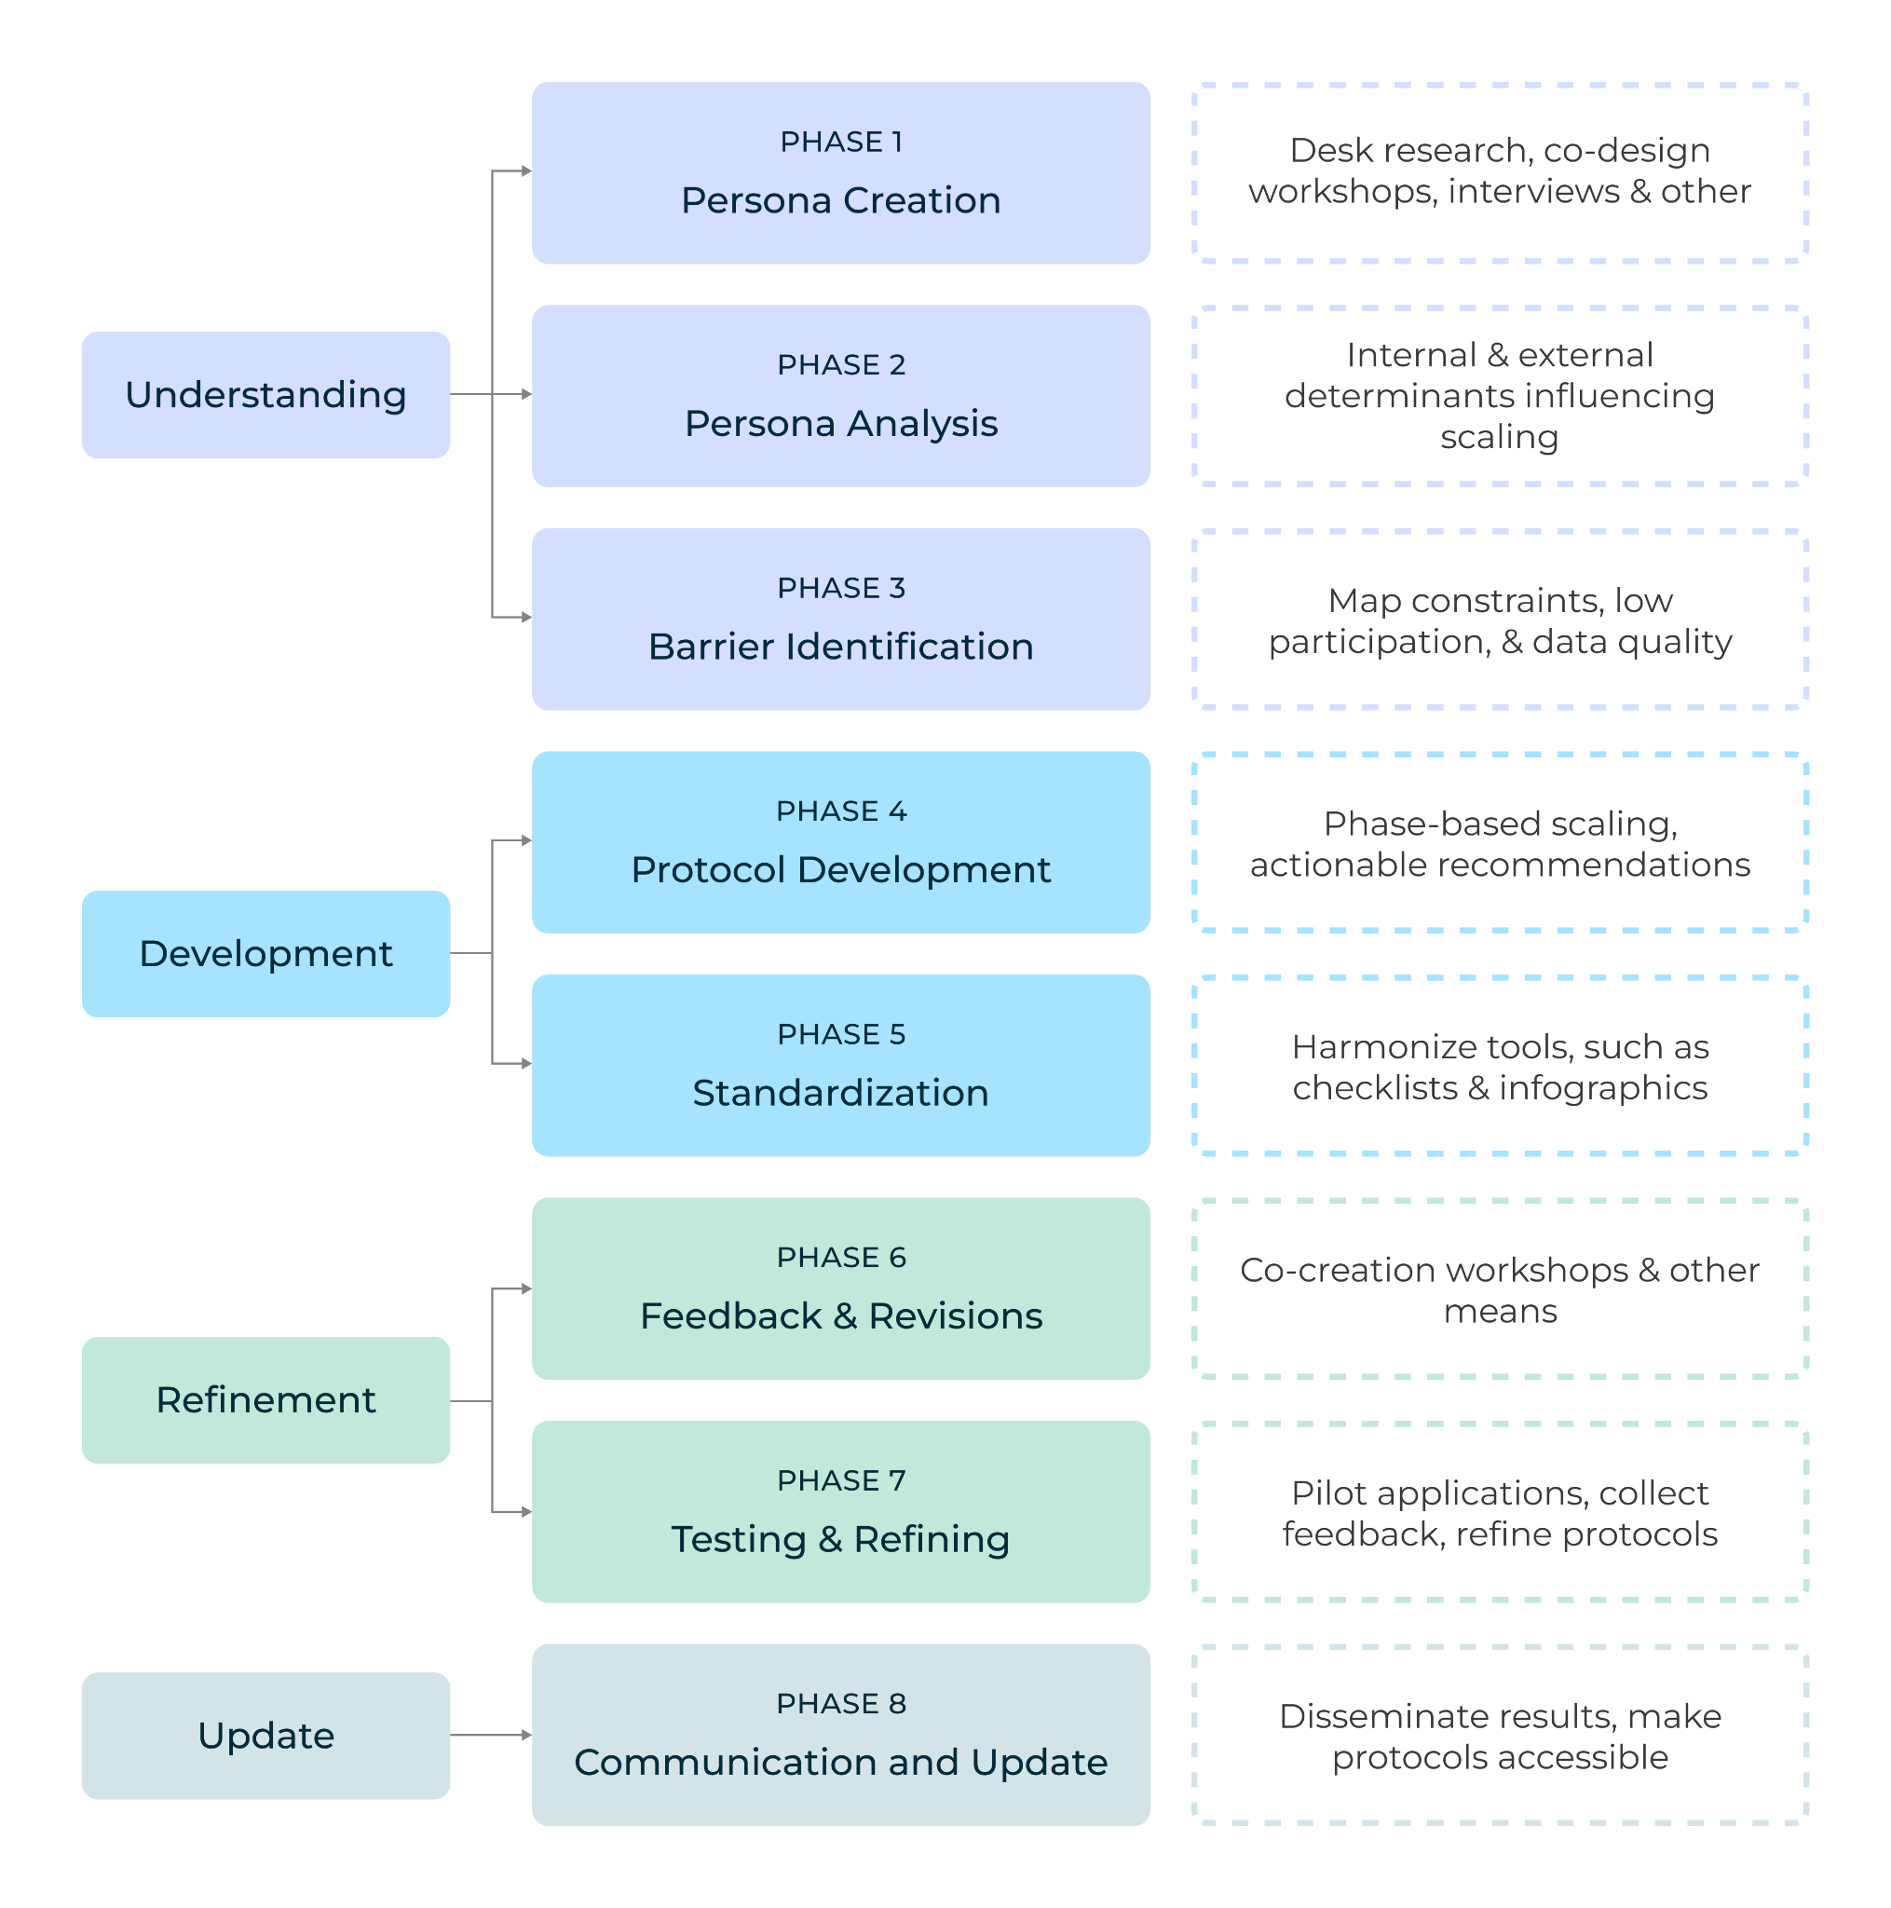
From Personas to Protocols

Slide 11
Example: Coastal Watch - Phase 2 Persona Analysis
Internal characteristics:
1. Scientific architecture and design:
  Standardized contributory biodiversity observations: Photo-based submissions combined with multi-layered verification help ensure data quality, scientific credibility, and interoperability with national and international biodiversity data systems (e.g. iNaturalist, GBIF).
  Modes of participation: Data are contributed either individually or through organized community activities (bioblitz events), supporting both regular coastal monitoring and collective, time-bound observation campaigns.
  Formalized data governance: Review workflows, geo-obscuring of sensitive species, and controlled data release mechanisms are implemented to maintain data integrity, protect vulnerable ecosystems, and ensure consistency and trust, which will be helpful as the project scales across regions.
  Presentation: Scientific papers, visualizations and an educational toolkit make collected data understandable and actionable.
Scaling Implication: To expand successfully, Coastal Watch should scale its existing methodology and sustain clear data governance as geographic scope expands.
2. Expansion and local relevance:
  Context-sensitive expansion: Anchoring activities in local realities, ensuring that monitoring priorities, species of concern, and environmental challenges reflect community interest and lived experience rather than a one-size-fits-all model.
  Local trust and legitimacy: Maintaining local relevance strengthens trust among participants and stakeholders, which is critical for long-term engagement and data continuity.
  Adaptable communication and tools: Educational materials, visualizations, and feedback mechanisms are adapted to local languages, cultural contexts, and decision-making needs, ensuring that data outputs remain useful for local context and awareness.
Scaling implication: Coastal Watch can expand across countries without losing relevance by scaling its principles and method rather than applying uniform practices, allowing local adaptation while preserving coherence, credibility, and collective impact.

Slide 12
Example: Coastal Watch - Phase 3 - Barrier identification:
In the third phase, that may limit the ability of the project to scale deeply. These barriers will help guide taThe following are the potential barriers rgeted interventions by linking insights about user personas to the design of context-specific scaling protocols and strategies in the next phase.
Lack of standardized and transferable methodologies ➡️ Risk of inconsistent data quality and reduced scientific credibility as the project expands geographically.
Lack of flexibility for local adaptation ➡️ Loss of local relevance and reduced engagement in new regions.
Lack of balance between standardization and contextual flexibility ➡️ Over-standardization or excessive fragmentation will create either poor comparability or incoherent datasets across countries.
Lack of visible and measurable impact frameworks ➡️ Difficulty in demonstrating value to communities, partners, and funders, slowing further expansion.
Lack of robust ethical and data governance safeguards ➡️ Weak protection of communities, ecosystems or data integrity and loss of trust and reputational risk during scaling.
Lack of stakeholder mapping and coordination structures ➡️ Unclear roles and unmanaged stakeholder growth leading to coordination failure and institutional friction across regions.
Lack of multilingual and culturally adapted communication strategies ➡️ Barrier to participation and uneven engagement across diverse target groups.
Lack of engagement in relevant networks and partnerships ➡️ Operating in isolation leading to missed opportunities for visibility, legitimacy, and resource sharing.
Lack of diversified and stable funding models ➡️ Sustainability risks and limit the project ability to scale responsibly.

Slide 13
Example: Coastal Watch - Phase 4 – Protocol Development
Using these barriers as a guiding framework, we have developed the protocols in a number of categories aligned with the literature, recognized principles and guidance in citizen science, such as the ECSA 10 Principles and the ECSA Characteristics of Citizen Science:
Establish a balance between standardized methods and locally adaptable approaches to maintain comparability while ensuring local relevance.
Develop strategies to clearly demonstrate project value to all stakeholders, customizing messaging and outputs to their priorities.
Maintain robust ethical standards and data governance measures, such as participant protection and sensitive species management.
Map key stakeholders, understand their priorities, and define clear roles and coordination mechanisms.
Implement multilingual and culturally adapted communication strategies to engage diverse communities effectively.
Diversify funding sources to include public, private, and alternative streams, ensuring financial sustainability for long-term scaling.

Slide 14
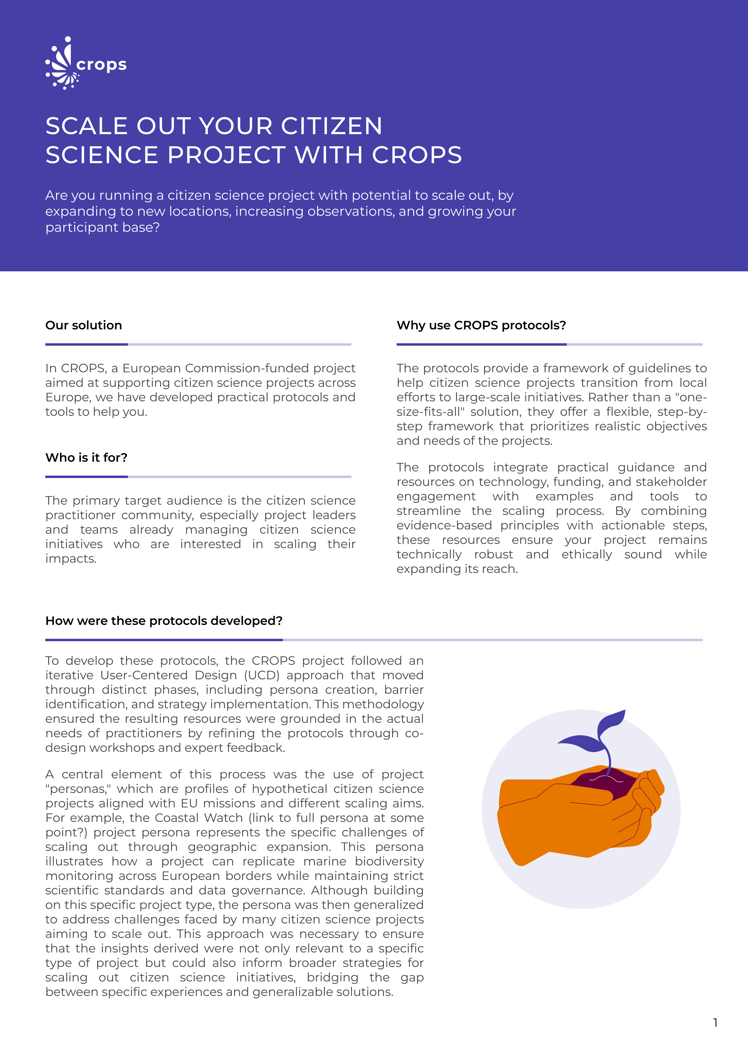
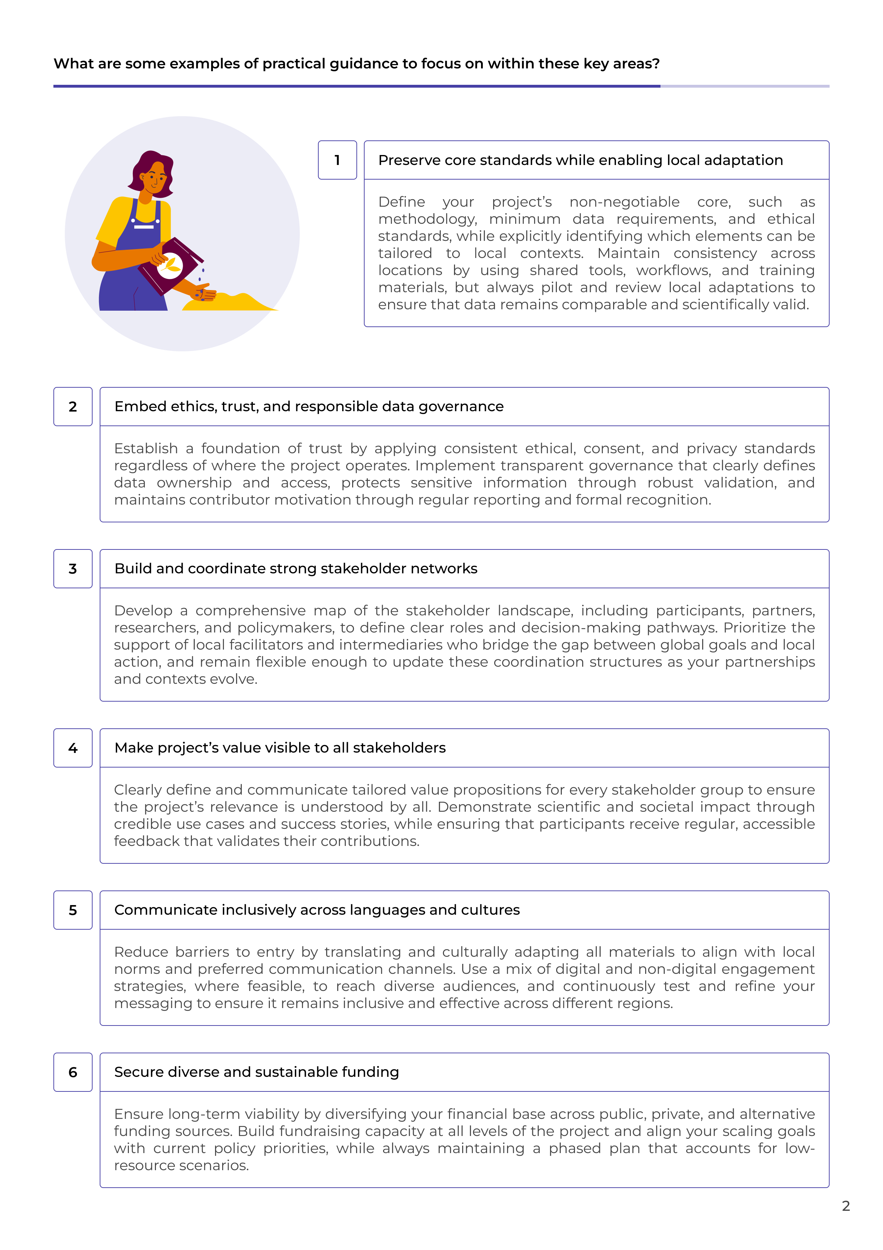
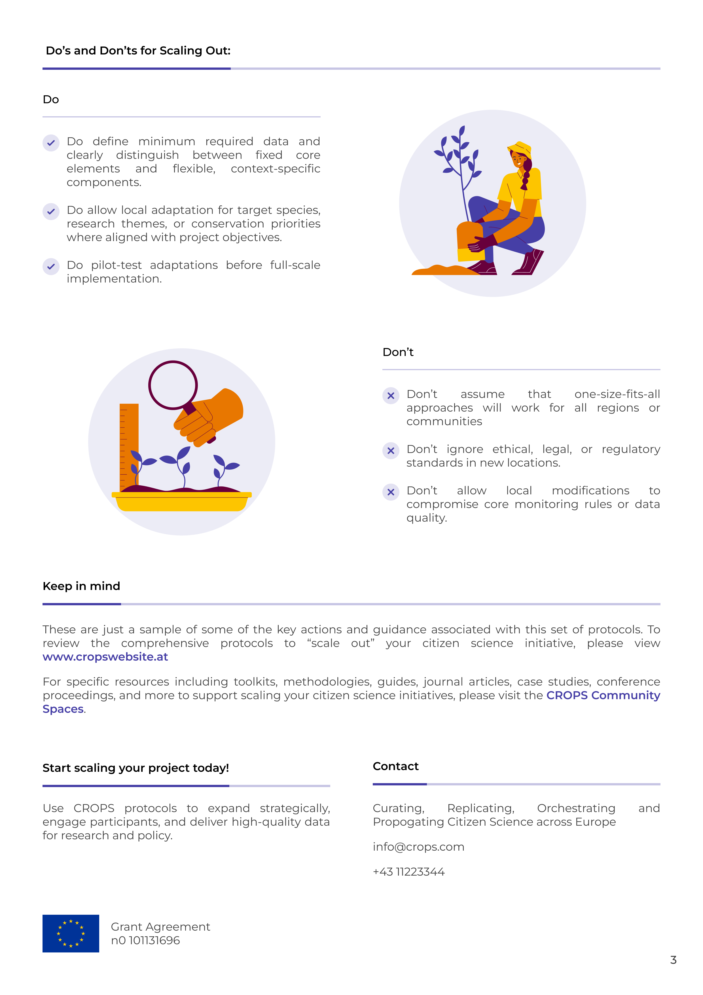
Protocols

Slide 15
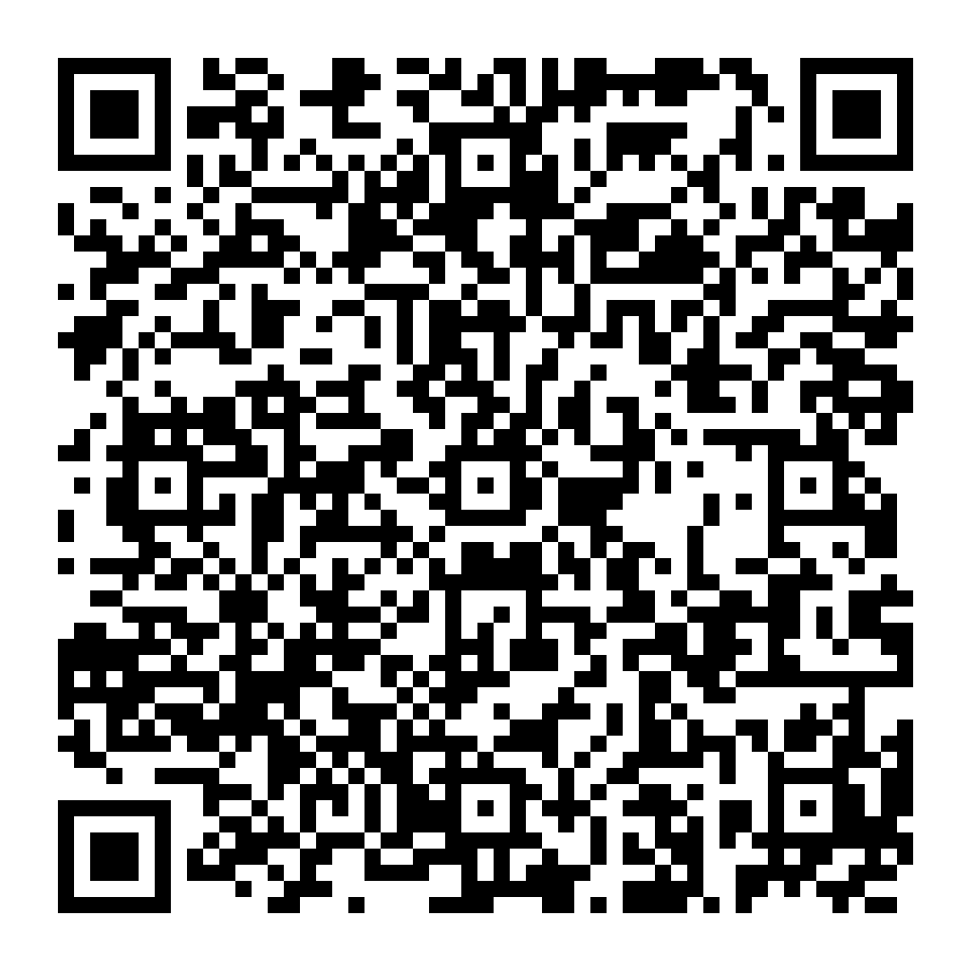
Please leave your feedback directly in this document if interested in reviewing/contributing or reach out if you want to be more actively get involved.
Thank you!
Dr. Dilek Fraisl on behalf of the CROPS team
fraisl@iiasa.ac.at

