Slide 1
BUILDING A FEDERATED FUTURE: CONCEPTUALIZING GOVERNANCE AND SUSTAINABILITY FOR THE PAN-EUROPEAN CITIZEN SCIENCE INFRASTRUCTURE
ECSA 2026, Roundtable, Oulu, Finland
Conveners:
Dr. Dilek Fraisl, Dr. Katya Perez Guzman, Fermin Serrano Sanz, Rosy Mondardini,
Elisabetta Marafioti

Slide 2
Session Objectives
To unite policy-makers, RI managers, and CS leaders to explore together how to align EU, national, and regional policies for sustainable, federated citizen science infrastructures. We will discuss coherence with regional and global frameworks such as the SDGs, EU targets, R&I strategies, local priorities and other frameworks for a shared long-term vision.
To explore governance and sustainability models for the Research Infrastructure for Excellent Citizen Science (RIECS).
To serve as a forum for high-level strategic dialogue and as a consultation.
All insights will feed directly into RIECS-Concept’s roadmap and sustainability plan, shaping a pan-European policy-relevant research infrastructure for citizen science.

Slide 3
Agenda and Logistics
Scene setting on the RIECS-Concept and RI
Policy Debate
Open Microphone
Co-creation of the roadmap, Group work & User Stories
Key take-aways and wrap up

Slide 4
Speakers
Frederike Schmitz, Open Science NL (Dutch Research Council)
Austin Mast, Citizen Science Global Partnership (CSGP), Association for Advancing Participatory Sciences (AAPS)
Timo Pyhälahti, Finnish Environment Institute (Syke)
Dilek Fraisl, CSGP & IIASA
Katya Perez Guzman, CSGP & IIASA
Fermín Serrano Sanz, Ibercivis
Rosy Mondardini, Citizen Science Zürich

Slide 5
RIECS-Concept
Introducing the RIECS initiative and its conceptualization process towards ESFRI roadmap

Slide 6
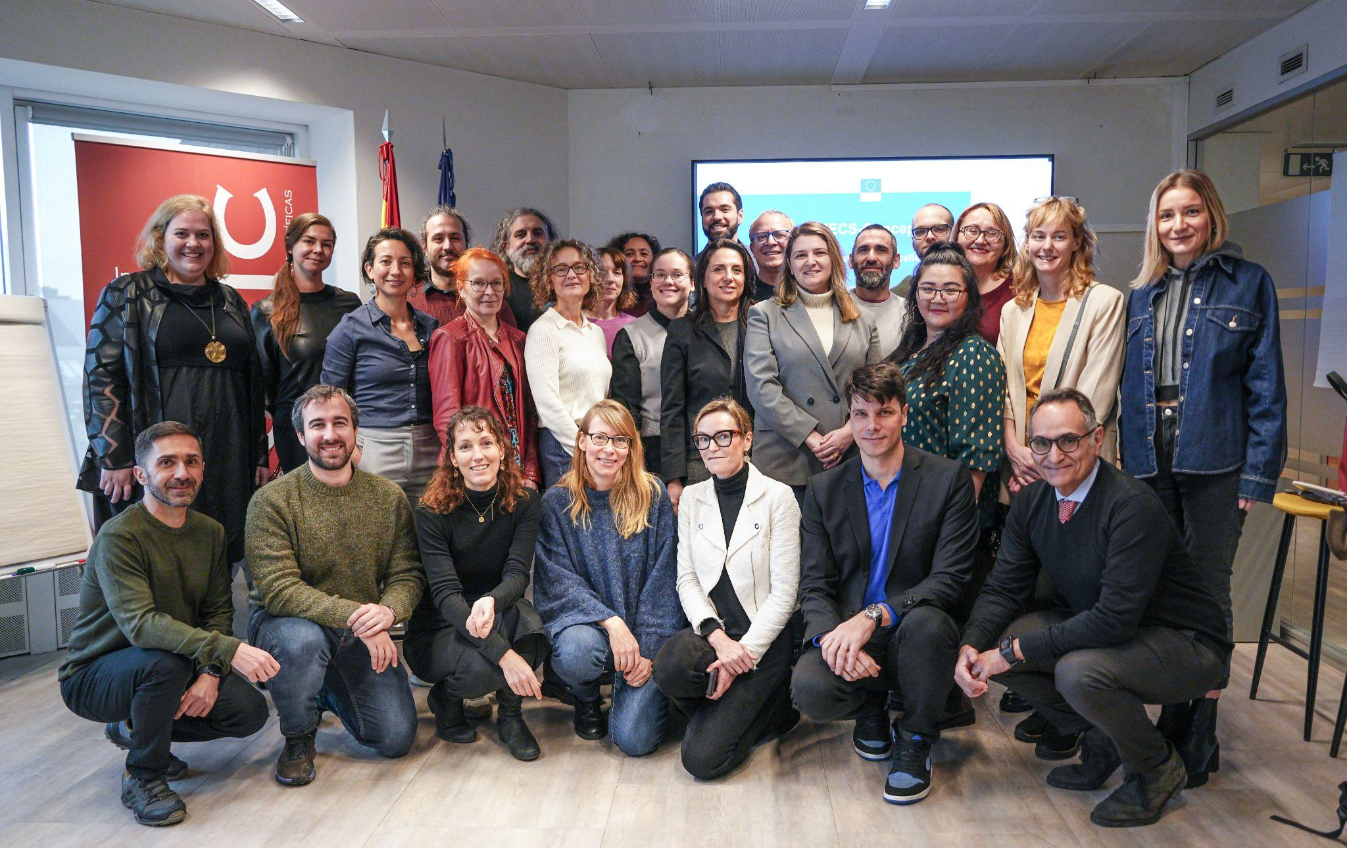













concept.riecs.eu

Slide 7
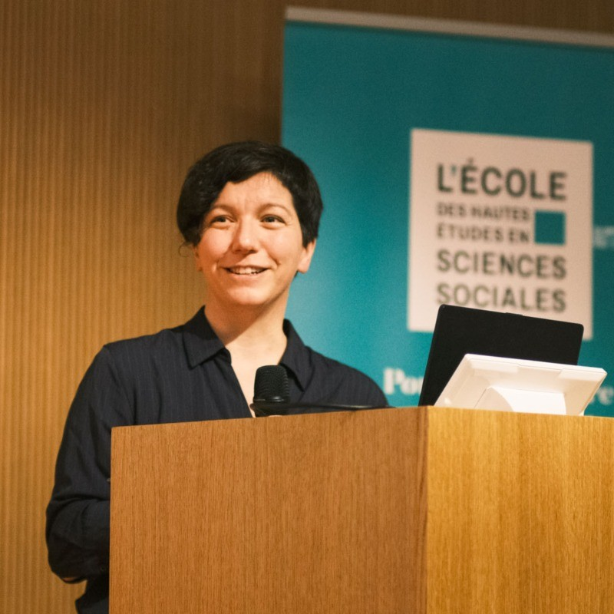
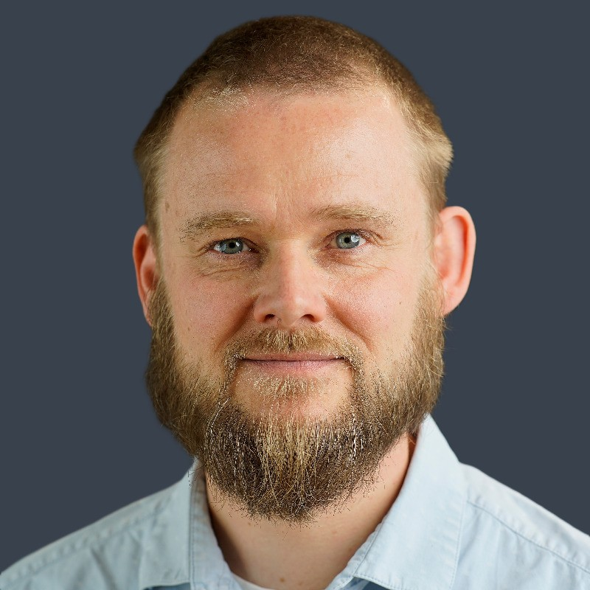
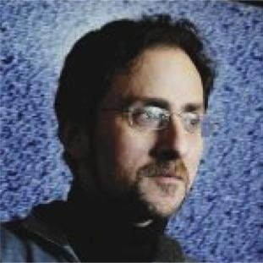
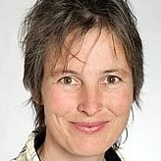
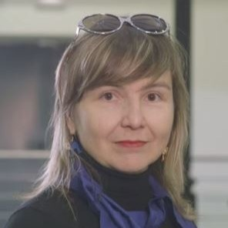
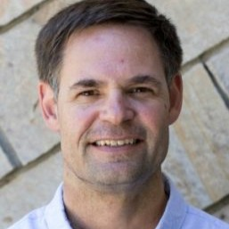
EAB
Members
Alessia SmaniottoEmail Linkedin
Sven Schade Email Linkedin
Francois Grey Email Linkedin
Katrin Vohland Email Linkedin
Eva Méndez Email Linkedin
Greg Newman Email Linkedin

Slide 8

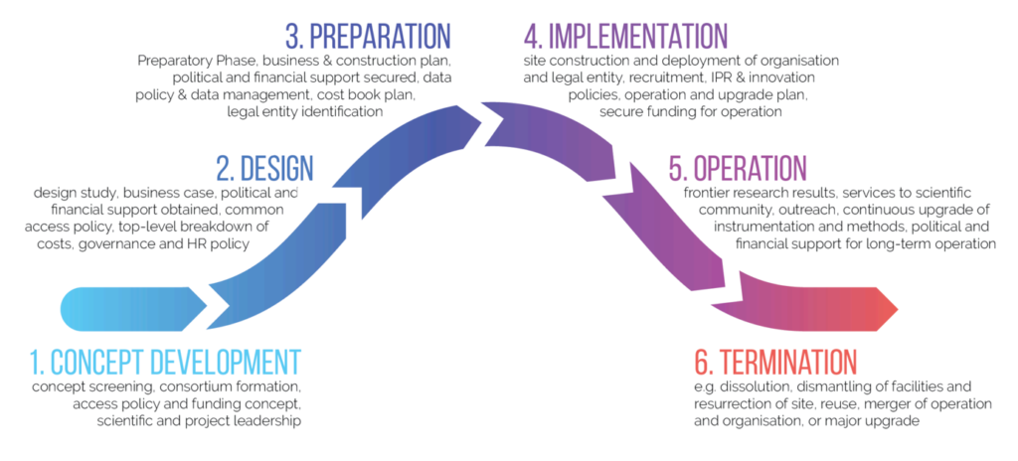
Research Infrastructures
RIs are facilities that provide resources, services and support to a given scientific community to conduct top-level research.
The European Strategy Forum on Research Infrastructures (ESFRI: EU MS + AC+ EC) runs the strategy and policy-making on RIs in Europe:
Long-term sustainability, scientific excellence and impact, open access and data policies, interoperability with other RIs, strategic alignment, positioning Europe, clear governance, societal relevance, industry collaboration, etc.
Some specific aspects of Citizen Science:
Citizens as contributors
Citizens as users
Transversal (differentiate from other RIs e.g. ELTER or Lifewatch) incl. health!
See https://research-and-innovation.ec.europa.eu/strategy/strategy-research-and-innovation/our-digital-future/european-research-infrastructures_en
Notes:
In science, we also have infrastructures: telescopes, particle accelerators, or research vessels.
Shared facilities that give scientists access to tools, data, and expertise they could never develop alone. They don’t belong to one project or one country — they serve entire research communities. They exist so that excellent research can happen more efficiently, collaboratively, and at scale.

Slide 9
Methodology for the conceptualization of RIECS
July 2026
December 2026
PHASE 1
PHASE 2
Catalogue of resources and services
Conceptual design & technical feasibility study
(scientific case)
Roadmap and strategic plan (implementation case)
Desk research
Desk research
~50 co-design workshops
~50 co-design workshops,
conversations and consultations
needs & solutions
user stories
requirements
Deeper analysis
Refinement
Wider focus
Other communities incl. RIs
Technical focus + CS communities
* Commitment of, at least, 3 countries
ESFRI roadmap 2030 application?
Notes:
What type of services, resources, and functionalities should RIECS provide to genuinely benefit our SHs and achieve excellence in CS?

Slide 10
User Stories (example) → functionalities (what and why)
User Type | As a nature enthusiast (not necessarily an expert),
Task / Need | I want to easily upload my observations from my mobile phone or camera,
Goal / Expected Outcome | so I can receive confirmations or corrections of my identifications, see how my data is used in projects, maps, reports, or articles, and participate in challenges, bioblitzes, or local projects
Additional Notes | Lack of feedback on the value of my data, doubts about how to improve the quality of photos or identifications, and difficulty understanding how my contributions reach GBIF or are used in science.
Notes:
This is a dialogue: learned experiences, plans, recommendations… Potential features:
→ data traceability and attribution with real-time updates
→ leaderboard or achievement stats
→ integration with larger data ecosystems? Metadata standards

Slide 11
Initial findings
Cross-domain integration through a unified infrastructure (shared demand for a single point of access)
Interoperability and shared standards to address systemic fragmentation across technical, data sets, and community layers
Federated, modular design: allow integration of existing platforms across domain rather than replacing them into using standard interfaces
Data quality validation and accreditation to ensure scientific rigor and institutional trust.
Long-term sustainability vs. project-based lifespan (e.g. hosting data and guarantee project maintenance after grants)
Participatory co-design approach strengthens ownership

Slide 12
concept.riecs.eu
Stay in touch!
Linkedin https://www.linkedin.com/company/riecs-concept
Facebook https://www.facebook.com/profile.php?id=61572894387384
X https://x.com/RIECS_Concept
Bluesky https://bsky.app/profile/riecs-concept.bsky.social
Instagram https://www.instagram.com/riecsconcept/

Slide 13
Debate
Frederike Schmitz, Open Science NL (Dutch Research Council)
Austin Mast, Citizen Science Global Partnership (CSGP), Association for Advancing Participatory Sciences (AAPS)
Timo Pyhälahti, Finnish Environment Institute (Syke)
Dilek Fraisl, CSGP & IIASA
Katya Perez Guzman, CSGP & IIASA
Fermín Serrano Sanz, Ibercivis
Rosy Mondardini, Citizen Science Zürich

Slide 14
Group Work

Slide 15
What we expect from you today?
•Sign consent form (required for ethics and GDPR compliance).
•If you agree in the consent form, your names will be included in the set of contributors to the conceptual design (e.g. the first catalogue to be delivered next Summer 2026)
---------------------
•Fill out your User Story (next 20 mins): short narratives describing your needs, expectations, and challenges when engaging in citizen science or using infrastructures.
•Example:
“As a city policy officer, I need citizen-generated data that helps identify local hotspots, trends, or community concerns that are not captured in official datasets, so that I can make more informed and publicly supported decisions.”

Slide 16
Potential guiding questions
Have you been involved in building or using infrastructures for citizen science?
If so, what have you learned when building or using them?
What has worked or not worked in your own citizen science infrastructure or platform or collaboration?
What has worked or not worked when using other infrastructures or platforms?
What is your vision for the future of citizen science infrastructure/s?
What are the main opportunities and challenges ahead?
What steps are needed to advance citizen science infrastructures?

Slide 17
Structure of User Story
○Actor “As a policy officer in a city administration…”
○Needs “…I need reliable and locally relevant citizen science data that I can assess and potentially integrate into municipal planning and reporting.”
○Expected Outcomes “…so that I can support evidence-based policies and address local data gaps.”
○Barriers “…uncertainty about data quality, legal compliance, and internal buy-in.”
○Opportunities “…growing EU-level recognition of citizen science strengthens its legitimacy for official use.”
○Additional Notes “…better alignment with official standards and reporting frameworks (e.g., SDGs) would facilitate uptake.”

Slide 18
Key Takeaways

Slide 19
THANK YOU!

