Slide 1

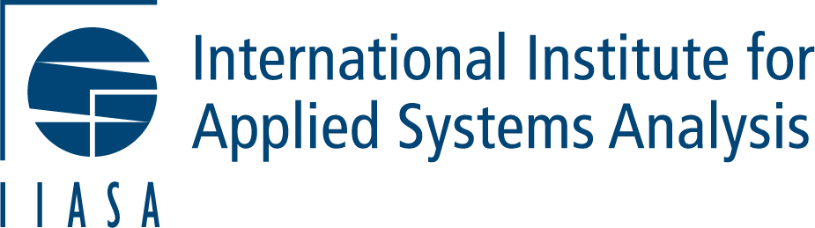
Revitalizing official statistics:
Citizen science for inclusive SDG data in times of financial and political crisis
Dr. Dilek Fraisl (IIASA & CSGP)
Francesca Perucci (UNSD Collaborative on Citizen Data & Open Data Watch
Omar Seidu (Ghana Statistical Service)
Dr. Katya Perez Guzman (IIASA & CSGP)

Slide 2
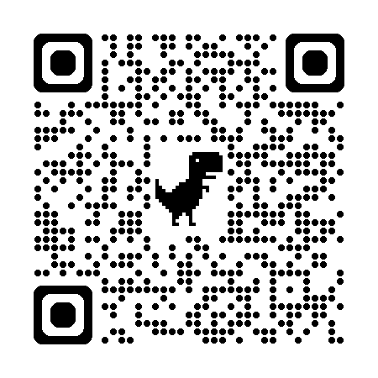
Session Objectives
Official statistics are under pressure from political pushback, financial cuts, and shifting priorities, threatening SDG and global development progress. The loss of major health surveys once backed by the United States Agency for International Development (USAID) and proposed cuts to environmental programs in the US (EPA) threaten the tracking of sustainable development. Citizen science can and should be central to building stronger, more resilient data systems.
To explore how citizen science can address these data gaps and build more resilient, inclusive data ecosystems rooted in trust, collaborations and inclusivity.
To introduce the the UN Statistics Division and partners-led Collaborative on Citizen Data and soft-launch of the Citizen Science Working Group under this Collaborative.

Slide 3
Agenda and Logistics
Scene setting on why citizen science is essential for official statistics, Dilek (10 min)
Policy Debate, Dilek & speakers (40 min)
UNSD Collaborative on Citizen Data and its Citizen Science WG (10 min)
Open Microphone, Dilek (35 min)
Key take-aways and wrap up, Austin (5 min)

Slide 4
Speakers & Conveners
Dr. Inian Moorthy, IIASA
Dr. Karen Soacha Godoy, RICAP
Prof. Francois Grey, CSGP
Martin Brocklehurst, CSGP, ECSA
Prof. Austin Mast, CSGP & AAPS
Dr. Dilek Fraisl, CSGP & IIASA
Francesca Perucci, Open Data Watch
Omar Seidu, Ghana Statistical Service
Dr. Katya Perez Guzman, CSGP & IIASA

Slide 5
Why Citizen Science is Now Essential for Official Statistics
The termination of DHS, a critical source of data on population, health, HIV, and nutrition in over 90 countries, supported by the USAID, constitutes a crisis for official statistics. This is particularly true for low- and middle-income countries that lack their own survey infrastructure.
The U.S. Mission to the UN formally rejected the SDGs stating that "globalist endeavors like Agenda 2030 and the SDGs lost at the ballot box”.
Such political changes have exposed the risks of relying too heavily on a single country or institution to run global surveys and placing minimal responsibility on individual countries for their own data collection.
Many high-income countries, particularly European ones, are experiencing similar challenges and financial pressures on their statistical systems as their national budgets are increasingly prioritizing defense spending.
Along with these budget cuts perceived efficiency gains from AI are increasingly viewed as a pretense to put further budgetary pressure on official statistical agencies.
The 2025 SDG Report indicates that with only five years left to the 2030 deadline, only 18% of the targets are on track, with over a third having stalled or regressed.
Although progress has been made, we have 4 years to achieve the SDGs, but goals like Goal 5 (Gender equality), Goal 11 (Sustainable cities and communities), Goal 13 (Climate action) and Goal 16 (Peace, justice and strong institutions) continue to lag significantly in terms of data availability, at below 30%.
Notes:
In this evolving environment, we argue that citizen science can become an essential part of national data gathering efforts. To date, policymakers, researchers, and agencies have viewed it as supplementary to official statistics. We contend that, rather than an optional complement, citizen science data should be systematically integrated into national and global data ecosystems.

Slide 6
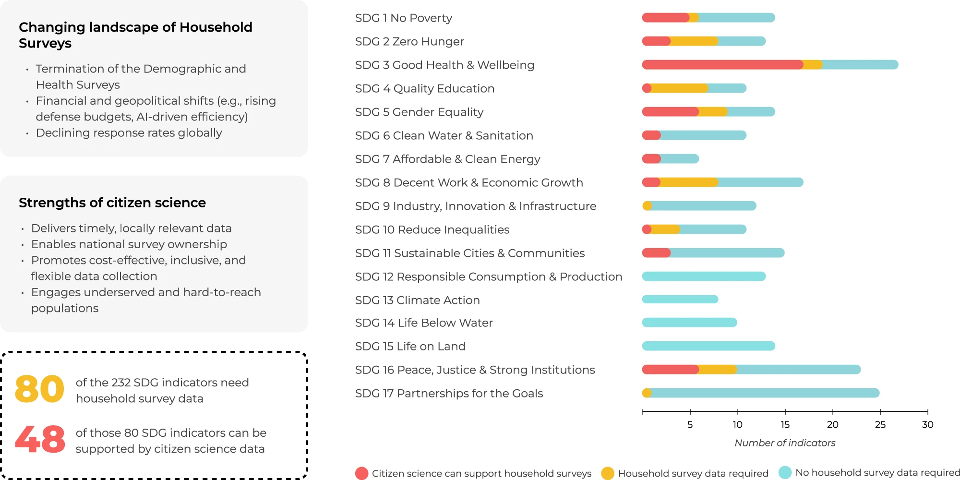
Demographic and Health Surveys contribute directly to the calculation of around 30 of the indicators that underpin the Sustainable Development Goals (SDGs). Athird of SDG indicators rely on household surveys data. Citizen science data could potentially support 48 (or 60%) of the indicators that currently rely on household surveys, across 13 SDGs.
Notes:
Citizen science can play a role in monitoring environmental SDGs. The potential of citizen science extends far beyond environmental indicators, covering socioeconomic and governance indicators. This is particularly true for indicators that require self-reported data on citizen experiences, such as feeling safe walking home and experiencing physical, sexual, or psychological violence. More specifically, a pilot initiative used citizen science to measure satisfaction with public services in Ghana13, informing SDG indicators related to peace, justice, and strong institutions (SDG 16). These projects show the ability of citizen science to reach underserved groups, tailor approaches to local contexts, and collect feedback-driven data. We find that citizen science data could potentially support 48 (or 60%) of the indicators that currently rely on household surveys5, across 13 SDGs. The Inter-secretariat Working Group on Household Surveys (ISWGHS) has identified that 80 SDG indicators require household survey data across 13 SDGs. 48 which means 60% of these SDG indicators can be monitored through citizen science data. SDG 3 Good Health and Wellbeing stands out with the greatest potential from this analysis: 17 indicators out of the 19 that are currently supported by household surveys could be informed by citizen science data. As such, citizen science is already positioned to address data gaps left by the end of the Demographic and Health Surveys. The critical challenge is to scale up these efforts to cover the globe.

Slide 7
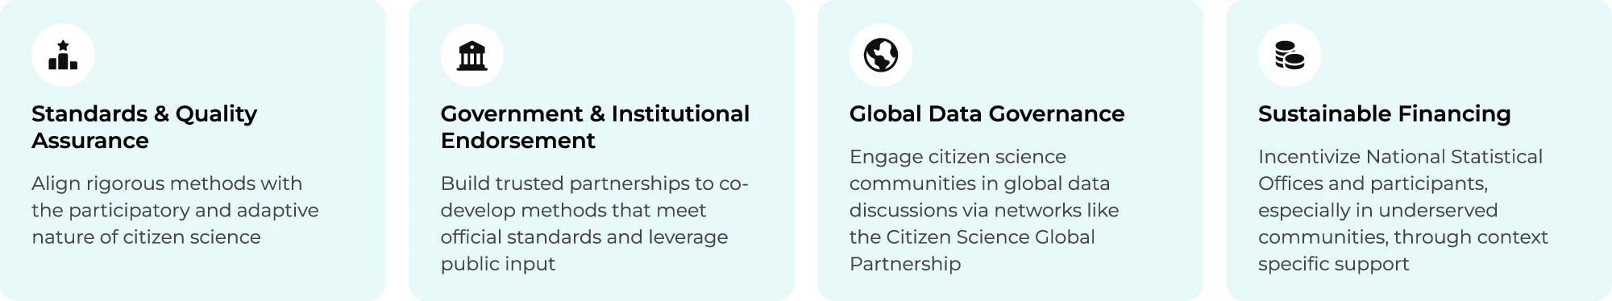
Why Citizen Science is Now Essential for Official Statistics
The transition from optional to essential
We need a fundamental shift in how we view citizen science. Official statistics and policy communities have long seen it as a secondary data source, with concerns over data quality and limited awareness of its potential. They must recognize data generated by the public voluntarily as an essential contribution to official statistics.
Notes:
A crucial first step is the formal integration of citizen science into national statistical systems through official acknowledgment, such as via statistical acts, regulations and frameworks and standardized protocols. While citizen science offers flexibility and bottom-up engagement, ensuring data quality, comparability and privacy requires structured frameworks. Agencies should develop standards specifically tailored to citizen science that carefully balance methodological rigor with the participatory and adaptive nature of citizen science.
The next step is to secure government support and institutional backing to work with agencies, researchers, practitioners and technology developers to design data collection methods that meet official quality standards.
The third is for the global initiatives and statistical agencies to include citizen science communities in global data governance conversations, such as the Global Digital Compact and Artificial Intelligence ethics frameworks. Inclusive and participatory global data governance will be critical in shaping an equitable future for official statistics.
Finally, sustainable financing is essential. Although more affordable than traditional data collection, citizen science is not free and often requires technological developments and community co-design.

Slide 8
Policy Debate
Dr. Inian Moorthy, IIASA
Dr. Karen Soacha Godoy, RICAP
Prof. Francois Grey, CSGP
Martin Brocklehurst, CSGP, ECSA
Prof. Austin Mast, CSGP & AAPS
Dr. Dilek Fraisl, CSGP & IIASA
Francesca Perucci, Open Data Watch
Omar Seidu, Ghana Statistical Service
Dr. Katya Perez Guzman, CSGP & IIASA

Slide 9
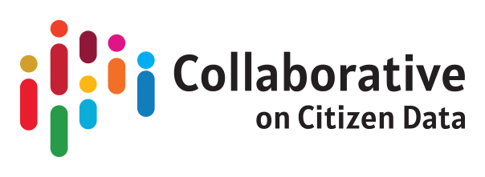
Collaborative on Citizen Data
Citizen Science Working Group

Slide 10
Collaborative on Citizen Data
Abbreviated History
April 2023: Launch of Collaborative on Citizen Data after earlier expert meeting and the receipt of mandate to work on citizen data by UN Statistical Commission.
September 2023: Expert group meeting produces the “Copenhagen Framework on Citizen Data.”
March 2025: UN Statistical Commission endorses Copenhagen Framework.
November 2025: Implementation framework meeting (Bangkok, Thailand) at which work on a Citizen Science Working Group occurs.

Slide 11
Copenhagen Framework on Citizen Data
Motivation
[Filling] critical data gaps for marginalized groups, ensuring that their experiences are reflected in data and statistics and advancing fairness, inclusiveness, openness, accountability, and transparency in statistics and in public policy.” . . . “particularly relevant to the leave no one behind principle, anchored in the 2030 Agenda for Sustainable Development.

Slide 12
Copenhagen Framework on Citizen Data
Operational Definition of “Citizen Data”
Data originating from initiatives where citizens either initiate or are sufficiently engaged, at the minimum, in the design and/or collection stages of the data value chain, irrespective of whether these data are integrated into official statistics.
Underlining is as written in Framework

Slide 13
Copenhagen Framework on Citizen Data
Objectives of Citizen Data
Responding to data needs of groups or communities that do not feel represented by the data available in their national or local data ecosystems.
Evaluating or monitoring service access and supporting legal and policymaking.
Assessing and monitoring the level of recognition and implementation of rights.
Challenge official data or fill in gaps not addressed by official data.
Understanding complex issues, dynamics and powers prevailing in communities.
Increasing public understanding and awareness, mobilizing actions and empowering local communities.
Providing evidence for scientific studies and research.

Slide 14
Copenhagen Framework on Citizen Data
Principles of Citizen Data
Independence
Relevance
Participation and informed consent
Professional standards
Data security
Self-definition and self-identification
Transparency
Ethical and safe production and use
Confidentiality, privacy and data attribution
Openness and accessibility

Slide 15
Citizen Science Working Group of the Collaborative on Citizen Data
Overall Objective from Draft Terms of Reference
Foster collaboration between the citizen science and the citizen data communities and promote meaningful dialogue and knowledge exchange between the citizen science and citizen data communities. . . serves as a platform to connect diverse initiatives working at the intersection of citizen science, citizen data, official statistics, and policy.
February 2026 Version

Slide 16
Citizen Science Working Group of the Collaborative on Citizen Data
Objectives, Tasks, and Deliverables
Objective 1: Build a shared understanding and capacity for citizen science and citizen data across both communities.
Task 1.1 – Building on the Collaborative’s work and the Copenhagen Framework, develop shared concepts and values, including common definitions, identified synergies, a Terms of Reference, glossary, and shared human rights and ethics principles and practices.
Outputs:
Terms of Reference of the Working Group
Common concepts and terminology, including a glossary, shared definitions
Map commonalities, overlaps, or contrasts in citizen science and citizen data
Human rights impact assessment guidance for citizen science

Slide 17
Citizen Science Working Group of the Collaborative on Citizen Data
Objectives, Tasks, and Deliverables
Task 1.2 – Build capacity and awareness of citizen science initiatives across communities including NSOs, CSOs, academia, and grassroot initiatives
Outputs:
Contribution to the training modules and capacity-building materials of the Collaborative
Awareness products explaining citizen science applicability for policy and the SDGs, such as a policy brief and/or an infographic building on the guidance material of the collaborative
Translated and adapted citizen science tools and methods that can be useful for adaptation and easy to use in citizen data project implementation protocols consistent with the Copenhagen Framework and based on existing citizen science resources and tools for civil society and community use

Slide 18
Citizen Science Working Group of the Collaborative on Citizen Data
Objectives, Tasks, and Deliverables
Task 1.3 – Identify key actors, touchpoints, and collaboration pathways
Outputs:
Stakeholder map and collaboration pathways
List of touchpoints (common areas of work, implementation, outreach, etc.) between citizen data and citizen science communities

Slide 19
Citizen Science Working Group of the Collaborative on Citizen Data
Objectives, Tasks, and Deliverables
Objective 2: Strengthen collaboration, shared tools, implementation of the SDGs, policymaking and data literacy between citizen science and citizen data communities
Task 2.1 – Identify and share existing tools, platforms, best practices and methods that support collaboration
Outputs:
Knowledge-sharing platform specifically tailored to collaboration between the two communities under the Collaborative website

Slide 20
Citizen Science Working Group of the Collaborative on Citizen Data
Objectives, Tasks, and Deliverables
Task 2.2 – Produce collaborative knowledge products and research
Outputs:
A paper on collaboration models between citizen science and the broader citizen data actors
Scientific paper outlining documented best practices, case studies, and lessons learned from both communities in the context of policy
Methodological guidance on collaboration between the two communities

Slide 21
Citizen Science Working Group of the Collaborative on Citizen Data
Objectives, Tasks, and Deliverables
Task 2.3 – Develop citizen science and citizen data policy influence frameworks in the context of SDG monitoring and beyond
Outputs:
Manual and training materials for applying citizen science and citizen data to SDG monitoring
Inventory/repository of citizen science initiatives mapped to SDGs
Policy alignment guidelines for integrating CS into official monitoring

Slide 22
Citizen Science Working Group of the Collaborative on Citizen Data
Next Steps
UN World Data Forum, Riyadh, 9-12 November 2026

Slide 23
Open Microphone

Slide 24
Reflections - Contributions
Would anyone like to share reflections on the discussions we’ve heard so far?
Do you have a specific example of successful data uptake and resulting policy impact at the local, national, or global level that you could share?

Slide 25
THANK YOU and PLEASE REACH OUT!
Dilek Fraisl: fraisl@iiasa.ac.at
Francesca Perucci: francescaperucci@opendatawatch.com
Collaborative on Citizen Data
https://unstats.un.org/UNSDWebsite/citizen-data/
citizen.data@un.org
Citizen Science Global Partnership
https://citizenscienceglobal.org/
info@globalcitizenscience.org

