Slide 1



Scenario Compass Initiative
Keywan Riahi, Karl Scheifinger, Daniel Huppmann et al.
04th May 2026
Notes:
What is it?
Community effort to collect new scenarios, vet them, and make them accessible to users of scenario information.
Who is involved?
* Multiple scientific working groups, and users of scenario information (e.g. WWF, WRI, Climateworks)

Slide 2
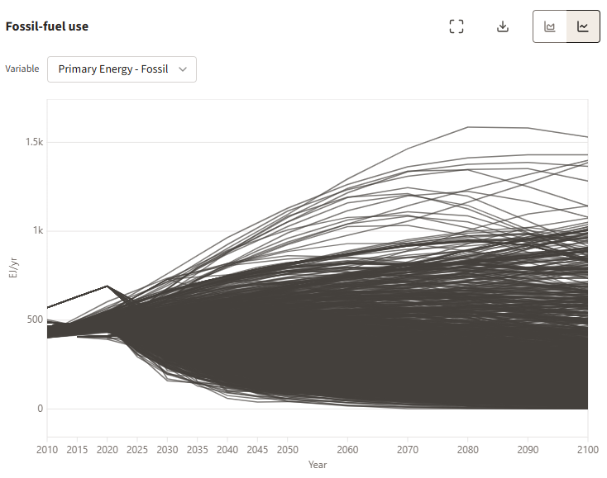
Scenario Compass Initiative
Presentation outline
Scenario Users Struggle
Problem statement
The Scenario Compass Initiative
Updated global mitigation benchmarks
1

Slide 3
Scenario Compass Initiative
Scenario Users Struggle
Many scenarios
All scenarios
2

Slide 4
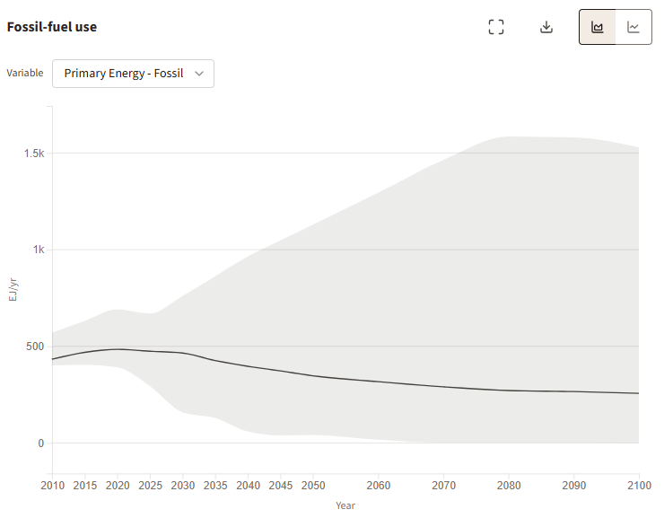
Scenario Compass Initiative
Scenario Users Struggle
Many scenarios
All scenarios
3
Notes:
Many scenarios: every year, community release new scenarios ~ easily more than 1.500 global scientific scenarios

Slide 5
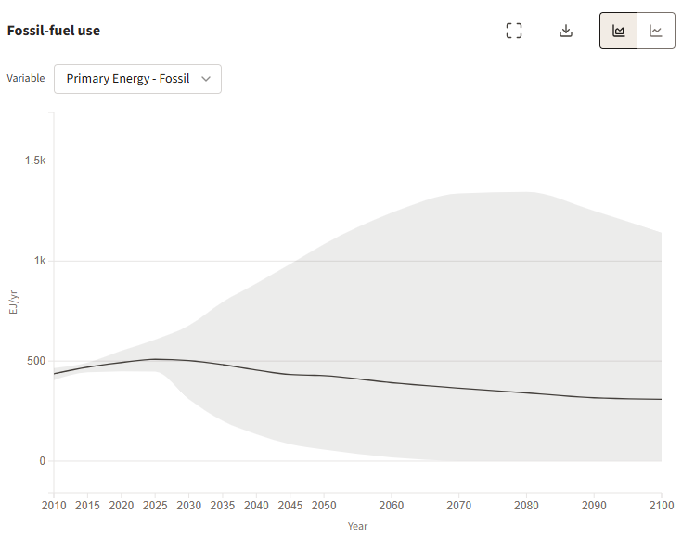
Scenario Compass Initiative
Scenario Users Struggle
Many scenarios
Rapid developments
Scenarios correctly representing current systems
4
Notes:
Rapid developments = those that pass vetting only

Slide 6
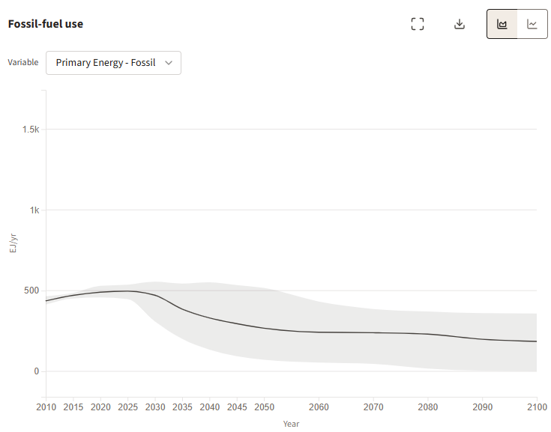
Scenario Compass Initiative
Scenario Users Struggle
Many scenarios
Rapid developments
Many assumptions
Scenarios correctly representing current systems
+ Paris-aligned
5
Notes:
Complex Assumptions: Paris-aligned only

Slide 7
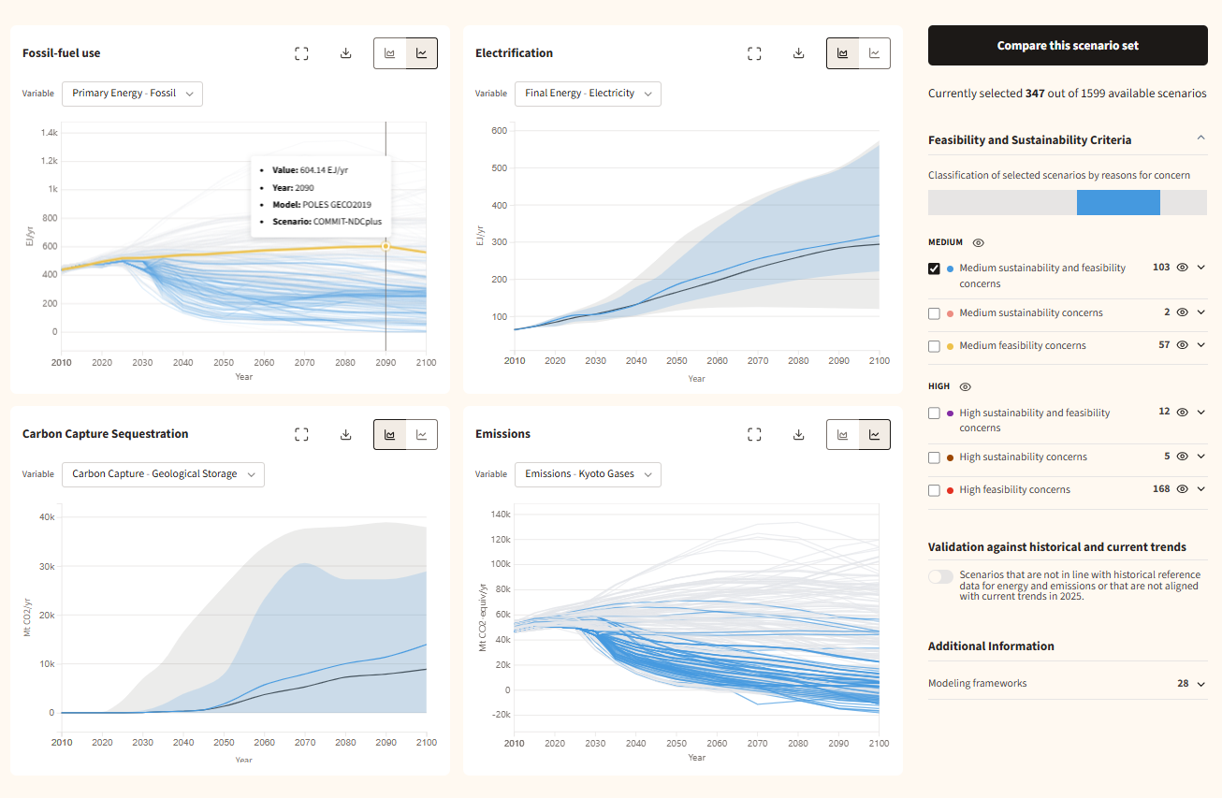
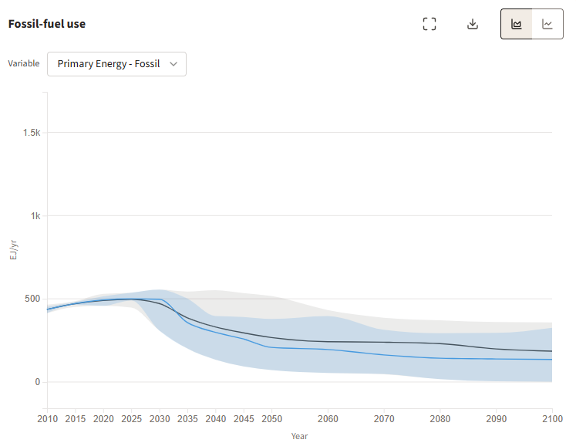
Scenario Compass Initiative
Scenario Users Struggle
Many scenarios
Rapid developments
Many assumptions
Scenarios correctly representing current systems
+ Paris-aligned + No high concerns
6
Notes:
Complex Assumptions: Paris-aligned only + those without high sus & feas concerns

Slide 8
Scenario Compass Initiative
The SCI
7
Scenario database
Dynamic assessment
Accessible interface
Notes:
Lack of clarity: hampers relevance of scenarios for decision making
Establish the Scenario Compass, a community-driven live database and interface that caters to the specific needs of decision-makers providing easy access to relevant scenarios.

Slide 9
Scenario Compass Initiative
The SCI
Scenario database
Dynamic assessment
Accessible interface
7
Notes:
Test, share enrich
The SCI aims to provide a new resource for scenario users, including a continuously updated, curated ensemble of global emissions scenarios
Moves beyond static scenario snapshots (e.g. IPCC AR6)
CMIP-style community activity of global emissions modellers designed to support policy assessment, tracking progress, and updating benchmarks over time

Slide 10
Scenario collection, vetting, and resulting emission trajectories
Submissions to SCI
(by region)
Basic checks: Can the scenario represent the current system?
Sustainability and feasibility/plausibility “flagging”
Sustainability
Food production
Bioenergy
CCS
Feasibility
- Technology build up
8
Notes:
What kicks out most scenarios? In vetting: 2025 values for Primary Energy|Coal (too high) & Primary Energy|Nuclear (too low)
Annual release of benchmarks derived from scenarios that meet feasibility and sustainability thresholds
No statistical outlier removal; instead, scenarios are filtered by explicit concern thresholds
Feasibility: too high nuclear & geological storage + too little solar
Sustainability: Biomass use

Slide 11
Updated missions ranges and new temperature categorization
10
Notes:
The mitigation landscape has shifted since AR6
Lowest AR6 category scenarios (C1) in scientific literature are no longer available under current conditions
New categorization with peak warming level of 1.7°C (50% chance)
Highest warming scenarios of the AR6 have become less plausible given current ramp-up of non-fossil energy carriers around the world

Slide 12
The mitigation landscape has shifted since AR6
Lowest AR6 category scenarios (C1) are no longer attainable under current conditions
New categorization with minimum peak warming level of 1.7C (50% chance)
Highest warming scenarios of the AR6 have become less plausible given current ramp-up of non-fossil energy carriers around the world
Overall less reliance on CO₂ removal than AR6
Solar and wind deployment shifted upwards
11

Slide 13
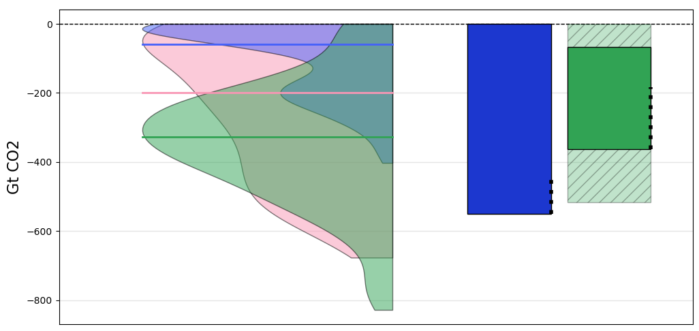
Overall less reliance on CO₂ removal than AR6
(i) Cumulative Net-negative Emissions
Feasible and sustainable scenarios
Dots indicate the sub-range of scenarios that bring back warming to below 1.5C by the end of the century
Distribution of IPCC AR6 scenarios in categories C1, C2, and C3
Range of vetted 2025 scenarios for category GW2 (below 1.7°C) and GW3 (likely below 2°C)

Slide 14
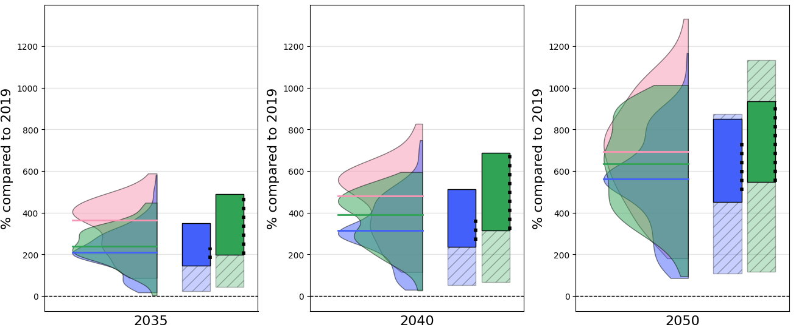
Solar and wind deployment shifted upwards
(i) Upscaling of Renewables
Feasible and sustainable scenarios
Dots indicate the sub-range of scenarios that bring back warming to below 1.5C by the end of the century
Distribution of IPCC AR6 scenarios in categories C1, C2, and C3
Range of vetted 2025 scenarios for category GW2 (below 1.7°C) and GW3 (likely below 2°C)
12

Slide 15
Main scenario benchmarks
"Mitigation benchmarks from the 2025 community update of global emissions pathways" (Riahi et al., submitted).
https://doi.org/10.21203/rs.3.rs-8891091/v1
13

Slide 16
SCI Activities in 2026
Expand with national scenarios, and new global scenarios
New Methods: weighting & conditionality, equity checker
Sectoral benchmarks for the industry, buildings and mobility sectors
14

Slide 17
Scenario Compass Initiative
Presentation outline
Problem statement
The Scenario Compass Initiative
Updated global mitigation benchmarks
15

Slide 18

Thank you
Want to know more?
Join the pop-up event at X224, IIASA booth,
12:00 – 13:00
Grant ID: G-2023-201305841
Notes:
Mention IIASA Booth in Hall X2 right next to the coffee area, 12:00 – 13:00 on the Scenario Compass Initiative

Slide 19
Interpreting benchmarks requires care
Benchmarks reflect reported model outputs, not necessarily the full space of conceivable futures
Benchmarks are dynamic and depend on action over the next years
Benchmarks indicate conditional feasibility, not guaranteed policy achievability
Need to increase diversity of model representation at the low end of the spectrum (1.5C scenarios) → encourage inclusive MIPs
Limited diversity of underlying narratives constrains interpretation, despite wide quantitative ranges
Benchmarks are conditional on the dimensions for feasibility and sustainability and thresholds (users can do their own analysis)
Reporting of land use and CDR requires more attention
Results depend on model structures and shared assumptions, including technology availability and governance effectiveness
The scenario ensemble is influenced by research focus and reporting incentives, potentially biasing coverage

Slide 20
Figure SI.2: All benchmarks

Slide 21
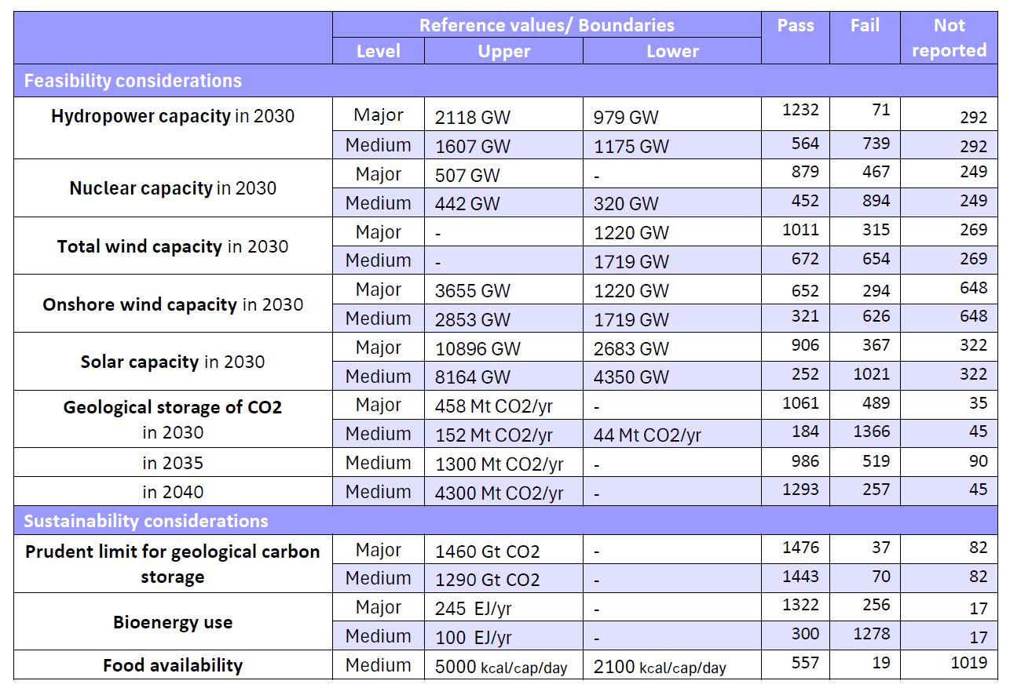
Basic checks and "flagging"
Overview of vetting criteria related to …
near-term feasibility/
plausibility concerns
sustainability concerns

Slide 22
Scenario collection, vetting, and resulting emission trajectories

Slide 23
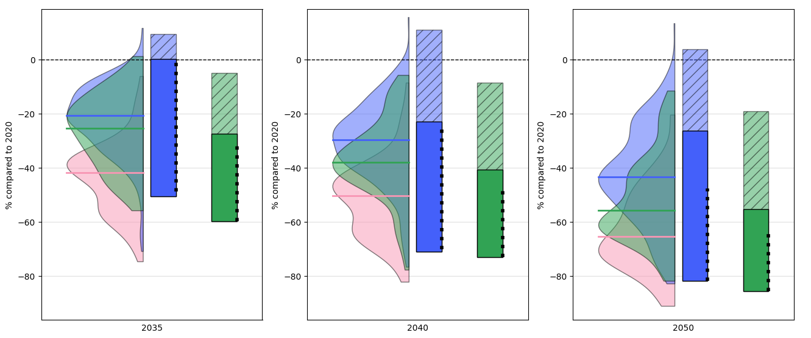
Main scenario benchmarks
Transitioning away from fossil fuels

Slide 24
Socio-economic scenario drivers
Most scenarios assume continued global income growth ​
Global average income over the course of the century typically exceeds today’s EU levels, and often today’s US levels
Substantial reductions in global income inequality are a common feature
Median North–South income ratio declines from >3 today to ~1.5​
Quantitatively wide ranges exist, but scenarios rely on a limited set of shared narratives (mainly SSP1–SSP2–like futures)

Slide 25
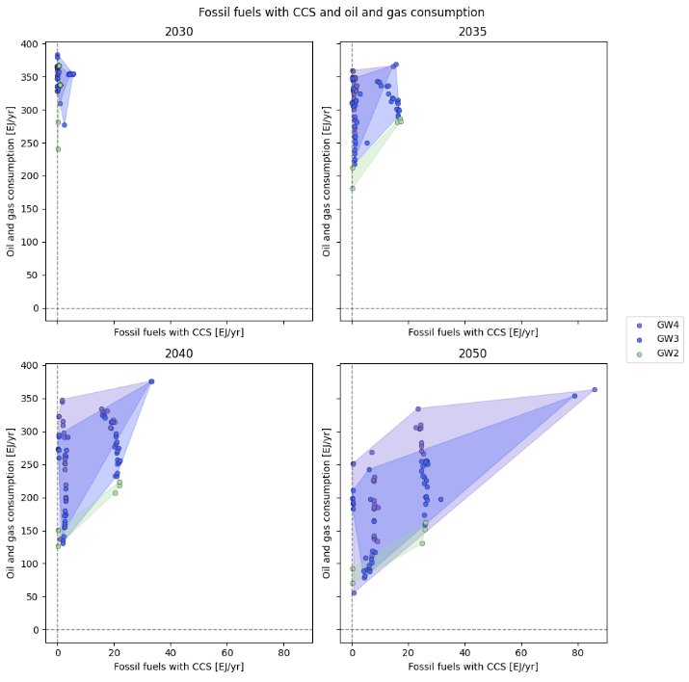
Figure SI.1: Benchmark trade-offs

Slide 26
Figure 3: Net-zero characteristics
Net-zero CO2 needs to be between 2050-2060 to limit peak warming and <2065 to bring warming back to 1.5C
Timing of net-zero GHG about 10 years later than net-zero CO2
200-300 GtCO2 cumulative negative emissions (2025-2100)
2-8 GtCO2 negative emissions at the time of net zero CO2
Issues: reporting of CDR

