Slide 1









Risk Communication and Public Engagement During the
2023 Turkey–Syria Earthquakes
Insights from Facebook Posts Analysis
Abraham Yosipof
Or Elroy
Faculty of Information Systems and Computer Science
The College of Law & Business, Ramat-Gan, Israel
Faculty of Information Systems and Computer Science
The College of Law & Business, Ramat-Gan, Israel
International Institute for Applied Systems Analysis
Laxenburg, Austria
Nadejda Komendantova
Antonella Peresan
International Institute for Applied Systems Analysis
Laxenburg, Austria
National Institute of Oceanography
and Applied Geophysics - OGS, Italy
EGU General Assembly 2026
Vienna, Austria, 8/05/2026
Contact: aviyo@clb.ac.il

Slide 2









Presentation Outline
2
Methodology
1
Introduction and Research Questions
4
Practical Implications
3
Results Analysis
Contact: aviyo@clb.ac.il

Slide 3










Background & Motivation
Understanding the context and importance of social media in disaster response
The Earthquake Event
Role of Social Media
February 6, 2023: Two massive earthquakes (Mw 7.8 and Mw 7.5) hit Turkey and Syria
Critical supplementary data stream for disaster response and coordination
50,000+ Casualties across Turkey and Syria
Real-time distress signals from trapped individuals via social platforms
15 million+ people impacted
Aid coordination & resource mobilization through community-driven posts
Communication infrastructure heavily damaged
Social media emerged as a critical supplementary data stream for creating a Common Operational Picture (COP)
50,000+
15M+
Casualties
Impacted
Contact: aviyo@clb.ac.il

Slide 4





Research Questions
Main Topics on Social Media
1
Community Needs & Response
2
What are the main topics discussed on social media during the earthquakes?
How did social media activity highlight community needs and response efforts?
3
4
Engagement Metrics & Gratifications
Risk Message Amplification
How do engagement metrics reflect gratifications motivating social media use?
How were risk-related messages amplified or attenuated through social media?
EGU General Assembly 2026

Slide 5



















Research Methodology
1
2
3
4
Data Collection
Embedding
Clustering
Analysis
Collected Facebook posts in Turkish from February 7-20, 2023
Used LaBSE model for language-agnostic sentence embeddings
Applied k-Means clustering with hierarchical merging
Comprehensive analysis of engagement metrics and patterns
117,760 posts
768-dimensional embeddings
20 clusters initially
Engagement metrics
Merged into 5 main topics
Temporal dynamics
14-day analysis period
Language-agnostic processing
Hierarchical analysis
Regression analysis
Contact: aviyo@clb.ac.il

Slide 6
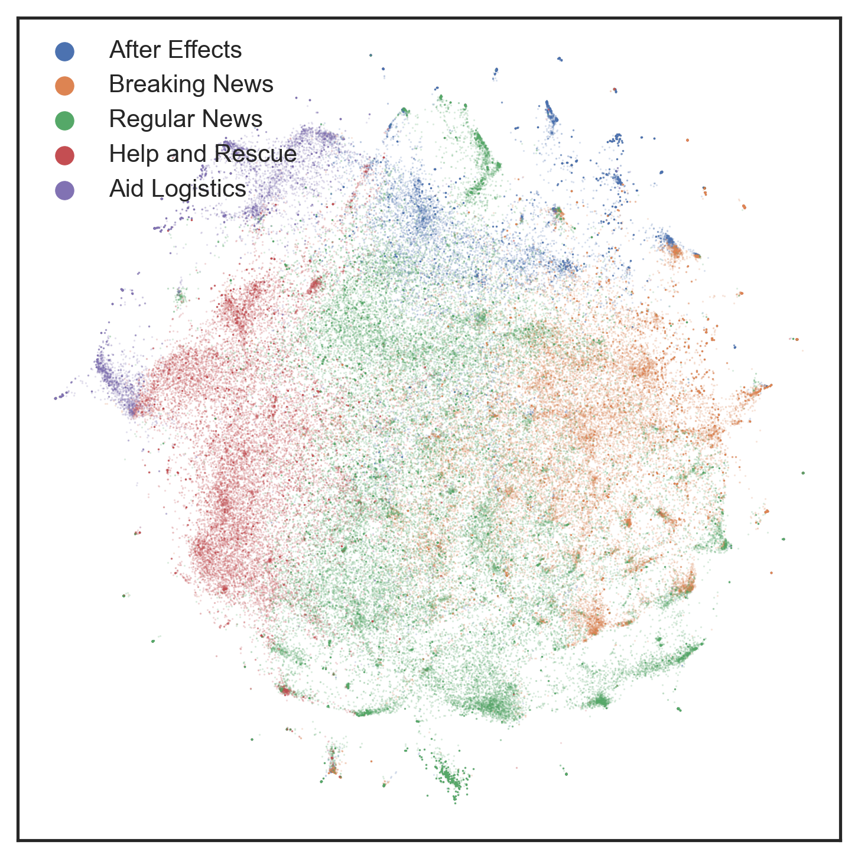
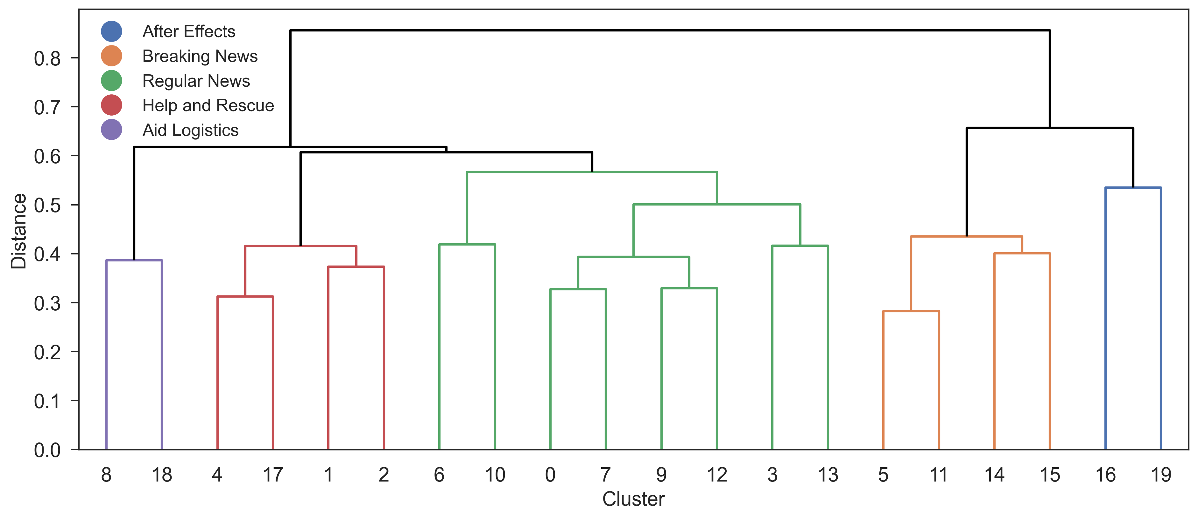
Topic Clustering Results
A. Hierarchical Clustering Dendrogram
B. t-SNE Visualization of Posts

Slide 7










Five Identified Topic Clusters
After Effects
Breaking News
Regular News
Help & Rescue
Aid Logistics
12,543
28,753
48,352
20,500
7,612
posts
posts
posts
posts
posts
Socio-economic impacts, price changes, entity responses
Real-time updates, rescue operations, public figures
Government initiatives, ongoing coverage
Rescue efforts, community help, distress signals, solidarity
Resource coordination, transportation, urgent needs
15%
#5
24%
#2
41%
#1
17%
#3
6%
#4
of total
rank
of total
rank
of total
rank
of total
rank
of total
rank

Slide 8









Engagement Metrics by Cluster
Analysis of user engagement across 5 topic clusters
Engagement Analysis
N = 117,760 posts
Metric
After Effects
Breaking News
Regular News
Help & Rescue
Aid Logistics
Likes
70.43
97.21
208.56
191.60
37.73
Comments
8.14
16.21
26.00
20.22
7.51
Shares
10.38
16.73
27.04
19.02
8.89
Love
2.59
3.44
9.33
7.76
1.41
Sad
5.82
6.21
25.48
13.05
2.23
Angry
1.21
2.93
3.03
0.28
0.31
Key Finding
Regular News and Help & Rescue posts received the highest engagement across all metrics, while Aid Logistics showed the lowest: indicating targeted but narrower reach.
Contact: aviyo@clb.ac.il

Slide 9
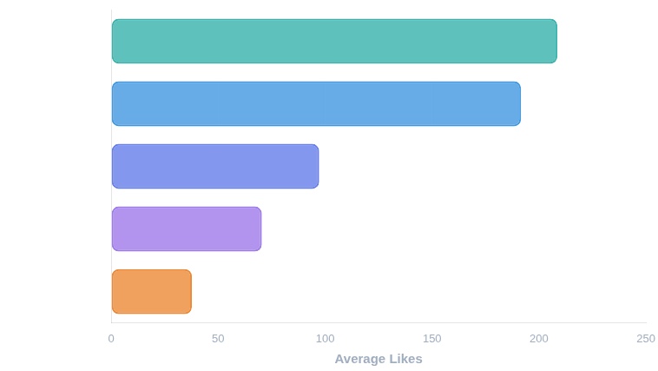
Average Engagement: Likes per Post
Comparing user interaction across 5 topic clusters

Slide 10







User Gratifications and Reactions
Emotional engagement patterns across different clusters
Emotional Solidarity
Frustration & Risk
Informational Needs
Breaking News and Regular News elicited most anger
Regular News fulfilled informational needs
Help & Rescue posts showed strong emotional reactions
Regular News
3.03
Average likes
208.6
Love reactions
7.76
Breaking News
2.93
Average shares
27.0
13.05
Sad reactions
Highest engagement across all metrics
Reflecting public frustration
Highlighting empathy and community support
Contact: aviyo@clb.ac.il

Slide 11
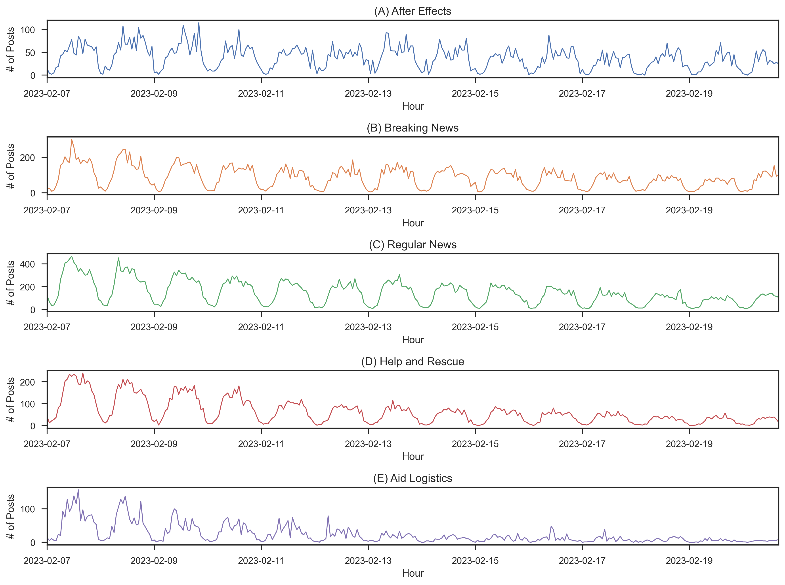
Temporal Analysis STL Decomposition
Temporal Dynamics: Engagement peaks during midday hours

Slide 12


Practical Implications
Recommendations for crisis responders and communication strategies
For Crisis Responders
Strategic Insights
Strategic Timing
Engagement Patterns
Post updates during midday peak cycles for maximum reach.
Regular News and Help & Rescue topics maintain public attention with 208.6 and 191.6 likes per post respectively.
Prioritize Persistence
Community Engagement
News and Rescue narratives sustain engagement longest. Maintain continuous updates in these categories during crises.
High empathetic reactions (love, sad) on Help & Rescue posts demonstrate social media's power for collective solidarity.
Feedback Loop
Monitor Aid Logistics status updates to identify real-time resource gaps and adjust communication strategy.
Alert Systems
Real-time monitoring of Aid Logistics can help identify urgent needs and coordinate response efforts.
Contact: aviyo@clb.ac.il

Slide 13





