Slide 1
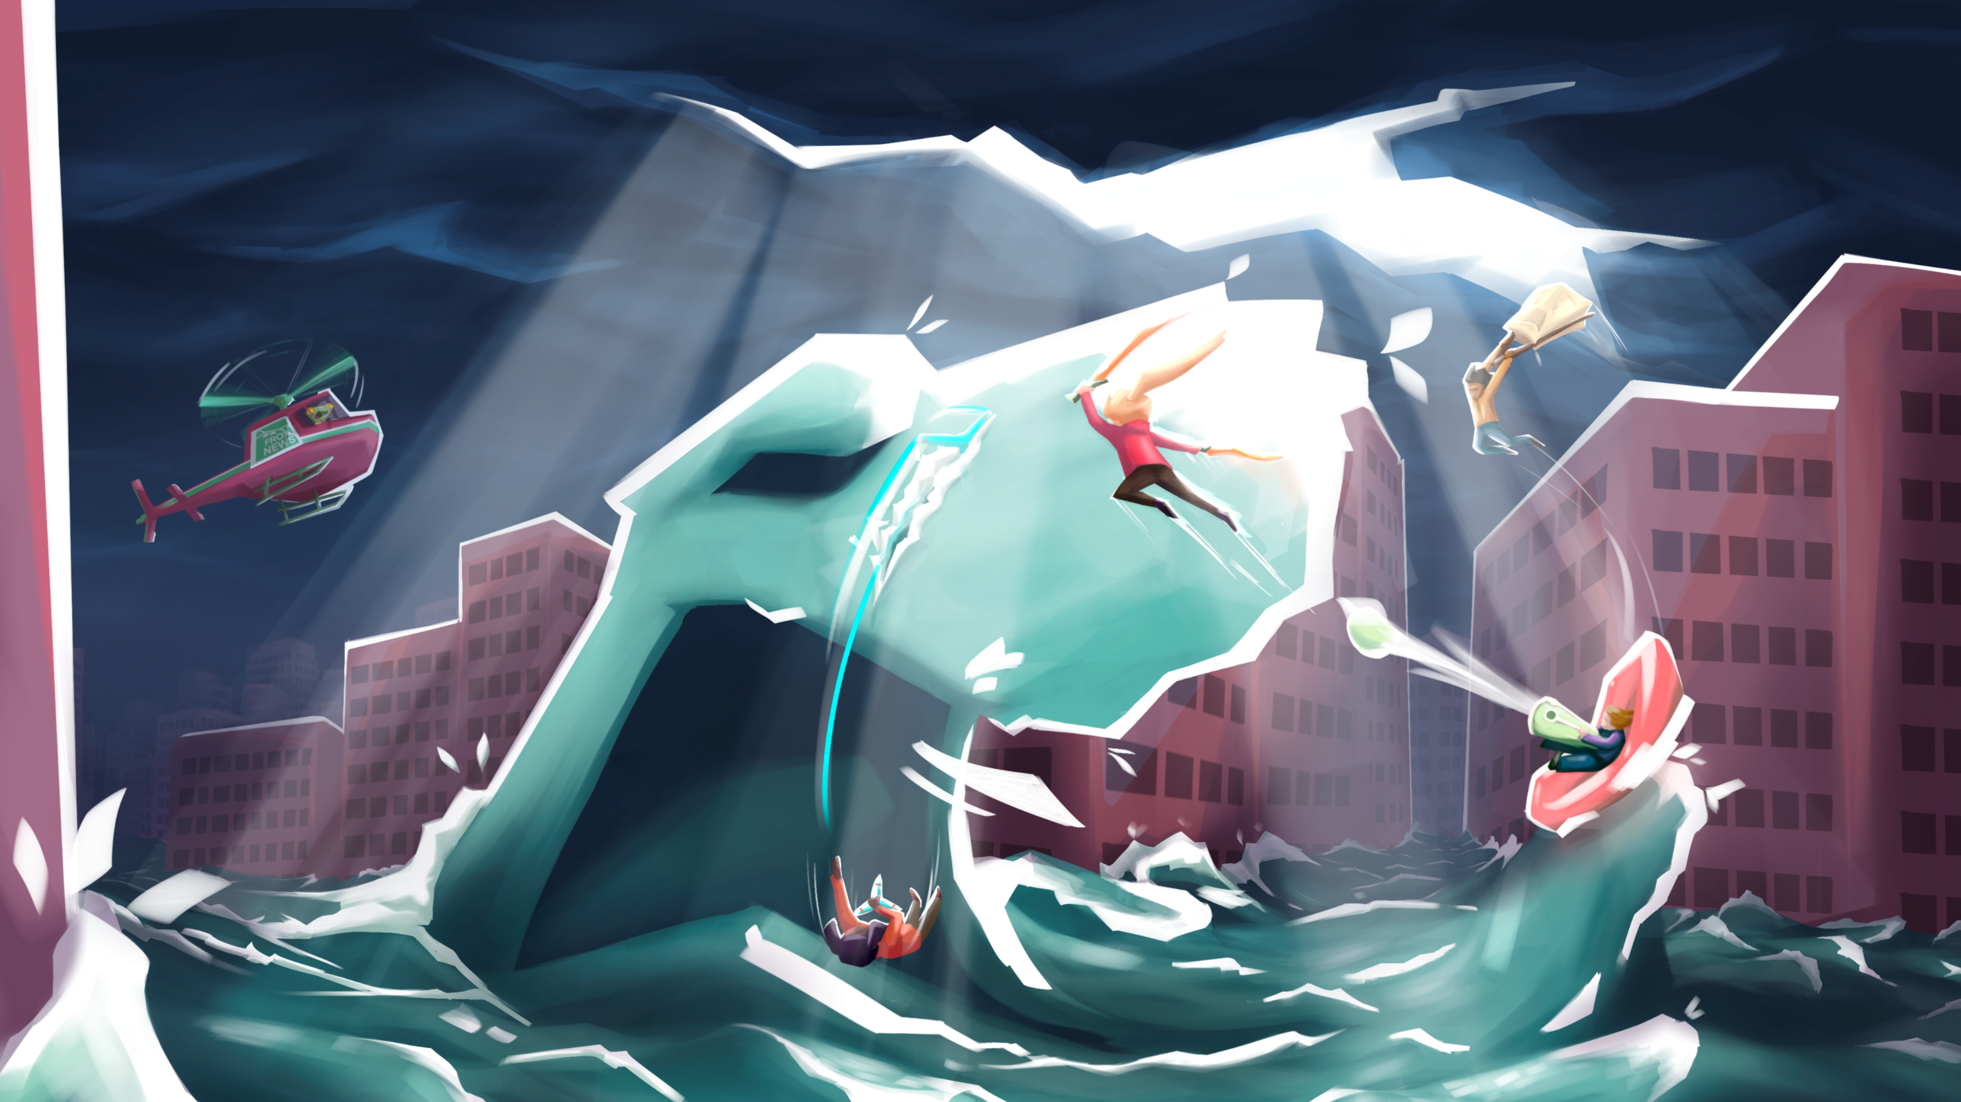


Slide 2




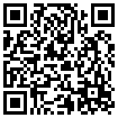

A climate action game
Jan Steinhauser^{1,2,3}, Doris Vollgruber², Steffen Fritz³, Ian McCallum³, Monika Mayer¹, Harald Rieder¹
¹ BOKU University ² Terragami Interactive GmbH ³ International Institute for Applied Systems Analysis
© 2026 Terragami Interactive GmbH. All rights reserved

Slide 3





Climate action meets light management and simulation elements
Brotato
Fast-paced survivors-like action
In Hotspot Earth, players fight climate-driven monsters, such as droughts and floods, manage an activist movement, and influence societal and climatic changes through their choices.
Hotspot Earth transports actionable knowledge about real needs and measures. At the same time, it is an engaging entertainment product. It combines easy-to-learn action gameplay with near infinite combinations through its upgrades and player choices.
Into the Breach
Team management and a strategic campaign
Climate Action
Real threats and measures shown in an engaging way

Slide 4

Core loop: Climate action around the world
Trailer also available on YouTube

Slide 5
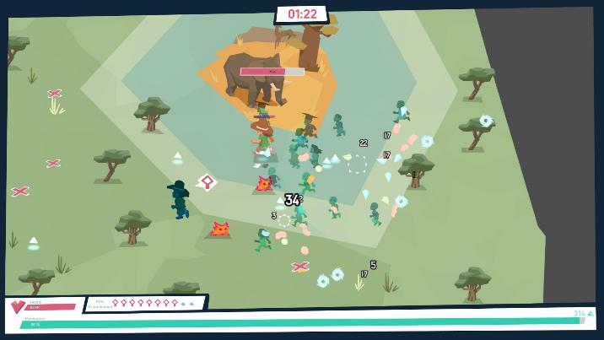
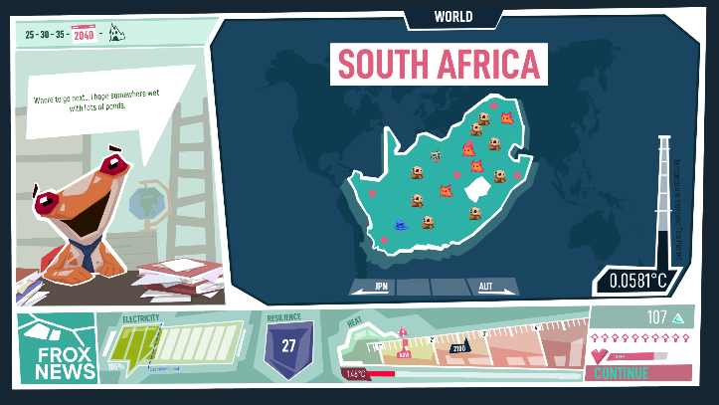
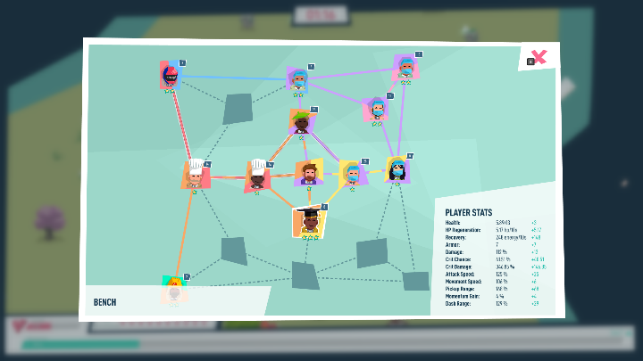
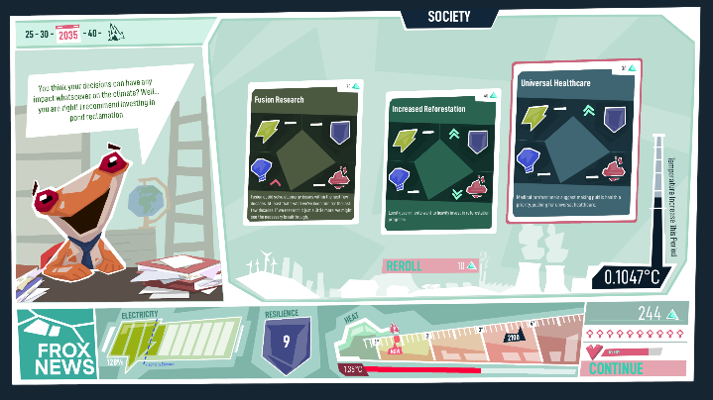
Core loop: Climate action around the world
Action
Plan your campaign and choose the next country to visit, with special challenges and rewards everywhere.
Defend yourself and points of interests against hordes of climate hazards. Collect momentum to spend in the Society & Climate Phase.
World
Empower your movement.
Face the crisis.
Survive the century.
Climate Movement
Society & Climate
Choose society’s direction and affect the internal climate model and thus the game world and hazard monsters.
Bring new activists into your network, adding new abilities and improving your stats. Color-match them for powerful synergies.

Slide 6

Core loop: Climate action around the world
Fight climate hazards
Action
Plan your campaign and choose the next country to visit, with special challenges and rewards everywhere.
Defend yourself and points of interests against hordes of climate hazards. Collect momentum to spend in the Society & Climate Phase.
World
Empower your movement.
Face the crisis.
Survive the century.
Climate Movement
Society & Climate
Choose society’s direction and affect the internal climate model and thus the game world and hazard monsters.
Bring new activists into your network, adding new abilities and improving your stats. Color-match them for powerful synergies.

Slide 7
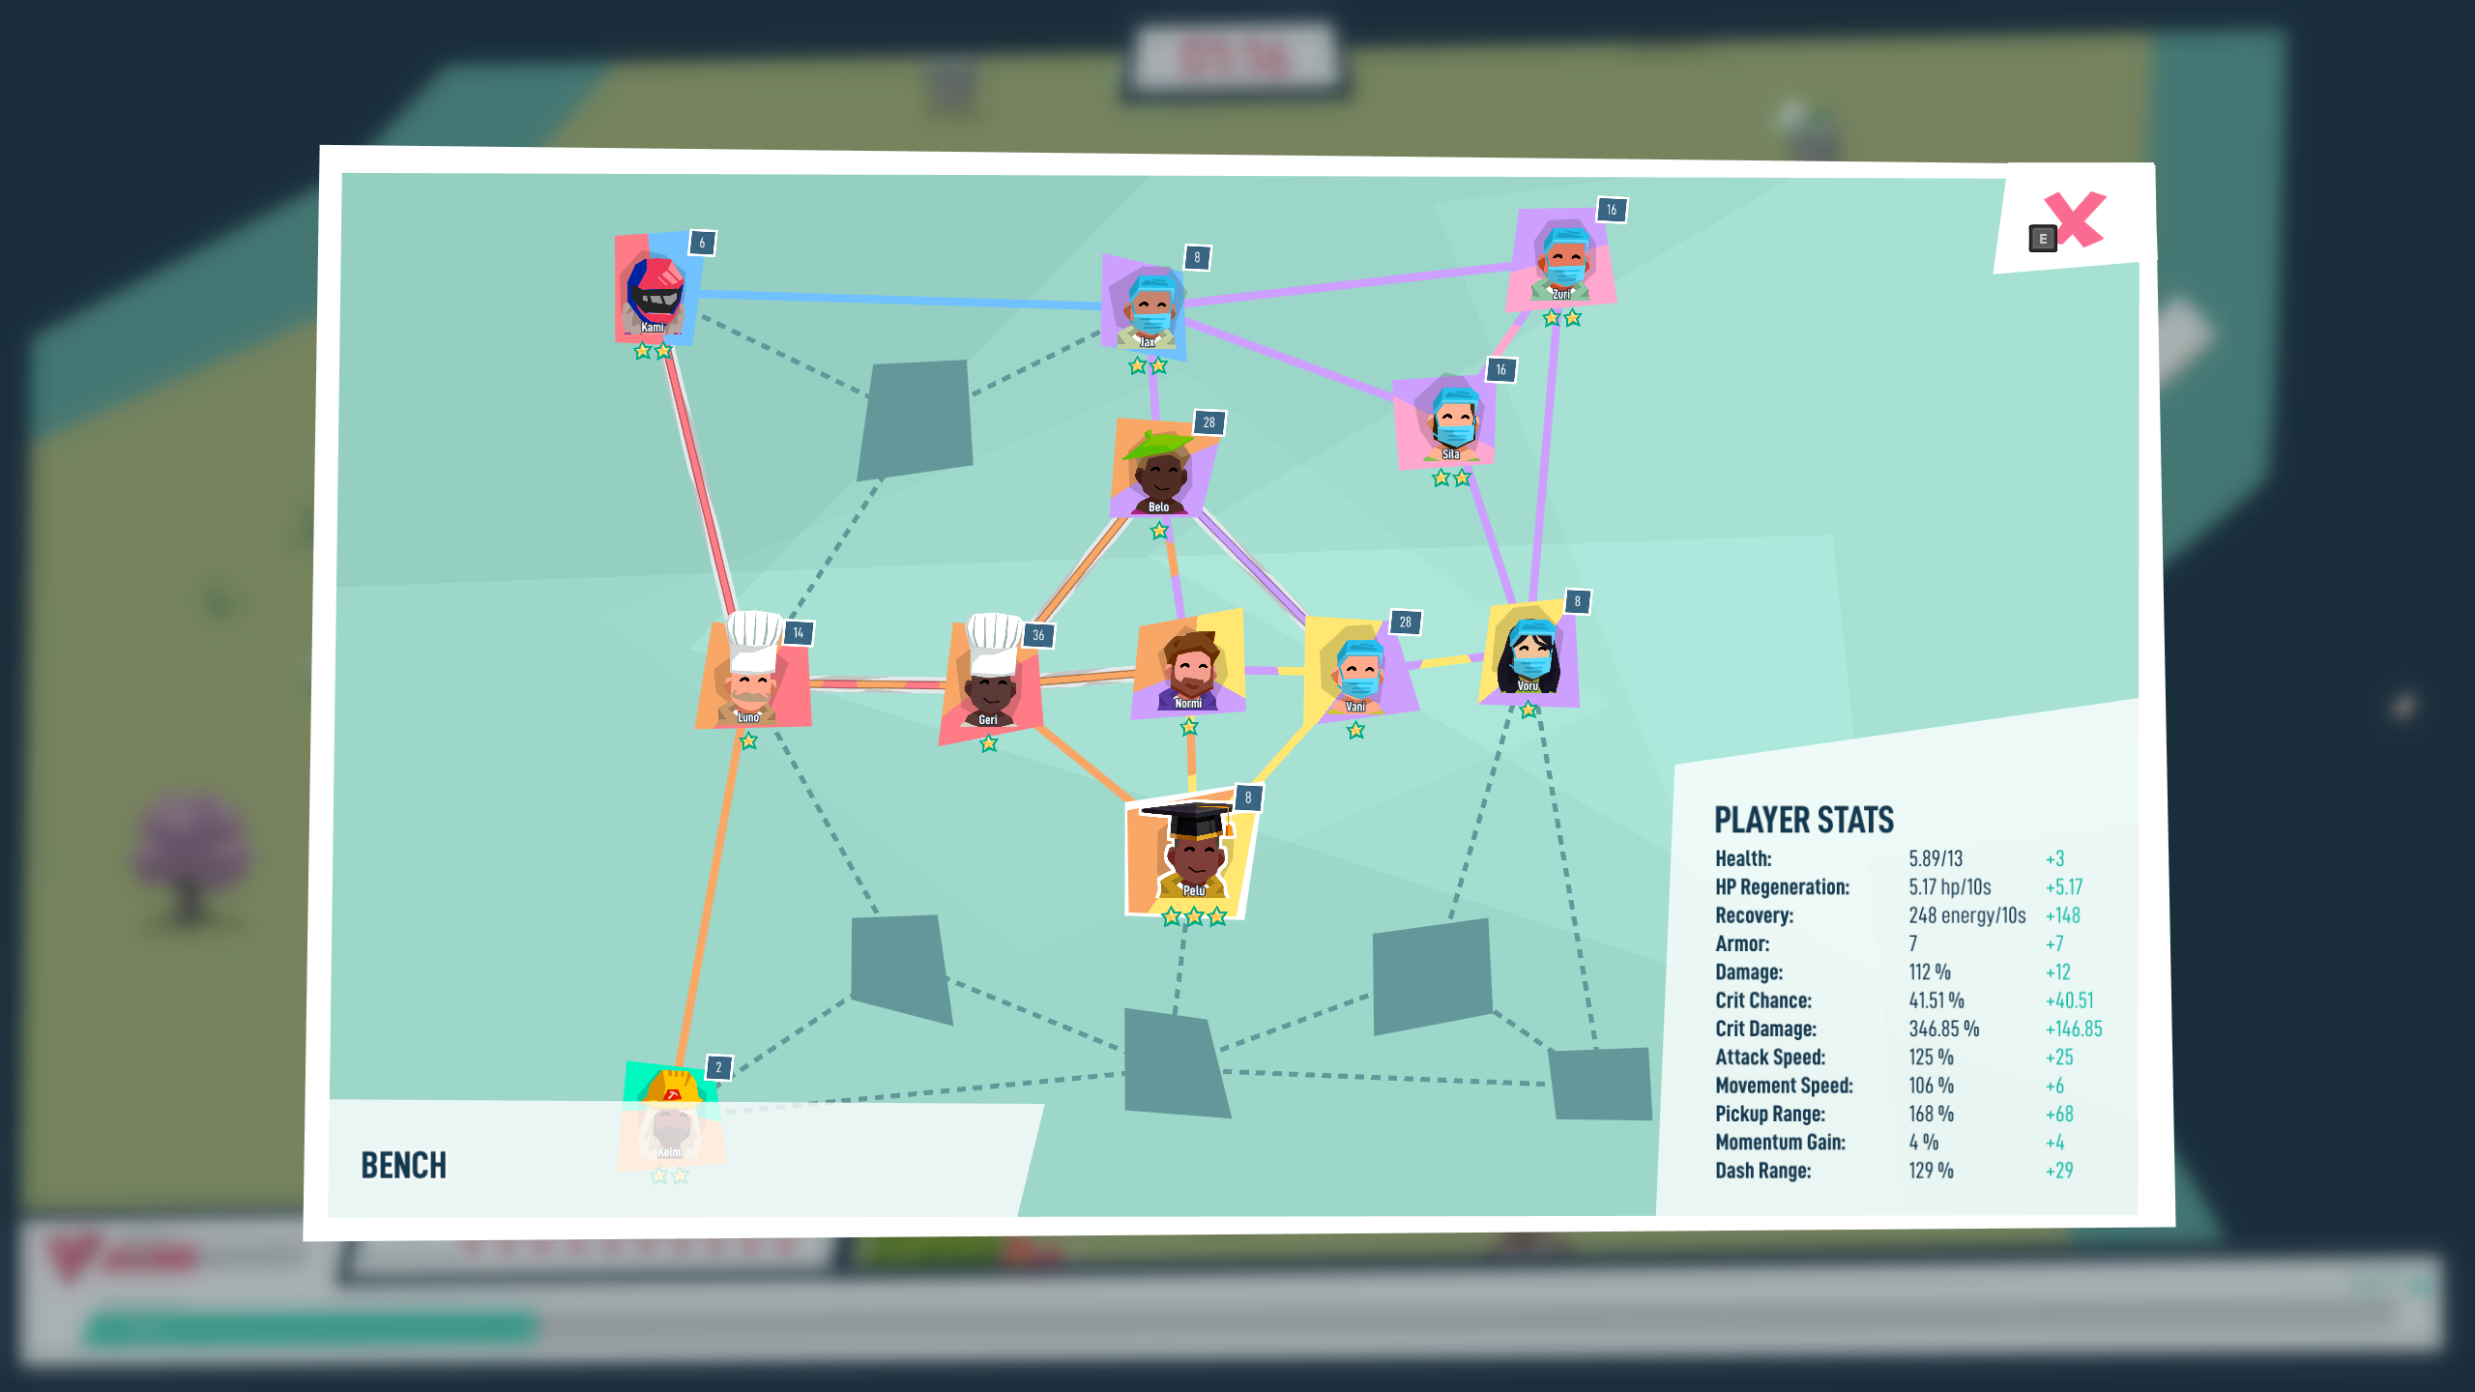
Core loop: Climate action around the world
Grow your movement
Action
Plan your campaign and choose the next country to visit, with special challenges and rewards everywhere.
Defend yourself and points of interests against hordes of climate hazards. Collect momentum to spend in the Society & Climate Phase.
World
Empower your movement.
Face the crisis.
Survive the century.
Climate Movement
Society & Climate
Choose society’s direction and affect the internal climate model and thus the game world and hazard monsters.
Bring new activists into your network, adding new abilities and improving your stats. Color-match them for powerful synergies.

Slide 8

Core loop: Climate action around the world
Action
Plan your campaign and choose the next country to visit, with special challenges and rewards everywhere.
Defend yourself and points of interests against hordes of climate hazards. Collect momentum to spend in the Society & Climate Phase.
World
Empower your movement.
Face the crisis.
Survive the century.
Climate Movement
Society & Climate
Choose society’s direction and affect the internal climate model and thus the game world and hazard monsters.
Bring new activists into your network, adding new abilities and improving your stats. Color-match them for powerful synergies.
Influence society and climate

Slide 9

Core loop: Climate action around the world
Action
Plan your campaign and choose the next country to visit, with special challenges and rewards everywhere.
Defend yourself and points of interests against hordes of climate hazards. Collect momentum to spend in the Society & Climate Phase.
World
Empower your movement.
Face the crisis.
Survive the century.
Climate Movement
Society & Climate
Choose society’s direction and affect the internal climate model and thus the game world and hazard monsters.
Bring new activists into your network, adding new abilities and improving your stats. Color-match them for powerful synergies.
Experience your impact around the world

Slide 10
Core loop: Climate action around the world
Action
Plan your campaign and choose the next country to visit, with special challenges and rewards everywhere.
Defend yourself and points of interests against hordes of climate hazards. Collect momentum to spend in the Society & Climate Phase.
World
Empower your movement.
Face the crisis.
Survive the century.
Climate Movement
Society & Climate
Choose society’s direction and affect the internal climate model and thus the game world and hazard monsters.
Bring new activists into your network, adding new abilities and improving your stats. Color-match them for powerful synergies.

Slide 11
A framework for effective climate communication
Uninformed
Active
Hotspot Earth builds on a framework for climate engagement through games by Ouariachi et al.
> Effectively engaging players requires not just knowledge sharing (cognitive engagement) but emotional and behavioral engagement as well.
> They proposed 15 game attributes that support engagement through one or multiple categories.
> Hotspot Earth aims to showcase all of the attributes in some form.
COGNITIVE
Credible
Experiential learning
Concrete
Challenging
Leveling-up
Fun
Achievable
Feedback- oriented
Simulating
Narrative-driven
Meaningful
EMOTIONAL
BEHAVIORAL
Identity-driven
Reward-driven
Efficacy-enhancing
Social
Informed but uncaring
Informed, caring but inactive
Steinhauser & Vollgruber (2024) based on Ouariachi et al. (2019)

Slide 12
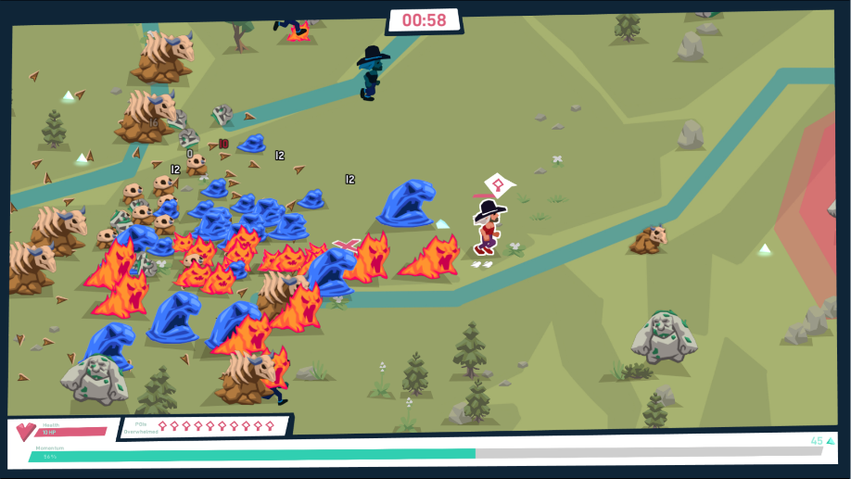
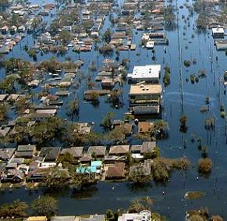
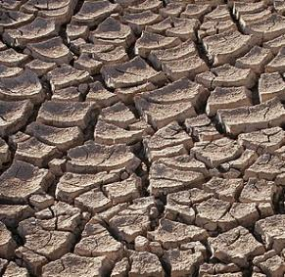
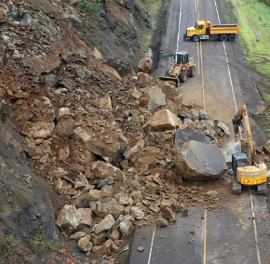



Action phase
Eye in eye with the crisis
> Players directly face a growing number of climate-driven hazards, both as monsters and emergencies affecting cultural points of interest.
> Players dodge and fight the monsters, help with emergency relief, collect momentum, and invite spawning activists to join their movement.
> Player weapons are inspired by various important individual actions, such as a Tofu Hammer or Wind-powered Shuriken, symbolizing low-footprint food choices or choosing green energy providers
Core message
Players directly experience how urgent the climate crisis already is and how much worse it can become if we, as society, don’t build up momentum and decide to act decisively.
Drought: © Tomas Castelazo, www.tomascastelazo.com / Wikimedia Commons / CC BY-SA 4.0 Rockslide: © Herbythyme / Wikimedia Commons / CC BY-SA 4.0

Slide 13
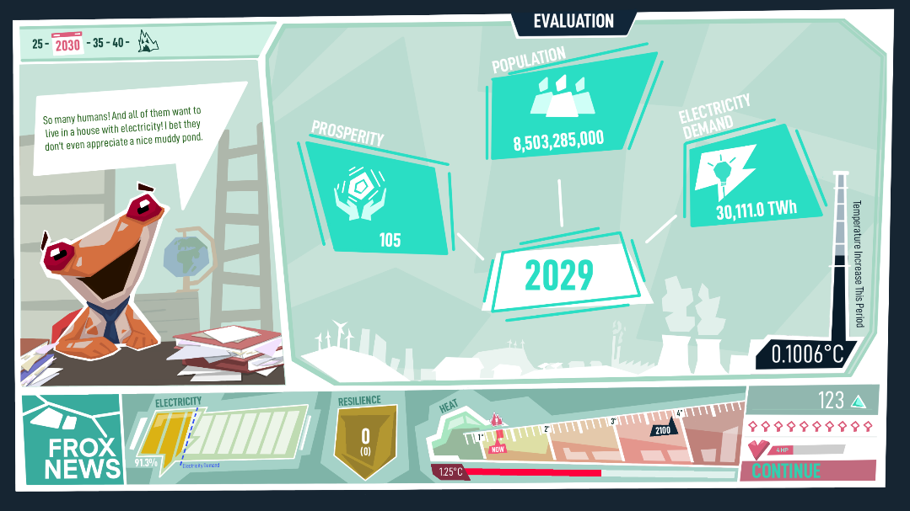

Society and climate phase
Moving the world forward
> Players learn how the baseline shifts based on combined population and prosperity growth and they previous round’s final indicators
> They “spend” momentum to activate various societal change cards, including cultural shifts, political developments and industrial investments.
> By combining efficient or synergizing cards, players create their individual pathways impacting the world’s resilience, prosperity and climate risks.
Core message
Correctly balancing various societal priorities is a difficult challenge. But we have countless measures in our toolkit. Some are more efficient than others, synergize well with some or block others, or carry co-benefits for, for example, health or biodiversity.
Underlying data
Population growth is based on SSP projections, baseline electricity demand on IEA data. Card effects are rough indicators of relative effect strength collected from various data bases and assessments. Collection is still ongoing.

Slide 14

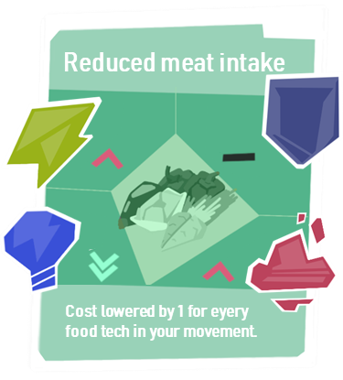




Action-society-climate link
Points of interest
Resilience
Electricity
Momentum
Emissions & heat
Action
Climate and society
Hazard strength
At Hotspot Earth’s core sits a simple climate model that links the two main phases of the game. Players collect momentum during the Action phase, then spend it during the Climate & Society phase to change the course of the world. Their choices shift emissions, the modelled temperature and thus how dangerous the hazard monsters and emergency events will become.
At the same time, players need to invest in adaptation measures to make the points of interests more resilient and keep an eye on societal needs (electricity) to avoid negative impacts on both resilience and momentum.

Slide 15
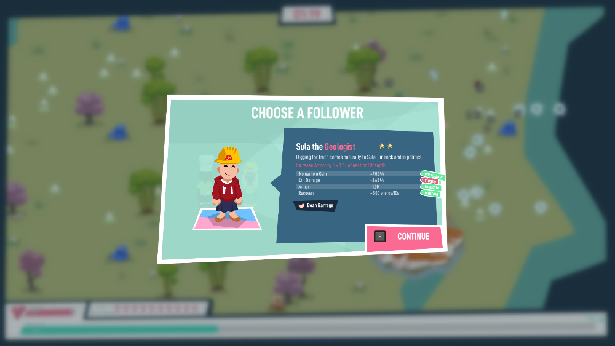

Climate movement
Player actions
> Players meet a large and diverse cast of activists, who expand and empower the movement.
> Besides a base skill shared across their respective profession, they are individuals adding random traits and weapons to the network. Even if they have negative traits, they are a net-gain for the network.
> Matching activists well with neighbours makes the network vastly stronger, lets them form long-term relationships and can create “game-breaking” synergies.
Core message
Every movement needs organizers and leaders at its core, like the player characters in Hotspot Earth. But it is the shared purpose and a diverse network that give any movement its true power. Every single person can become part of a larger lever for change and small individual actions add up.

Slide 16

World map: climate action everywhere
Player actions
> Players select the next level from a list of real-world countries.
> To help them decide, they see geographic information, such as the shape and size of the level, but also the type of hazards they are most likely to face as well as additional challenges and rewards
Core message
The crisis will be — and is already — everywhere, affecting everyone around the world. Impacts are much harder or felt much more strongly in some countries compared to others.

Slide 17
Strong sustainability scores
Player actions
Environment
> At the end of a run, players receive a score evaluating their relative success
> This score is based on various variable sustainability indicators, foremost the achieved temperature reduction below the base-line projection, but also collected co-benefit markers > The various sub-scores (e.g., per co-benefit count) are not just added up but multiplied, incentivizing a broad co-benefit portfolio over solely focusing on a single benefit
Society
Economy
Core message
While the climate crisis is a pressing issue, it is important and valuable to consider side effects of measures as well. Each of them has its merits, but none should be neglected while the others are expanded.
Giddings, Hopwood & O’Brien (2002)

Slide 18







Let's put the Action back into Climate Action
Hotspot Earth’s development is still ongoing. The project is currently in its Vertical Slice stage. Implementations are still being refined and the data shown are mostly still placeholders.
If you are interested in future updates, make sure to wishlist on Steam! And please share your feedback and input with us.
steinhauser@iiasa.ac.at
EGU26-11239

Slide 19
References
> Steinhauser J, Vollgruber D. Climate Survivors: A Bullet Heaven for Enhanced Climate Engagement. In: 2024 IEEE Gaming, Entertainment, and Media Conference (GEM) [Internet]. Turin, Italy: IEEE; 2024. p. 1–6. Available from: https://ieeexplore.ieee.org/document/10585396/ doi:10.1109/GEM61861.2024.10585396
> Ouariachi T, Olvera-Lobo MD, Gutiérrez-Pérez J, Maibach E. A framework for climate change engagement through video games. Environmental Education Research. 2019 May 4;25(5):701–16. doi:10.1080/13504622.2018.1545156
> Giddings B, Hopwood B, O’Brien G. Environment, economy and society: fitting them together into sustainable development. Sustainable Development. 2002 Nov;10(4):187–96. doi:10.1002/sd.199

