Slide 1

Disaster impact forecasting for risk-informed decision making with socioeconomic indices: evidence from earthquake-tsunami in India
Mohammad Reza Yeganegi
Elena Rovenskaya
Advancing System Analysis (ASA) Program
International Institute for Applied System Analysis (IIASA)
May | 2026 | Vienna
EGU 2026

Slide 2
Disaster Risk Management: Evidence Based Decision Making
The decision problem for Disaster Risk Reduction
Find the optimal solution to mitigate the disaster impact.
Evidence based decision making:
The severity of disaster impact needs to be measured
The disaster risk is being measured based on the impact of the disaster.

Slide 3
Disaster Risk Management: Socio-economic variables in DRR
The Socio-economic variable as decision criteria
Logic: the reduction in venerability would gradually reduce the severity of disaster’s undesirable outcome
Measuring efficiency can be challenging.
The Socio-economic variable as decision variables:
Espesificly plans to control the final outcome trough socio-economic variables in combination with other measures.
Needs structural model to track the changes in the environmental and socio-economic system.
Local level modeling can be challenging

Slide 4
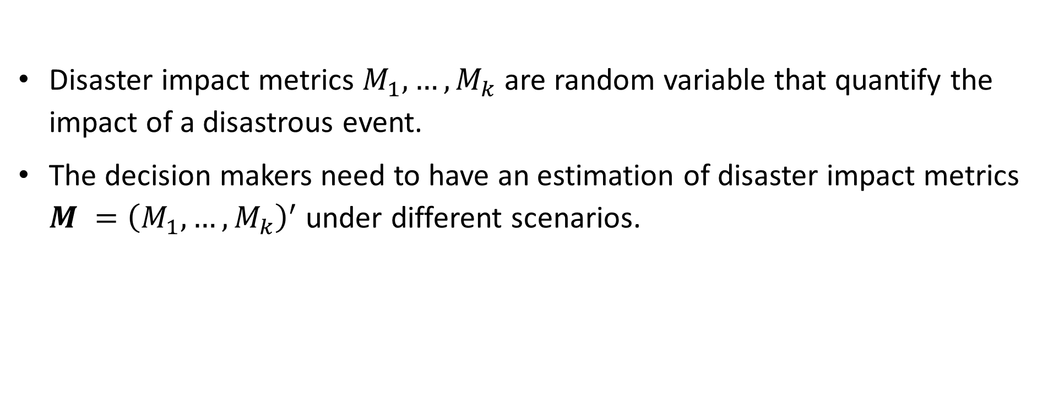
Disaster Risk Management: Evidence Based Decision Making
Disaster impact metrics $M_{1}, …, M_{k}$ are random variable that quantify the impact of a disastrous event.
The decision makers need to have an estimation of disaster impact metrics $M ={\left(M_{1}, …, M_{k}\right)}^{′}$ under different scenarios.

Slide 5
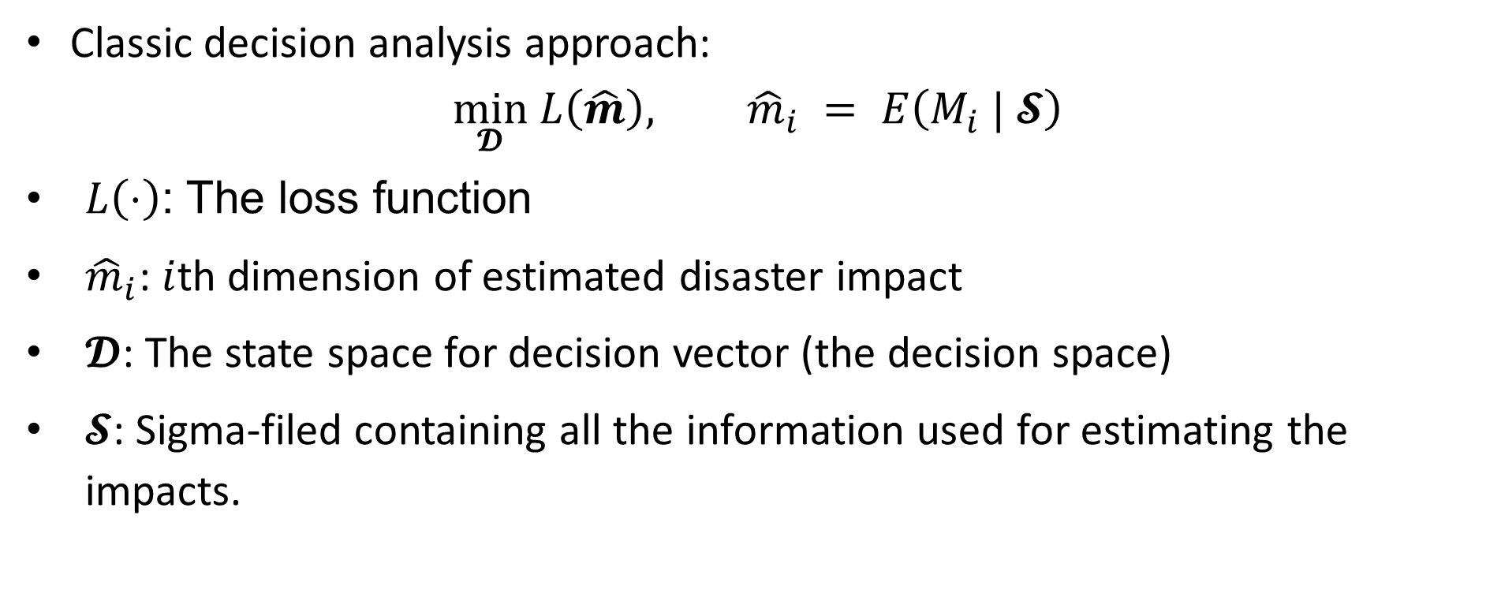
Disaster Risk Management: Evidence Based Decision Making
Classic decision analysis approach:
$$\min_{𝓓} L\left(\hat{m}\right), {\hat{m}}_{i} = E\left(M_{i} | 𝓢\right)$$
$L\left(⋅\right)$: The loss function
${\hat{m}}_{i}$: $i$th dimension of estimated disaster impact
$𝓓$: The state space for decision vector (the decision space)
$𝓢$: Sigma-filed containing all the information used for estimating the impacts.

Slide 6
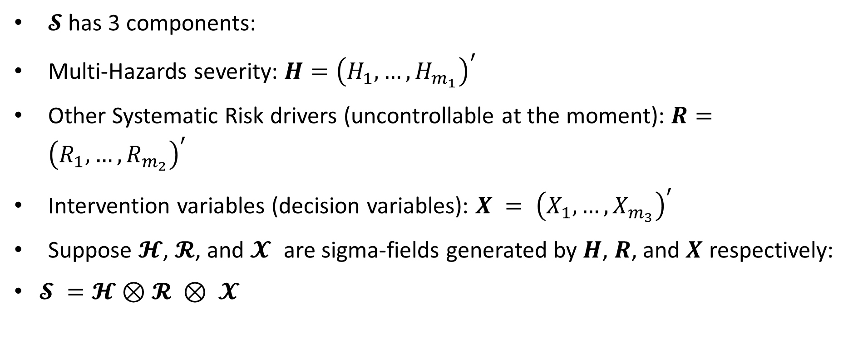
Disaster Risk Management: Evidence Based Decision Making
$𝓢$ has 3 components:
Multi-Hazards severity: $H={\left(H_{1}, …, H_{m_{1}}\right)}^{′}$
Other Systematic Risk drivers (uncontrollable at the moment): $R={\left(R_{1}, …,R_{m_{2}}\right)}^{′}$
Intervention variables (decision variables): $X = {\left(X_{1}, …, X_{m_{3}}\right)}^{′}$
Suppose $𝓗$, $𝓡$, and $𝓧$ are sigma-fields generated by $H$, $R$, and $X$ respectively:
$𝓢 =𝓗⊗𝓡 ⊗ 𝓧$

Slide 7

Disaster Risk Management: Socio-economic variables in DRR
The Socio-economic variable as decision criteria:
Socioeconomic variables are in the space expanded by $M$ (impact space)
The Socio-economic variable as decision variables:
Socioeconomic variables are in the space$𝓧$ (Decision space)

Slide 8

Disaster Risk Management: Evidence Based Decision Making
Classic decision analysis approach:
$$\min_{𝓓} L\left(\hat{m}\right)=L\left(E\left(M|h,r,x\right)\right),$$
For a linear loss function:
$$\min_{𝓓 }{L\left(\hat{m}\right)=w⋅E\left(M|h,r,x\right)}$$

Slide 9
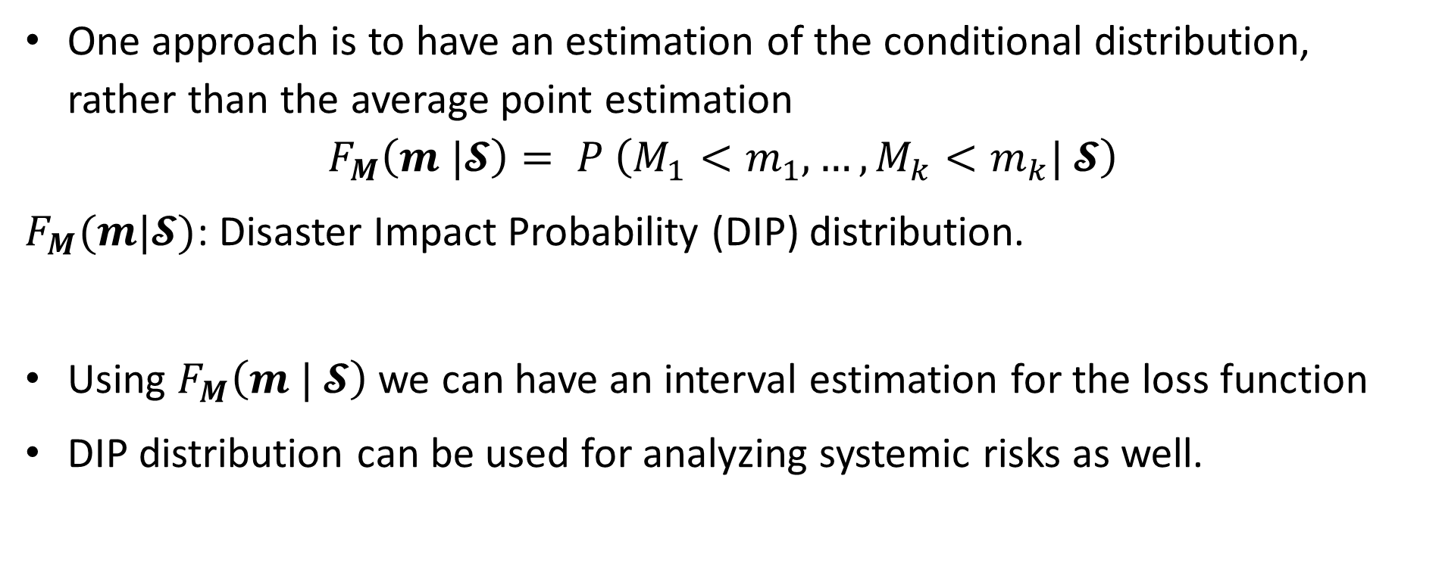
Accounting for uncertainty: Evidence Based Decision Making
One approach is to have an estimation of the conditional distribution, rather than the average point estimation
$$F_{M}\left(m |𝓢\right)= P \left(M_{1}<m_{1}, …, M_{k}<m_{k}| 𝓢\right)$$
$F_{M}(m|𝓢)$: Disaster Impact Probability (DIP) distribution.
Using $F_{M}\left(m | 𝓢\right)$ we can have an interval estimation for the loss function
DIP distribution can be used for analyzing systemic risks as well.

Slide 10
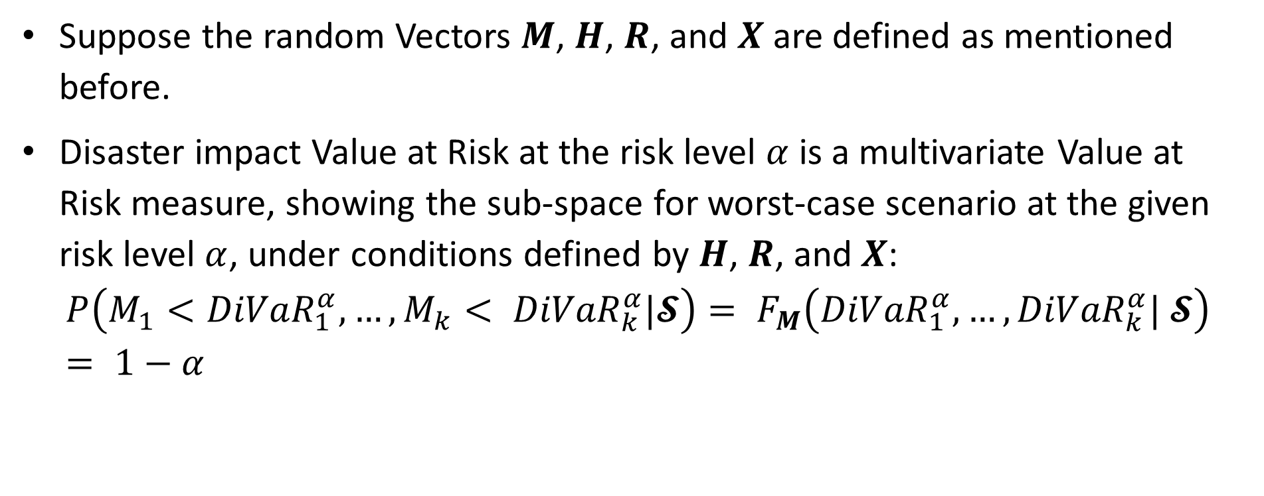
Other Disaster Risk Measures
Suppose the random Vectors $M$, $H$, $R$, and $X$ are defined as mentioned before.
Disaster impact Value at Risk at the risk level $α$ is a multivariate Value at Risk measure, showing the sub-space for worst-case scenario at the given risk level $α$, under conditions defined by $H$, $R$, and $X$:
$$P\left(M_{1}<{DiVaR}_{1}^{α}, …, M_{k}< {DiVaR}_{k}^{α}|𝓢\right)= F_{M}\left({DiVaR}_{1}^{α}, …, {DiVaR}_{k}^{α}| 𝓢\right)= 1−α$$

Slide 11
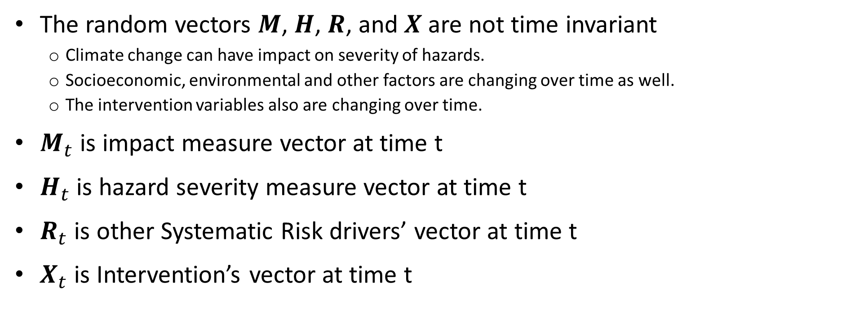
Accounting for time:
The random vectors $M$, $H$, $R$, and $X$ are not time invariant
Climate change can have impact on severity of hazards.
Socioeconomic, environmental and other factors are changing over time as well.
The intervention variables also are changing over time.
$M_{t}$ is impact measure vector at time t
$H_{t}$ is hazard severity measure vector at time t
$R_{t}$ is other Systematic Risk drivers’ vector at time t
$X_{t}$ is Intervention’s vector at time t

Slide 12
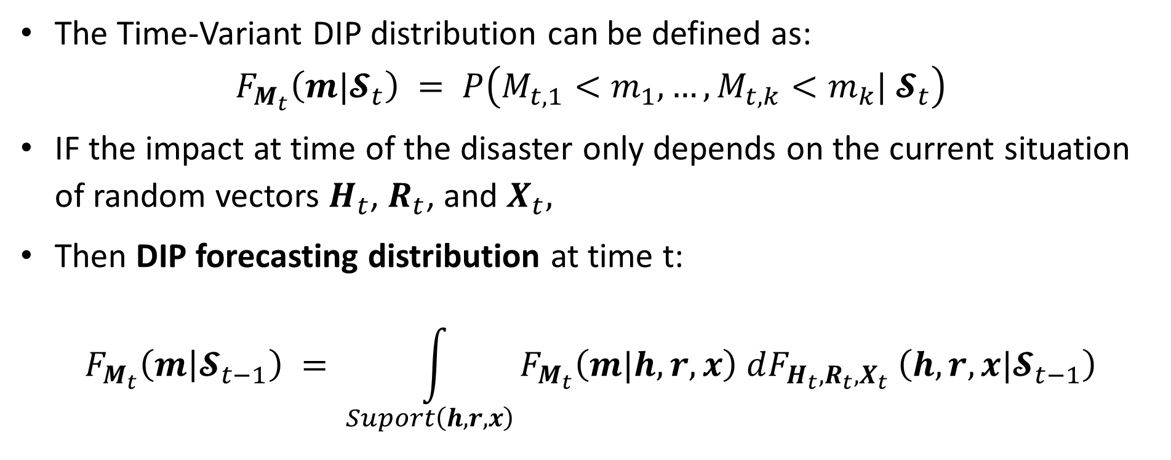
Accounting for time: Time-variant DIP distribution
The Time-Variant DIP distribution can be defined as:
$$F_{M_{t}}\left(m|𝓢_{t}\right) = P\left(M_{t,1}<m_{1}, …, M_{t,k}<m_{k}| 𝓢_{t}\right)$$
IF the impact at time of the disaster only depends on the current situation of random vectors $H_{t}$, $R_{t}$, and $X_{t},$
Then DIP forecasting distribution at time t:
$$F_{M_{t}}\left(m | 𝓢_{t−1}\right) = \int_{Suport\left(h, r, x\right)}{F_{M_{t}}\left(m|h, r, x\right) dF_{H_{t},R_{t},X_{t}} \left(h, r, x|𝓢_{t−1}\right)}$$

Slide 13
Human development index role in resilience
A Three dimensional Index:
Education: ‘Mean years of schooling of adults aged 25+’ and ‘Expected years of schooling of children aged 6’;
Health: ‘Life expectancy at birth’
Standard of living: ‘Gross National Income per capita (PPP, 2011 US$)’.
Higher education level can increase awareness for preparation and response.
The health index shows the development of health care system
Income contributes to better housing, capacity building, and reduced venerability in general.

Slide 14
A Multi-Hazard Example: Earthquake and Tsunami Impact forecasting in India
Disaster impact metrics:
Casualties
Infrastructure damage (million USD)
Hazard severity metrics
Earthquake Magnitude
Tsunami height (m)
Risk factors and decision variables
Maximum and Minimum Population Density (district level)
Wealth inequality (Gini Coefficient; district level)
Human Development Index (district level)
Flood Risk Index (district level)
Dataset:
Earthquakes and Tsunamis from 2000 to 2025
Contains 20 regions (to districts)
Time series are also from 2000 to 2025

Slide 15
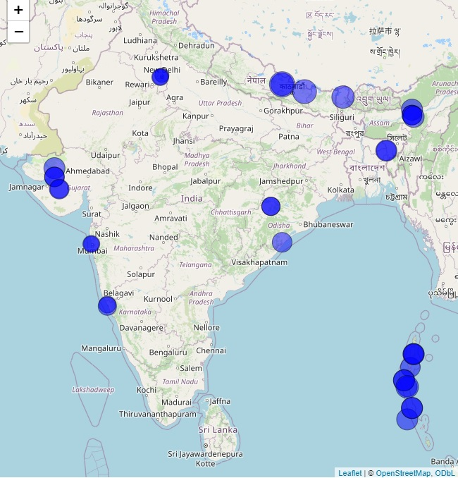
A Multi-Hazard Example: Earthquake and Tsunami Impact forecasting in India
Earthquake Magnitude
Disaster impact metrics:
Casualties
Infrastructure damage (million USD)
Hazard severity metrics
Earthquake Magnitude
Tsunami height (m)
Risk factors and decision variables
Maximum and Minimum Population Density (district level)
Wealth inequality (Gini Coefficient; district level)
Human Development Index (district level)
Flood Risk Index (district level)

Slide 16
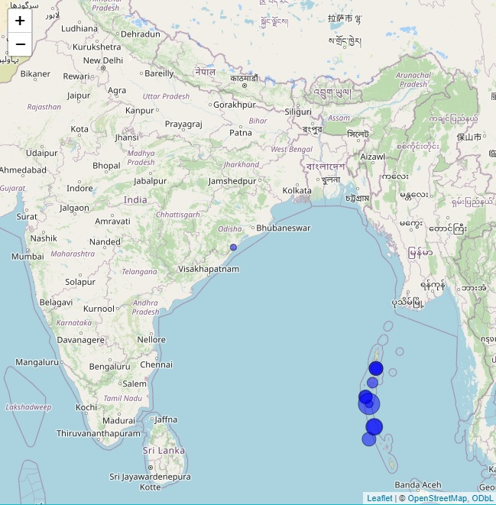
A Multi-Hazard Example: Earthquake and Tsunami Impact forecasting in India
Tsunami height (m)
Disaster impact metrics:
Casualties
Infrastructure damage (million USD)
Hazard severity metrics
Earthquake Magnitude
Tsunami height (m)
Risk factors and decision variables
Maximum and Minimum Population Density (district level)
Wealth inequality (Gini Coefficient; district level)
Human Development Index (district level)
Flood Risk Index (district level)

Slide 17
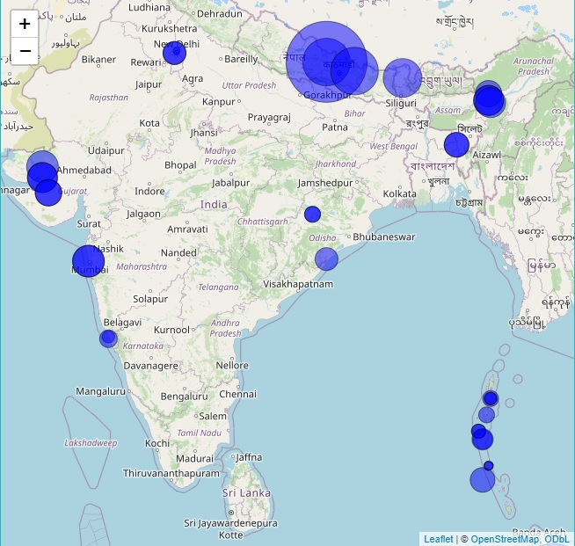
A Multi-Hazard Example: Earthquake and Tsunami Impact forecasting in India
Casualties (Log)
Disaster impact metrics:
Casualties
Infrastructure damage (million USD)
Hazard severity metrics
Earthquake Magnitude
Tsunami height (m)
Risk factors and decision variables
Maximum and Minimum Population Density (district level)
Wealth inequality (Gini Coefficient; district level)
Human Development Index (district level)
Flood Risk Index (district level)

Slide 18
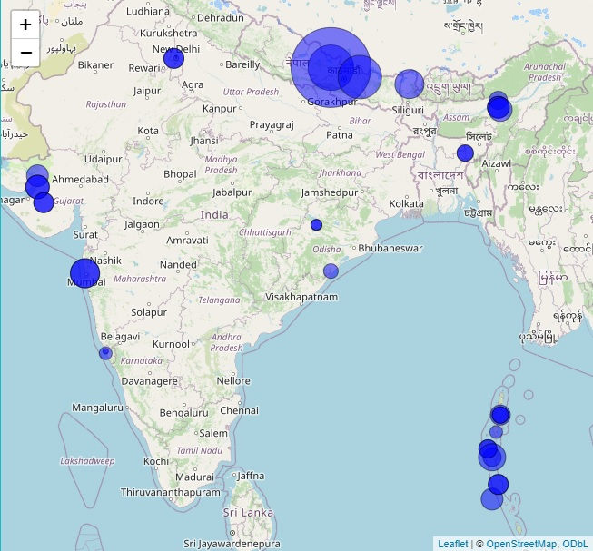
A Multi-Hazard Example: Earthquake and Tsunami Impact forecasting in India
Infrastructure damage (Log)
Disaster impact metrics:
Casualties (Log)
Infrastructure damage (million USD;Log)
Hazard severity metrics
Earthquake Magnitude
Tsunami height (m)
Risk factors and decision variables
Maximum and Minimum Population Density (district level)
Wealth inequality (Gini Coefficient; district level)
Human Development Index (district level)
Flood Risk Index (district level)

Slide 19
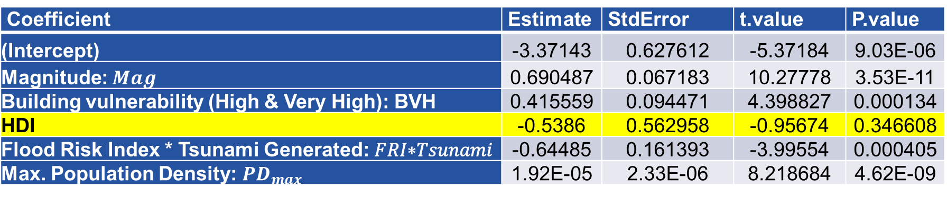
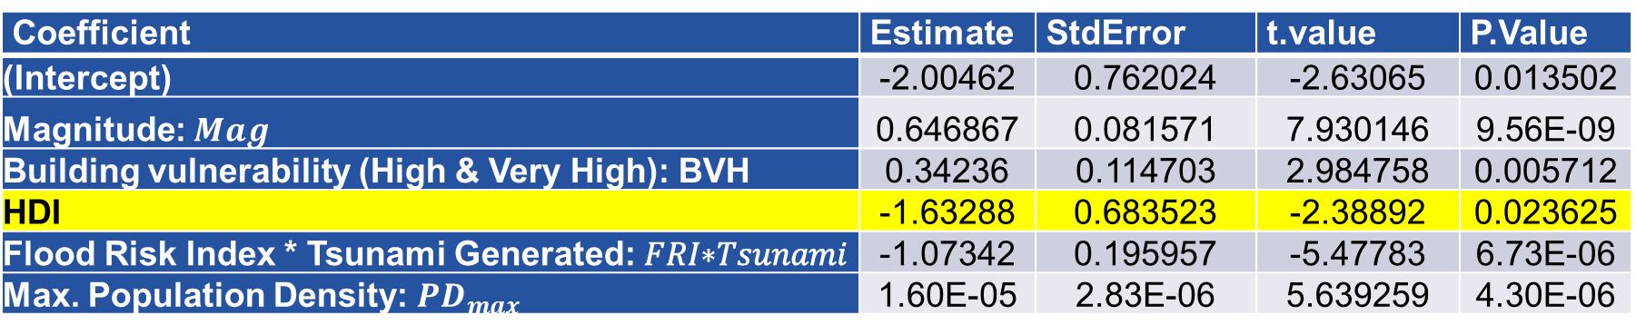
A Multi-Hazard Example: Earthquake and Tsunami Impact forecasting in India
Expected loss function forecasting with HDI (Stepwise model)
Coefficient | Estimate | StdError | t.value | P.Value
(Intercept) | -2.00462 | 0.762024 | -2.63065 | 0.013502
Magnitude: $Mag$ | 0.646867 | 0.081571 | 7.930146 | 9.56E-09
Building vulnerability (High & Very High): BVH | 0.34236 | 0.114703 | 2.984758 | 0.005712
HDI | -1.63288 | 0.683523 | -2.38892 | 0.023625
Flood Risk Index * Tsunami Generated: 𝐹𝑅𝐼∗𝑇𝑠𝑢𝑛𝑎𝑚𝑖 | -1.07342 | 0.195957 | -5.47783 | 6.73E-06
Max. Population Density: $PD_{max}$ | 1.60E-05 | 2.83E-06 | 5.639259 | 4.30E-06
Casualties (log)
Coefficient | Estimate | StdError | t.value | P.value
(Intercept) | -3.37143 | 0.627612 | -5.37184 | 9.03E-06
Magnitude: $Mag$ | 0.690487 | 0.067183 | 10.27778 | 3.53E-11
Building vulnerability (High & Very High): BVH | 0.415559 | 0.094471 | 4.398827 | 0.000134
HDI | -0.5386 | 0.562958 | -0.95674 | 0.346608
Flood Risk Index * Tsunami Generated: 𝐹𝑅𝐼∗𝑇𝑠𝑢𝑛𝑎𝑚𝑖 | -0.64485 | 0.161393 | -3.99554 | 0.000405
Max. Population Density: $PD_{max}$ | 1.92E-05 | 2.33E-06 | 8.218684 | 4.62E-09
Infrastructural Damage (log)

Slide 20
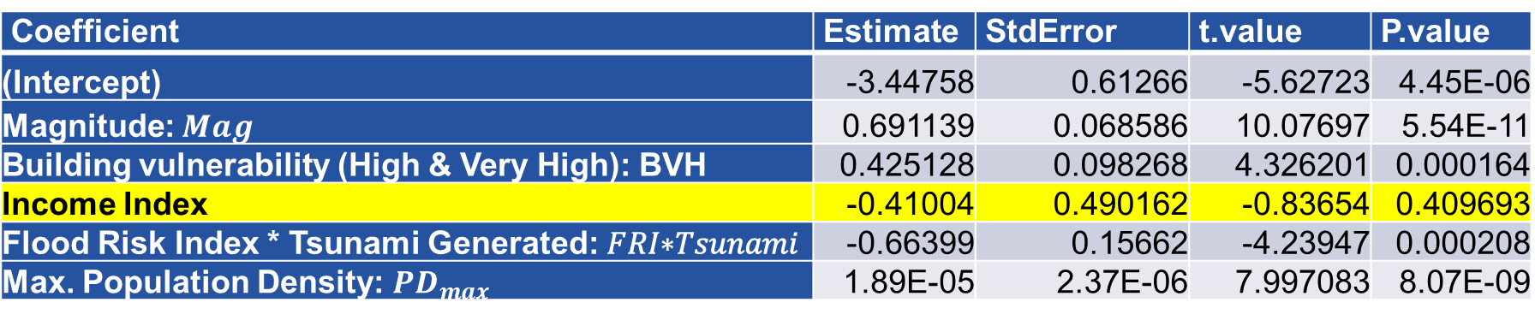
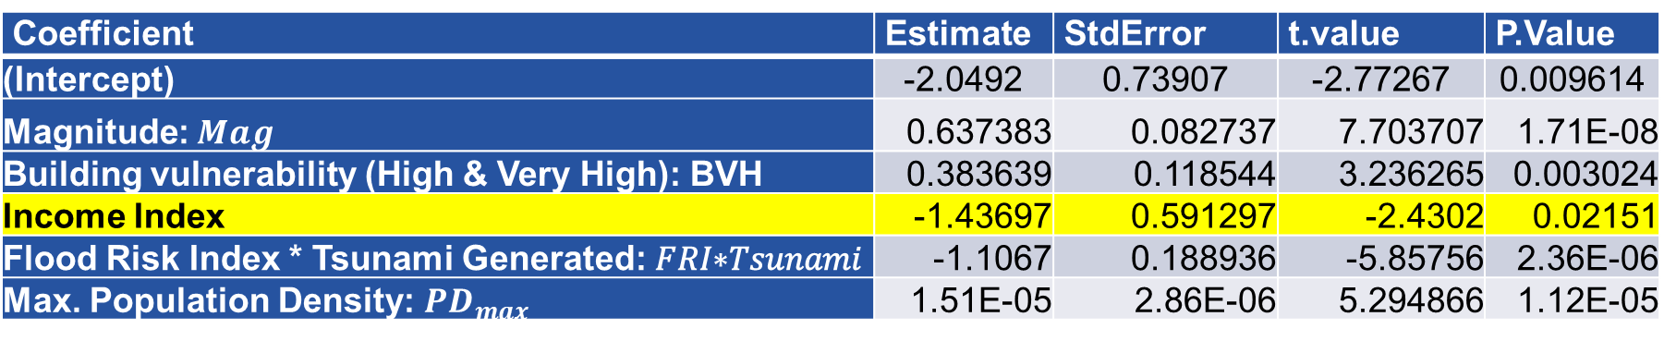
A Multi-Hazard Example: Earthquake and Tsunami Impact forecasting in India
Expected loss function forecasting with Decomposed Index
Coefficient | Estimate | StdError | t.value | P.Value
(Intercept) | -2.0492 | 0.73907 | -2.77267 | 0.009614
Magnitude: $Mag$ | 0.637383 | 0.082737 | 7.703707 | 1.71E-08
Building vulnerability (High & Very High): BVH | 0.383639 | 0.118544 | 3.236265 | 0.003024
Income Index | -1.43697 | 0.591297 | -2.4302 | 0.02151
Flood Risk Index * Tsunami Generated: 𝐹𝑅𝐼∗𝑇𝑠𝑢𝑛𝑎𝑚𝑖 | -1.1067 | 0.188936 | -5.85756 | 2.36E-06
Max. Population Density: $PD_{max}$ | 1.51E-05 | 2.86E-06 | 5.294866 | 1.12E-05
Casualties (log)
Coefficient | Estimate | StdError | t.value | P.value
(Intercept) | -3.44758 | 0.61266 | -5.62723 | 4.45E-06
Magnitude: $Mag$ | 0.691139 | 0.068586 | 10.07697 | 5.54E-11
Building vulnerability (High & Very High): BVH | 0.425128 | 0.098268 | 4.326201 | 0.000164
Income Index | -0.41004 | 0.490162 | -0.83654 | 0.409693
Flood Risk Index * Tsunami Generated: 𝐹𝑅𝐼∗𝑇𝑠𝑢𝑛𝑎𝑚𝑖 | -0.66399 | 0.15662 | -4.23947 | 0.000208
Max. Population Density: $PD_{max}$ | 1.89E-05 | 2.37E-06 | 7.997083 | 8.07E-09
Infrastructural Damage (log)

Slide 21
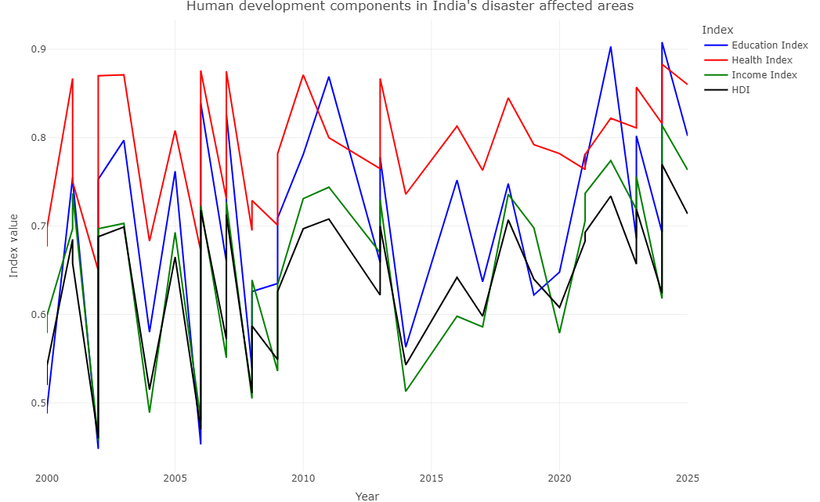
A Multi-Hazard Example: Earthquake and Tsunami Impact forecasting in India
HDI Components In disaster areas
HDI component Correlations
 | EDU | Health | Income | HDI
EDU | 1 | 0.854 | 0.869 | 0.957
Health | 0.854 | 1 | 0.821 | 0.919
Income | 0.869 | 0.821 | 1 | 0.953
HDI | 0.957 | 0.919 | 0.953 | 1

Slide 22
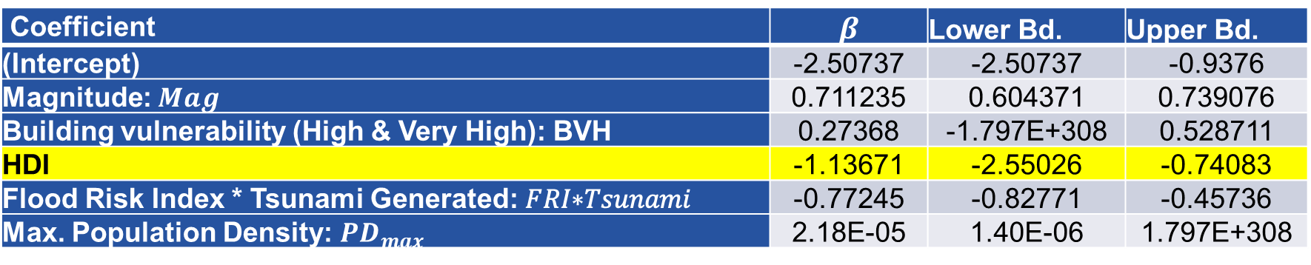

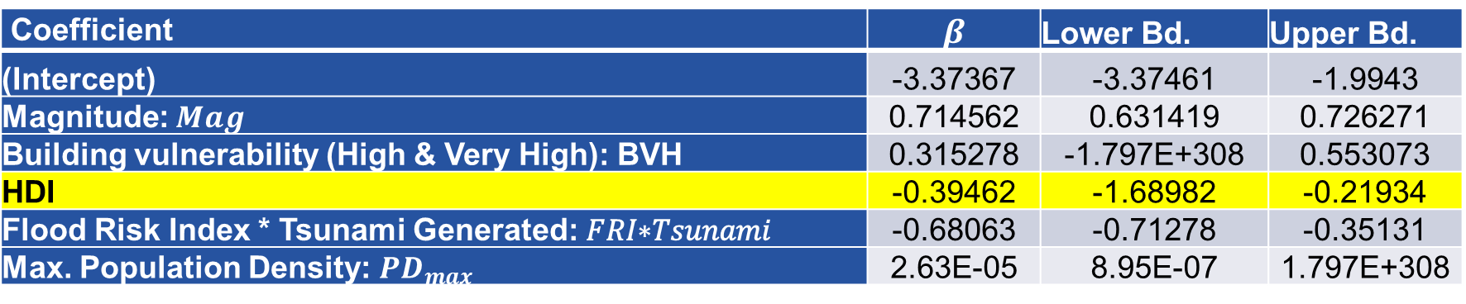
A Multi-Hazard Example: Earthquake and Tsunami Impact forecasting in India
DiVaR with HDI ($α = 0.1$)
Coefficient | $$β$$ | Lower Bd. | Upper Bd.
(Intercept) | -2.50737 | -2.50737 | -0.9376
Magnitude: $Mag$ | 0.711235 | 0.604371 | 0.739076
Building vulnerability (High & Very High): BVH | 0.27368 | -1.797E+308 | 0.528711
HDI | -1.13671 | -2.55026 | -0.74083
Flood Risk Index * Tsunami Generated: 𝐹𝑅𝐼∗𝑇𝑠𝑢𝑛𝑎𝑚𝑖 | -0.77245 | -0.82771 | -0.45736
Max. Population Density: $PD_{max}$ | 2.18E-05 | 1.40E-06 | 1.797E+308
Casualties (log)
Coefficient | $$β$$ | Lower Bd. | Upper Bd.
(Intercept) | -3.37367 | -3.37461 | -1.9943
Magnitude: $Mag$ | 0.714562 | 0.631419 | 0.726271
Building vulnerability (High & Very High): BVH | 0.315278 | -1.797E+308 | 0.553073
HDI | -0.39462 | -1.68982 | -0.21934
Flood Risk Index * Tsunami Generated: 𝐹𝑅𝐼∗𝑇𝑠𝑢𝑛𝑎𝑚𝑖 | -0.68063 | -0.71278 | -0.35131
Max. Population Density: $PD_{max}$ | 2.63E-05 | 8.95E-07 | 1.797E+308
Infrastructural Damage (log)

Slide 23
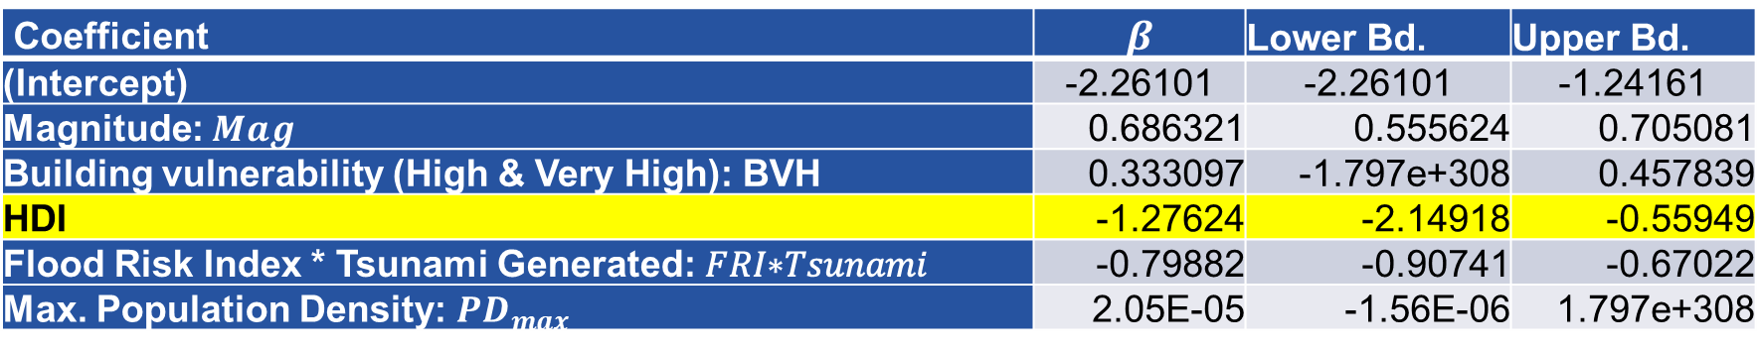

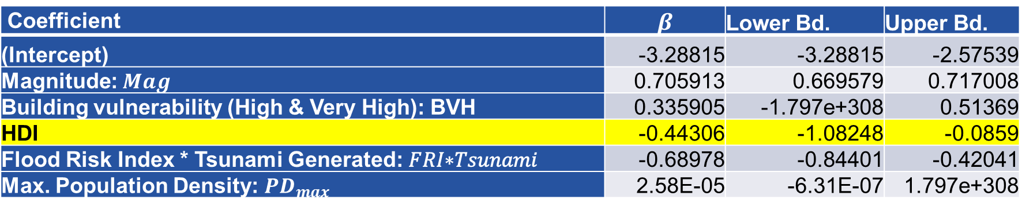
A Multi-Hazard Example: Earthquake and Tsunami Impact forecasting in India
DiVaR with HID Components (Income) ($α = 0.1$)
Coefficient | $$β$$ | Lower Bd. | Upper Bd.
(Intercept) | -2.26101 | -2.26101 | -1.24161
Magnitude: $Mag$ | 0.686321 | 0.555624 | 0.705081
Building vulnerability (High & Very High): BVH | 0.333097 | -1.797e+308 | 0.457839
HDI | -1.27624 | -2.14918 | -0.55949
Flood Risk Index * Tsunami Generated: 𝐹𝑅𝐼∗𝑇𝑠𝑢𝑛𝑎𝑚𝑖 | -0.79882 | -0.90741 | -0.67022
Max. Population Density: $PD_{max}$ | 2.05E-05 | -1.56E-06 | 1.797e+308
Casualties (log)
Coefficient | $$β$$ | Lower Bd. | Upper Bd.
(Intercept) | -3.28815 | -3.28815 | -2.57539
Magnitude: $Mag$ | 0.705913 | 0.669579 | 0.717008
Building vulnerability (High & Very High): BVH | 0.335905 | -1.797e+308 | 0.51369
HDI | -0.44306 | -1.08248 | -0.0859
Flood Risk Index * Tsunami Generated: 𝐹𝑅𝐼∗𝑇𝑠𝑢𝑛𝑎𝑚𝑖 | -0.68978 | -0.84401 | -0.42041
Max. Population Density: $PD_{max}$ | 2.58E-05 | -6.31E-07 | 1.797e+308
Infrastructural Damage (log)

Slide 24
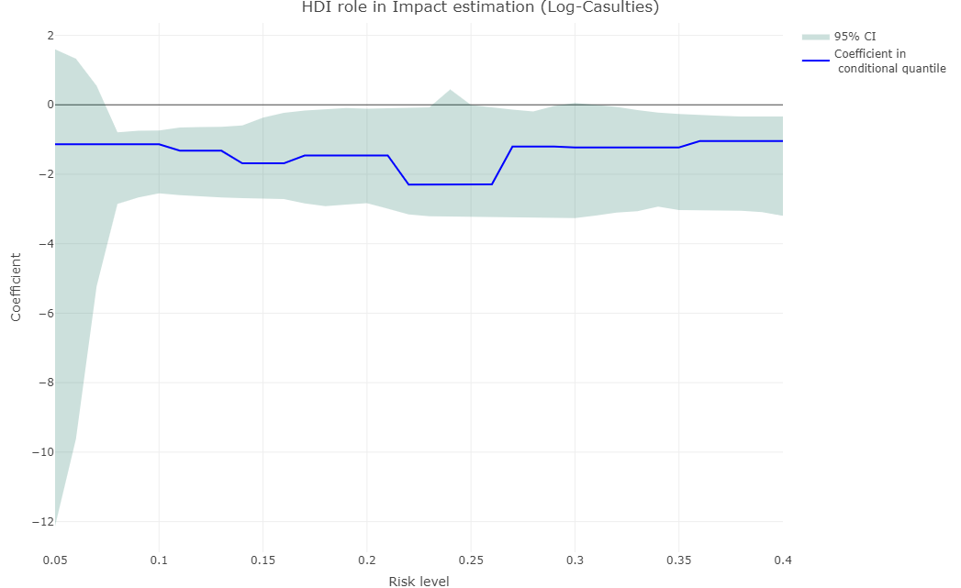
A Multi-Hazard Example: Earthquake and Tsunami Impact forecasting in India
HID role in different risk levels (Conditional Quantiles)

Slide 25
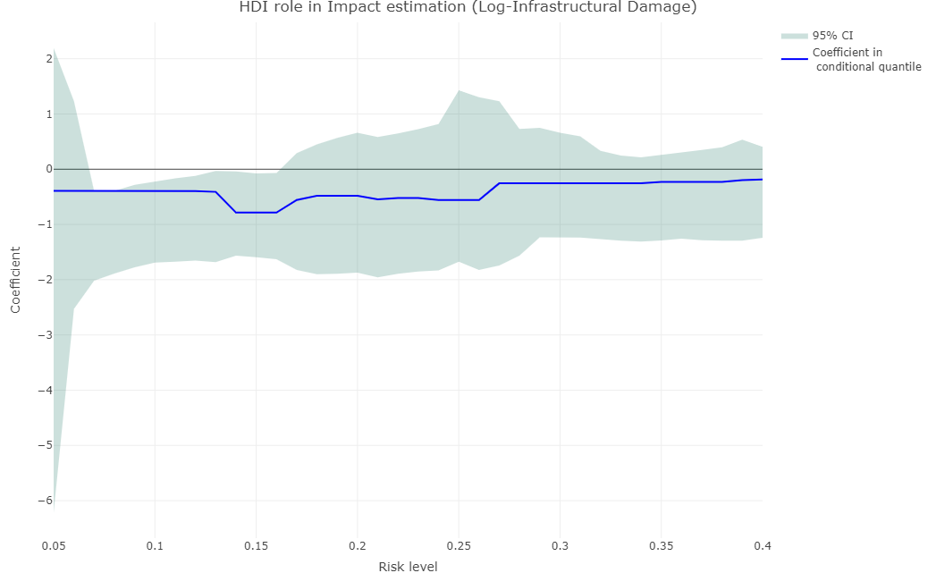
A Multi-Hazard Example: Earthquake and Tsunami Impact forecasting in India
HID role in different risk levels (Conditional Quantiles)

Slide 26
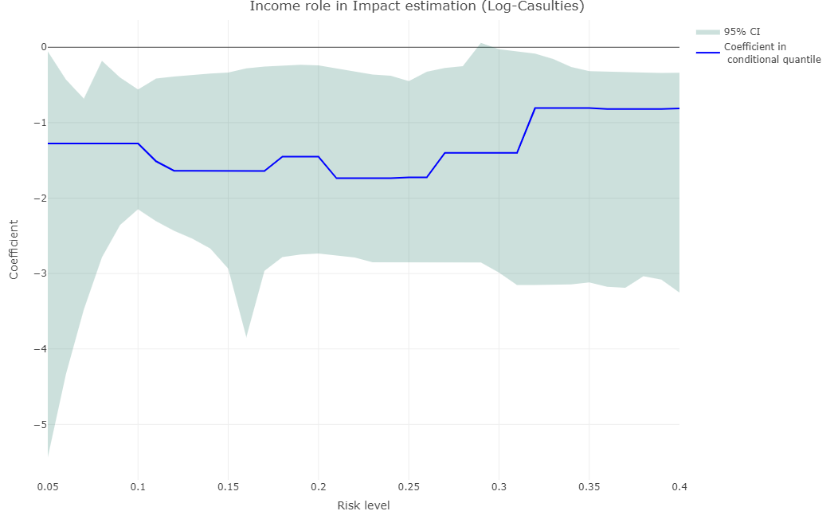
A Multi-Hazard Example: Earthquake and Tsunami Impact forecasting in India
HID Components (Income) role in different risk levels (Conditional Quantiles)

Slide 27
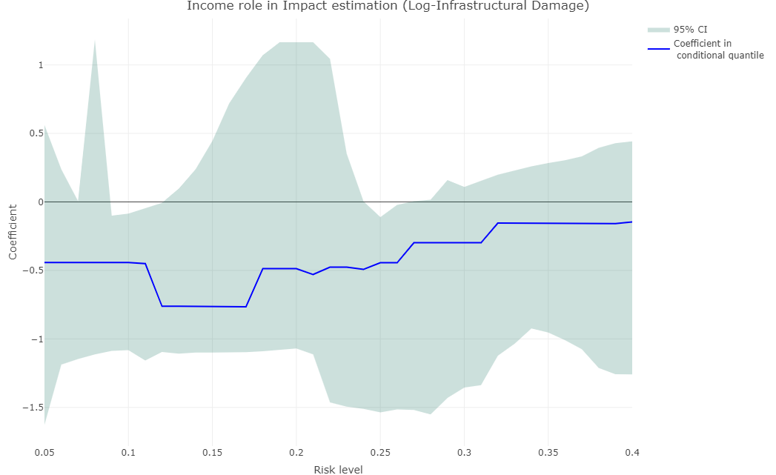
A Multi-Hazard Example: Earthquake and Tsunami Impact forecasting in India
HID Components (Income) role in different risk levels (Conditional Quantiles)

Slide 28
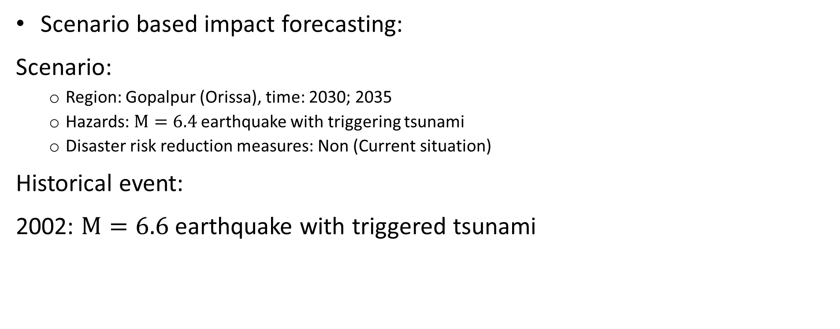
A Multi-Hazard Example: Earthquake and Tsunami Impact forecasting in India
Scenario based impact forecasting:
Scenario:
Region: Gopalpur (Orissa), time: 2030; 2035
Hazards: $M=6.4$ earthquake with triggering tsunami
Disaster risk reduction measures: Non (Current situation)
Historical event:
2002: $M=6.6$ earthquake with triggered tsunami

Slide 29
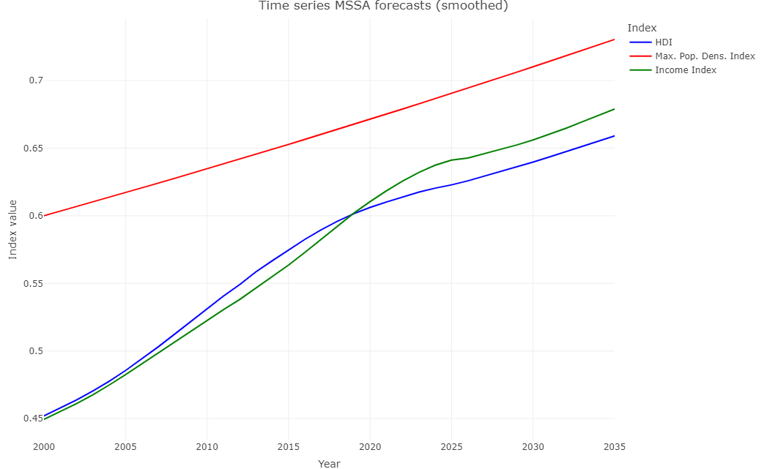
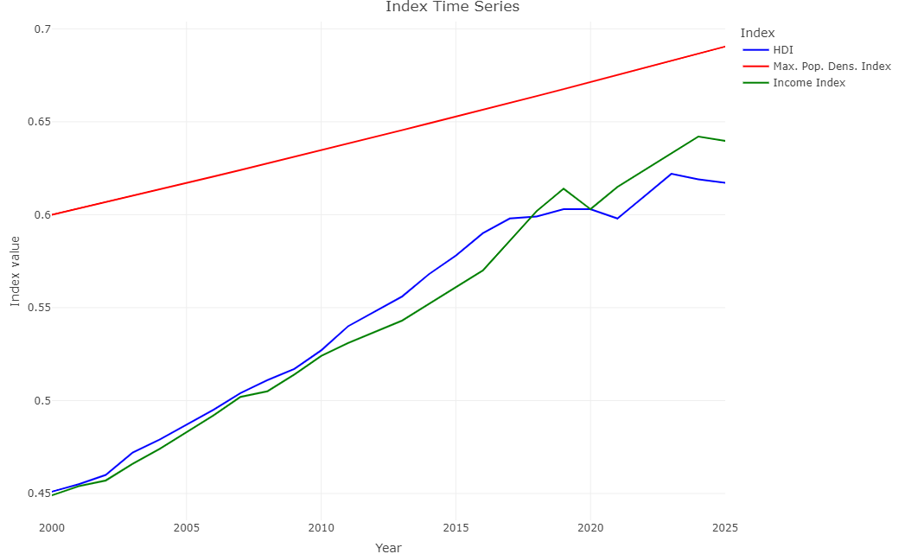
A Multi-Hazard Example: Earthquake and Tsunami Impact forecasting in India
Risk factors forecast (no intervention):

Slide 30
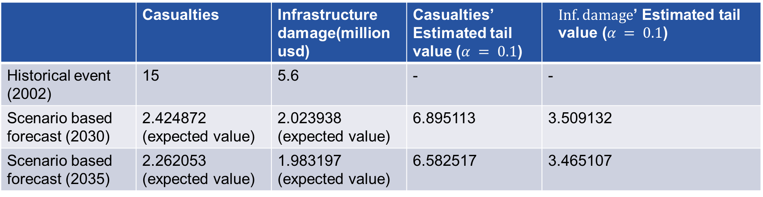
A Multi-Hazard Example: Earthquake and Tsunami Impact forecasting in India
Scenario based impact forecasting using HDI’s current terend:
 | Casualties | Infrastructure damage(million usd) | Casualties’ Estimated tail value ($α = 0.1$) | $$Inf. damage\text{’ }\text{Estimated} \text{tail} \text{value}\text{ (}α = 0.1\text{)}$$
Historical event (2002) | 15 | 5.6 | - | -
Scenario based forecast (2030) | 2.424872 (expected value) | 2.023938 (expected value) | 6.895113 | 3.509132
Scenario based forecast (2035) | 2.262053 (expected value) | 1.983197 (expected value) | 6.582517 | 3.465107

Slide 31

Effective policy crafting hinges on informative models.
The impact of a model depends on its practical usability.

