Slide 1
Mapping Urban Realities: Integrating Citizen Science and Earth Observation for the UMF
Dilek Fraisl, Inian Moorthy, Linda See, Gerid Hager, Dennis Mwaniki, Robert Peter Ndugwa
fraisl@iiasa.ac.at

Slide 2
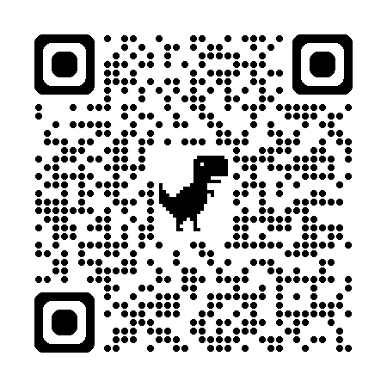
Opportunities for citizen science within the Global Urban Monitoring Framework (UMF)
UMF tracks 77 urban sustainability indicators.
5 domains: Society, Economy, Culture, Environment and Governance & Implementation.
4 objectives: Safe and peaceful, Resilient, Inclusive and Sustainable Cities.
Major data gaps in timeliness and disaggregation.
CS & EO can help address these gaps.
Notes:
UMF consists of five domains: society, economy, culture, environment and governance & implementation and four objectives, which are to achieve safe and peaceful, resilient, inclusive and sustainable cities.

Slide 3
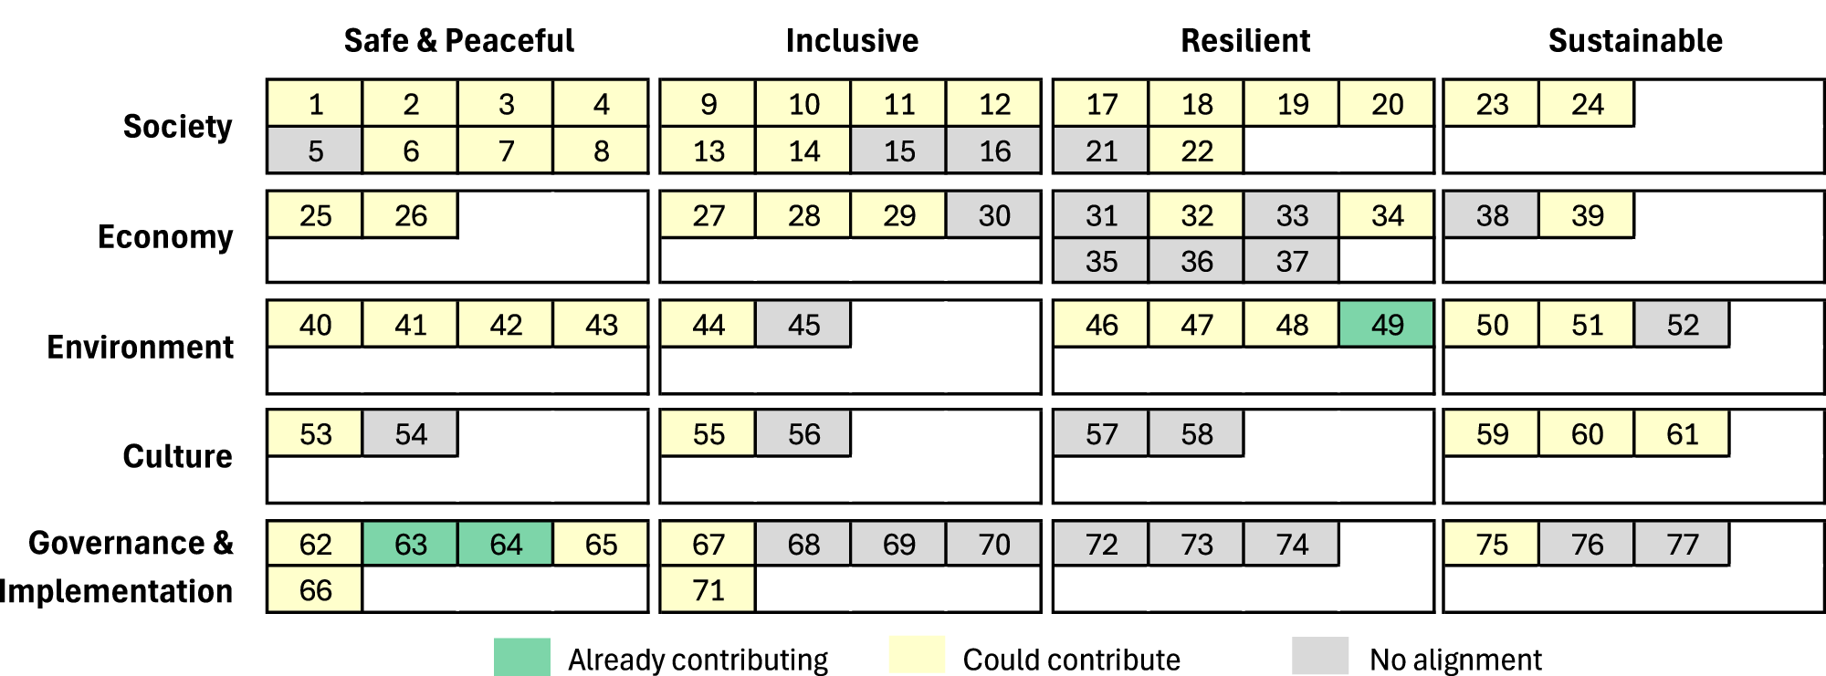
Citizen science contributions to UMF
Citizen science supports 3 UMF indicators (or around 4%) and it can support 49 more
Total potential: 52 of 77 (68%)
Notes:
The UMF indicators from 1 to 77, listed by domain and objective, shaded according to whether citizen science is already contributing (4%) to the indicator, whether it could potentially contribute (64%) or whether there is no alignment (32%) between the indicator and citizen science.

Slide 4
Citizen science contributions to UMF domains
Environment: Strongest alignment with 85% potential
Already contributing to one indicator (protected natural areas) and could support 10 additional indicators such as air quality and access to open public spaces.
Society: 83% potential
Neighborhood safety, access to safe drinking water and basic services.
Culture: 56% potential
Can support indicators on heritage & access to cultural spaces.
Economy: 53% potential
Relevant for employment rate & public transport.
Governance & Implementation: 50% potential
Supports 2 indicators and could contribute to 6 more, including violence public participation in city planning.

Slide 5

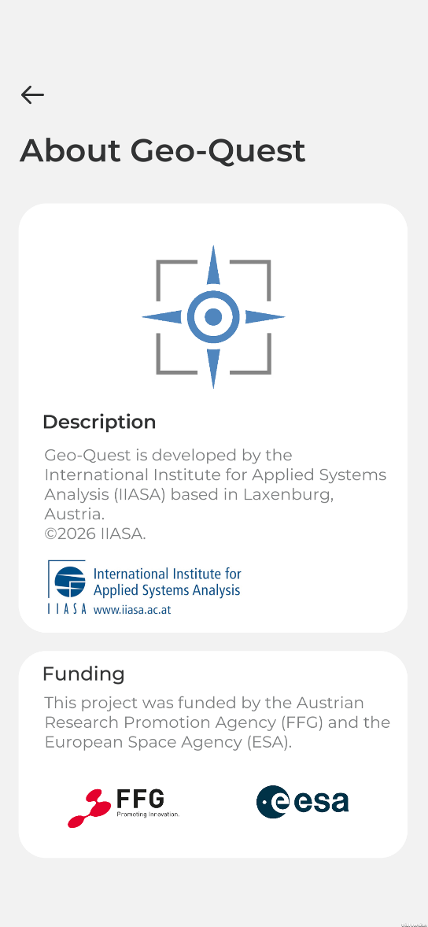
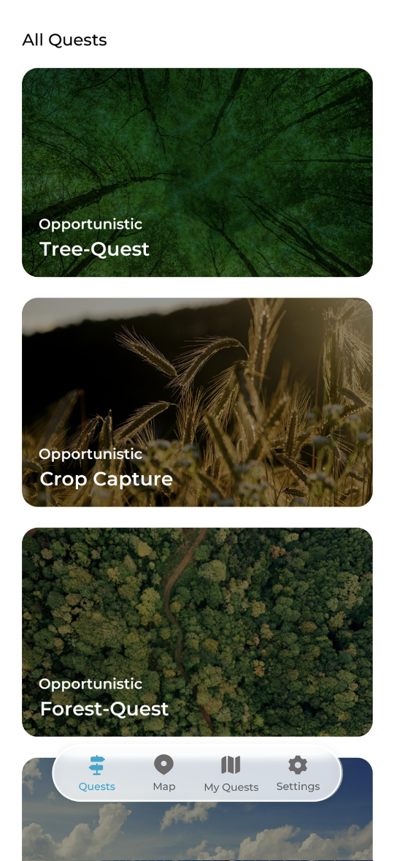
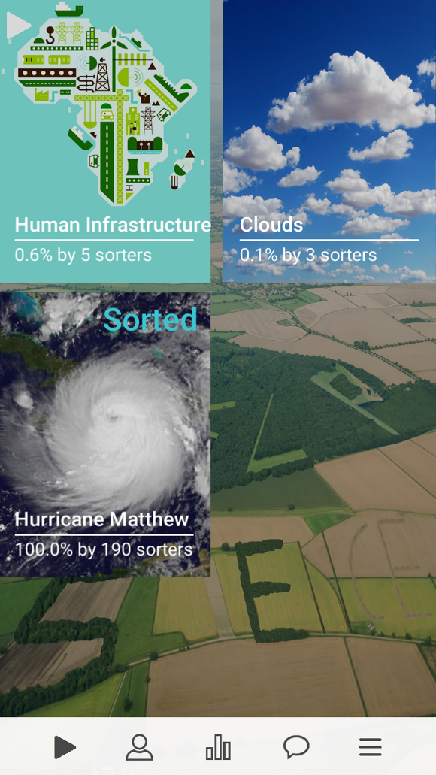
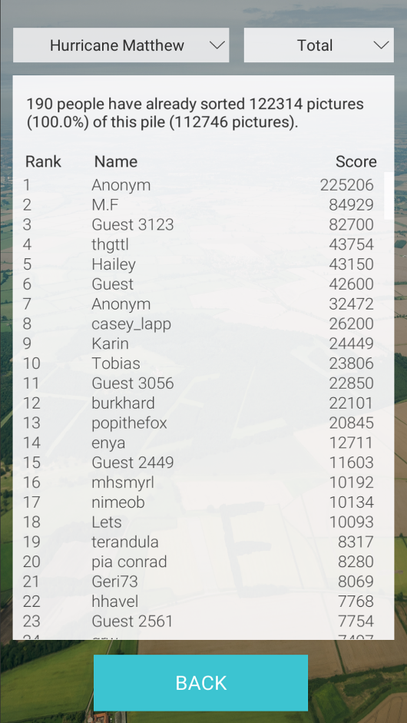
Citizen science and Earth Observation for UMF: Top-down & bottom-up citizen science
Complemented by bottom-up citizen science:
Geo-Quest
Top-down: Picture Pile

Slide 6
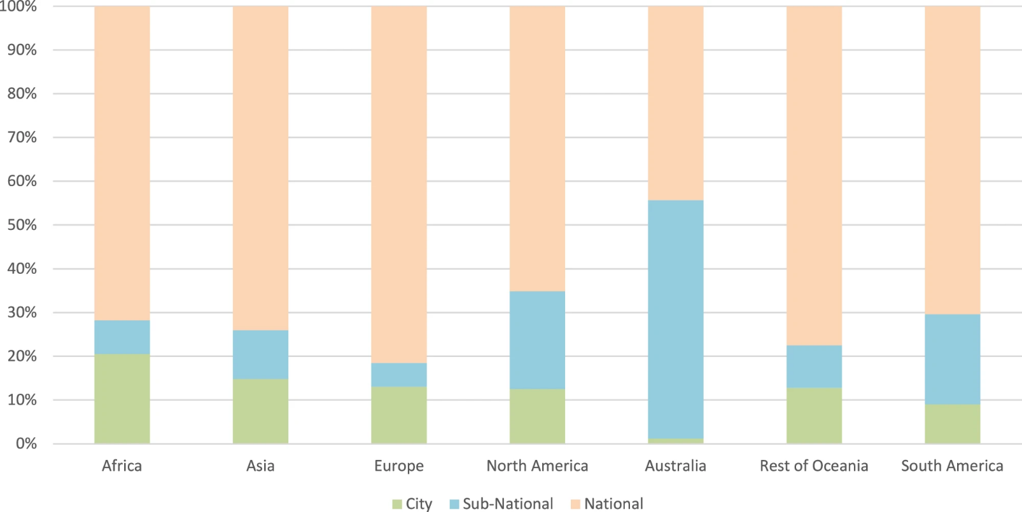
UMF monitoring needs city-level data
UMF implementation is limited by a lack of city-level data.
Citizen science and EO can make urban monitoring more local, timely, and actionable.
466 cities analyzed
<20% city-level reporting
Most data still national
Data completeness of UMF indicators across continents and domains.

Slide 7
Key barriers
Misalignment with UMF requirements
Citizen science projects are often not designed around standardized data, quality, and validation requirements.
Limited resources for alignment
Meeting official standards requires training, technical support, financial resources, and long-term planning.
Trust and awareness gaps
Public authorities and statistical agencies may question accuracy, credibility, and relevance, or may be unaware of the value of citizen science data.
Data access and documentation gaps
Data, protocols, definitions, and metadata are not always openly available or well documented.
Comparability across cities
Differences in protocols, participant demographics, and representativeness can limit consistency across urban contexts.

Slide 8
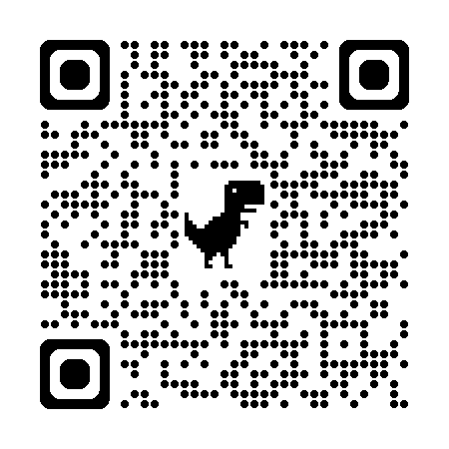
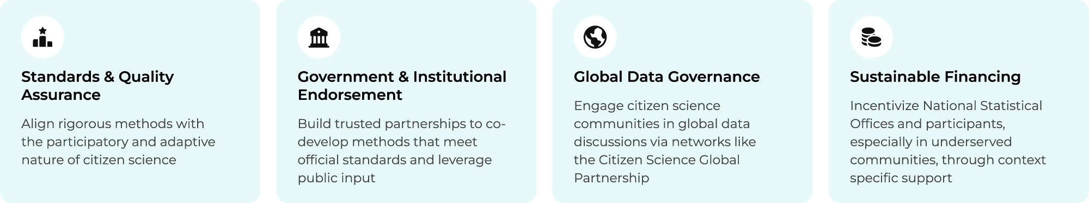
Key steps for transitioning citizen science into an essential resource for official statistics

Slide 9
Future work and recommendations
Future Work:
Demonstrate and expand the role of citizen science in monitoring and advancing urban sustainability.
Support high-potential citizen science initiatives for scaling
Support the development of a research infrastructure for excellent citizen science through the RIECS Concept.
Recommendations:
Establish dedicated citizen science tracks at future conferences.
Foster greater collaboration and exchange among the citizen science, Earth Observation, official statistics, data, and policy communities.
Integrate citizen science into future research, development, and policy agendas.

Slide 10



Thank you!
Dilek Fraisl, Inian Moorthy, Linda See, Gerid Hager, Dennis Mwaniki, Robert Peter Ndugwa
fraisl@iiasa.ac.at

