Slide 1
Integrated Assessment of Cost-Effective Air Quality Mitigation Pathways for Uttar Pradesh, India
Parul Srivastava, Pallav Purohit, Wolfgang Schöpp, Fabian Wagner, Zbigniew Klimont, Gregor Kiesewetter, Sagnik Dey, Jostein Nygard, Ashish Tiwari, Mukesh Sharma, and Markus Amann
EGU General Assembly 2026
Vienna, Austria, 5 May 2026

Slide 2

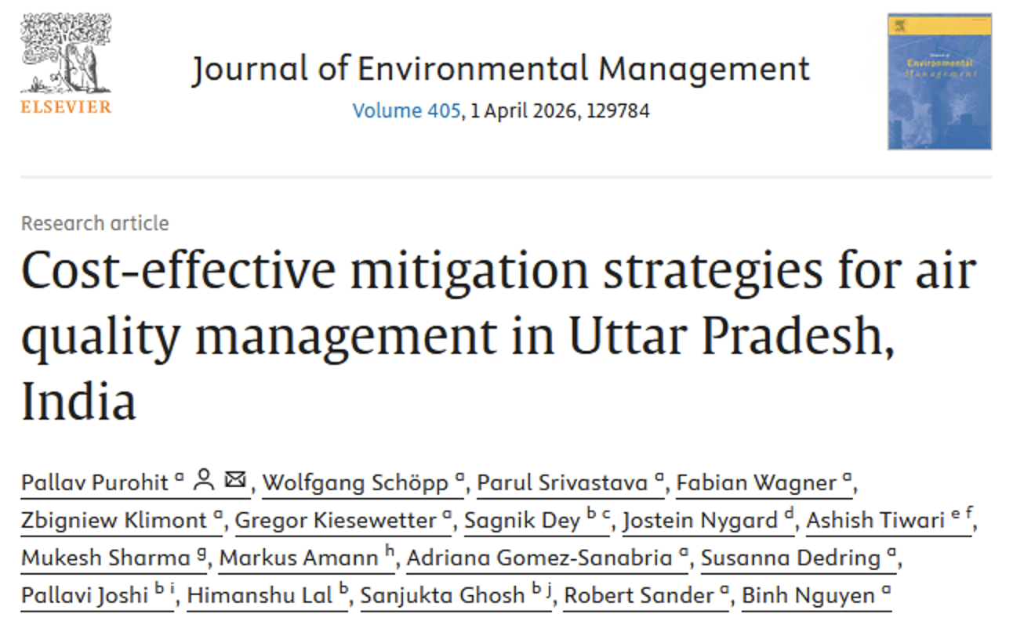
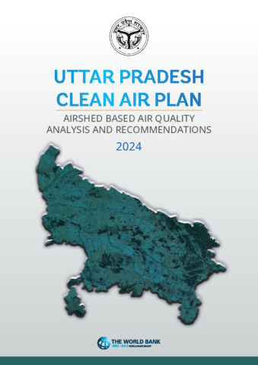
Air Quality Management – Case Study, (Clean Air Plan for Uttar Pradesh, India)
Start
AQM Project
Phase 1
Local Partnership & Data Validation
Phase 2
PM2.5 Modelling and Validation
Phase 3
Stakeholder Consultation (Model/Report)
Phase 4
Approved Clean Air Plan (CAP)
Phase 5
Legislative
Approval
Local partners
IITD, IITK, TERI
Data validation
Activities
Emission factors
Control strategy
PM2.5 modelling (GAINS)
Satellite validation
Ground monitoring (CPCB)
Stakeholders
DoE, Energy, Transport, Industry, MSMEs, Agri, Urban affairs
Data validation
Cost-optimal strategy
Legislative process
Parliamentary approval
EGU26-6350 | AS4.9 | GAINS-IGP | Uttar Pradesh air quality pathways
2

Slide 3
GAINS framework: from emissions to impacts and mitigation costs
Scenario set used in this study
CLE 2020, Base year: Historical emissions and PM_{2.5} exposure.
FLE 2035: Frozen legislation, no policy advances since 2015.
FLE-CF 2035: Frozen legislation but with clean-fuel transition in household.
CLE 2035: Current legislation, full enforcement of all policies.
CAS: Coordinated Action Scenario across IGP, targeting WHO IT-1 (35 µg/m³), assessed for UP-only implementation and IGP-wide coordinated action.
EGU26-6350 | AS4.9 | GAINS-IGP | Uttar Pradesh air quality pathways
3

Slide 4
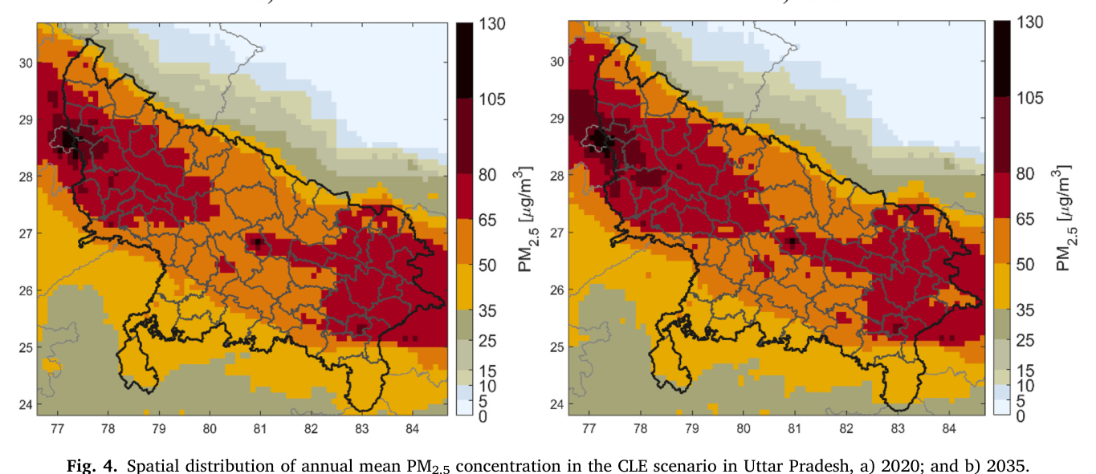
Why Uttar Pradesh (UP) is a difficult air-quality case
2020
2035
Annual mean PM2.5 concentration in UP
India's most populous state, with very high population exposure.
UP sits at the centre of the Indo-Gangetic Plain
PM_{2.5} remains above national and WHO-aligned benchmarks across much of the state.
Can Uttar Pradesh clean its air alone?
EGU26-6350 | AS4.9 | GAINS-IGP | Uttar Pradesh air quality pathways
4

Slide 5
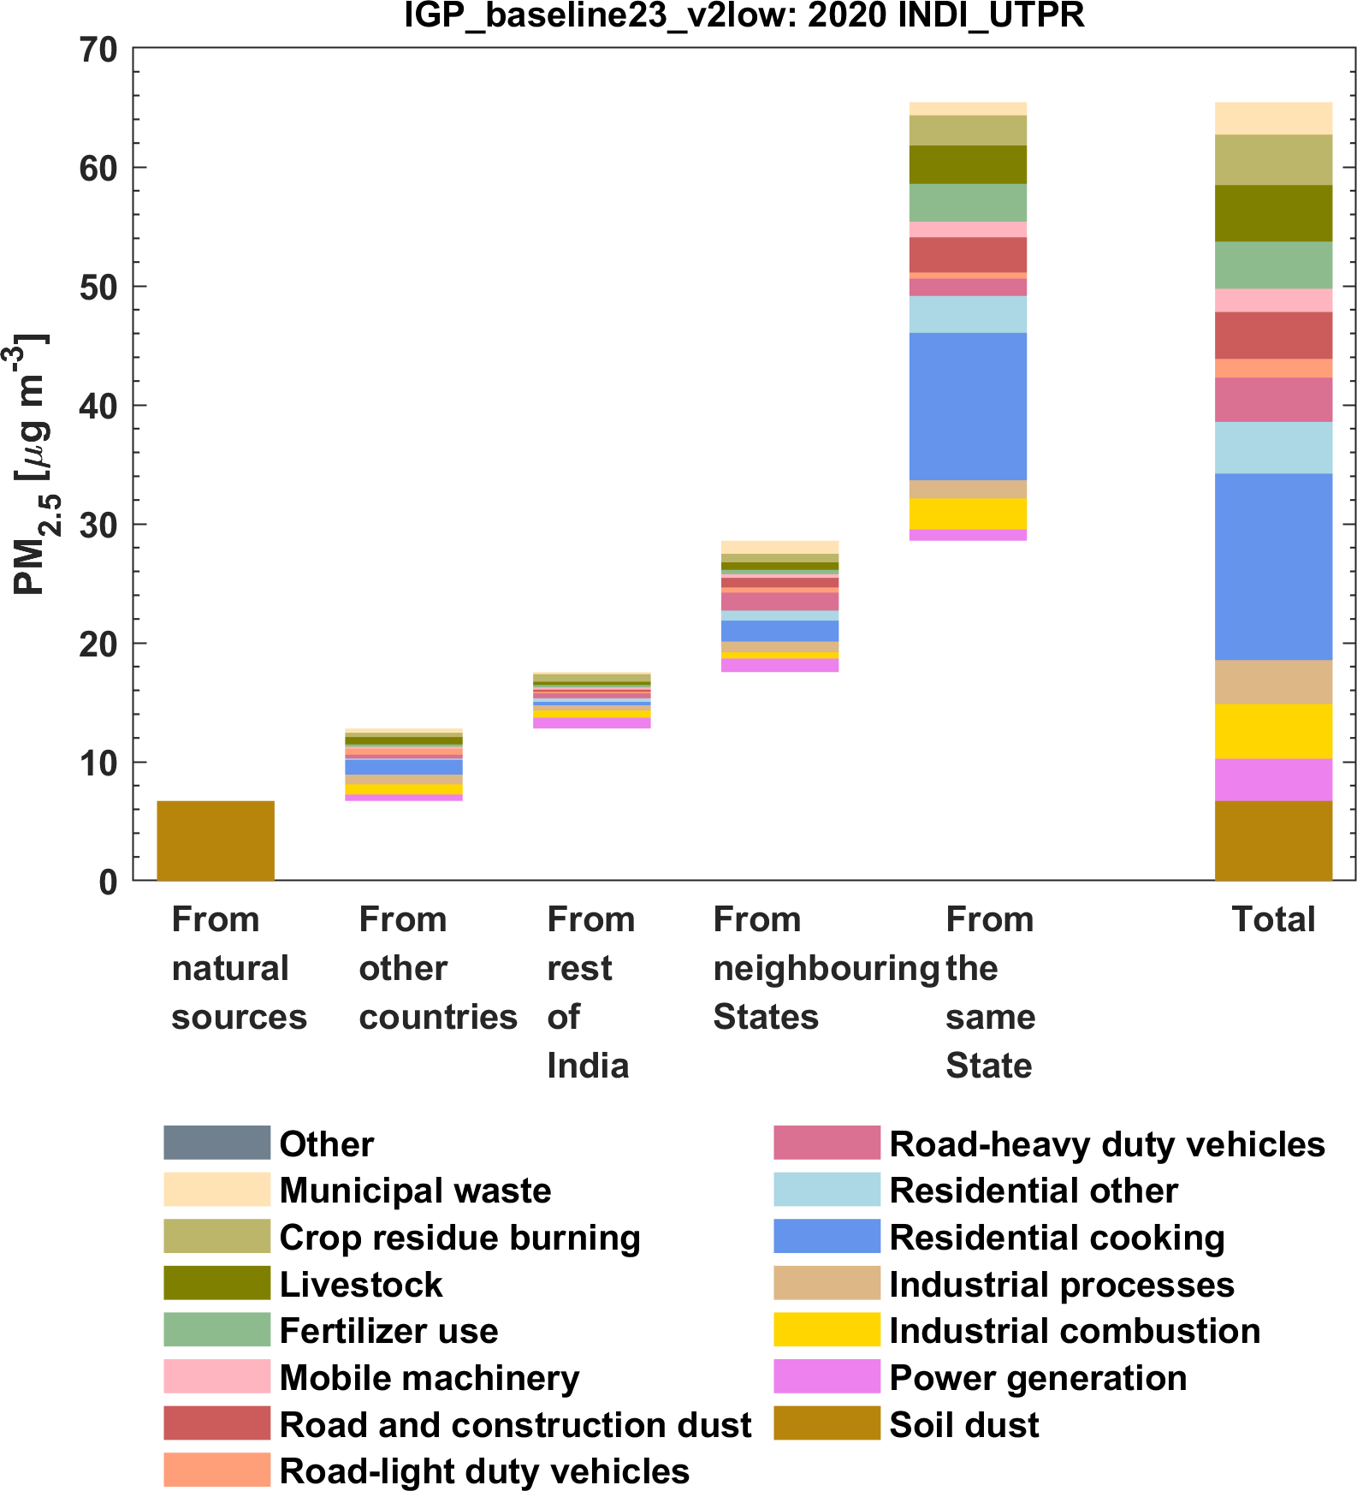
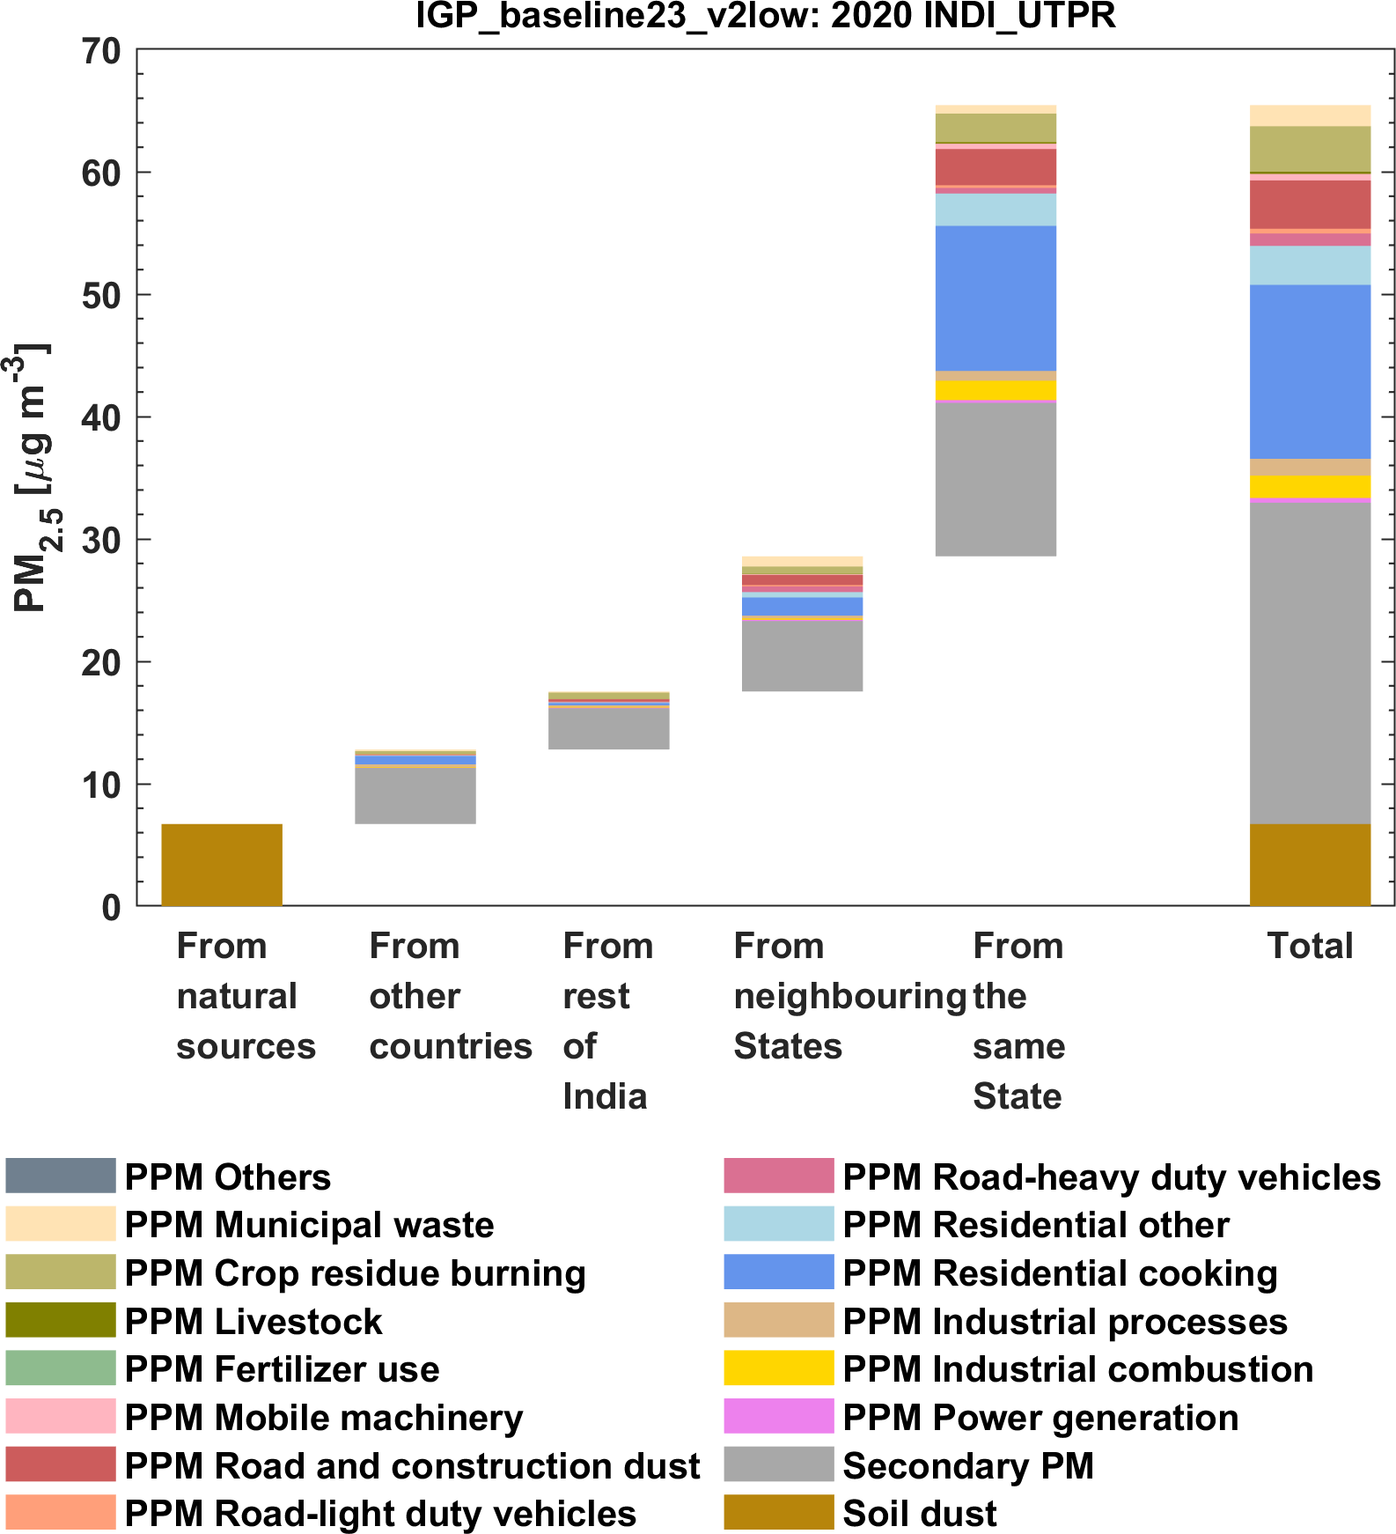
PM2.5 exposure is both local and regional (base-year 2020)
Base-year 2020: key insights
65.4 µg/m³
~40%
44%
population-weighted PM2.5 exposure in UP in 2020
secondary PM_{2.5} contribution
outside UP and natural dust
Residential cooking remains the largest single source category.
Agriculture matters through ammonia and secondary particle formation.
Mitigation needs local controls and IGP wide coordination.
Contribution of local, regional and secondary sources to PM₂.₅ exposure in UP, 2020
EGU26-6350 | AS4.9 | GAINS-IGP | Uttar Pradesh air quality pathways
5

Slide 6
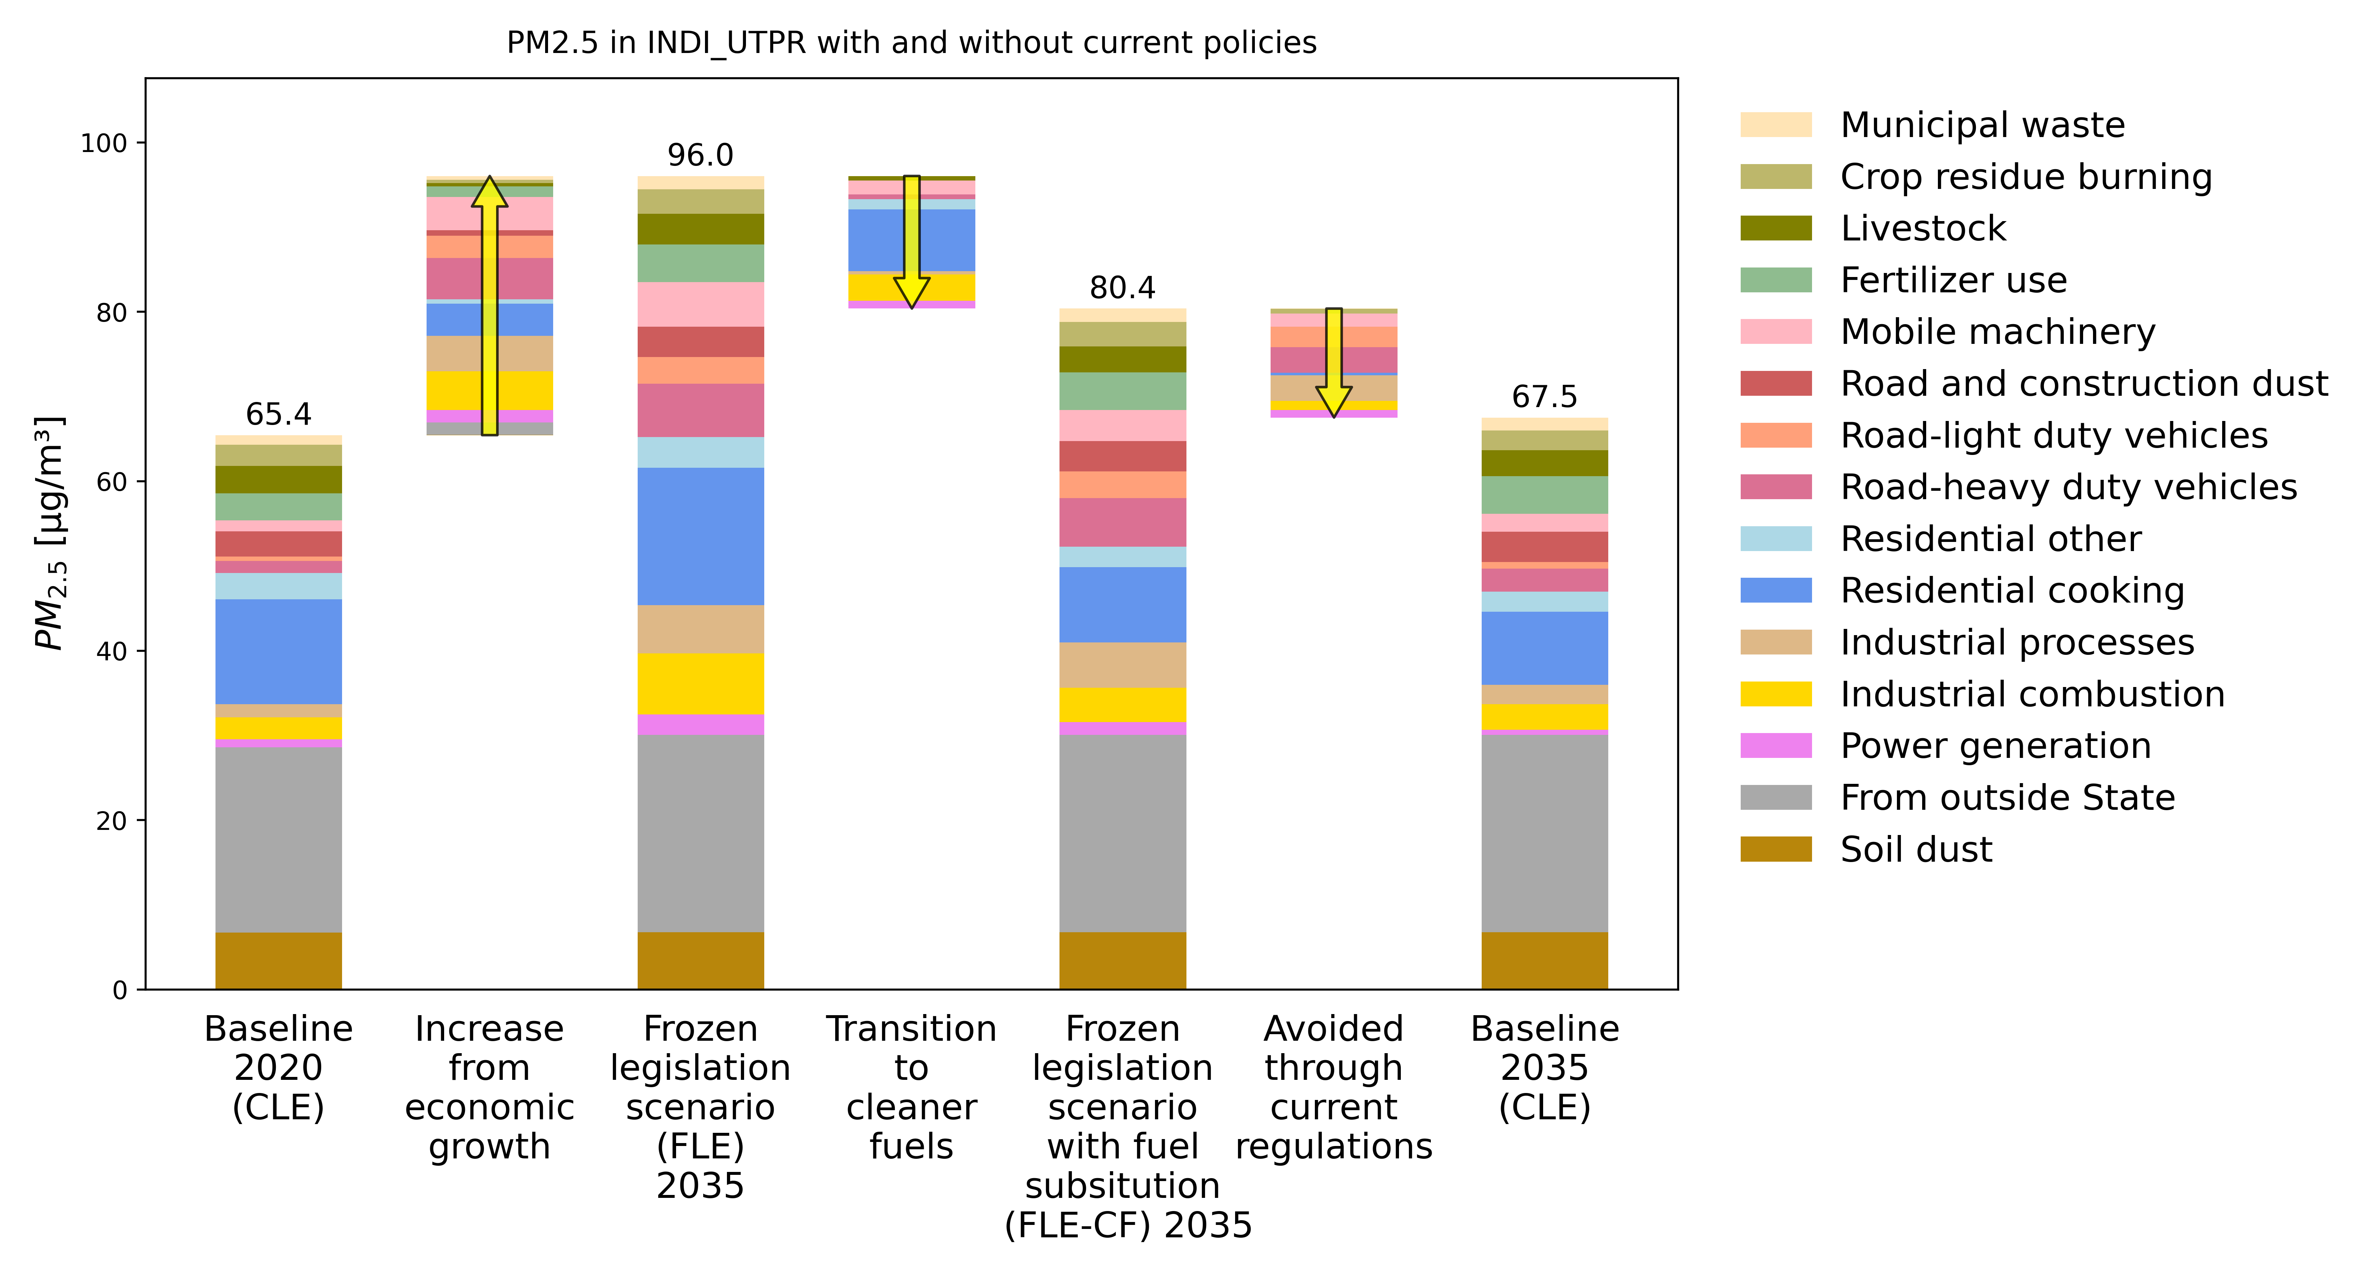
Current legislation slows the rise in exposure, but UP stays well above WHO IT-1
65.4
96.0
80.4
67.5
µg/m³
µg/m³
µg/m³
µg/m³
CLE 2020,
Base-year
FLE 2035,
No-new- policy
FLE-CF 2035, Clean-fuels
CLE 2035,
Full policy enforcement
Without policy advances, exposure would rise ~47% higher than the 2020 level.
Current legislation avoids ~30 µg/m³ if no-new-policy is implemented.
Even with full enforcement, UP stays above NAAQS (40 µg/m³) and nearly 2× the WHO IT-1 target of 35 µg/m³.
EGU26-6350 | AS4.9 | GAINS-IGP | Uttar Pradesh air quality pathways
6

Slide 7
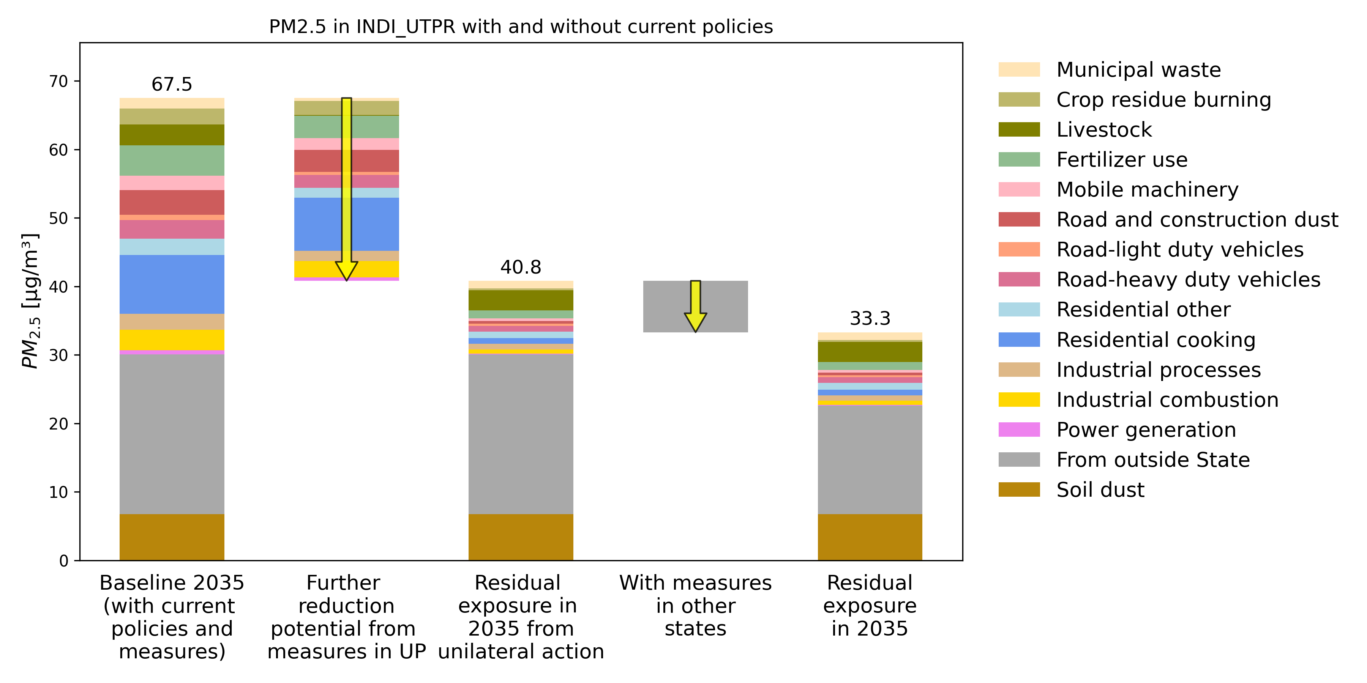
UP-only action helps, but coordinated IGP action delivers NAAQS and WHO IT-1
Population-weighted PM_{2.5} exposure pathway in 2035
67.5
40.8
33.3
µg/m³
µg/m³
µg/m³
Baseline 2035
CLE
CAS- with UP only measures
CAS- with coordinated
IGP action
Regional action reduces inflow by about 7.5 µg/m³
The benefits are shared across the airshed, since IGP states face similar air quality challenges.
Regional coordination reduces the need for UP to rely only on the most costly local measures.
UP-only measures almost reach the national standard, but IGP-wide coordination brings exposure below both targets.
EGU26-6350 | AS4.9 | GAINS-IGP | Uttar Pradesh air quality pathways
7

Slide 8
Which measures matter most?
Eight high impact measures deliver about
87%
of the additional PM_{2.5} exposure reduction beyond current legislation
about 30 µg/m³ further reduction potential
Estimated reduction in UP under coordinated action (µg/m³)
Clean cooking and heating
8.7
Road and construction dust control
4.2
Improved urea fertilizer efficiency
3.8
Elimination of crop-residue burning
3.6
Industrial PM controls and brick kiln compliance
Message: The mitigation strategy is multi-sectoral, not focused on one sector alone
3.5
Heavy-duty diesel vehicle standards
2.9
Non-road mobile machinery regulation
1.7
Low-emission municipal waste management
1.1
EGU26-6350 | AS4.9 | GAINS-IGP | Uttar Pradesh air quality pathways
8

Slide 9
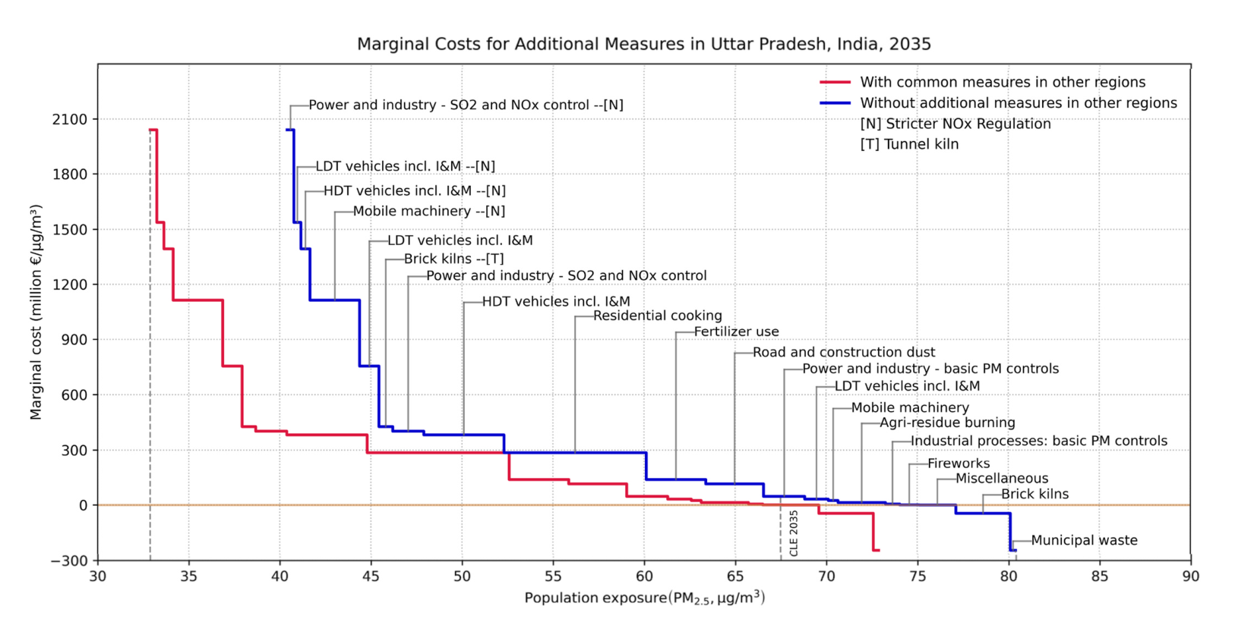
COST-EFFECTIVENESS
Cost curve: coordination lowers exposure and reduces reliance on high-cost local measures
How to read it
Read from right to left: as more measures are added, PM₂.₅ exposure is reduced further.
Higher steps indicate higher marginal cost per additional µg/m³ reduction.
Coordinated IGP action shifts UP to a lower-exposure pathway.
Cost-effective mitigation depends on both measure selection and IGP-wide coordination; analysis shows that coordinated action can help UP reach NAAQS at about €5 billion per year regionally, while making WHO IT-1 more feasible.
EGU26-6350 | AS4.9 | GAINS-IGP | Uttar Pradesh air quality pathways
9

Slide 10
Summary
The starting point. UP exposure is 65.4 µg/m³, more than 13 times the WHO guideline. Residential cooking is the largest local source at 42%, but about 40% of exposure is secondary PM₂.₅ and 44% originates outside UP.
What UP-only action delivers. Full enforcement of current policies stabilises exposure at 67.5 µg/m³ in 2035. Eight high-impact measures (clean cooking, dust, fertilizer, crop burning, and others) reduce this further to 40.8 µg/m³, just above NAAQS but still above WHO IT-1.
The airshed is shared, the solution must be too. Coordinated IGP action cuts cross-border inflow into UP by 7.5 µg/m³, bringing exposure to 33.3 µg/m³ . IGP-wide coordination helps reach NAAQS at about €5 billion/year regionally and makes WHO IT-1 more feasible.
EGU26-6350 | AS4.9 | GAINS-IGP | Uttar Pradesh air quality pathways
10

