Slide 1


Scaling near-term climate benefits through low-GWP refrigerants and energy efficiency in China
Pengnan Jiang^{1, 2,*} | Peking University / IIASA
Pallav Purohit², Xueying Xiang³, Ziwei Chen¹, Fuli Bai¹, Xingchen Zhao¹, Xu Zhang¹, Jianxin Hu^{1,*}
1 College of Environmental Sciences and Engineering, Peking University, Beijing, 100871, China
2 Pollution Management Research Group, Energy, Climate, and Environment (ECE) Program, International Institute for Applied Systems Analysis (IIASA), Laxenburg, A-2361, Austria
3 Department of Civil and Environmental Engineering, National University of Singapore, 119077, Singapore
NCGG in Utrecht
15 June 2026

Slide 2


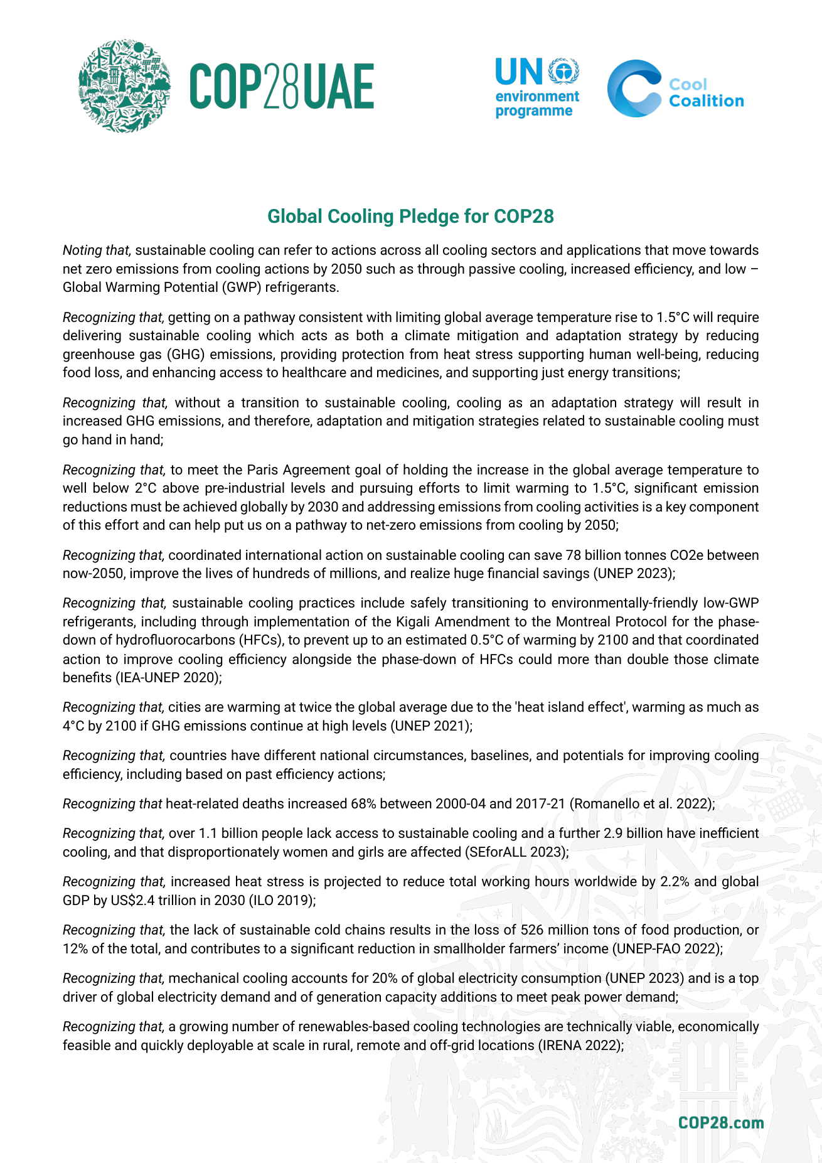

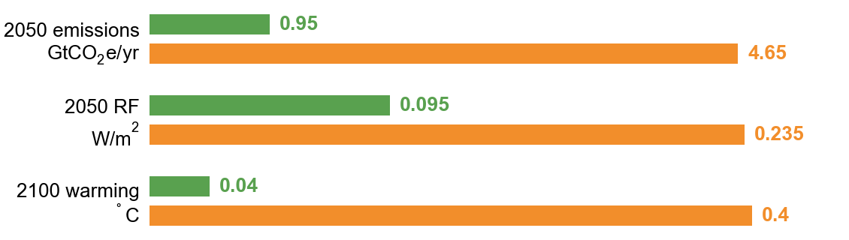
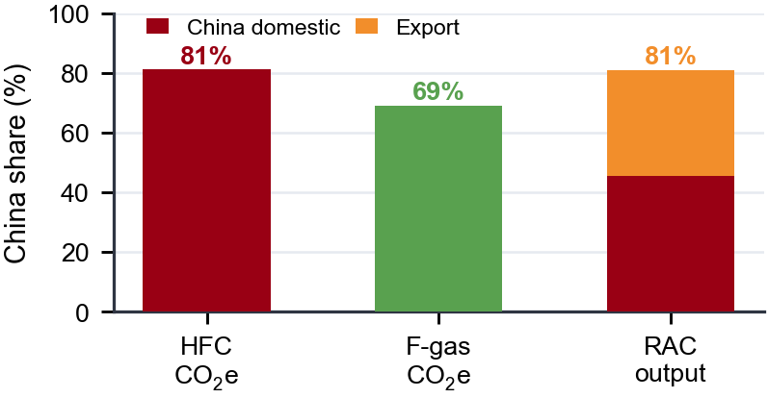
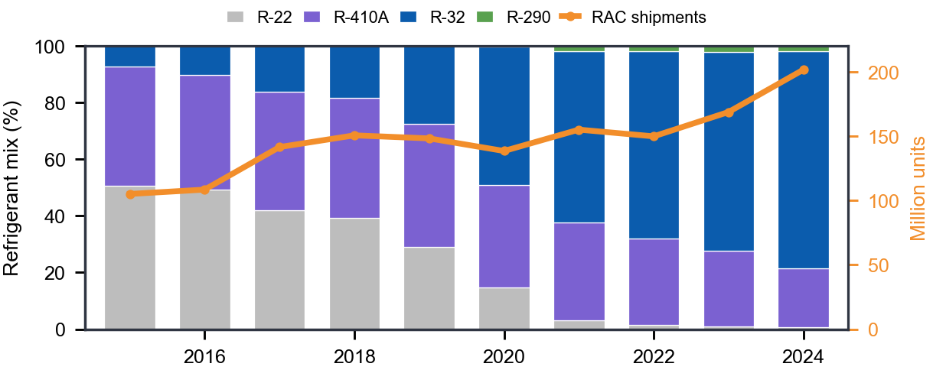
Background: cooling is a policy target and a near-term climate risk
Global Cooling Pledge
Kigali
WMO ozone assessment
No controls
-68%
cooling emissions
by 2050 vs. 2022
+50%
average efficiency of
new air conditioners
by 2030
Policy benchmark: refrigerants + efficiency + access
Kigali pathway lowers projected HFC emissions, forcing,
and warming.
China's manufacturing centrality
RAC refrigerant transition
81.2%
of 2021 global HFC
production in CO₂-eq
81.0%
of world RAC output
56% domestic / 44% export
2024 RAC shipments in workbook: 202 million units; R-32 share: 77%.
This motivates a China-focused, sector-specific assessment that connects refrigerant transition, efficiency, emissions, and climate response.
2
Sources: UNEP/Cool Coalition; WMO Ozone Assessment; China IOL; 2021 global F-gas workbook.

Slide 3
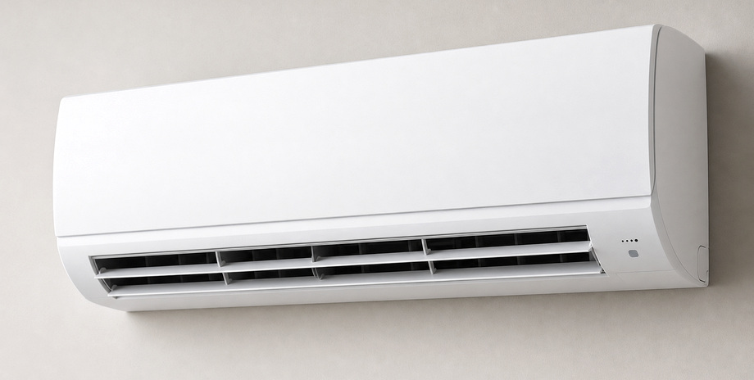
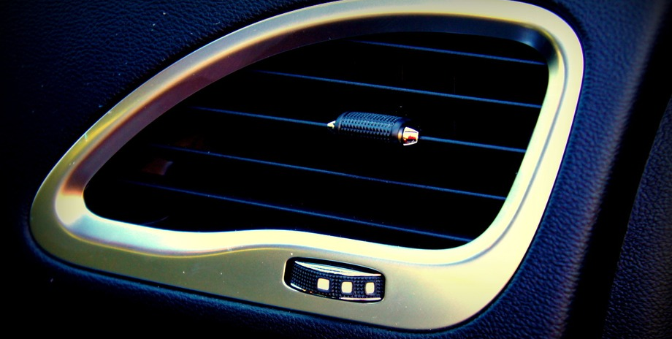
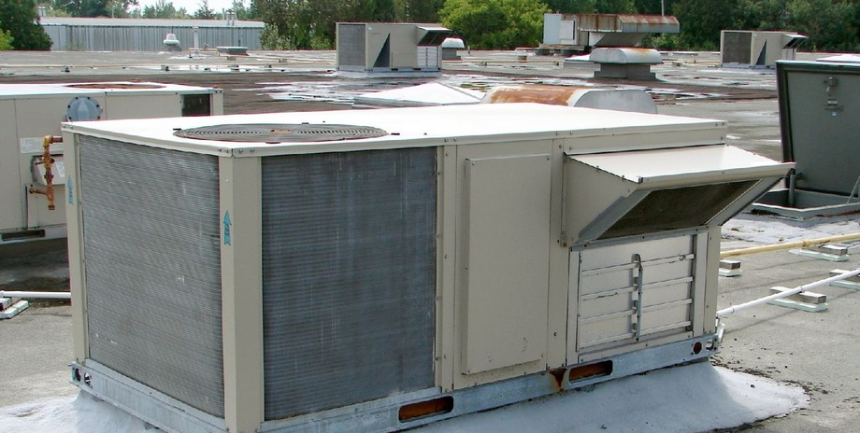
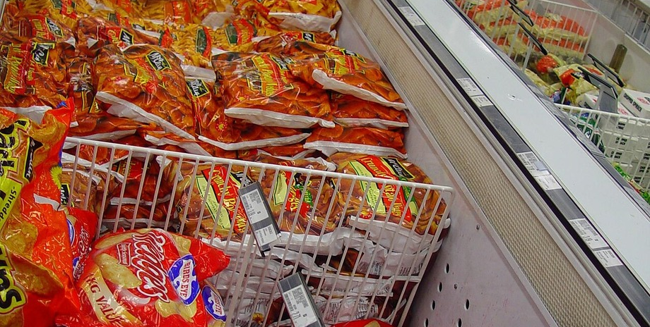
Model boundary: four cooling sectors
The model focuses on four major cooling sectors; other F-gas uses remain outside the quantified boundary.
RAC
Room AC
MAC
Mobile AC
CAC
Commercial AC
CCR
Cold chain
split/window room AC;
household heat-pump cooling
passenger cars, buses,
trucks and EV AC
unitary, VRF,
chillers and heat pumps
display cabinets, cold rooms,
transport refrigeration
HCFC-22 / HFC-410A
→ HFC-32 / HC-290
HFC-134a
→ HFO-1234yf / CO₂
HCFC-22 / HFC-410A / HFC-134a
→ HFC-32 / HFOs / natural refrigerants
HFC-404A / HFC-507A / HFC-134a
→ HC-290 / CO₂ / ammonia
Each sector is modeled separately because equipment lifetimes, refrigerant choices, efficiency pathways, and costs differ.
3
Sources: sector boundary adapted from this study, XMind classification, and TEAP/RTOC sector taxonomy.

Slide 4
Research question and scenarios
Scenario design
Research gap
BAU
recent market refrigerants + current efficiency
Cooling demand, HFC controls, efficiency standards, power-sector CO₂, air pollutants, and climate response are often assessed separately.
KAE
Kigali-compliant HFC phase-down + China efficiency plan
Question
What climate and air-quality improvement could China achieve by considering low-GWP refrigerants and higher efficiency together?
ATE
faster low-GWP transition + stronger efficiency gains
BAU = Business as usual; KAE = Kigali Amendment + Efficiency; ATE = Accelerated Transition + Efficiency.
All scenarios use the same 2022-2060 demand pathway; mitigation comes from refrigerants and efficiency, not reduced cooling service.
4
Sources: Kigali Amendment; Global Cooling Pledge; China efficiency-policy assumptions in this study.

Slide 5
Technical route: RAC-DEC integrates demand, emissions, climate, and cost
A bottom-up chain converts sector activity into HFCs, electricity, RF / warming, and costs.
1
Demand drivers
2
Stock turnover
3
HFC bank-flow
4
Energy pathway
5
Climate & cost
population, income,
CDD, floor area,
vehicles, cold chain
>
sales, in-use stock,
retirements,
Weibull lifetime
>
mix, charge,
operation, service,
end-of-life leakage
>
efficiency, hours,
electricity, CO₂,
SO₂ / NOₓ / PM₂.₅
>
HFC IRF metrics,
CO₂ TCRE,
CAAC and MAC
RAC
room AC
MAC
vehicle AC
CAC
comm. AC
CCR
cold chain
Uncertainty
Direct HFC Monte Carlo: activity +/-5%, emission factors +/-10%, WPP population range. Indirect emissions and climate response carry added sensitivity bands.
Annual model years: 2000-2060; mitigation summaries use 2022-2060 cumulative reductions and 2060 climate response.
5
Source: RAC-DEC model and methods in this study / SI.

Slide 6
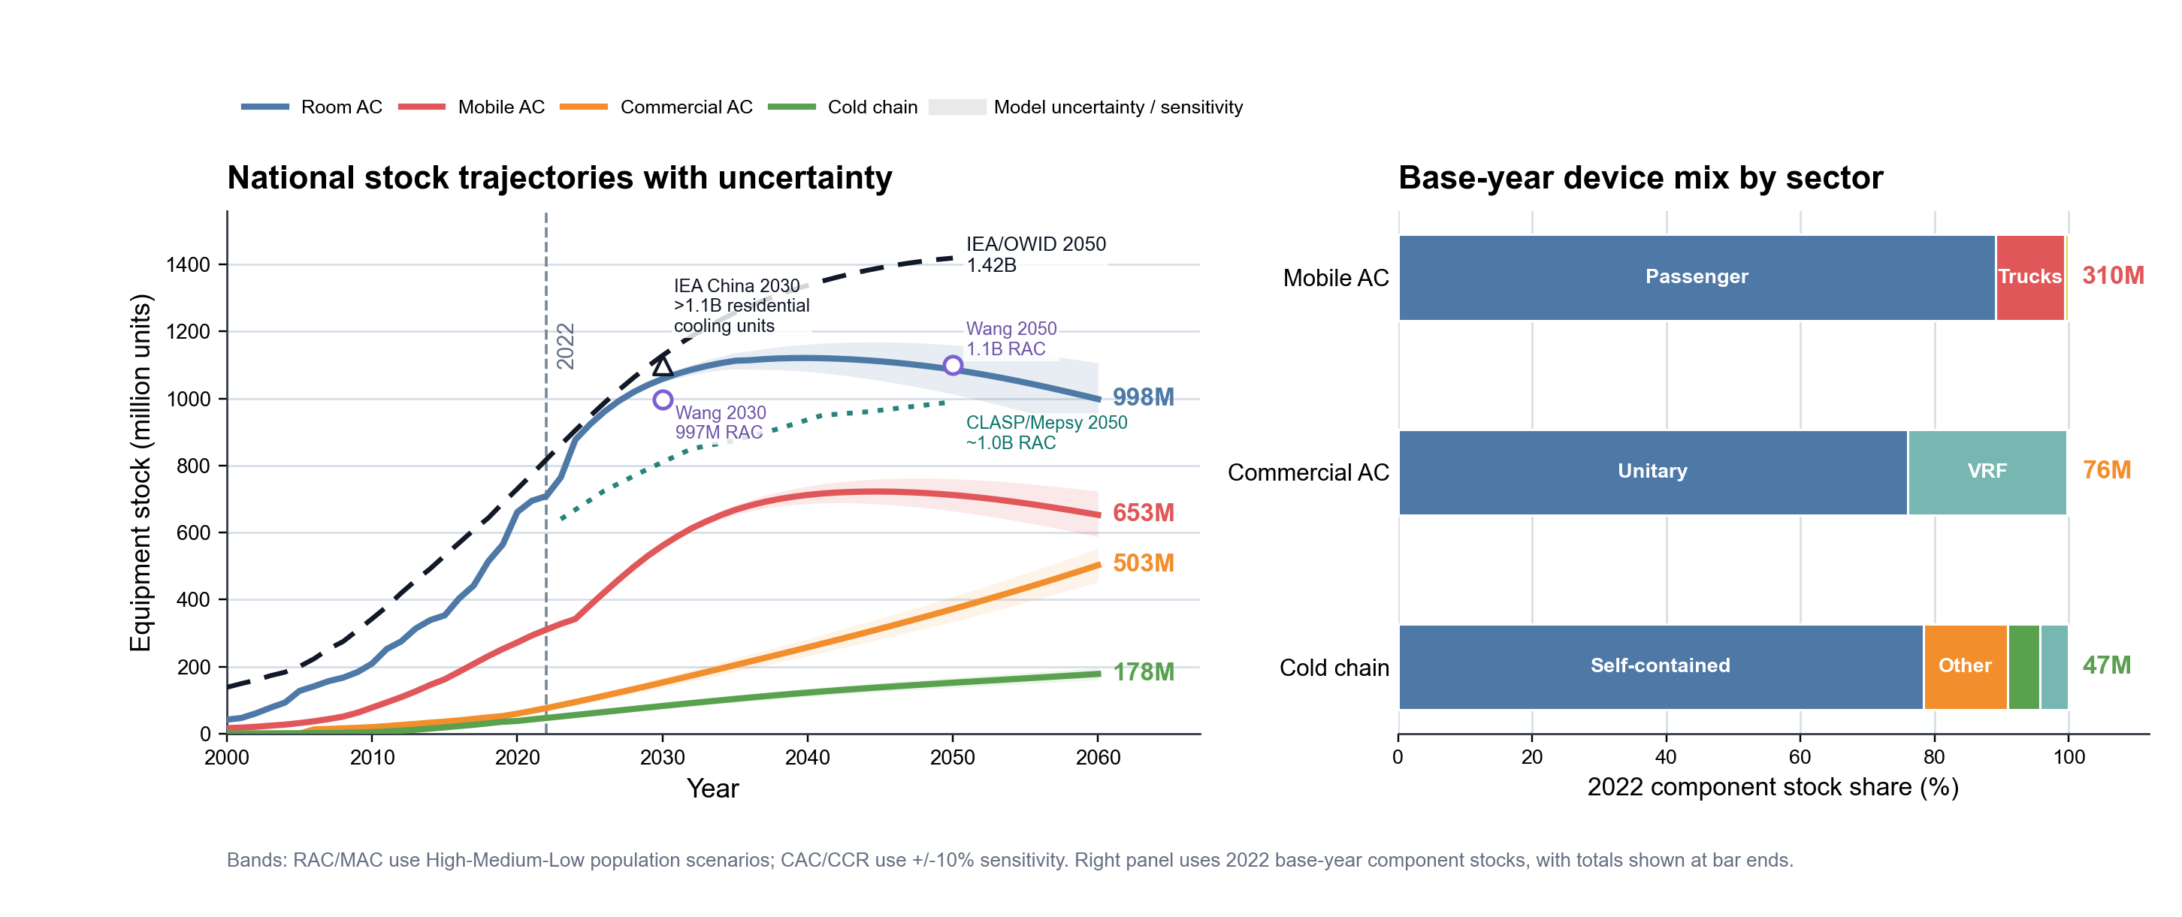
Demand result: equipment stock growth sets the scale of mitigation
By 2060, stock roughly doubles; the 2022 mix shows the starting structure for new equipment growth.
6
Sources: model results; IEA/OWID; Wang et al.; CLASP/Mepsy; sector workbooks.

Slide 7
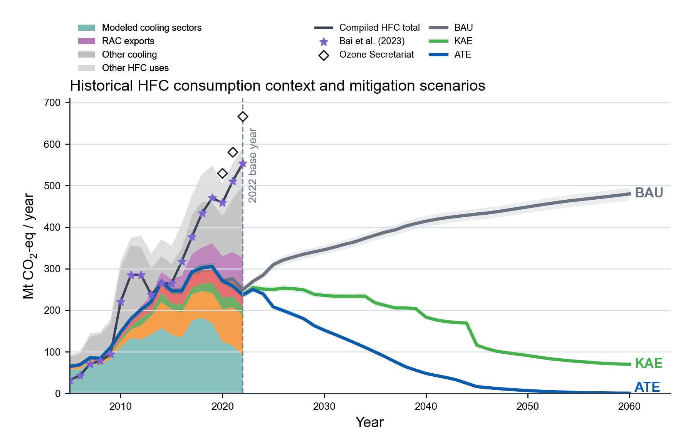
Low-GWP refrigerants drive the largest HFC consumption cut
Historical context and mitigation scenarios
12.6 ± 0.4 Gt
cumulative HFC consumption reduction, 2022-2060
~70%
of the HFC consumption cut comes from Kigali-compliant controls
Scenario means and shaded bands show model uncertainty.
7
Sources: model results in this study; Bai et al.; Ozone Secretariat inventory context.

Slide 8
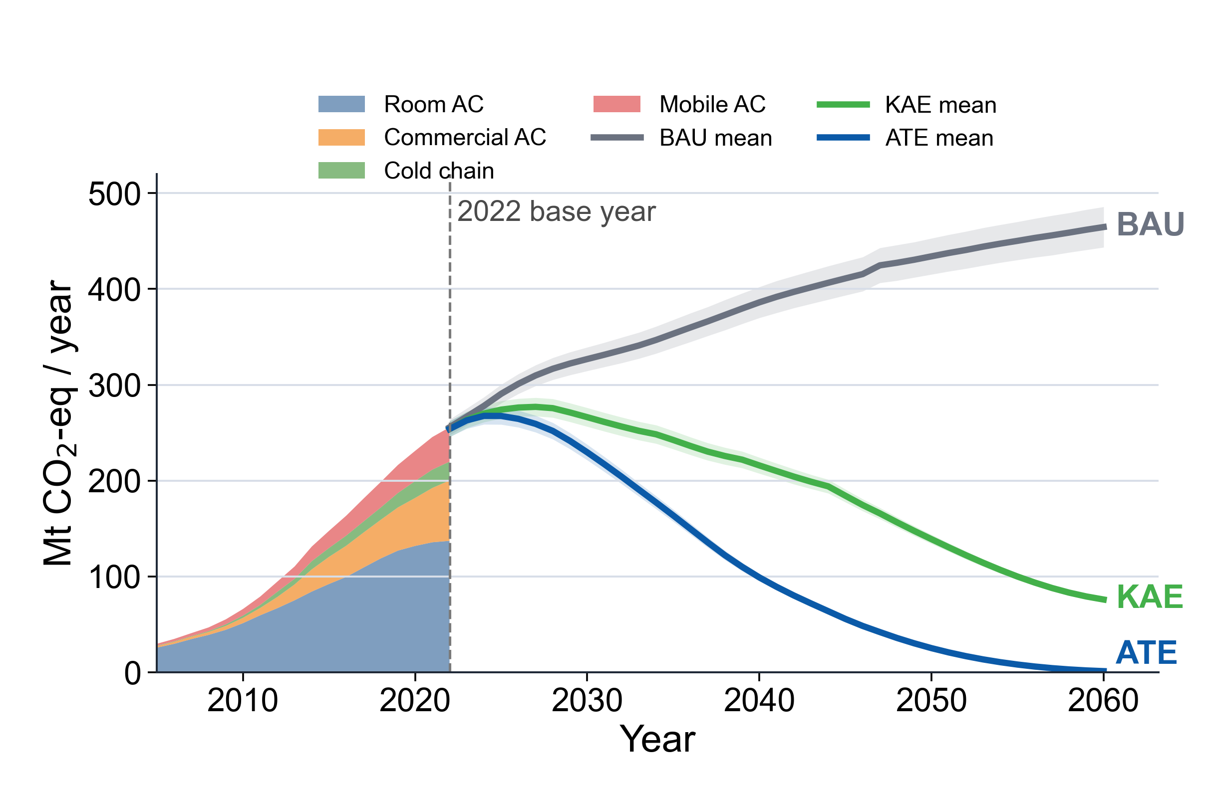
Direct HFC emissions
Shaded bands
show Monte Carlo uncertainty around each scenario pathway
Bank lag
existing equipment stocks delay the emissions response after consumption changes
ATE declines faster; BAU emissions persist through 2060.
8
Source: direct-HFC bank-flow model and Monte Carlo uncertainty in this study.

Slide 9
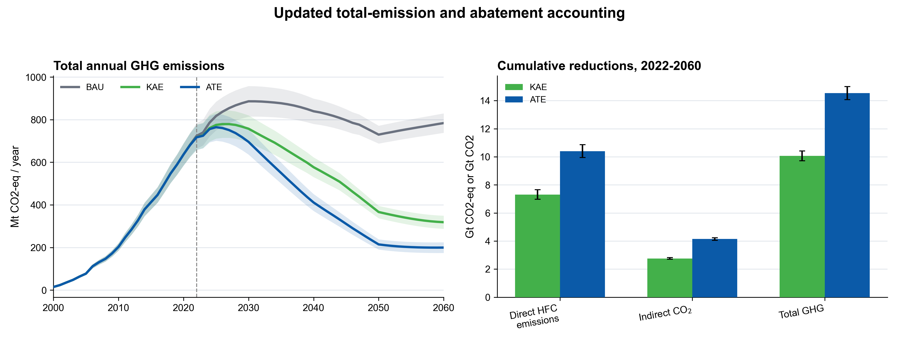
Updated accounting connects annual emissions to cumulative mitigation
Total GHG combines direct HFC emissions and indirect CO₂; bars report direct-HFC, indirect-CO₂, and total-GHG reductions.
9
Source: updated total-GHG accounting in this study; indirect CO₂ from electricity-demand module.

Slide 10
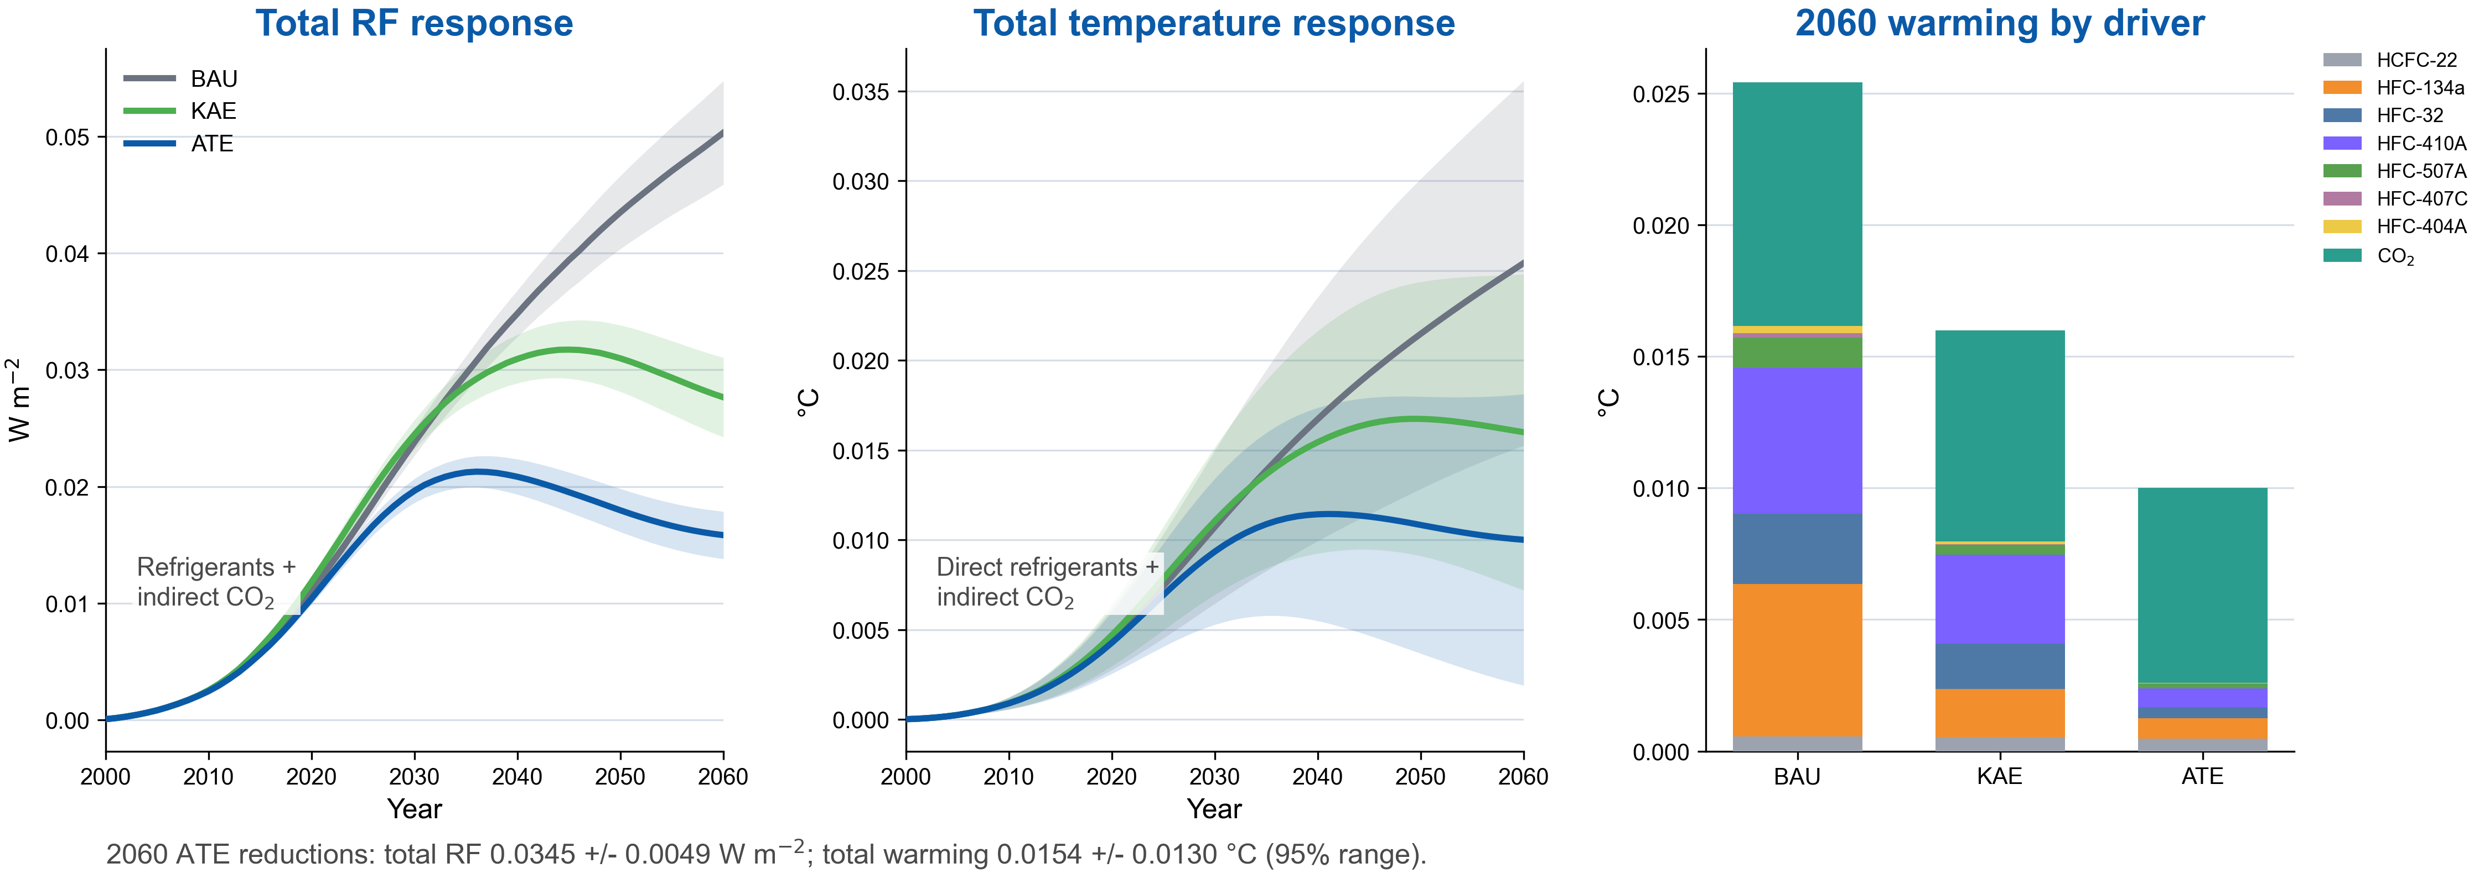
Co-benefits: efficiency cuts pollutants while RF and warming fall
Air-quality gains
1.82 Mt
avoided SO₂, 2022-2060
3.65 Mt
avoided NO_{x}, 2022-2060
0.31 Mt
avoided PM_{2.5}, 2022-2060
2060 ATE vs BAU: RF ↓0.0345 ± 0.0049 W m⁻²; warming ↓0.0154 ± 0.0130 °C.
10
Sources: model results; RF/temperature response calculation; corrected power-sector pollutant factors.

Slide 11
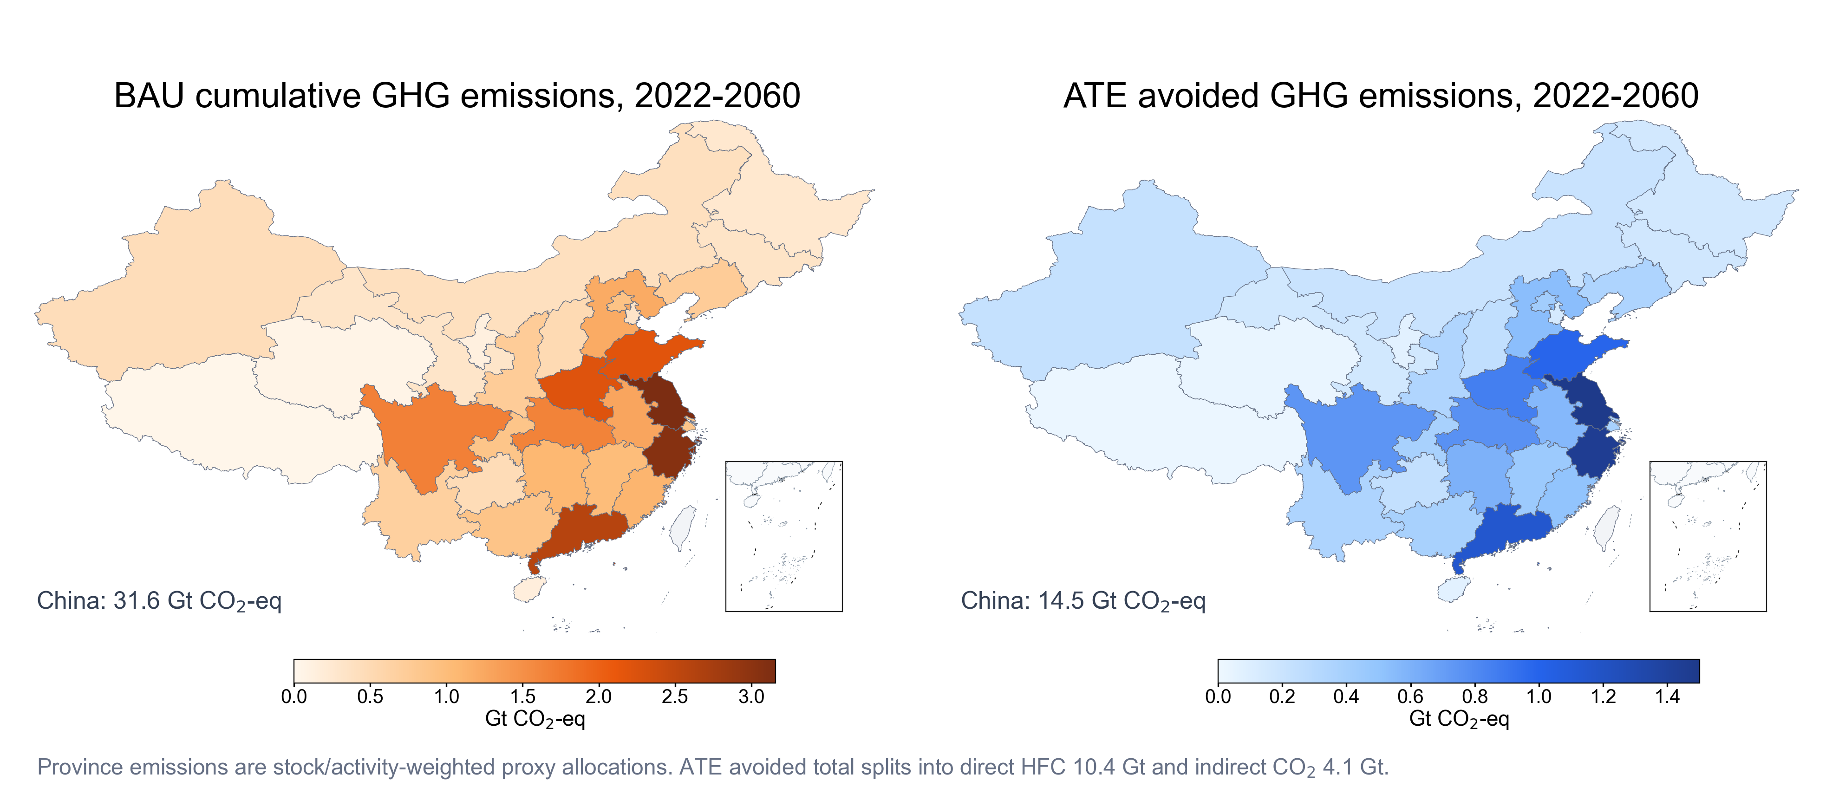
Provincial emissions maps: demand concentration becomes climate exposure
Maps show stock/activity-weighted proxy allocations of direct HFC plus indirect CO₂ emissions and ATE avoided emissions.
11
Source: provincial proxy allocation and emission model results in this study.

Slide 12
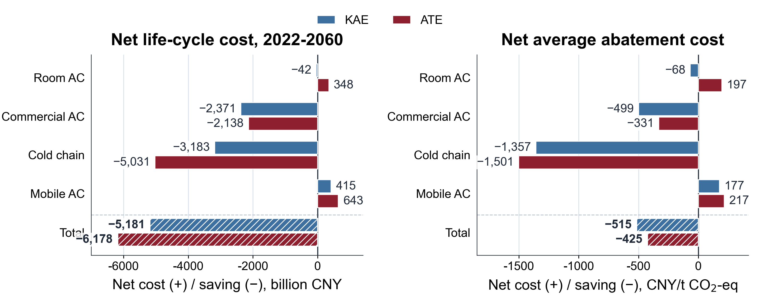
Preliminary sector net-cost screening
12
Preliminary screening: RAC/MAC use LCC/workbooks; CAC/CCR include refrigerant proxy + electricity savings; retrofit CAPEX/OPEX not fully parameterized.

Slide 13
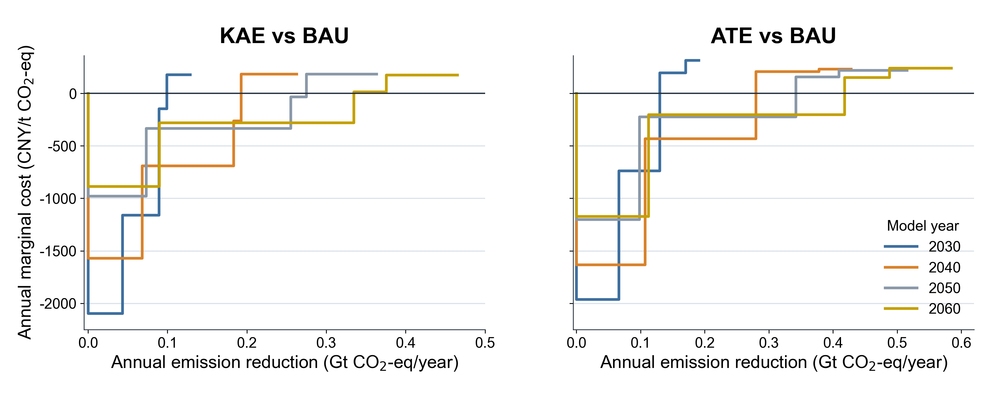
Preliminary annual marginal abatement cost curves
13
Preliminary screening: RAC/MAC use LCC/workbooks; CAC/CCR include refrigerant proxy + electricity savings; retrofit CAPEX/OPEX not fully parameterized.

Slide 14
Take-home: mitigation scale, policy bridge, and PFAS question
China matters globally
81.2% of 2021 global HFC production (CO₂-eq) and ~70% of world RAC output: China shapes both demand and supply chains.
Mitigation scale is large
ATE cuts HFC consumption by 12.6 ± 0.4 Gt CO₂-eq and total GHG by 14.5 Gt CO₂-eq during 2022–2060.
Efficiency makes it energy policy
Electricity savings reach ~19,600 TWh and avoid 4.1 Gt indirect CO₂: about 220× Three Gorges annual output, or 1.9× China 2025 power use.
A governance bridge
Montreal/Kigali controls substances; UNFCCC/NDCs target emissions. Cooling policy can connect refrigerants, efficiency, and power-sector CO₂.
Open question for the next transition: How can low-GWP refrigerants deliver climate benefits without creating tomorrow's PFAS/TFA legacy?
Scale context: Three Gorges designed annual generation = 88.2 TWh; China 2025 electricity use = 10.4 PWh. Electricity savings are modelled ATE vs BAU cumulative savings.
14
Sources: model results; China IOL; Three Gorges design output; China electricity statistics.

Slide 15
Thank you
Questions and discussion
pnjiang@pku.edu.cn; jiangp@iiasa.ac.at
Pengnan Jiang | Peking University / IIASA

